Slide 1
Dwelling

Slide 2
Furniture and Equipment

Slide 3
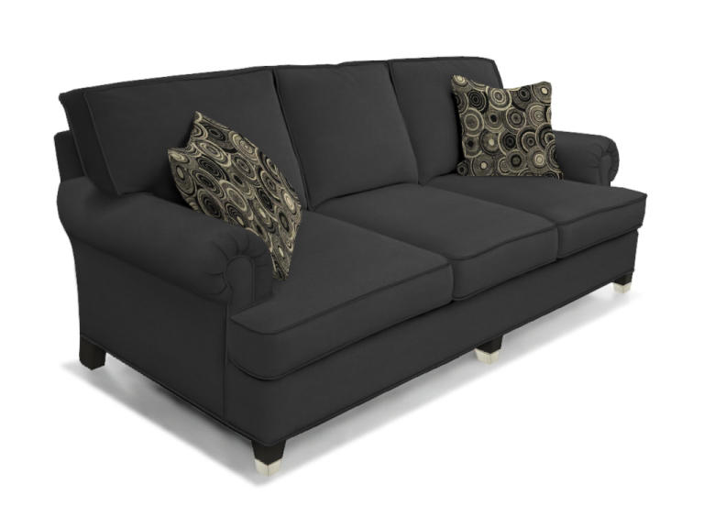
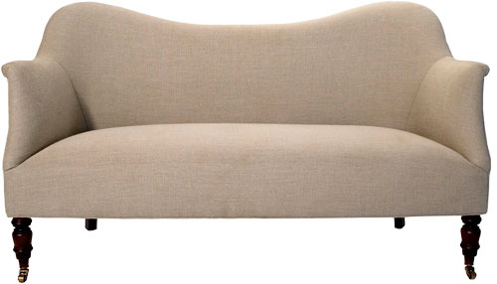
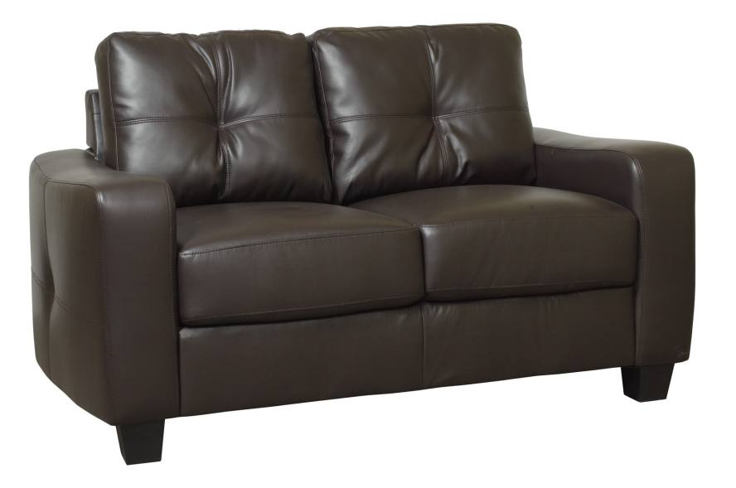
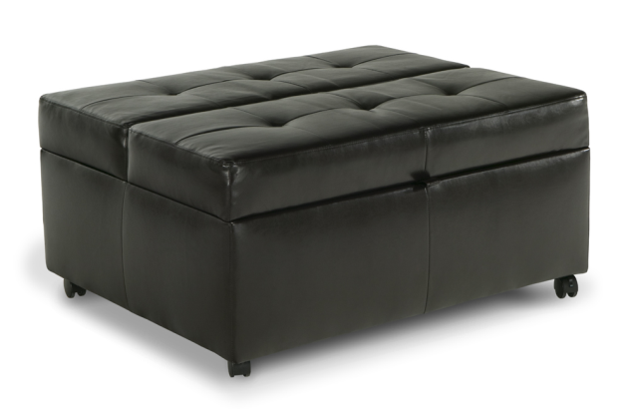
Sofas: a couch, a settee, a loveseat, an ottoman

Slide 4
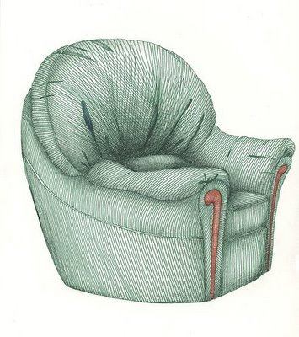
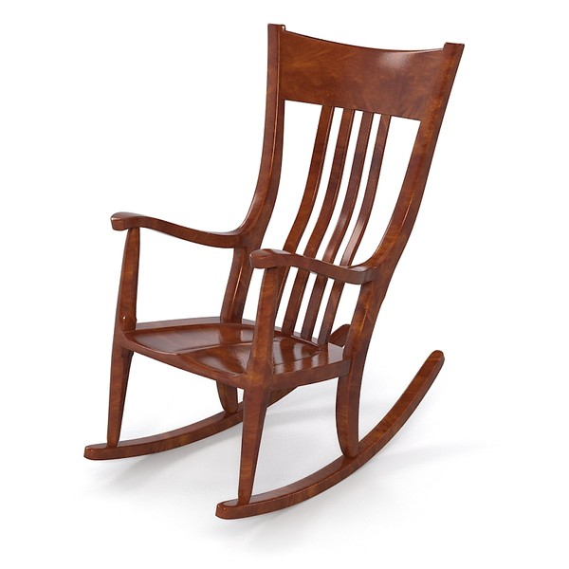
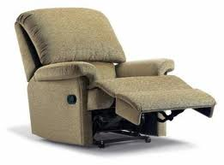
Chairs: an armchair, a rocking chair, a recliner

Slide 5
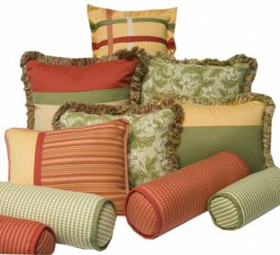
A throw pillow, a cushion

Slide 6
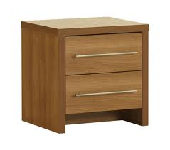
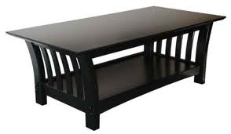
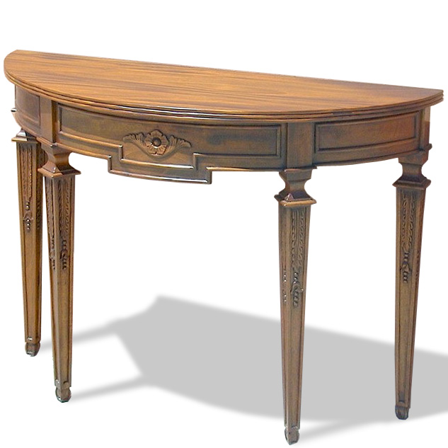
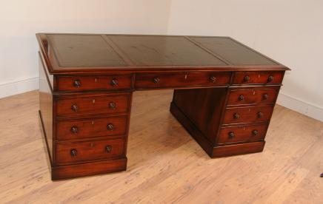
A coffee table, a side table, a bedside table, a writing table

Slide 7
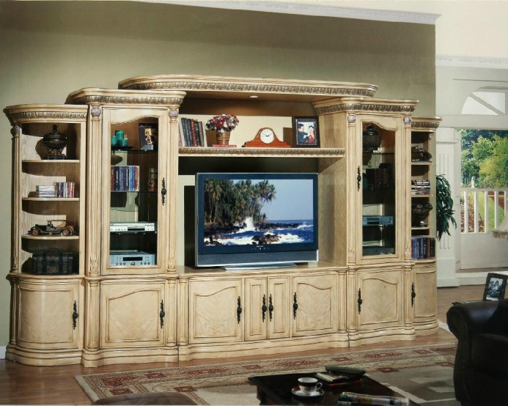
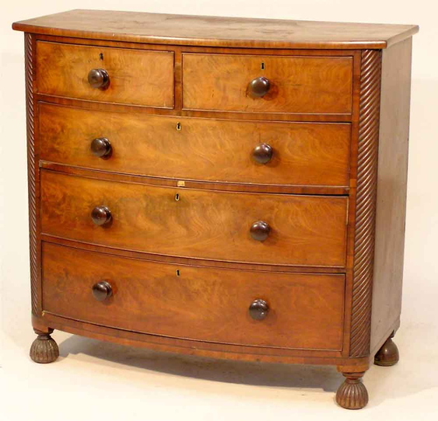
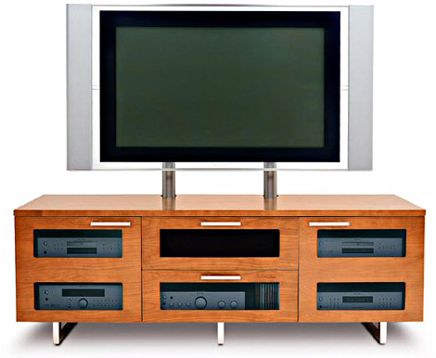
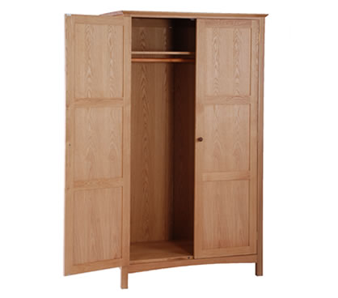
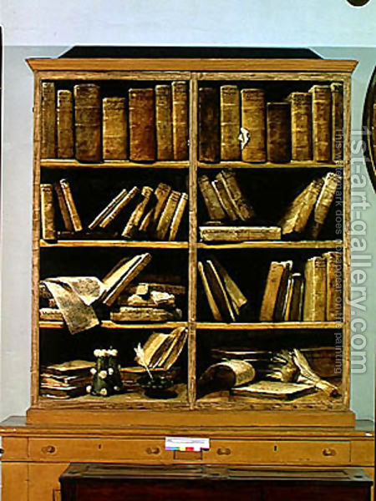
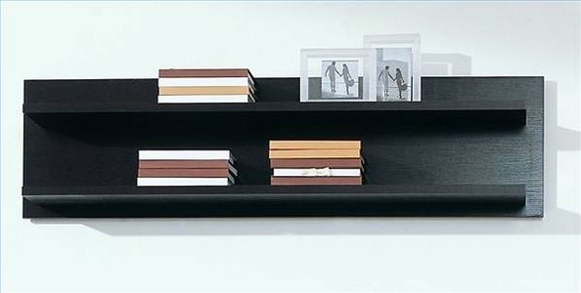
A wall unit, a TV stand, a chest of drawers, a wardrobe, a shelf, a bookcase

Slide 8
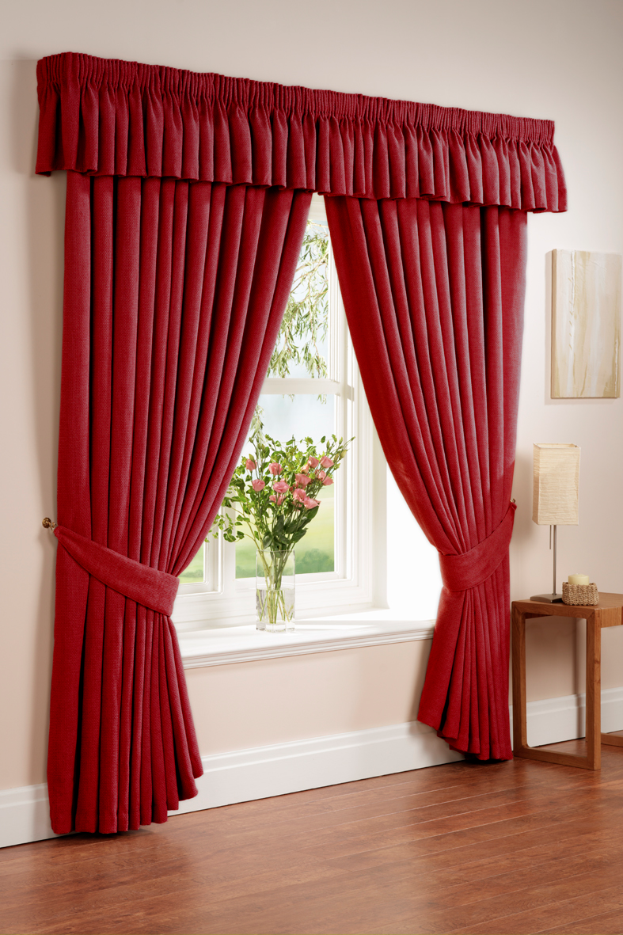

Curtains = drapers, shades = blinds

Slide 9
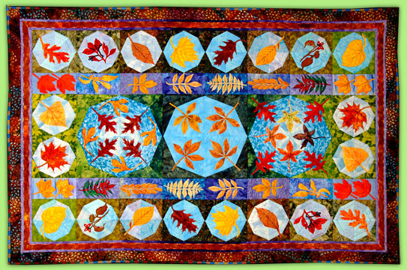
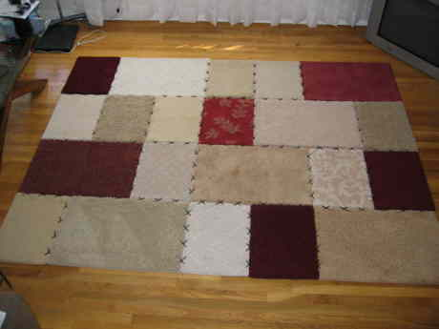
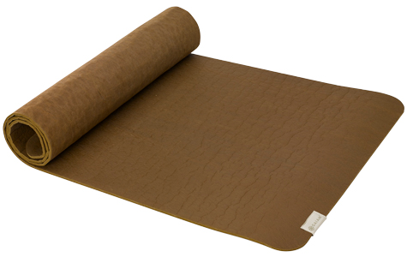
A carpet, a rug, a mat

Slide 10
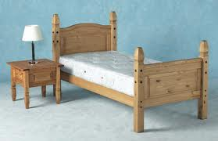
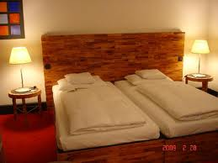
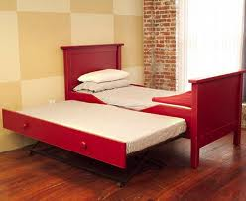
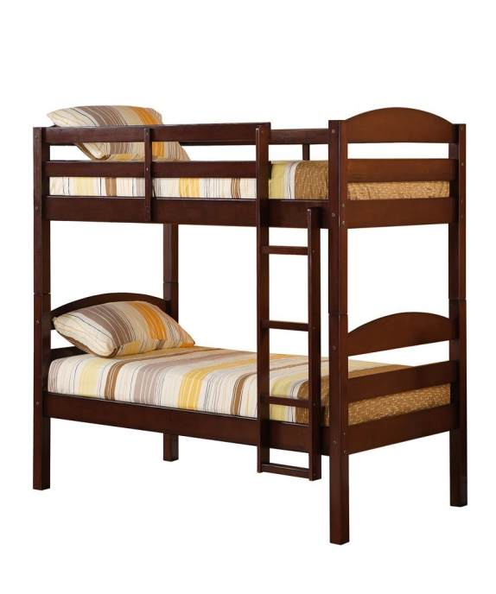
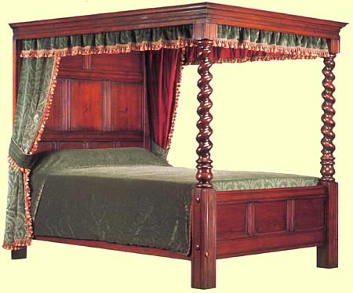
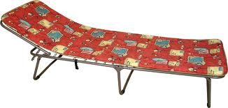
A single bed, a double bed, a twin bed, a futon, a four-poster, a bunk bed

Slide 11
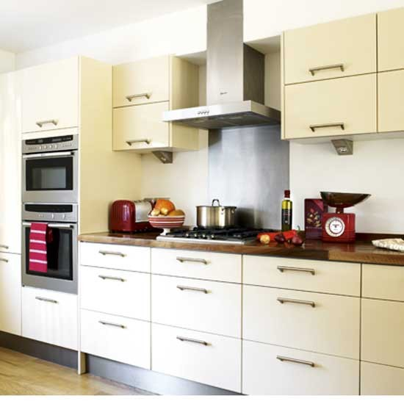
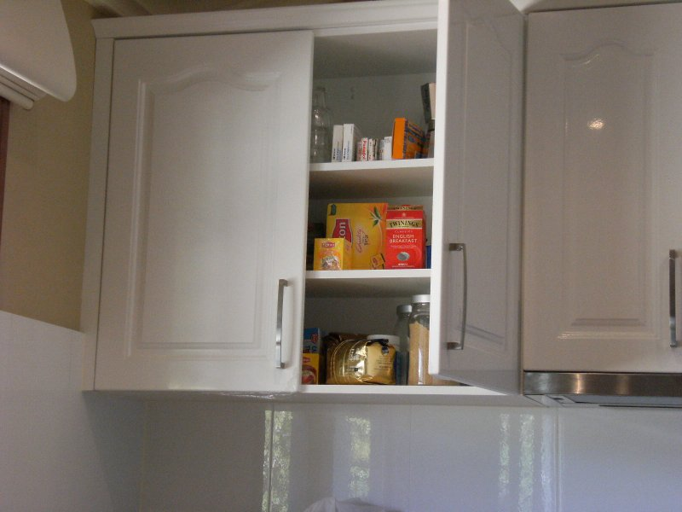
A kitchen unit, a cupboard = a cabinet

Slide 12
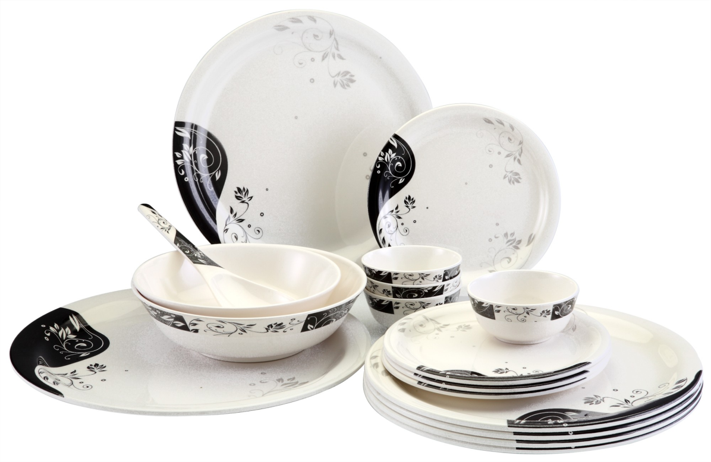
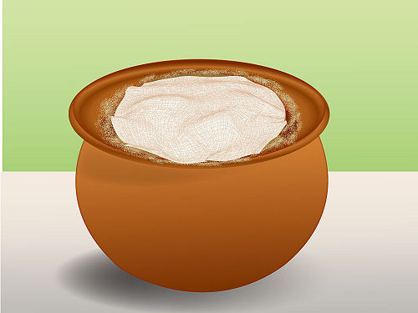
Crockery (plates, bowls), a pot

Slide 13
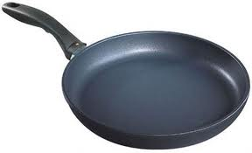
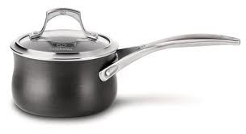
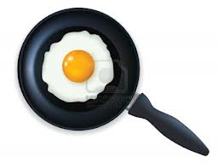
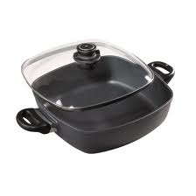
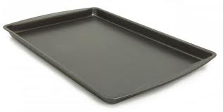
A pan, a saucepan, a frying pan, a casserole, a baking (roasting) tin

Slide 14
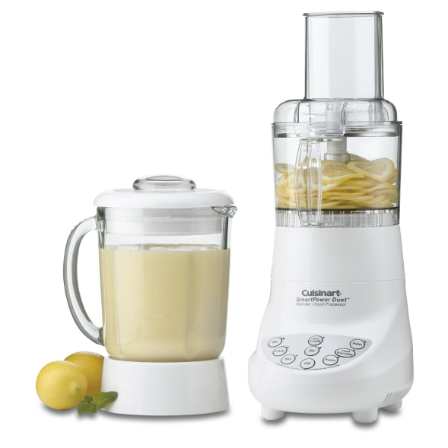
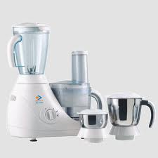
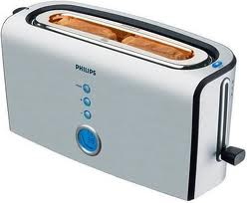
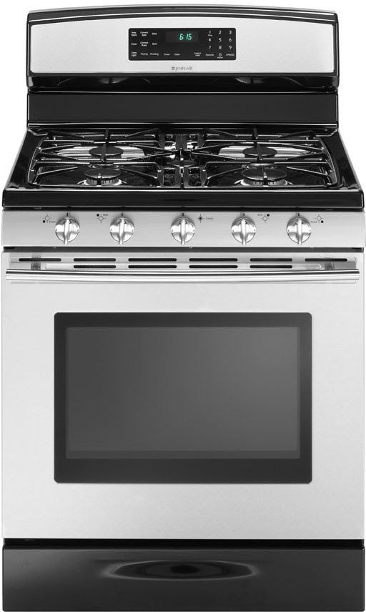
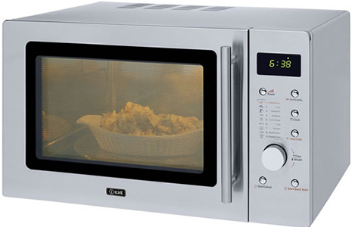
A blender, a food processor, a toaster, a microwave oven, a cooker

Slide 15
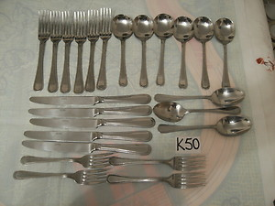
Cutlery (knives, forks, spoons)

Slide 16
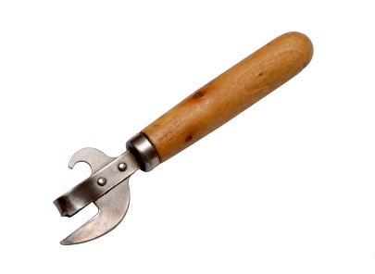
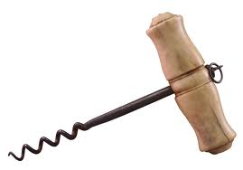
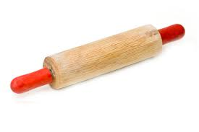
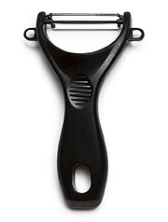
A tin opener, a corkscrew, a potato peeler, a rolling pin

Slide 17
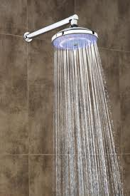
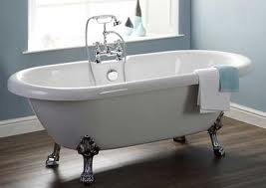
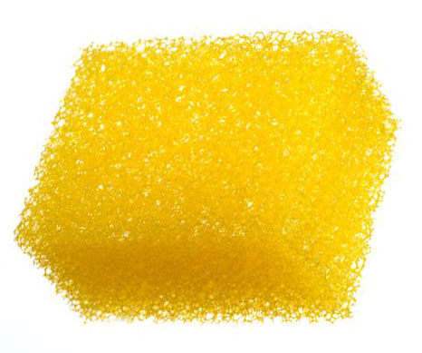

A shower, a bath, a soap dish, a sponge

Slide 18



Toilet seat, flush, brush, air freshener

Slide 19



Wash basin, a faucet (a tap), a plug, a drain

Slide 20
Idioms

Slide 21


To be a home bird

Slide 22


Home sweet home

Slide 23




East or West, home is best

Slide 24


There is no place like home

Slide 25

My home is my castle
My
is my

Slide 26


Make oneself at home

Slide 27


To keep the house

Slide 28



Apple-pie order

Slide 29

To live under the same roof

Slide 30


Not enough room to swing a cat

Slide 31

To live cooped up

Slide 32

To have a roof over head

Slide 33

To be homesick

Slide 34
Adjectives

Slide 35

cozy

Slide 36

ancient

Slide 37

spacious
ious

Slide 38

compact

Slide 39

convenient

Slide 40

cheap

Slide 41

expensive

Slide 42

huge

Slide 43


plain

Slide 44


exotic

Slide 45

charming

Slide 46



sparkling

Slide 47

oversized

Slide 48


magnificent
Notes:
Magnifying glass!

Slide 49


upscale

Slide 50


fabulous

Slide 51


stunning

Slide 52
House jobs and chores

Slide 53


To sweep – a sweeper

Slide 54


To dust – a duster

Slide 55


To mop – a mop

Slide 56


To fix – a fixer

Slide 57


To do laundry – laundry bag

Slide 58




To wash – washing machine, dishwasher, car washer

Slide 59


To clean – a cleaner

Slide 60



To dry – a clothes dryer, a hair dryer

Slide 61




To polish – nail polish, a polisher, polishing cloth

Slide 62


To scrub – a scrub brush

Slide 63


To vacuum – a vacuum cleaner

Slide 64



To throw out garbage/ waste/ litter – a garbage/ waste/ litter bin
Notes:
A throw – покрывало, легкая накидка

Slide 65


To water – a watering can

Slide 66


To shovel – a shovel

Slide 67


To rake - a rake

Slide 68


To mow – a lawnmower

Slide 69


To iron – an iron

Slide 70


To feed – a feeder

Slide 71


To set up a table – to clean up

Slide 72


To hang - hangers

