Slide 1
Leonardo’s inventions
Avramenko Ann
Bugay Tatyana
10- G
2013

Slide 2
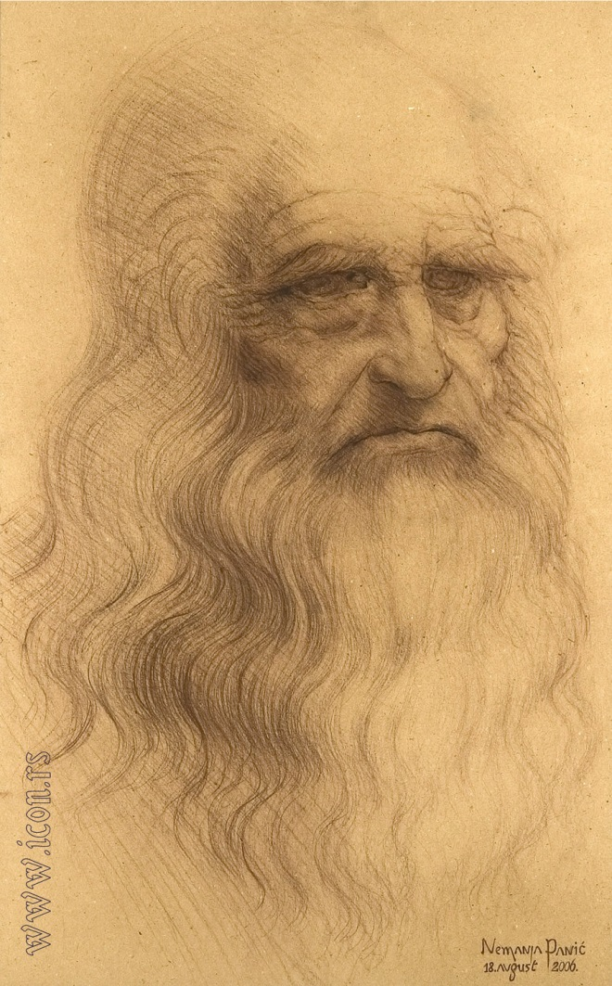
April 15, 1452 – May 2, 1519
Was an Italian Renaissance polymath: painter, sculptor, architect, musician, mathematician, engineer, inventor, anatomist, geologist, cartographer, botanist, and writer. His genius, perhaps more than that of any other figure, epitomized the Renaissance humanist ideal.

Slide 3
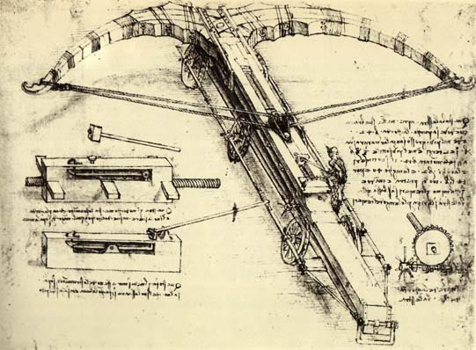
Designed for pure intimidation, da Vinci’s crossbow was to measure 42 braccia (or 27 yards) across. The device would have six wheels (three on each side) for mobility, and the bow itself would be made of thin wood for flexibility.
Crosbow

Slide 4
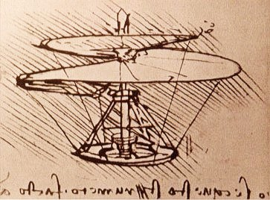
helicopter measured more than 15 feet in diameter and was made from reed, linen and wire. It was to be powered by four men standing on a central platform turning cranks to rotate the shaft. With enough rotation, da Vinci believed the invention would lift off the ground
Helicopter

Slide 5
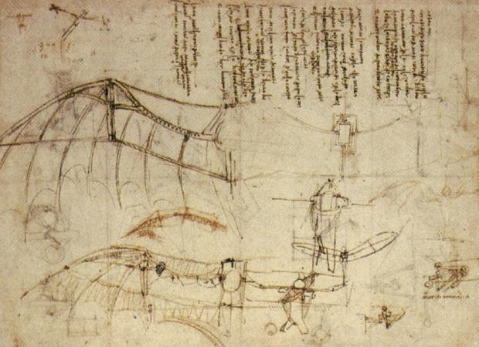
Design for a Flying machine

Slide 6
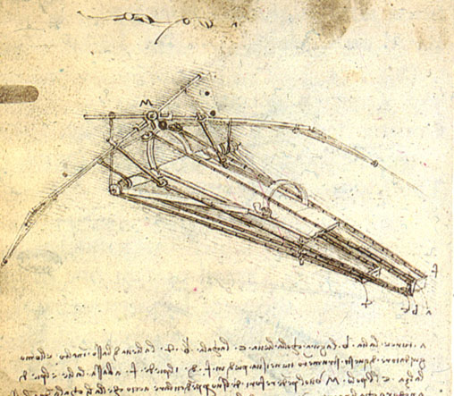
The pilot would lie face down in the center of the invention on a board. To power the wings, the pilot would pedal a crank connected to a rod-and-pulley system. The machine also had a hand crank for increased energy output, and a head piece for steering. As the busy pilot spins cranks with his hands and feet, the wings of the machine flap.
Flying machine

Slide 7
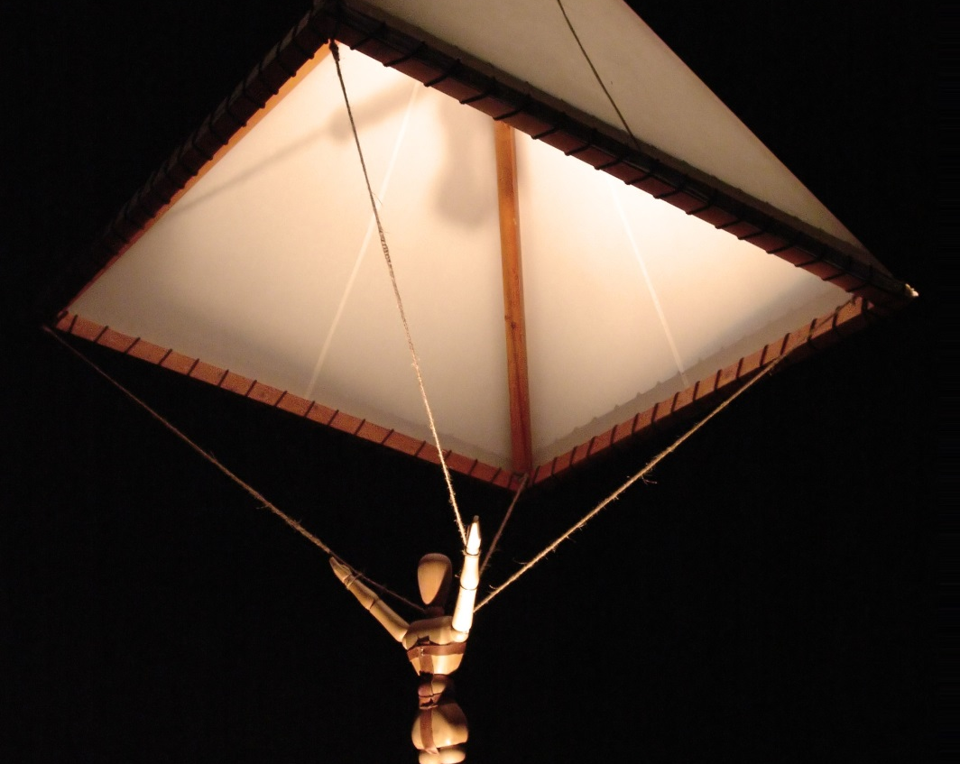
Da Vinci made a sketch of the invention with this accompanying description: "If a man have a tent made of linen of which the apertures (openings) have all been stopped up, and it be twelve braccia (about 23 feet) across and twelve in depth, he will be able to throw himself down from any great height without suffering any injury."
Parachute

Slide 8
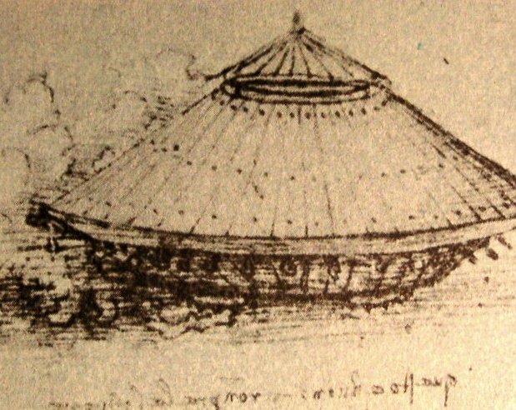
Da Vinci’s vehicle has a number of light cannons arranged on a circular platform with wheels that allow for 360-degree range. The platform is covered by a large protective cover (much like a turtle’s shell), reinforced with metal plates, which was to be slanted to better deflect enemy fire. There is a sighting turret on top to coordinate the firing of the canons and the steering of the vehicle.
Leonardo's tank

Slide 9
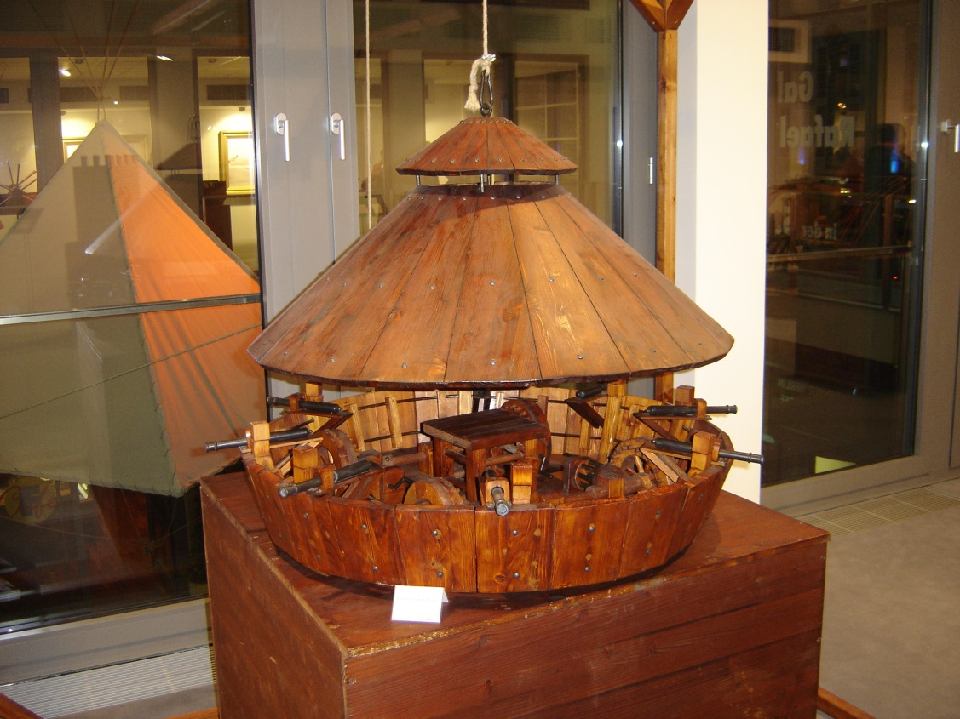
Leonardo's tank

Slide 10
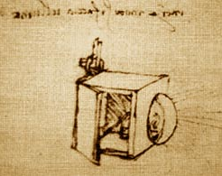
Searchlight

Slide 11
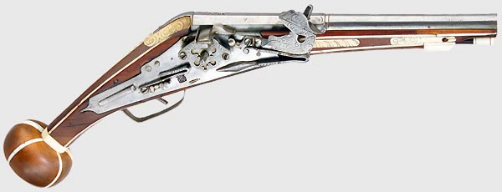
Wheellock

Slide 12
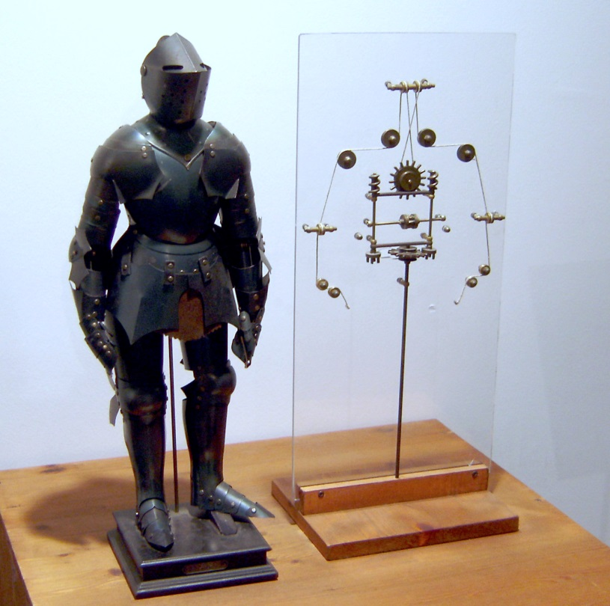
Leonardo's robot

