Slide 1
Pollution

Slide 2
About 150 years ago the air was pure and clean.

Slide 3
Then people started building factories and many of the things they make, like cars, put a lot of harmful gases into the air.

Slide 4
Today the air is so polluted in some places that it’s not always safe to breathe there.

Slide 5
Many cities around the world have air polluted with “smog”. This is so strong in some places that the air, which should be a beautiful blue, looks brown.

Slide 6
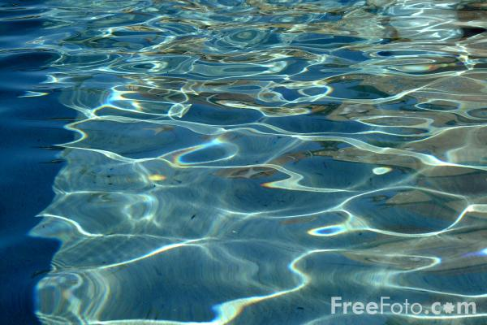
The planet Earth is mostly water. Oceans cover the biggest part of it – and there are lakes, rivers, streams and even water underground. All life on the Earth – from the smallest bug to the biggest whale – depends on the water. It’s precious.

Slide 7
But we are not doing a very good job of keeping water clean. In many places, the water has become polluted.

Slide 8
Rivers and lakes are polluted by garbage or by poisonous chemicals which are dumped right into them.

Slide 9
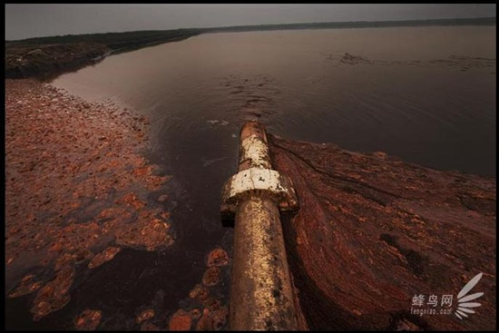
Underground water can be polluted by gasoline or by harmful liquids that seep into the ground. Some fertilizers and pesticides used in farming leak down through the dirt, too.

Slide 10
When you throw something away, it goes in a garbage can.

Slide 11
Once a week a garbage truck comes and the can is emptied, and that’s the last you see of it. But what do you think happens to the garbage then? Does it just disappear? No way!

Slide 12
Now we are making so much garbage that in many places, there is not enough room to bury it all.

Slide 13
We have to act fast and cut down the amount of garbage we make. Can we do it? You bet!

Slide 14
We can recycle (which means re – using materials instead of throwing them away) and reject (which means not buying things that can’t be re – used, like plastic wrapping and other packaging).

Slide 15
If we recycle and reject we will produce a lot less garbage, and help keep our planet green!

Slide 16
Art. Not Garbage.

Slide 17
Plastic Bottles

Slide 18
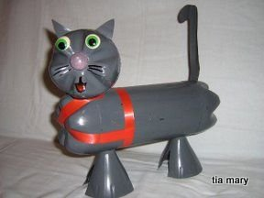

Slide 22
Shampoo Bottle

Slide 23
Old newspapers

Slide 25
Old jeans
Broken cups

Slide 26
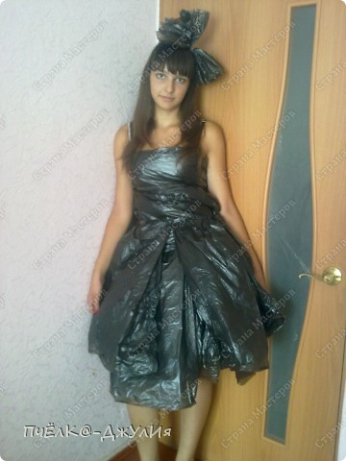
Garbage Bags

Slide 27
Old CDs

Slide 28
Metal things

Slide 29
Tea bags
Chips packs

Slide 30
Garbage Masterpieces

