Slide 1
DESERT SAHARA
The largest desert in the world

Slide 2
Purpose
Hear about geography position.
Hear about climate .
Vegetations and animals.

Slide 3
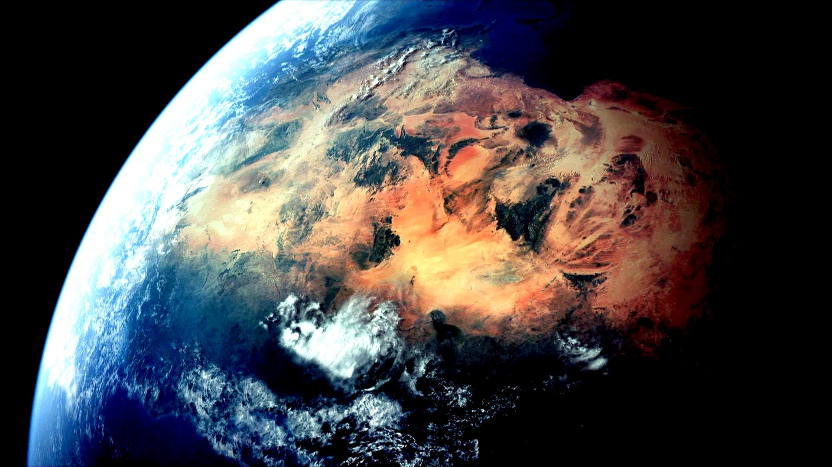
Cosmic picture Sahara

Slide 4
General information about the Sahara desert
Sahara – the largest desert in the world . Only a small part of the Sahara desert fertile – there is growing wheat , figs and other fruits – these parts of the desert are red underground rivers and oases . Sahara desert could be particularly interesting at night , with fresh , clean and transparent air , and the stars , seemingly very close . You will feel like you can almost touch them , being alone with a deafening silence. Sahara Desert stretches across most of North Africa , covering 9,000,000 square kilometers ( roughly the size of United States ). In fact , the Sahara Desert covers approximately 30% of the entire African continent. This – the honest place in the world with summer temperatures that often exceed 57 degrees Celsius. In the desert , passes the annual rainfall ( up to 25 millimeters ) and very windy sand storms , raising sand 1,000 meters in height and constantly moving dunes.

Slide 5
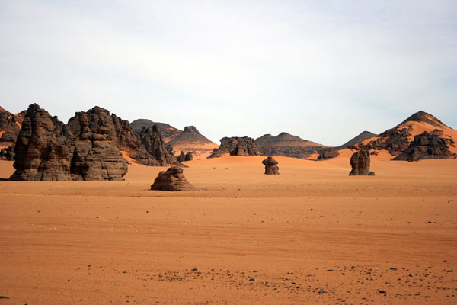
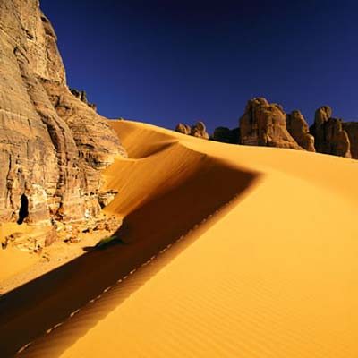
Volcanic mountains in the Sahara
Sahara consists of one quarter of volcanic mountains , one quarter of the sand rocks and gravel plains , and small areas of permanent vegetation. Vegetation includes shrubs , grasses and trees in the highlands and in the oases , situated on the river bed. Some of the plants are well adapted to this climate and grow within three days after rain , and sow their seeds in two weeks after that. Only a small part of the Sahara desert is fertile – these sites are talking water from underground rivers and oases.

Slide 6
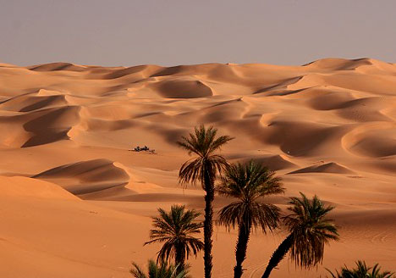
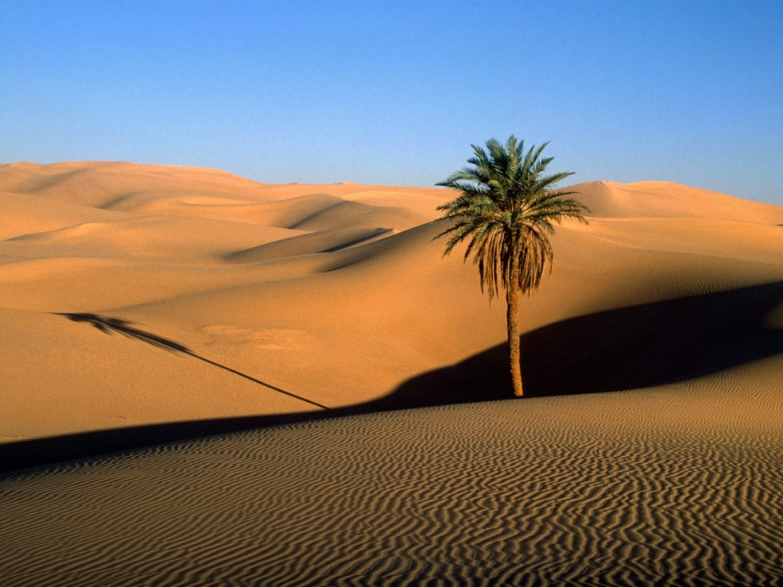
Vegetations in Sahara
Palms

Slide 7
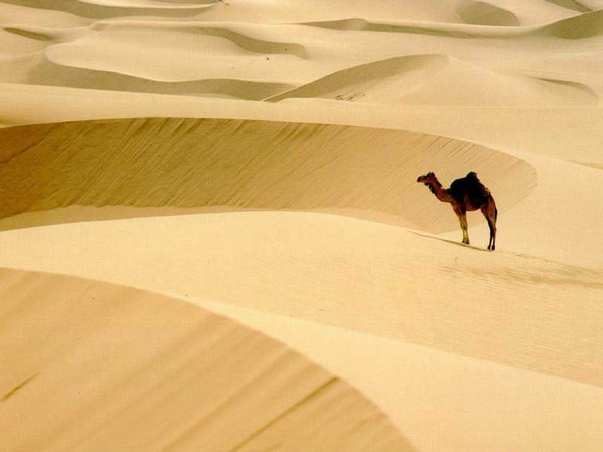
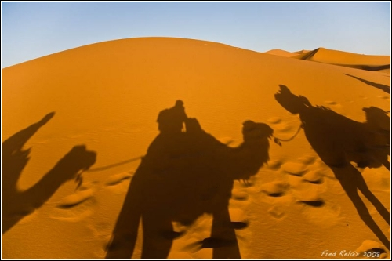
Animals in Sahara
Camels

Slide 8
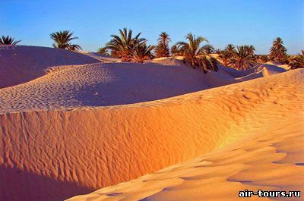
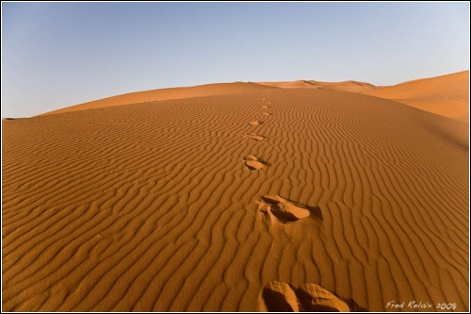
Sahara

Slide 9
source
Internet

Slide 10
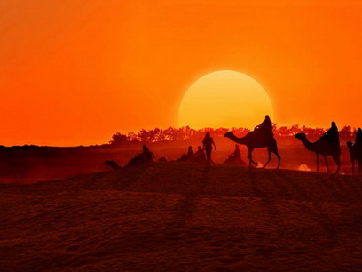
THE AND

