Slide 1
The Royal British Family
Julia Kolchag
Form 11-B

Slide 2
Plan
The UK of Great Britain and Northern Ireland.
British Royal Family:
1.Formation History;
2.The Family Tree of Members;
3.Interesting Facts and Video.
Summary and Conclusions.

Slide 3
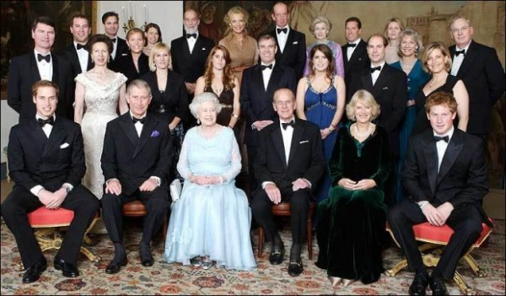
The British Royal Family is the family group of close relatives of the monarch of the United Kingdom.

Slide 4
Badge of The House of Windsor
The House of Windsor is the royal house of the United Kingdom and the other Commonwealth realms. It was founded by King George V by royal proclamation on 17 July 1917.

