Slide 1
Education

Slide 2
Ways of work

Slide 3
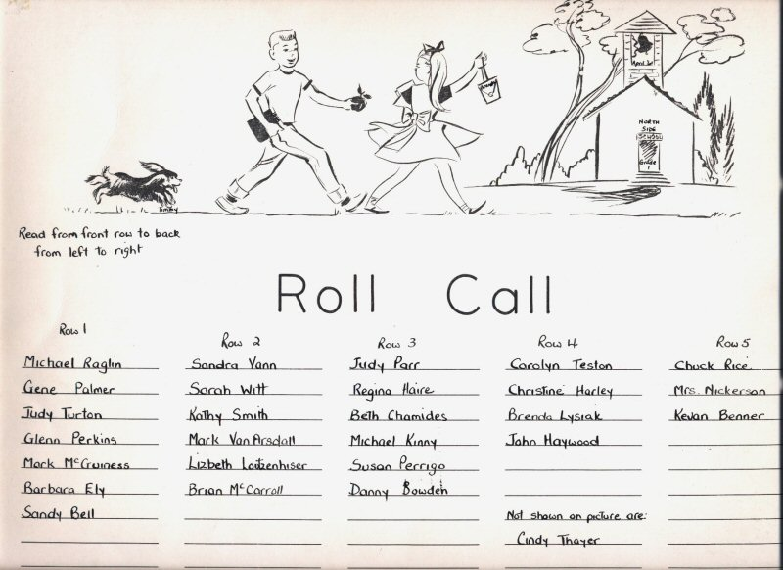
To call the roll

Slide 4
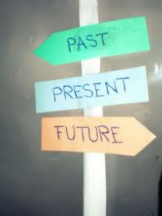
To get trained for future life

Slide 5
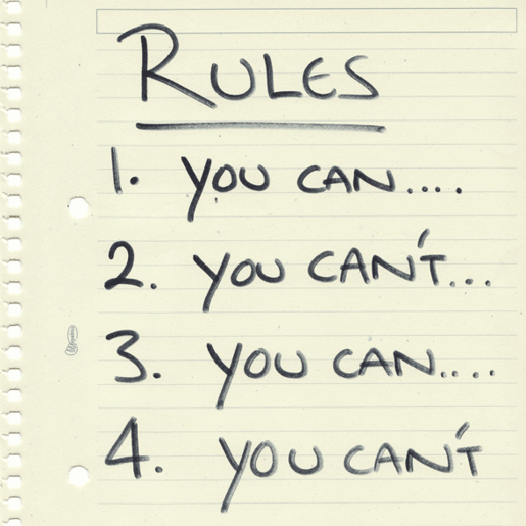
To follow the rules

Slide 6
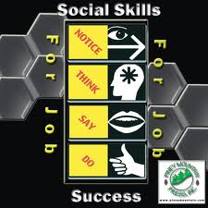
To gain social skills

Slide 7
To absorb information

Slide 8
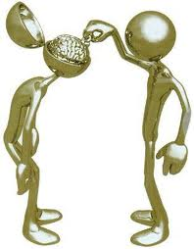
To stuff head with facts

Slide 9
To hit the books

Slide 10
To brush up on smth.

Slide 11
To crack a book

Slide 12
To have nose in a book

Slide 13
To catch up to

Slide 14
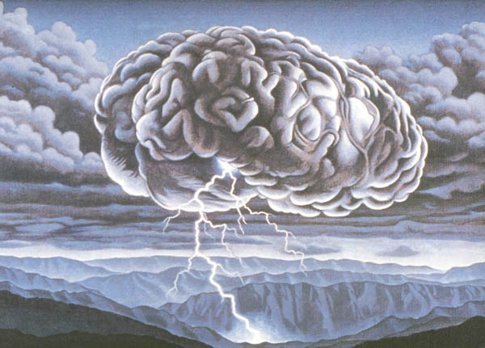
To brainstorm

Slide 15
to learn by heart

Slide 16
To pass with flying colors

Slide 17
To play hooky

Slide 18
To cut classes

Slide 19
learning

Slide 20
To hand in

Slide 21
to hand out

Slide 22
To trace with finger

Slide 23
To take notes

Slide 24
To interpret the meaning

Slide 25
To benefit from…

Slide 26
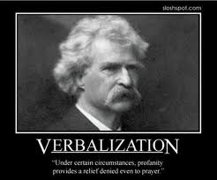
To verbalize questions
?s

Slide 27
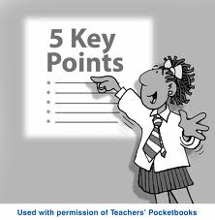
Emphasize key points

Slide 28
To envision the topic

Slide 29
People

Slide 30
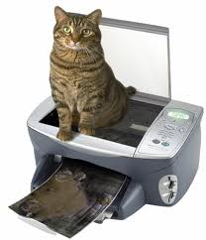
copycat

Slide 31
bookworm

Slide 32
Eager beaver

Slide 33
Walking dictionary

Slide 34
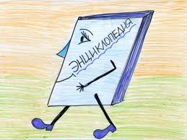
Walking encyclopedia

Slide 35
Academically oriented

Slide 36
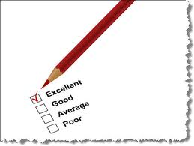
Above average

Slide 37
Teacher’s pet

Slide 38
Proverbs

Slide 39
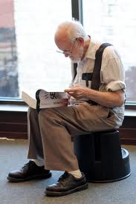
It’s never late to learn

Slide 40
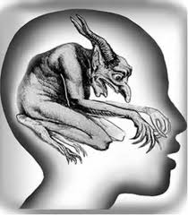
An idle brain is devil’s workshop

Slide 41
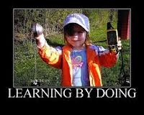
In doing we learn

Slide 42
Like teacher, like pupil
=

Slide 43
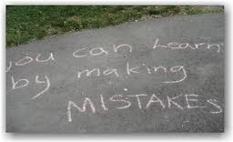
He, who makes no mistake, learns nothing

Slide 44
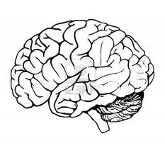
Money spent on brain is never spent in vain

