Slide 1
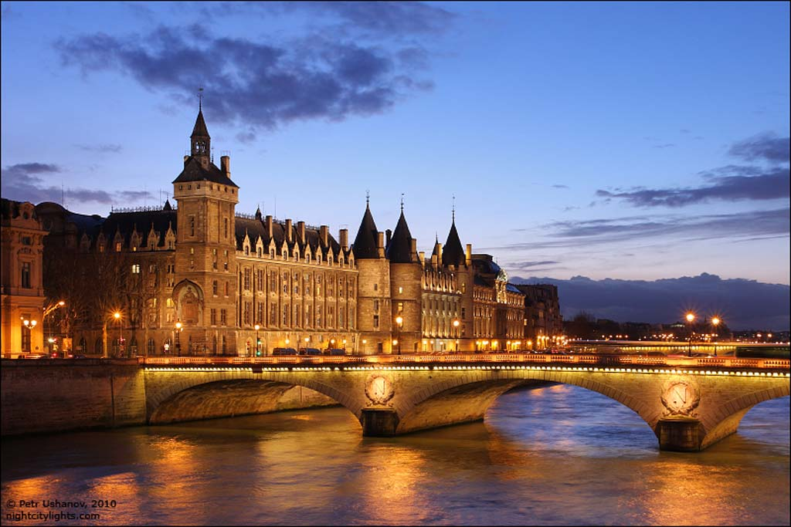
Louvre Museum
Prepared
Alena Rudenko

Slide 2
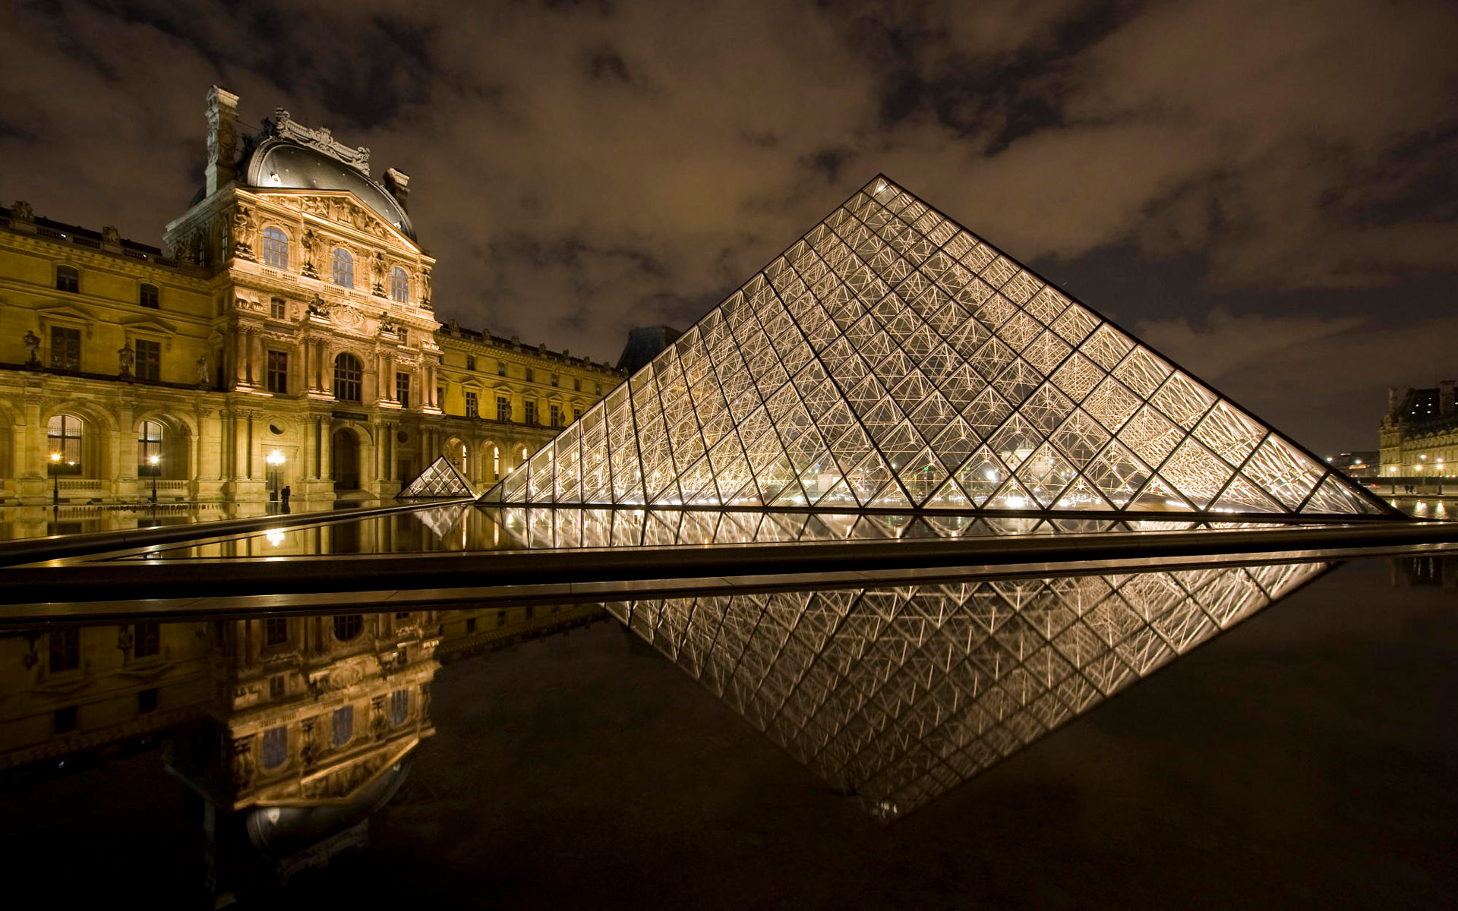
The Louvre or Louvre Museum is one of the world's largest museums and a historic monument. Nearly 35,000 objects from prehistory to the 21st century are exhibited over an area of 60,600 square metres.
The museum is housed in the Louvre Palace (Palais du Louvre), originally built as a fortress in the late 12th century under Philip II.

Slide 3
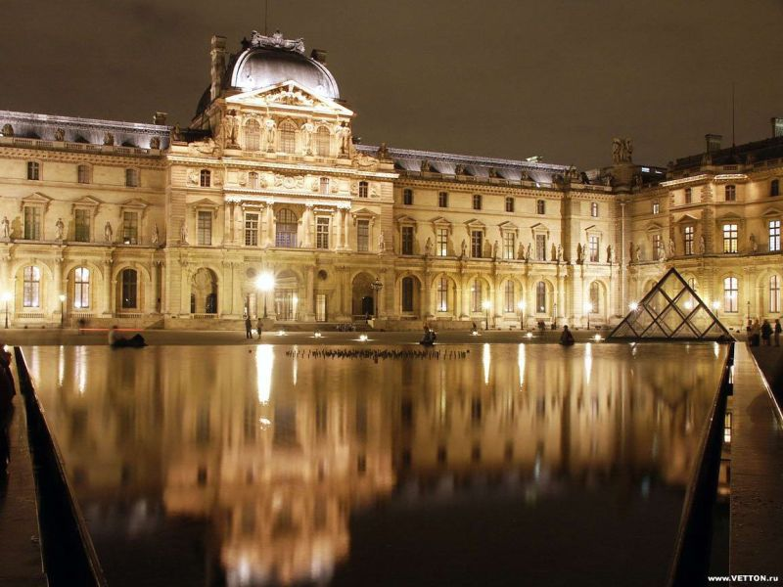
The museum opened on 10 August 1793 with an exhibition of 537 paintings, the majority of the works being royal and confiscated church property. The collection was increased under Napoleon and the museum renamed the Musée Napoléon.

Slide 4
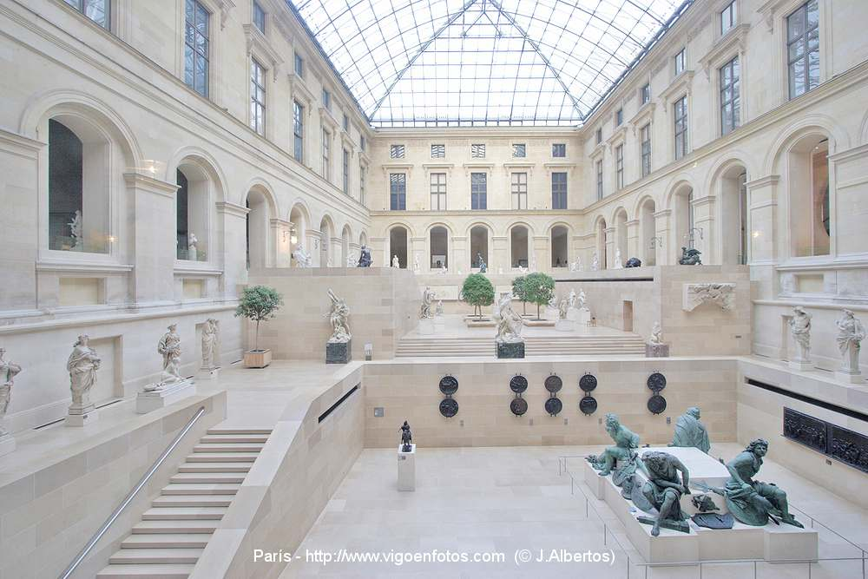
21st Century
The Louvre contains more than 380,000 items, of which only 35 000 exhibited in eight halls with a total area of ​​more than 60 000m ². Louvre shows a sculpture, artwork, paintings, drawings, and archaeological finds. It is the most visited museum in the world. Louvre became the the object high attention thanks to the book by American writer Dan Brown's "The Da Vinci Code."

Slide 5
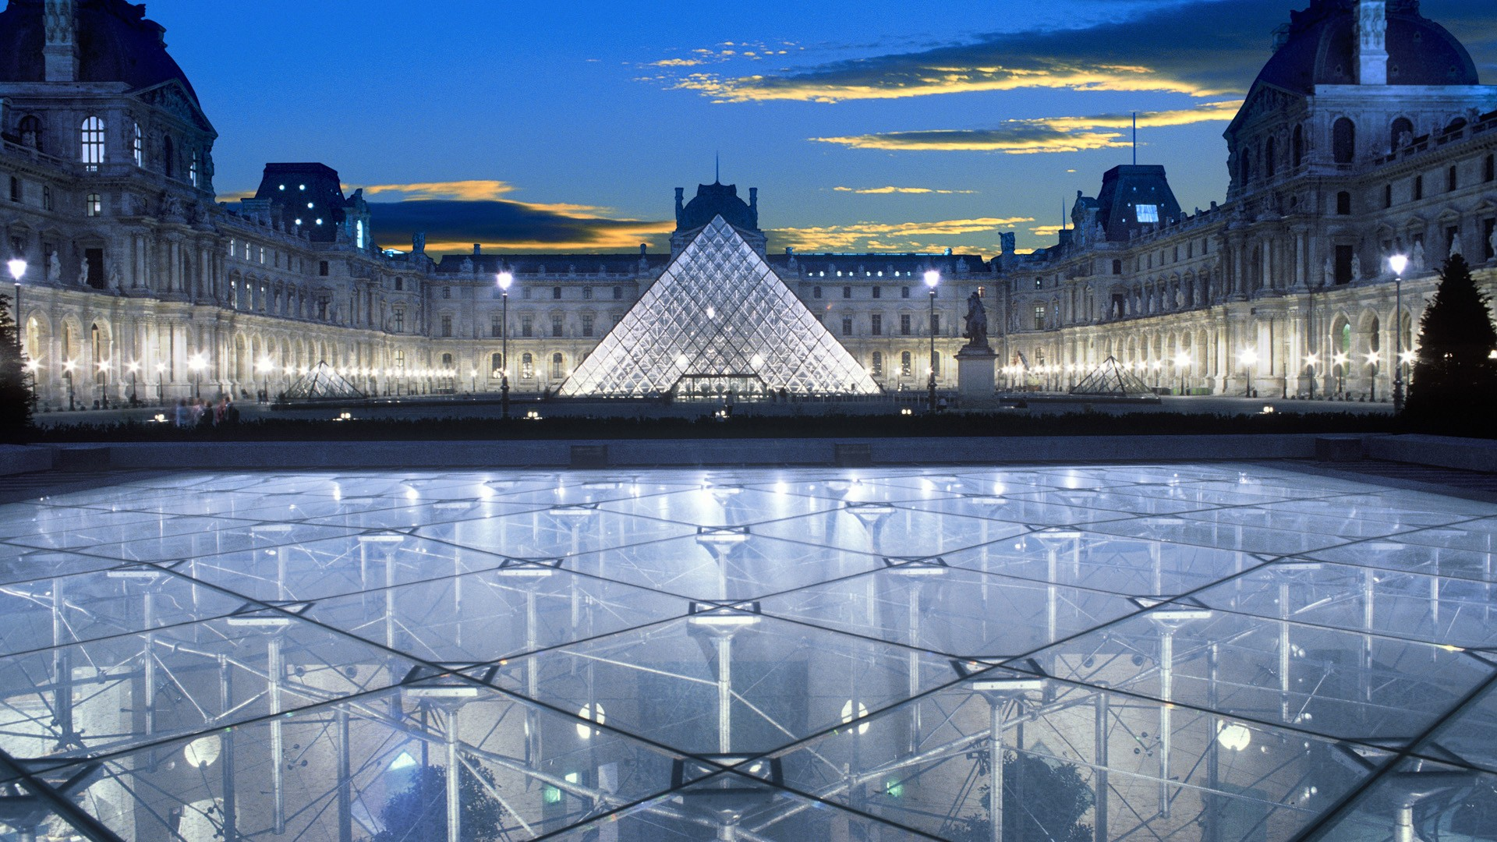
Since 2008, the museum exhibits are divided into 8 Collections Ancient East, Ancient Egypt, Ancient Greece, Rome, Islam, Art, Sculpture, arts, fine arts, graphic arts. Louvre - the most visited art museum in the world, in 2009 it was visited by 8.5 million people

