Slide 1
How We Take Care of the Environment

Slide 2
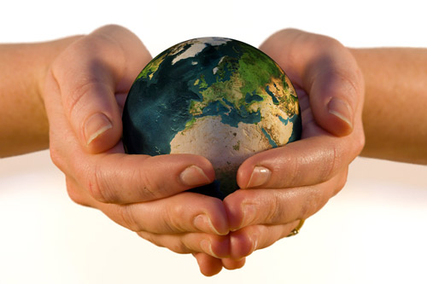
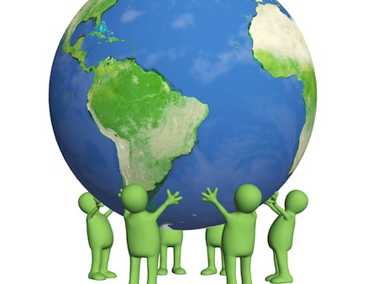
If we understand the global effects of our actions, we would be able to avoid or reduce the negative impacts in our planet and creating a healthier environment. The Global Warming is responsible for many meteorological disasters and can also be associated to the appearance of some diseases. But, how to take care of the environment? They are many things we can do to help to preserve and to save the planet, such as:

Slide 3
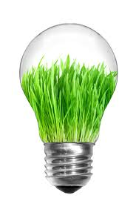
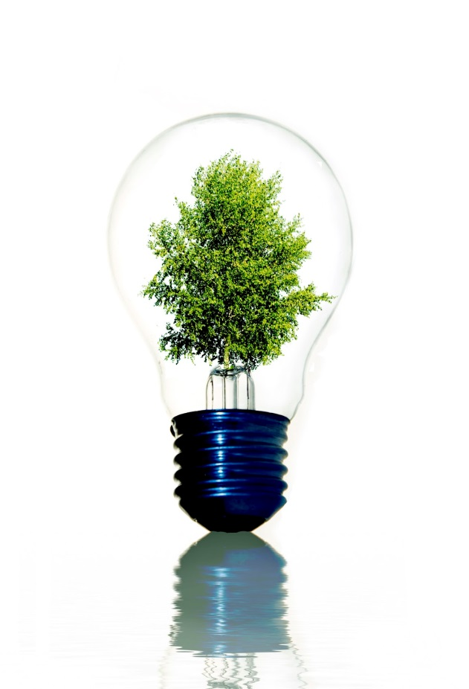
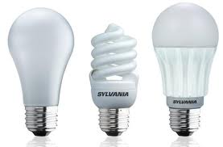
We always change the bulbs into LED light bulbs. This is one of the simplest things that we can do in order to help protect the environment from too much destruction.

Slide 4
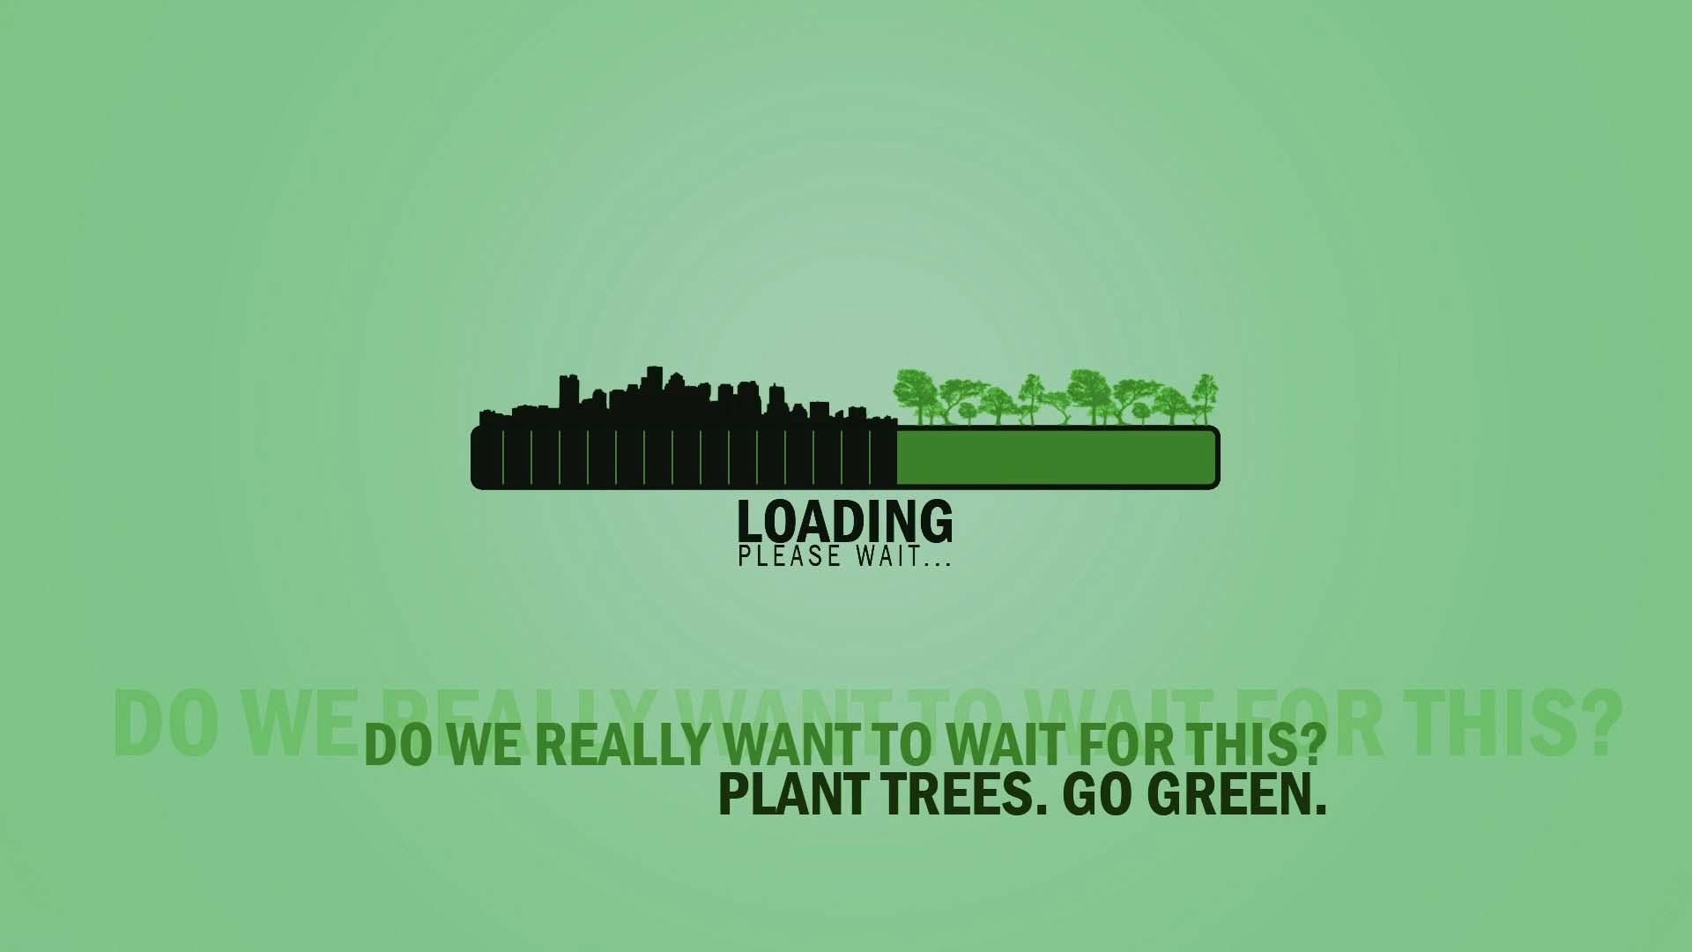
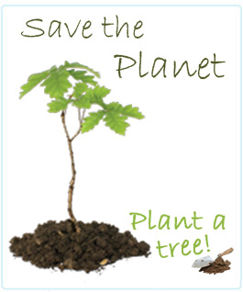
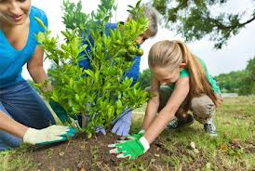
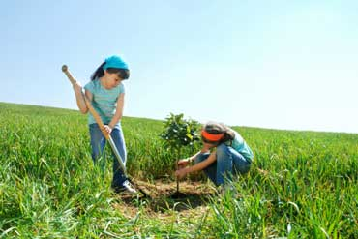
Also we try to plant more trees, as possible. Each live can save the planet and that is through planting trees. Trees are the only agent which will help lessen carbon dioxide in the air and therefore will minimize the extreme heat in the environment. Aside from that, trees help control flash floods.

Slide 5

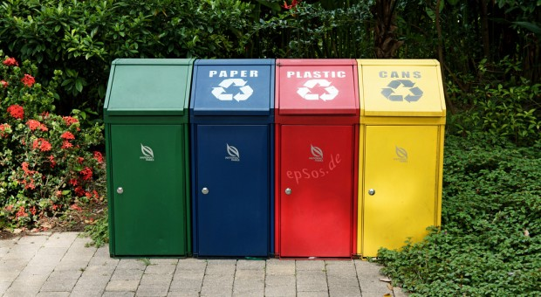

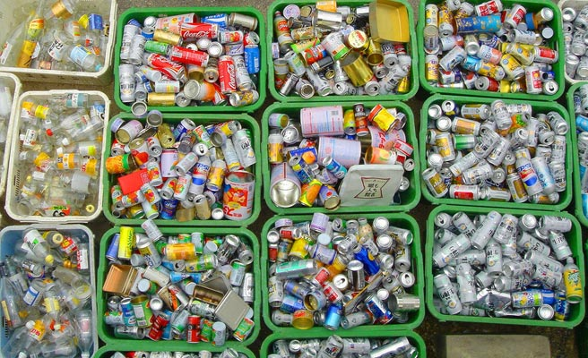
Recycling
Apart from saving energy and resources, the recycle also reduce the garbage and the toxic environments.

Slide 6
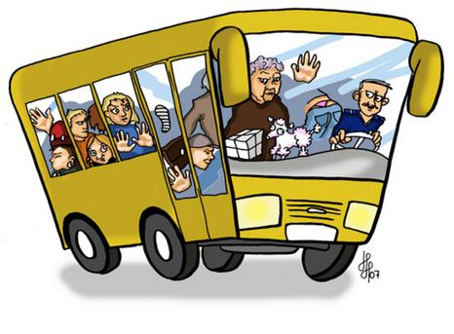
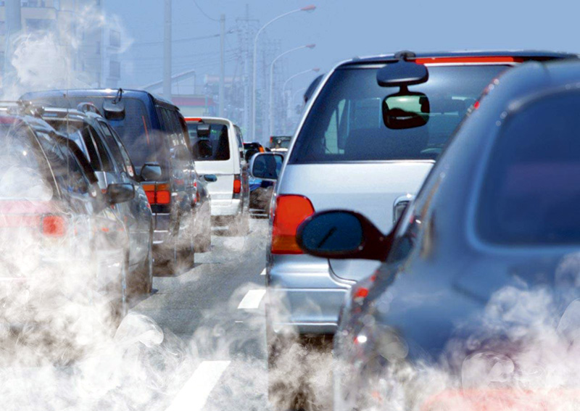
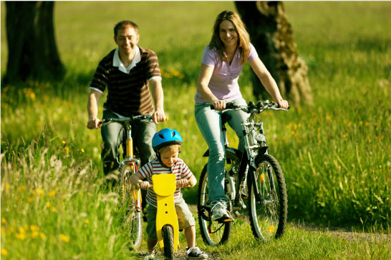
Choosing the transport
The public transport spends less energy than using your own car, and moves more people at the same time. The cars that burn less fuel per km decrease the air pollution. Whenever is possible, we try to use bicycles. They are good to do exercise and also for the environment.

Slide 7

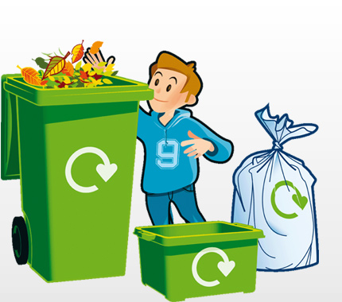

Reducing the garbage
Buying loose products will reduce the number of packages. By consummating local products, you'll not only be helping the local economy but you'll also guarantee that it was spent the minimal energy amount with the transportation.

Slide 8
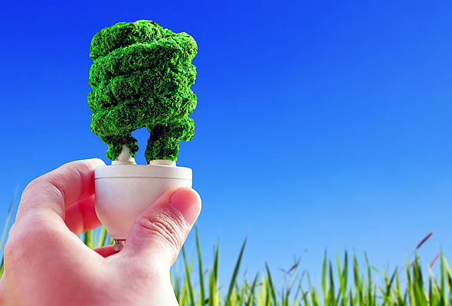
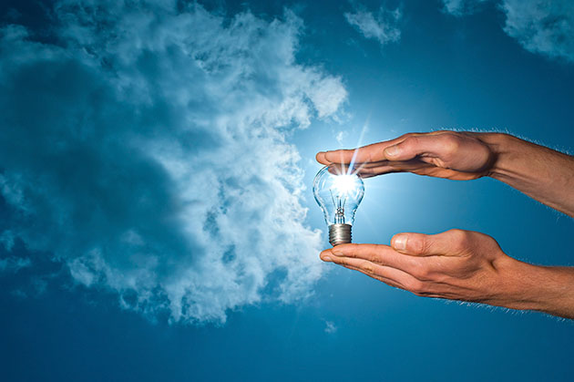
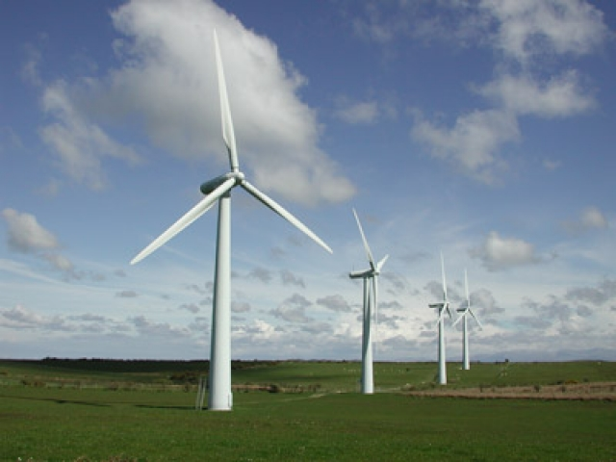
Preserving the energy
Isolating the attic can help to avoid the waste of energy. Using double glasses on windows and doors will decrease the heat loss. If you turn down the heater's thermostat just a few degrees you may reduce the bills to 10%.

Slide 9
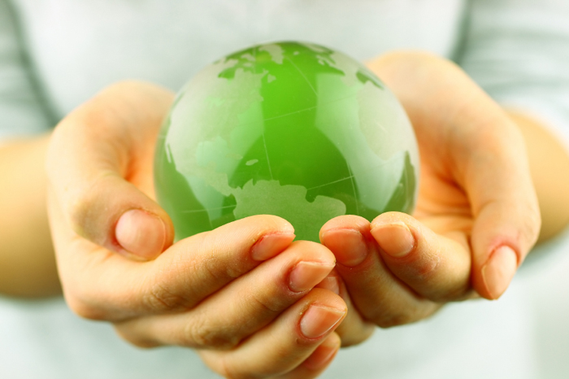
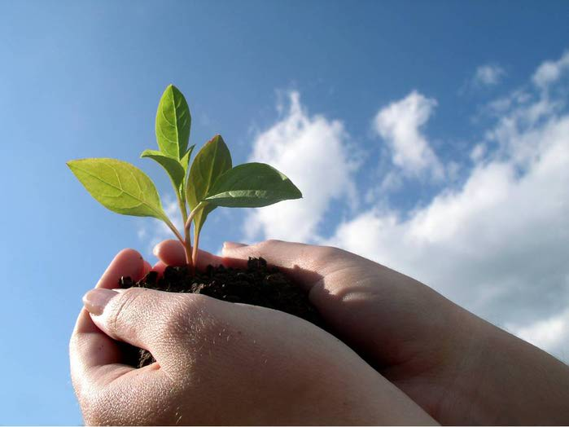
The Earth is our home.
It’s where we live, so we better take care of it! Would you rather live in a polluted dump?
“Out of all those millions and millions of planets floating around there in space, this is our planet, this is our little one, so we just got to be aware of it and take care of it.” – Paul McCartney (English musician)

