Slide 1
Australia

Slide 2
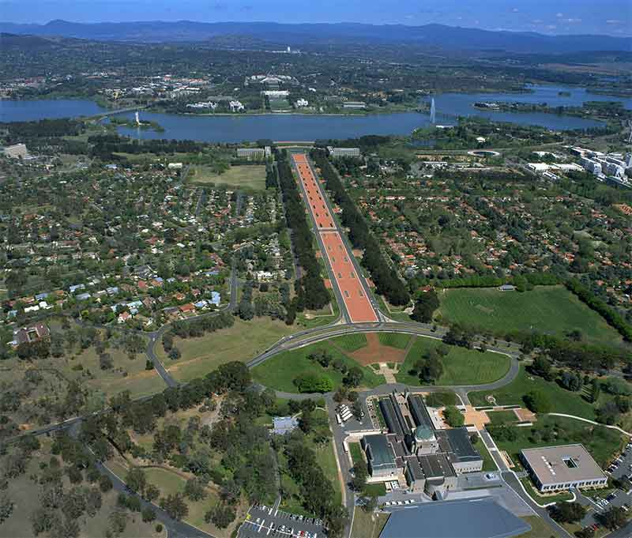

Slide 3
Australia
Australia officially the Commonwealth of Australia, is a country comprising the mainland of the Australian continent, the island of Tasmania, and numerous smaller islands. It is the world's sixth-largest country by total area.
For at least 40,000 years before the first British settlement in the late 18th century,Australia was inhabited by indigenous Australians, who spoke languages grouped into roughly 250 language groups.
In 2012 Australia had the world's fifth-highest per capita income,Australia's military expenditure is the world's 13th-largest.

Slide 4
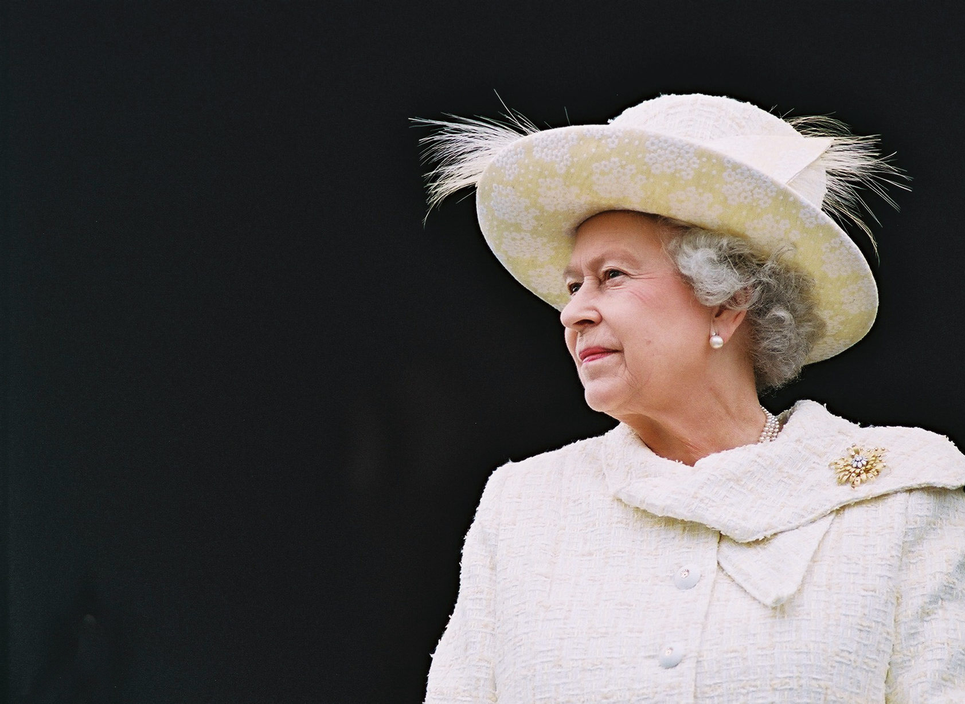
Government
Australia is a constitutional
monarchy with a federal division
of powers.
It uses a parliamentary system
of government with Queen Elizabeth II
at its apex as the Queen of Australia,
a role that is distinct from her position
as monarch of the other
Commonwealth realms.

Slide 5
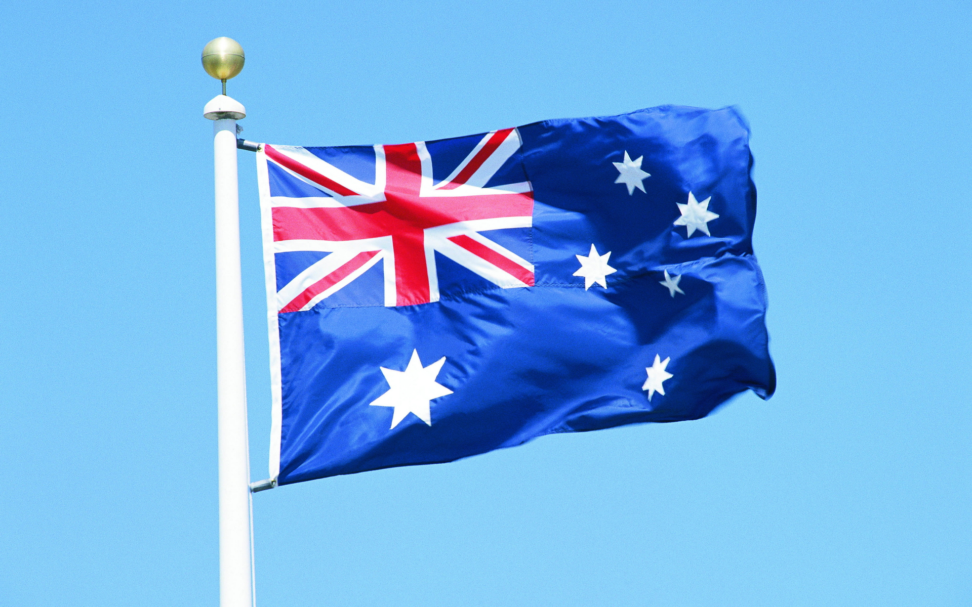
Flag of Australia
The flag of Australia is a defaced Blue Ensign:
a blue field with the Union Jack
in the canton (upper hoist quarter),
and a large white seven-pointed
star known as the Commonwealth Star
in the lower hoist quarter.
The fly contains a representation of the
Southern Cross constellation,
made up of five white stars –
one small five-pointed star
and four, larger,
seven-pointed stars.

Slide 6
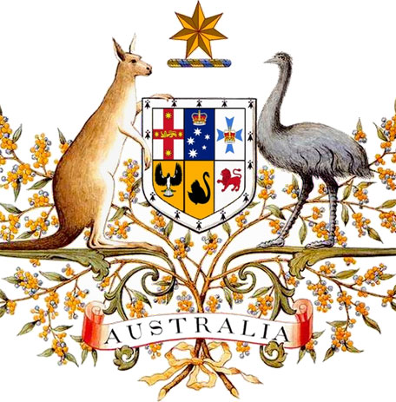
Coat of arms of Australia
The coat of arms of Australia is the official symbol of Australia. The initial coat of arms was granted by King Edward VII on 7 May 1908, and the current version was granted by King George V on 19 September 1912, although the 1908 version continued to be used in some contexts, notably appearing on the sixpenny coin until 1966.

Slide 7
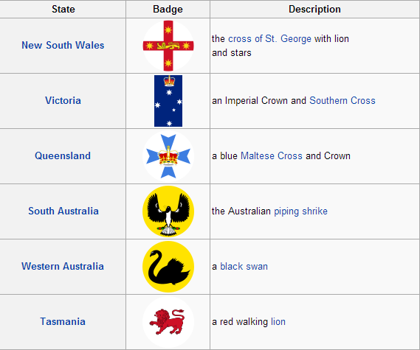
Design
The shield is the focal point of the coat of arms, contained within is the badge of each Australian state, the whole surrounded by an ermine border representing the federation of the states:

Slide 8
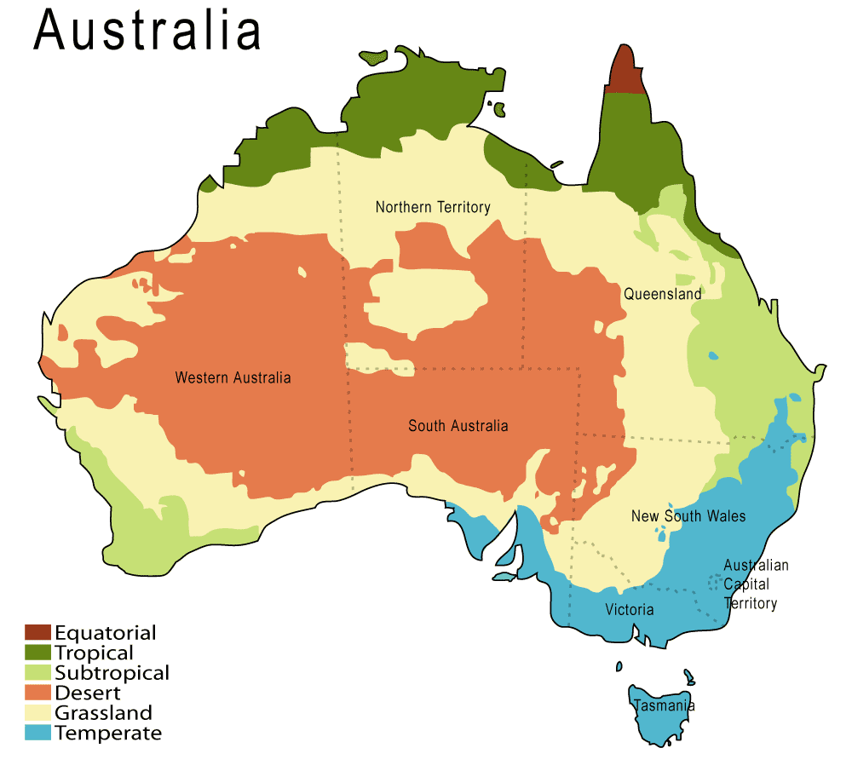
Geography and climate

Slide 9
Australia's landmass of 7,617,930 square kilometres is on the Indo-Australian Plate. Surrounded by the Indian and Pacific oceans, it is separated from Asia by the Arafura and Timor seas, with the Coral Sea lying off the Queensland coast, and the Tasman Sea lying between Australia and New Zealand.
The climate of Australia is significantly influenced by ocean currents, including the Indian Ocean Dipole and the El Niño–Southern Oscillation, which is correlated with periodic drought, and the seasonal tropical low-pressure system that produces cyclones in northern Australia.
These factors cause rainfall to vary markedly from year to year.

Slide 10
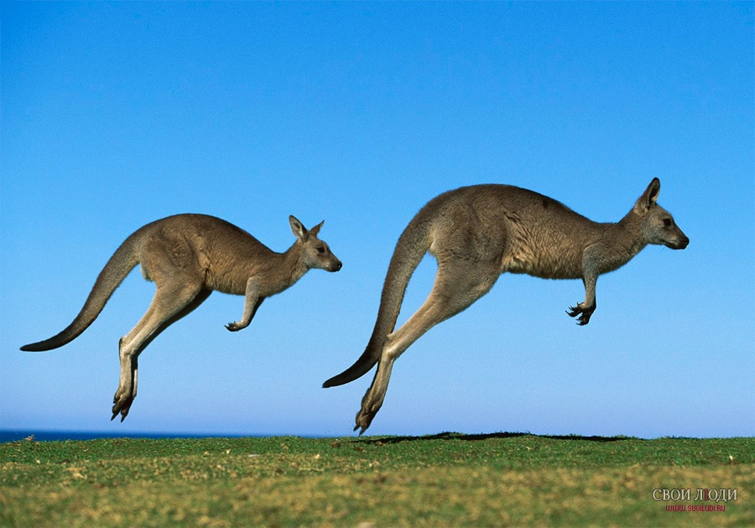
fauna of Australia

Slide 11
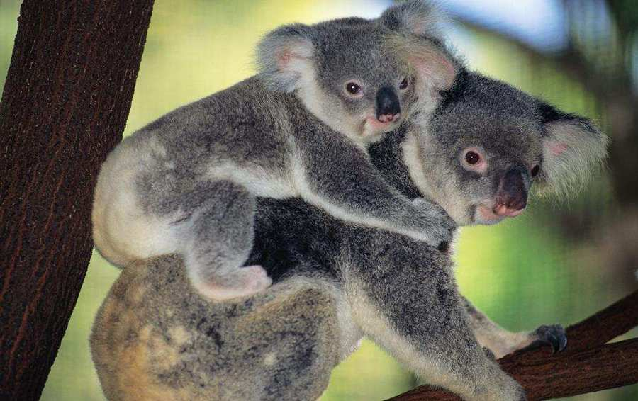
Koala
The koala is an arboreal herbivorous marsupial native to Australia.
The koala is a stocky animal with a large head and vestigial or non-existent tail.It has a body length of 60–85 cm (24–33 in) and a weight of 4–15 kg, making it among the largest arboreal marsupial.

Slide 12
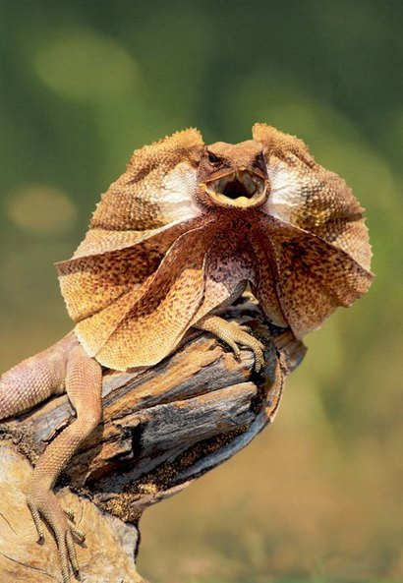
Frill-necked lizard
The frill-necked lizard, also known as the frilled lizard or frilled dragon, is found mainly in northern Australia and southern New Guinea.
The lizard is a relatively large member of the agamid family, growing up to 85 cm. It is capable of bipedal locomotion. The frill-necked lizard does not have a standard colour, but its body is darker than its frill.

Slide 13
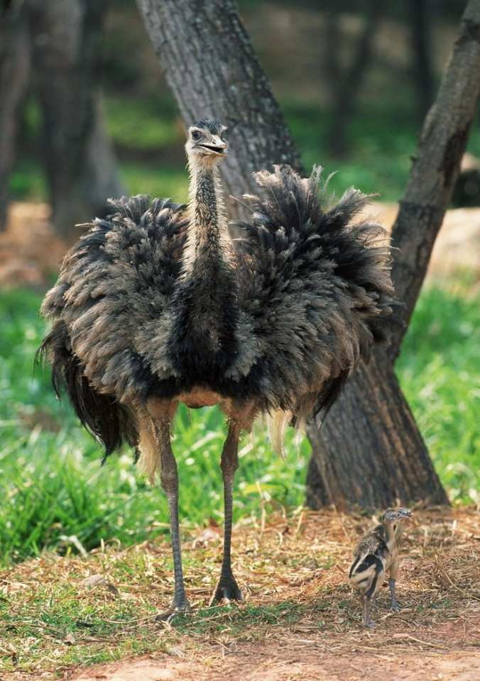
Emu
The emu is the largest bird native to Australia and the only extant member of the genus Dromaius. It is the second-largest extant bird in the world by height.
The largest can reach up to 1.5–1.9 m in height, 1–1.3 m at the shoulder.

Slide 14
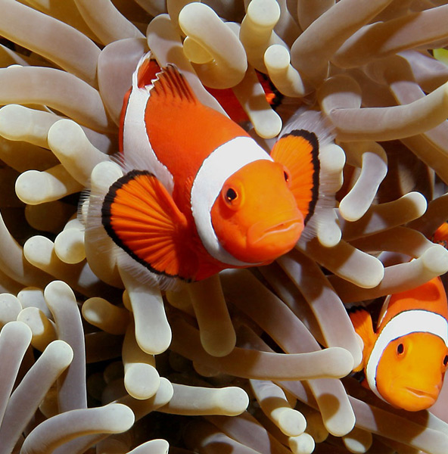
Ocellaris clownfish
Amphiprion ocellaris, also known as the Ocellaris clownfish, False Percula clownfish or Common clownfish, is a marine fish belonging to the family Pomacentridae which includes clownfishes and damselfishes.

Slide 15
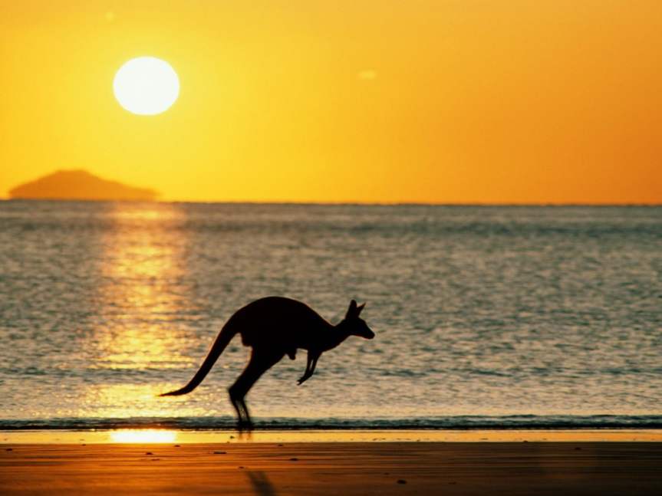
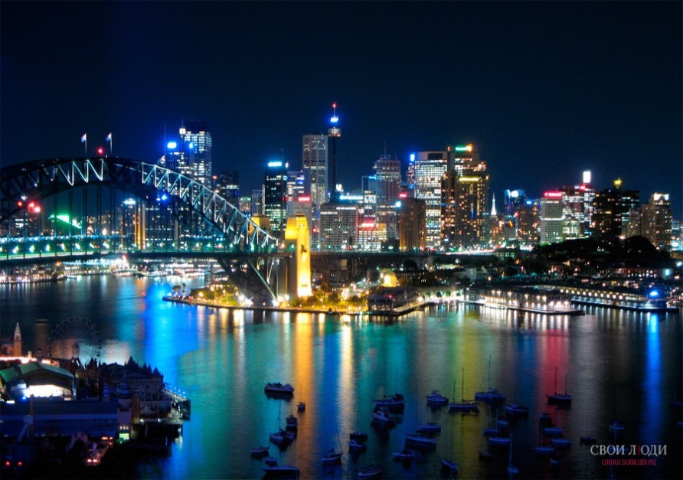
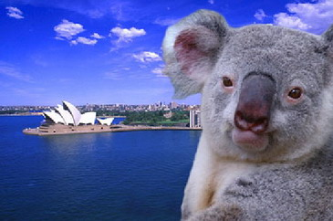
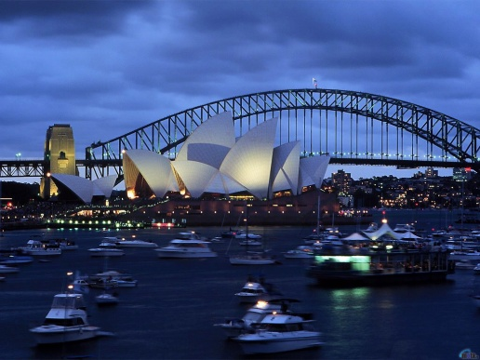
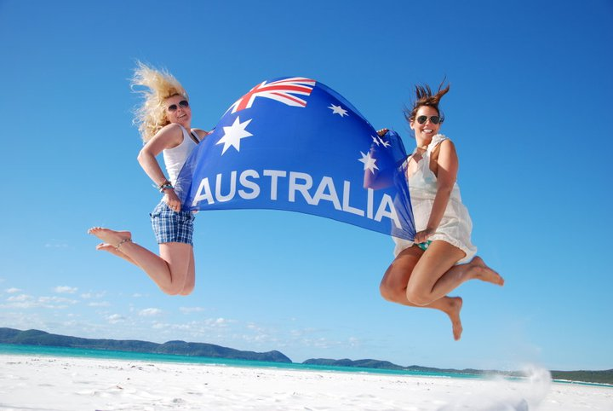
Thanks for watching!

