Slide 1
Lyuko Dashvar

Slide 2
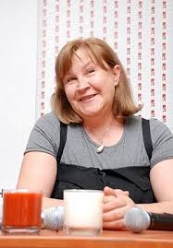
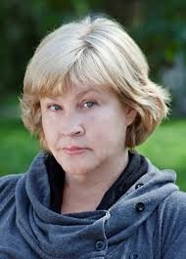
Biography
Lyuko Dashvar(real name Irina I. Chernov) was born on May 2, 1954 in Kherson. She has two degrees. After receipt of the first higher education (technical ), she got married and gave birth to children. Then Luuko worked in the newspaper. Then her family moved to Kyiv. Since 2001 she has been main editor of newspaper «Peasantn the star»

Slide 3
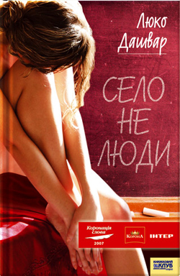
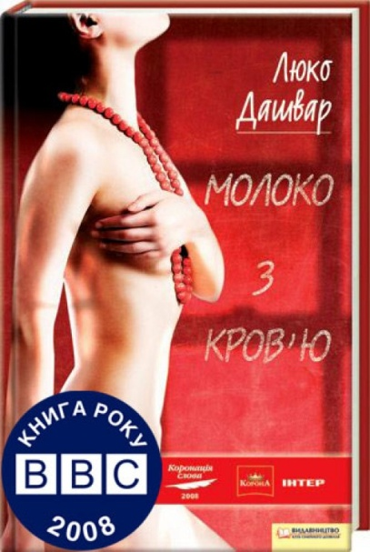
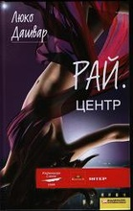
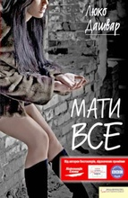
Creative activities
Her first novel, " The village is not people " became a laureate of the contest " A Word Coronation 2007".
The next novel "The Milk of blood " was the winner of the " Coronation word 2008" and winner of " The Book, the BBC- 2008 ."
The third novel by the author " Heavens. The Сenter. " was the winner of the contest " A Word Coronation 2009" in the category "Choice of a reader."
In autumn 2010, writer published a new novel «Have averything."

Slide 4



Creative activities
In the period from 2011 to 2012 the author presents the trilogy " The life“, It consist of three novels , each of them describes a future life of one of the boys – main heroes of the novel " Heavens. The Center" - Makar, Max and Hotsyk .

Slide 5
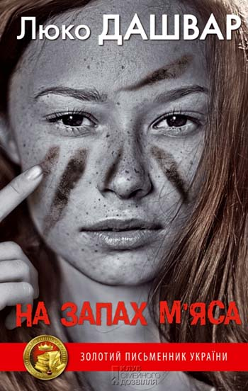
Her new book «The smell of meat» was published this year.

Slide 6
«The smell of meat»
A city girl Maya arrived to the farm. Why is she hear? Did she run away in search of love ? A local fellas, Tolik liked her very much! Maybe she was a witch…
The author said that human is a predator. But , unlike the kingdom of animals, our modern life has its "meat ". The thirst for wealth, power, more than you need – all this is meat.

Slide 7
«Have all»
My favourite book is «To have everything». It seems that professorial daughter Lidochtsi Verbitsky is lucky: a caring mother, a beloved husband, a beautiful apartment, plenty of money and a secret ... Deceit and falsehood are the principais exist in their family!!! To have everything - and everything can be lost at once!

Slide 8
Interesting facts from the life
The alias ​​Lyuko Dashvar was created by hear own collecting the letters of the names of dear to her people.
Children and her husband do not read her works for what she is grateful to them.
The plot and the prototypes her characters are taken from real life.

Slide 9
In my opinion we must be proud of this writer, as she presets our Ukranian word, literature and country.

