Slide 1
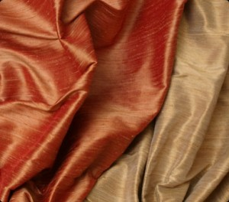
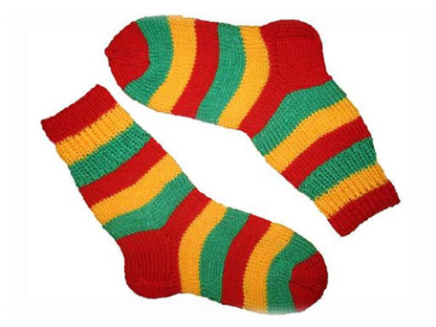
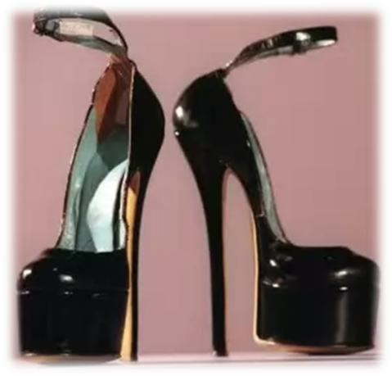
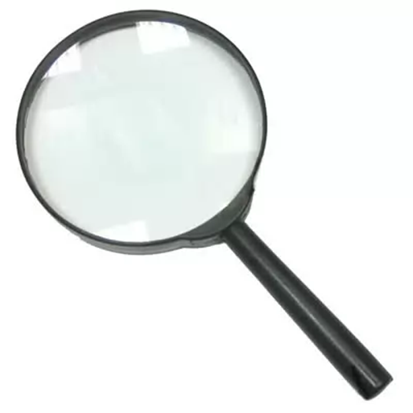
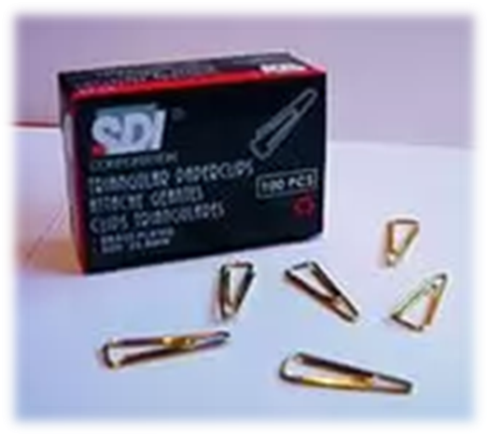
famous inventions

Slide 2

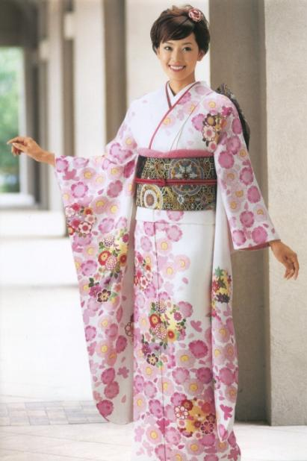
Silk began to produce in China from silkworm cocoons thousand years ago. Now with silk saris make excellent Indian and Japanese kimonos.

Slide 3
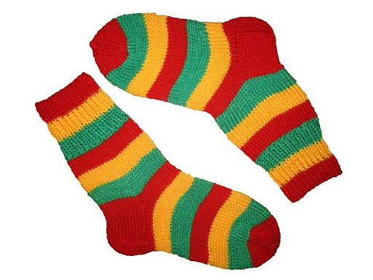
1842-1843 years Russian engineer and inventor Alexander S. Doe made the world's first socks that withstood all tests. They were worn only a week. When a thread started adding copper wire, socks became more durable.

Slide 4
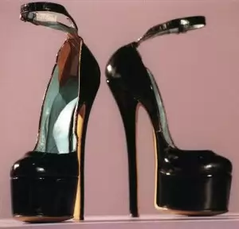
Heel in its present form has invented the greatest inventor and artist Leonardo da Vinci, but unfortunately his invention has been in vogue already in the XVII century. Women and girls have always wanted to be taller and slimmer so that wearing heels as much as six inches in length. In such a long shoe they can move and walk only with the help of two of his servants - they grew on both sides of the ladies, it will not drop. Here's a story heels. It turns out that the first heels invented by Leonardo da Vinci.

Slide 5
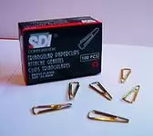
This simple accessories like paper clip was invented relatively recently - in 1899? A "father" indispensable holder sheets was Norwegian Johan Volery, mathematician and inventor. According to his contemporaries, he invented the paper clip in passing. The fact that one day he got heavily into debt. Looking around, I noticed a piece of steel wire, which decided to experiment. Twisted it - and received a patent to several variants of staples. This first clip was triangular. Patent brought Johan enough money to pay off debts.

Slide 6
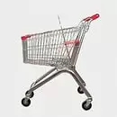
Shopping cart, so that makes it easier shopping, invented in 1936 by the owner of the grocery store Piggly-Wiggly Sylvan Goldman? This worthy man really cared about the convenience of customers. I found a way to help the customer to buy more goods.

Slide 7

Englishman Roger Bacon invented a magnifying glass in 1250.

Slide 8
Thank you

