Slide 1
William Shakespeare
Have executed Shvets Maxim and Mosiyuk Taras

Slide 2
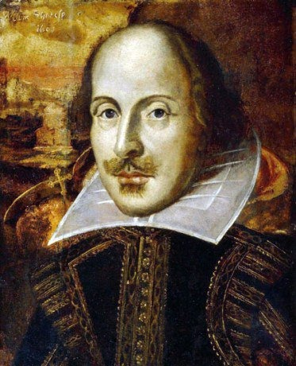
William Shakespeare
William Shakespeare, the great English poet and dramatist, author of 36 plays 154 sonnets and two epic poems. His work, "Hamlet," "Henry V," "King Lear," "Julius Caesar," "Macbeth," "Romeo and Juliet" and others. His personality is mysterious and there are many interesting facts biography of William Shakespeare.
For several centuries, there are disputes about whether he was the true author of the works that were published under his name. Some say that Shakespeare did not exist.

Slide 3
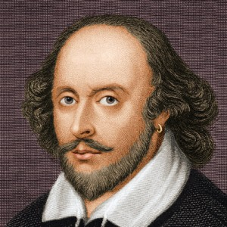
William Shakespeare
Life of the great playwright William Shakespeare has always been shrouded in some mystery, but it's safe to say that a small amount of preserved interesting facts and information about the life of Shakespeare.
Most interesting facts about Shakespeare, life and works of famous English poet and playwright are given below:
Fact number 1: Shakespeare is the account the world's second most-cited author after the Bible writers.

Slide 4
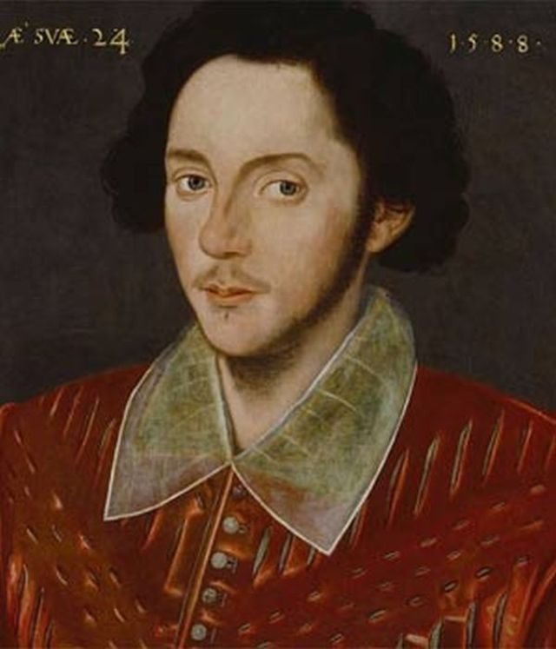
William Shakespeare
Fact number 2: reads that invented the word "murder" was actually coined and put into practice exactly Shakespeare.
Fact number 3: Shakespeare never went to university, but this did not prevent him to acquire global popularity, moreover, he is still considered one of the greatest figures in world literature.
Fact number 4: Extant works of Shakespeare is a collection of 38 pieces, two long narrative poems, huge range of poems, including 154 sonnets.

Slide 5
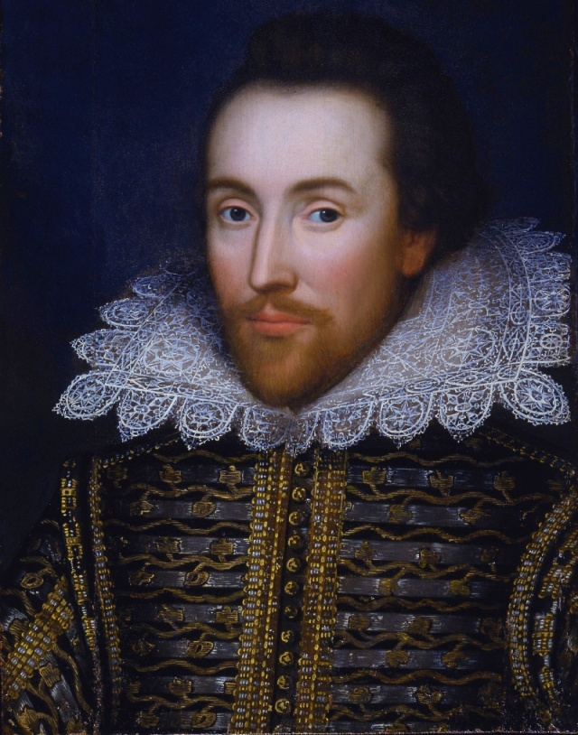
William Shakespeare
Fact number 5: The best part of all of Shakespeare's plays have been translated into all major languages ​​and life in theaters his plays are staged more often than other well-known plays playwrights.
Fact number 6: It is said that Shakespeare began his career in the art world as a regular actor, and his first play he wrote about the time when he was about 25 years old.

Slide 6
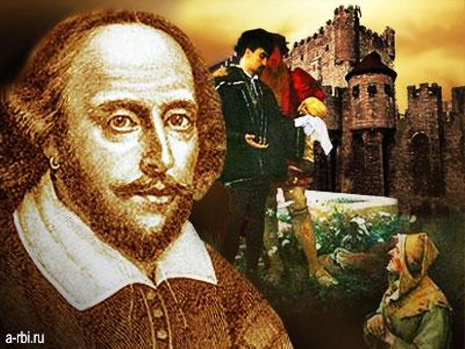
William Shakespeare
Fact number 7: Another interesting fact about the life and work of Shakespeare says that the playwright never published his plays. He wanted all of his plays were performed directly on the stage and was opposed to distributed copies of his plays and read at home.
Fact number 8: As for Shakespeare, then save the information about what to write some of his plays, he borrowed the information from various sources that were available to him, such as stories, plays or poems.

Slide 7
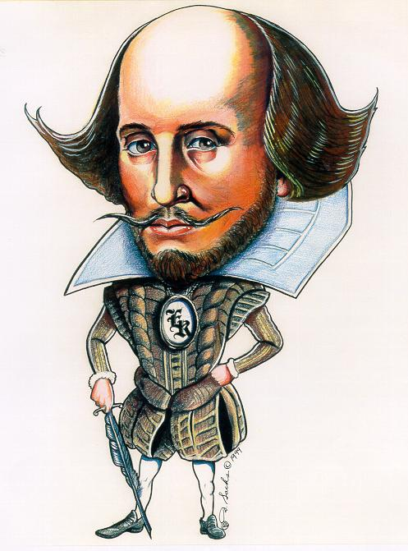
William Shakespeare
Fact number 9: There is also an interesting fact about the personal life of Shakespeare. Historians claim that Shakespeare married Anne Hathaway before his beloved 18 years. They had three children together. He had only one only granddaughter, who died, being childless is why the great playwright no descendants.
Fact number 10: The actual date of birth of Shakespeare to this day remains unknown, so historians push only their assumption that Shakespeare lived only 52 years.
Fact number 11: Shakespeare enriched the English language by 1700 new words

Slide 8
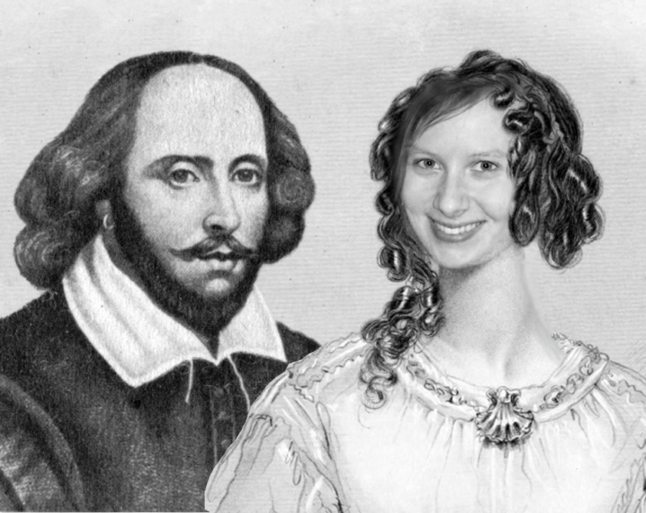
The end!

