Slide 1
Presentation of:
Prepared by:
Viktor Bihus and Sofia Dobush

Slide 2
Geographical location
New Zealand is an independent island country in the Southwest Pacific Ocean.
Its area is about
269 000 km² (75-th).
New Zealand belongs to a large island group called Polynesia.
It’s a country consisting of two large islands and several dozen smaller islands, that can be far away from the main ones.

Slide 3
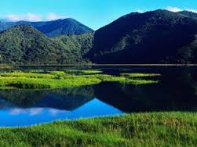
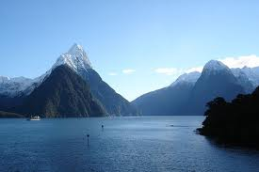
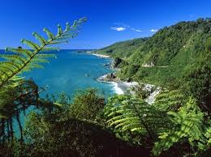
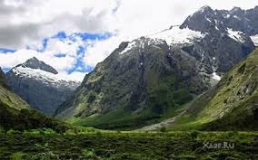
Climate
New Zealand has a mild and temperate climate. It never gets too hot in summer and there are not too cold in winter.
Feature of New Zealand is that summer months are December, January and February.
The average temperatures is – ( from 10 °C to 16 °C ).
Also, Smoke and steam are characteristic features of New Zealand (they come from volcanoes and geysers). That’s why the Maoris called it the country of long white clouds.
Because of the mild climate there are a lot of green forests and walleys.

Slide 4
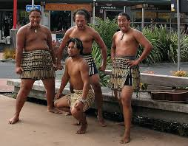
Population
2013
The first people who settled in New Zealand were a brown-skinned people called Maoris. They came from Polynesian islands located northeast of New Zealand.
The country was discovered by Europeans in 1642, but they did not start to settle in the islands until the late 1700's.
Maoris make up about 12 % of the country's population.
Today, most New Zealanders are descendants of the early European settlers.

Slide 5
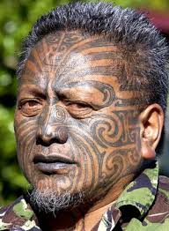
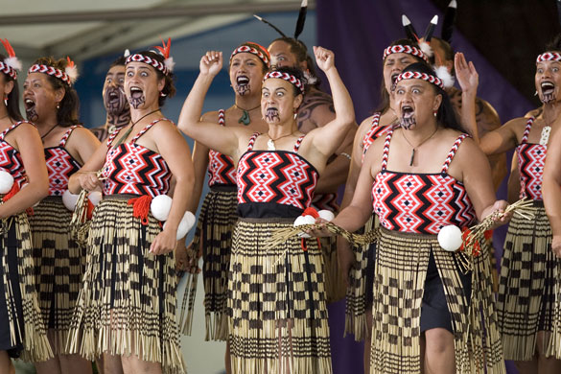
Apps: Maori

Slide 6
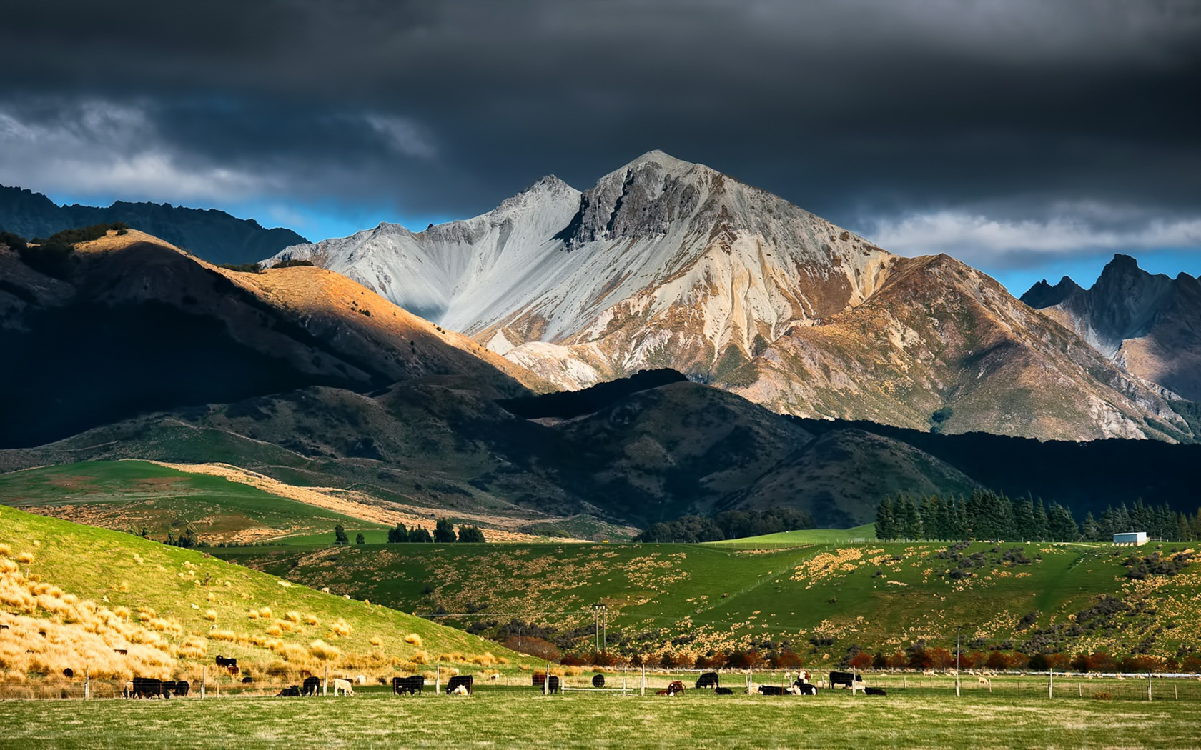
Apps: Landscapes

Slide 7
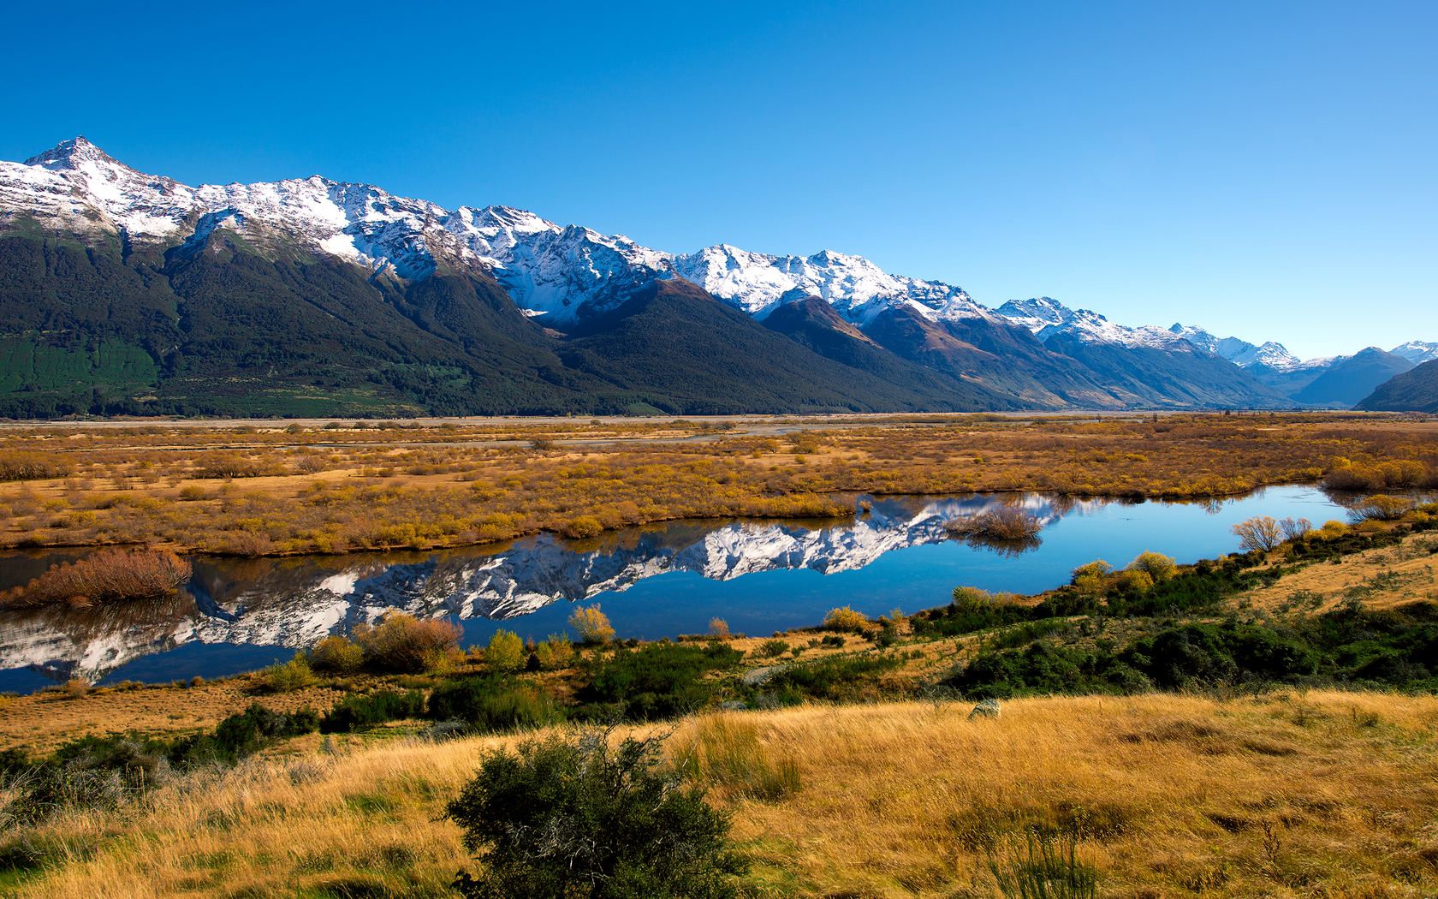
Apps: Landscapes

Slide 8
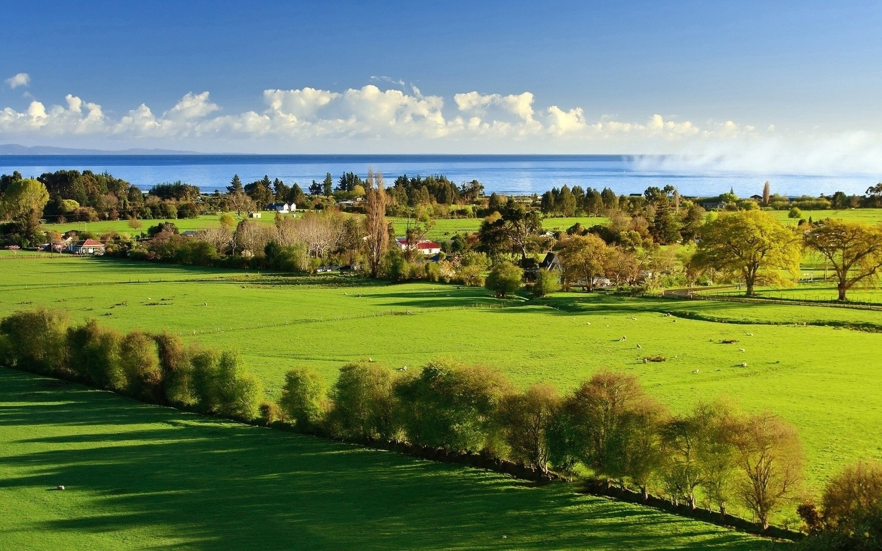
Apps: Landscapes

Slide 9
The End

