Slide 1
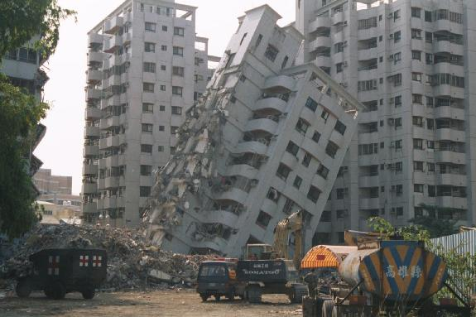
earthquake

Slide 2
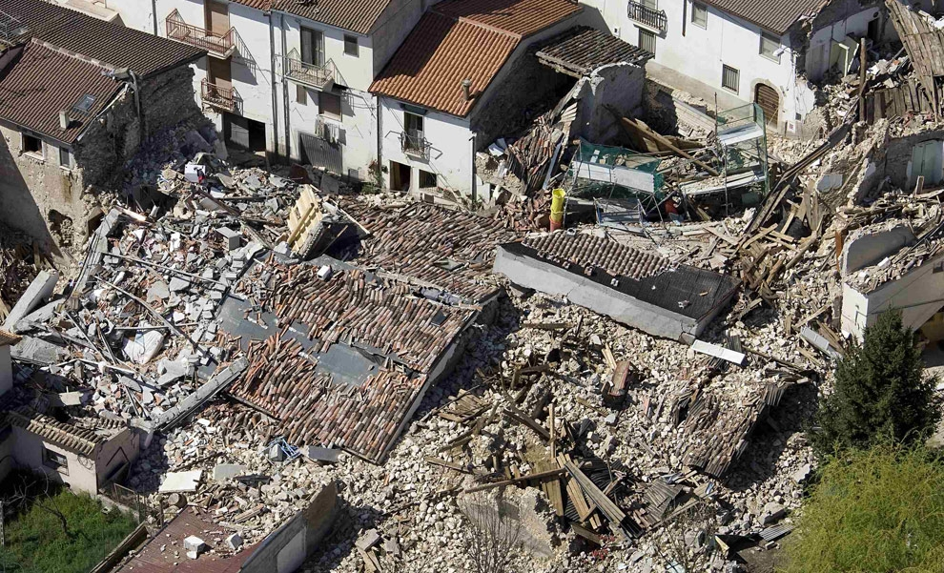
Earthquake is the result of a sudden release of energy in the earth’s crust that creates seismic waves.

Slide 3
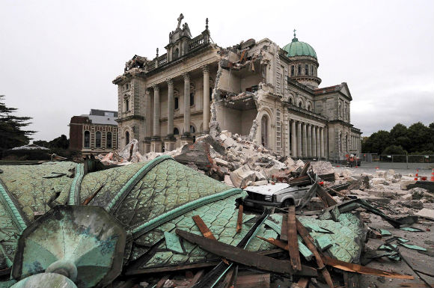
The seismicity and seismic activity of an area refers to the frequency, type and size of earthquakes experienced over a period of time.

Slide 4
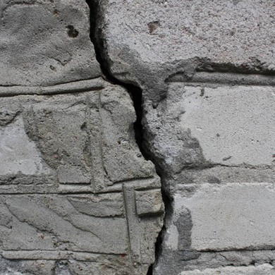
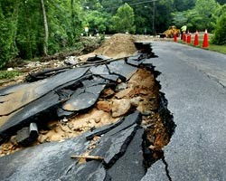
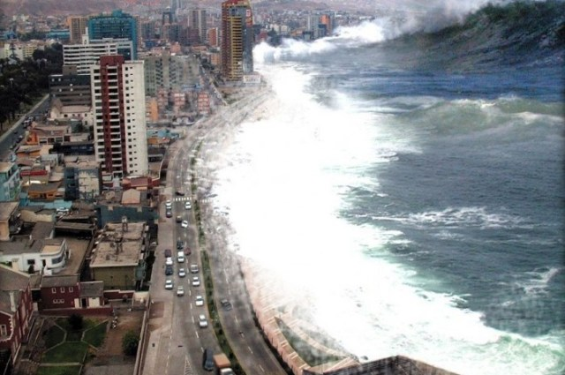
During strong earthquakes on Earth often have cracks, landslides, tsunamis

Slide 5
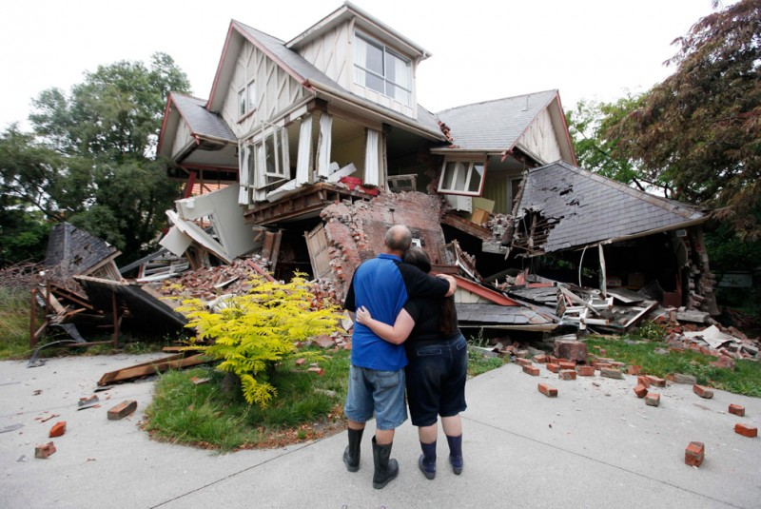
Of all the natural disasters, according to UNESCO, earthquakes rank first in the world in economic damage inflicted and the number of victims.

Slide 6
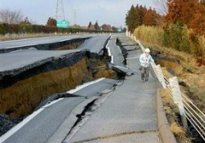
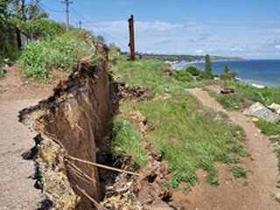
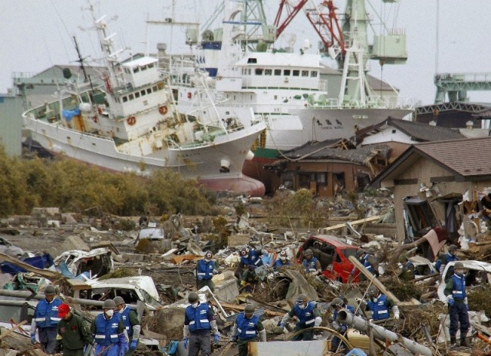
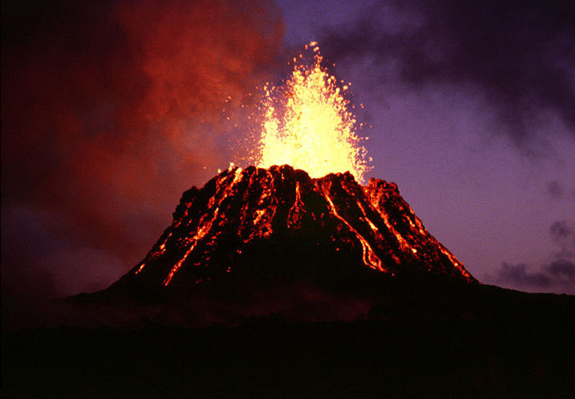
Depending on the cause and place of occurrence, earthquakes are divided into:
Tectonic
Volcanic
Landslide
Technogenic or anthropogenic

Slide 7
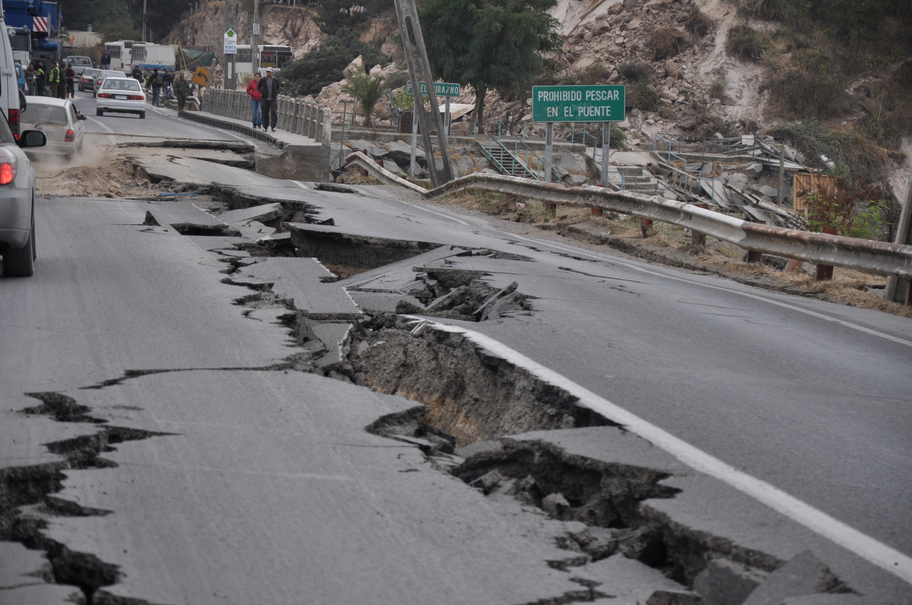
Tectonic earthquakes arise when the rock slabs or as a result of the collision of oceanic and continental platforms.

Slide 8
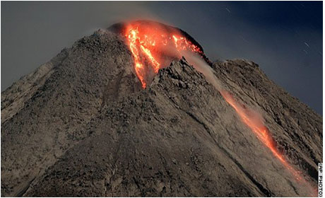
Volcanic earthquakes occur when red-hot lava flows and gases under pressure from below the earth's surface. Volcanic earthquakes are usually not too strong, but can last up to several weeks.

Slide 9
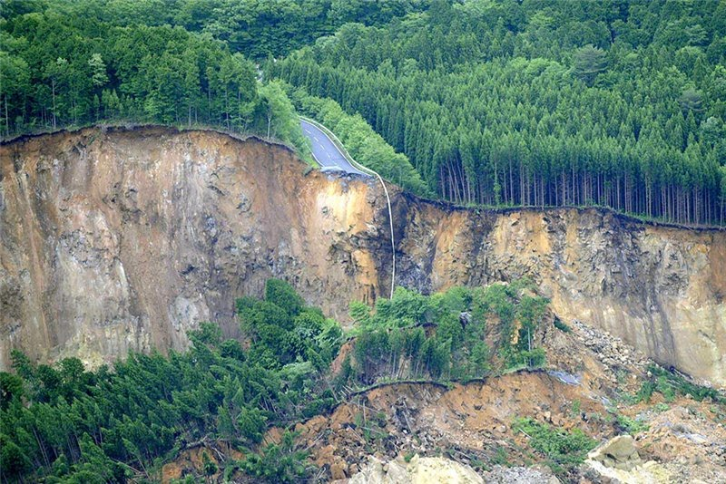
Landslide earthquake associated with the formation of underground voids caused by the action of groundwater and underground rivers. In this case, the top layer of the earth's surface falls down, causing a slight concussion.

Slide 10
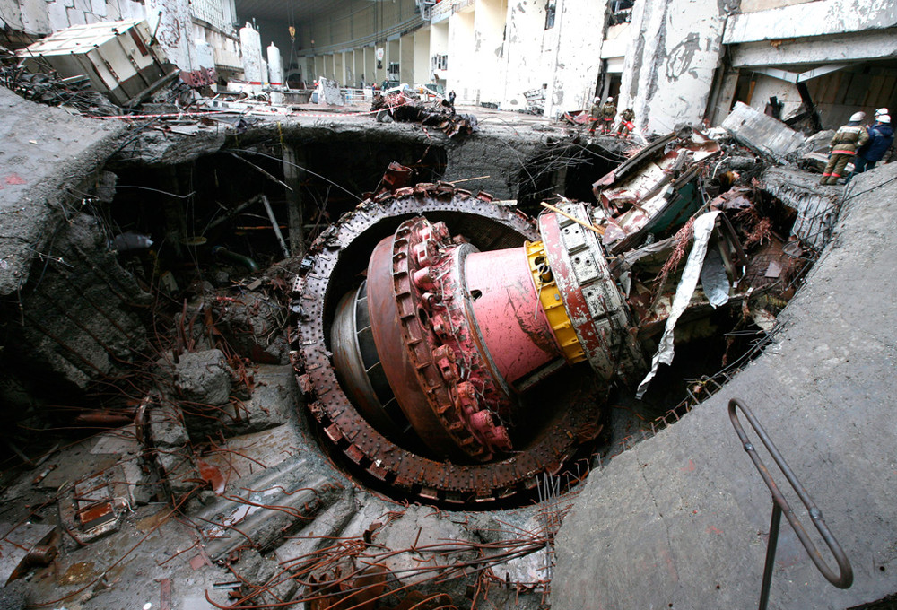
Technogenous earthquakes are associated with human impact on nature.

Slide 11
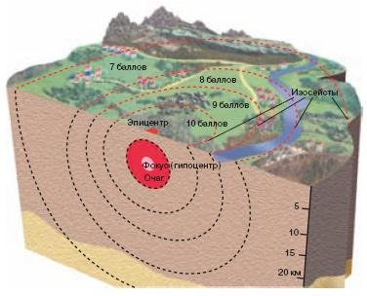
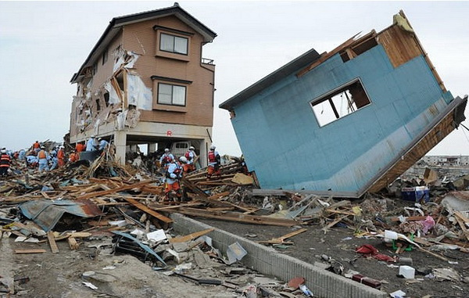
There are hypocenter and epicenter of the earthquake. They differ in all aspects of seismic waves. Cells are earthquakes at depths of 30-60 km, and sometimes - at a depth of 700 km.

Slide 12
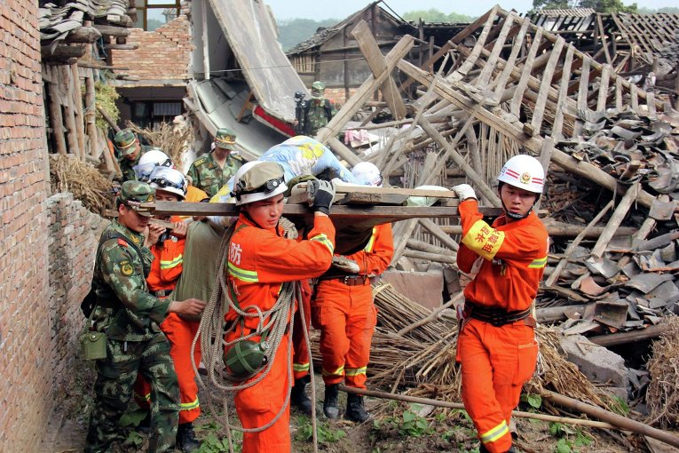
Assessment of earthquake action from the second half of the XIX century, by using special seismic scales. The most common of them - a 12-point scale (Richter scale). Seismology studying earthquakes, monitoring of earthquakes makes special seismic service.

Slide 13
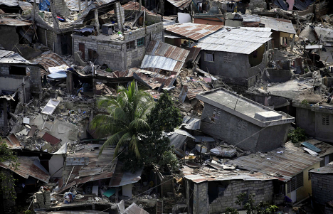
Signs of close earthquakes:
• smell of gas in the area where it had not previously been seen;
• concerns of birds and animals;
• flash in the form of scattered light lightning;
• arcing closely spaced but not touching electrical wires;
• bluish glow inner surface of the walls of the houses;
• spontaneous ignition of fluorescent lamps.

Slide 14
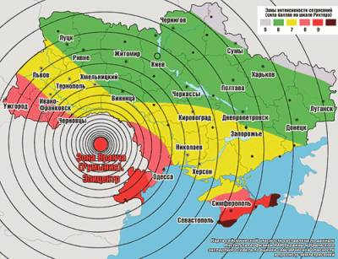
Recently, to our city and several regions of Ukraine swept seismic waves from the earthquake that occurred in Romania Vrancea mountain range.

Slide 15
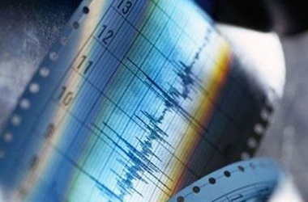
Magnitude in the epicenter of the earthquake was about 5 on the Richter scale, the amplitude of the dispersed radius of 40 kilometers.

