Slide 1
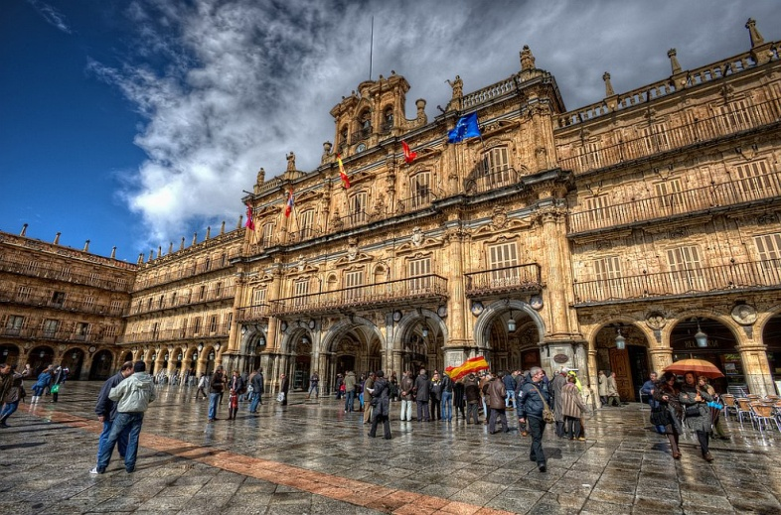
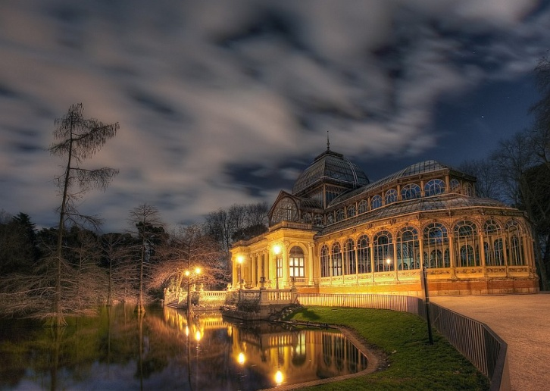
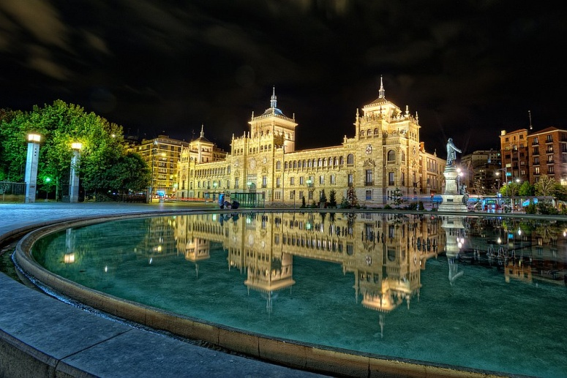
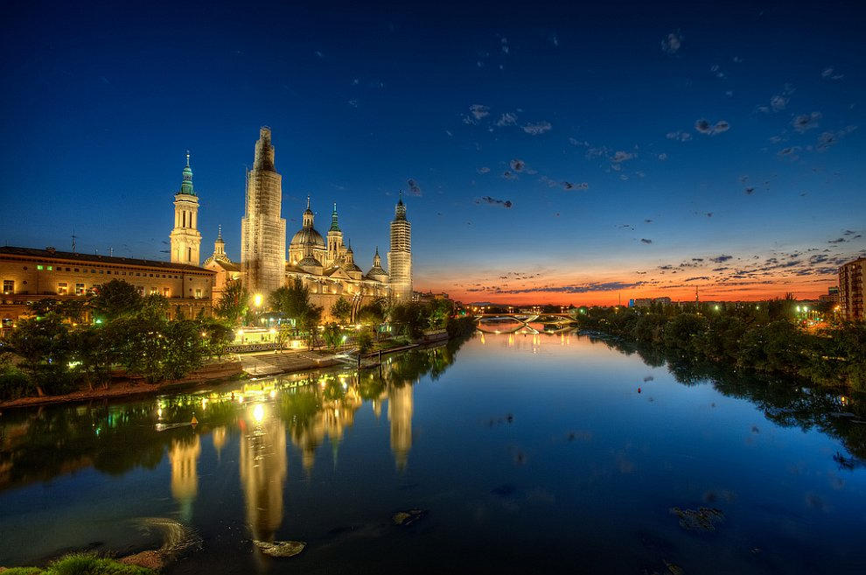
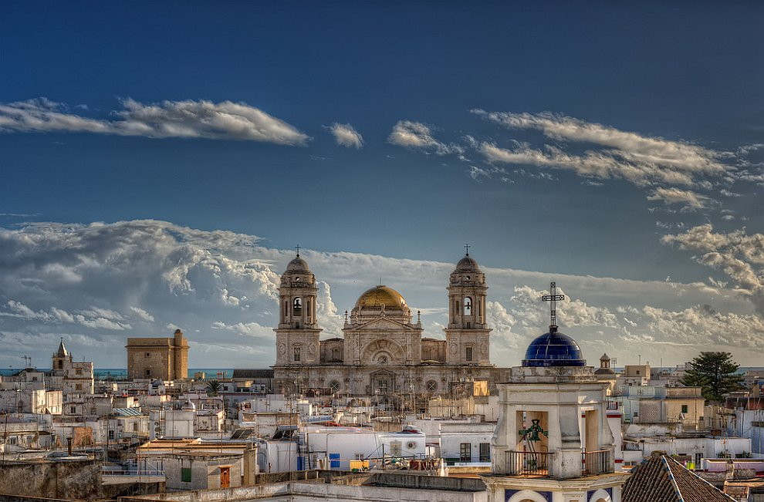
Architecture of Spain

Slide 2
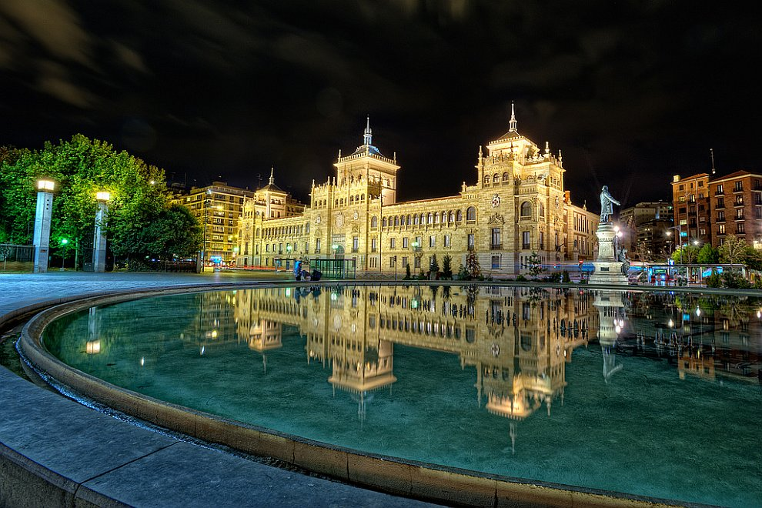
The main square in Valladolid. Valladolid city in XVI-XVII centuries. the capital of Spain. Now it is a large industrial city on the banks of the River Pisuerga

Slide 3

Plaza Mayor - the main attraction of the city of Salamanca.

Slide 4

Crystal Palace in the largest and most famous Retiro Park in Madrid

Slide 5
Cathedral of the Spanish city of Cadiz. Is one of the biggest in Spain, he is Baroque and Neoclassical

Slide 6
St. Mary's Cathedral dedicated to the Virgin Mary, patroness of Spain

