Slide 1
United States of America. Washington District of Columbia.
Tanya Bezkrovnaya 11B

Slide 2
1.Who, when and how created a design of Washington D.C.
It was established in 1790 by first president George Washington, and was designed by Pierre L'Enfant.
Washington D.C. was created is because Congress needed a permanent place to meet instead of going to a different spot every time.

Slide 3
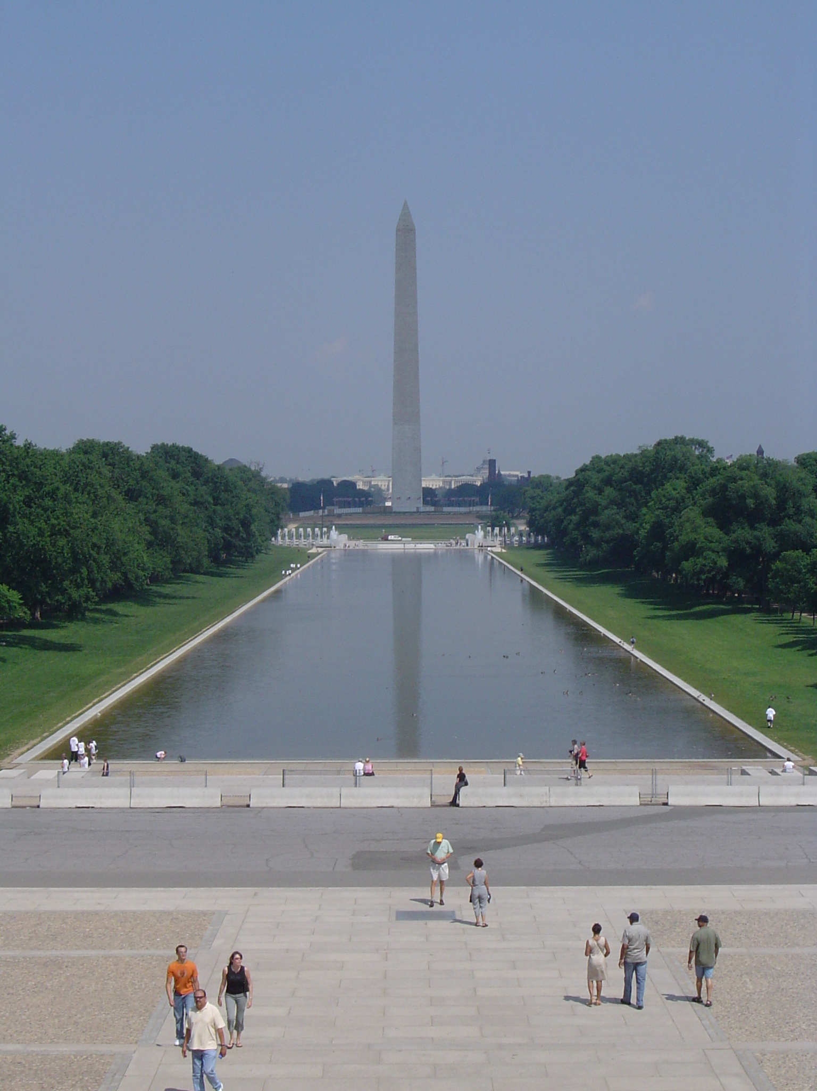
2.Washington National Monument

Slide 4
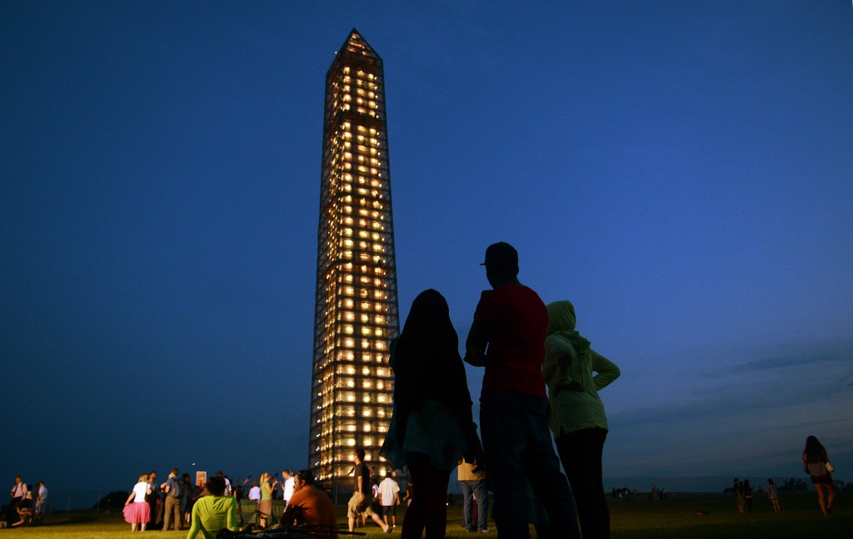
In 1833, at the 100th anniversary of George Washington's birth, James Madison and John Marshall founded the Washington National Monument Society; its purpose was to build a monument for George Washington.
The monument was finally dedicated on February 21, 1885, 37 years after construction started. It opened to the public more than 3 years later, in October 1888.
The Washington Monument is located at the National Mall.

Slide 5
The Mall

Slide 6
The National Mall or 'The Mall' is a long strip of green surrounded by museums and monuments. It stretches for over 2 miles/3 km.
Along the Mall are a number of the nation's most popular museums, including the National Gallery of Art, the National Museum of Natural History and the National Air and Space Museum.
The Mall was originally envisioned by French engineer and city planner Pierre Charles l'Enfant.

Slide 7
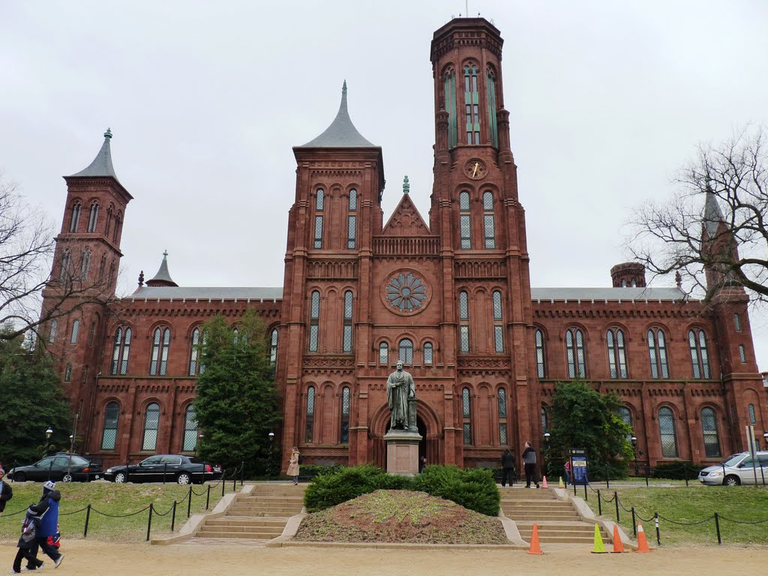
The Smithsonian Institution

Slide 8
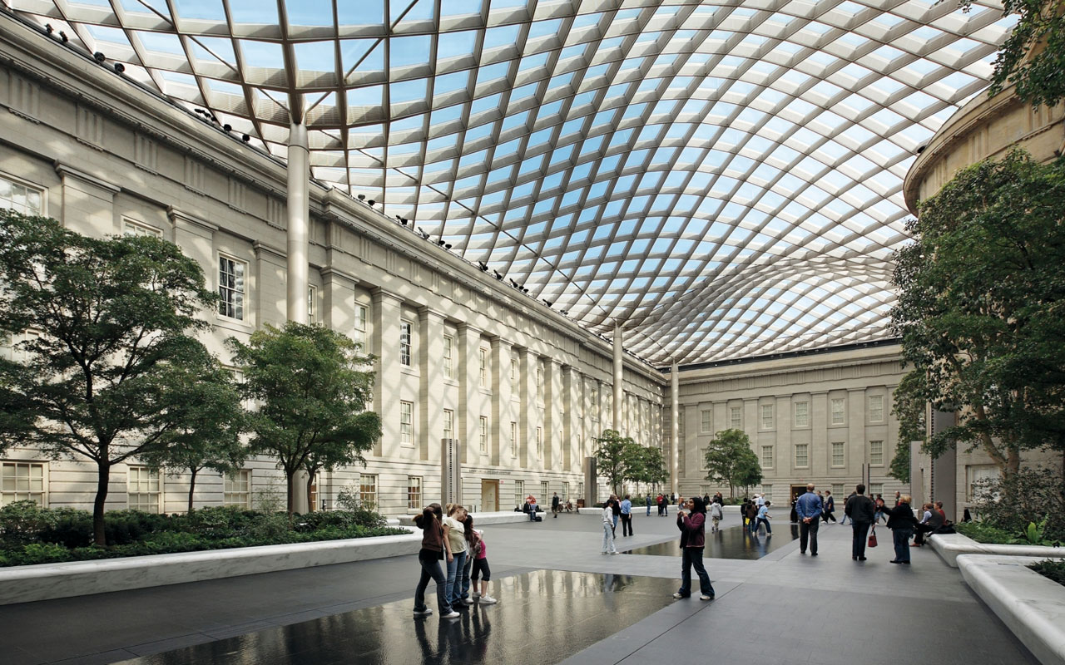
The Smithsonian Institution is a group of museums and research centers administered by the United States government, established in 1846.
Originally organized as the "United States National Museum"

Slide 9
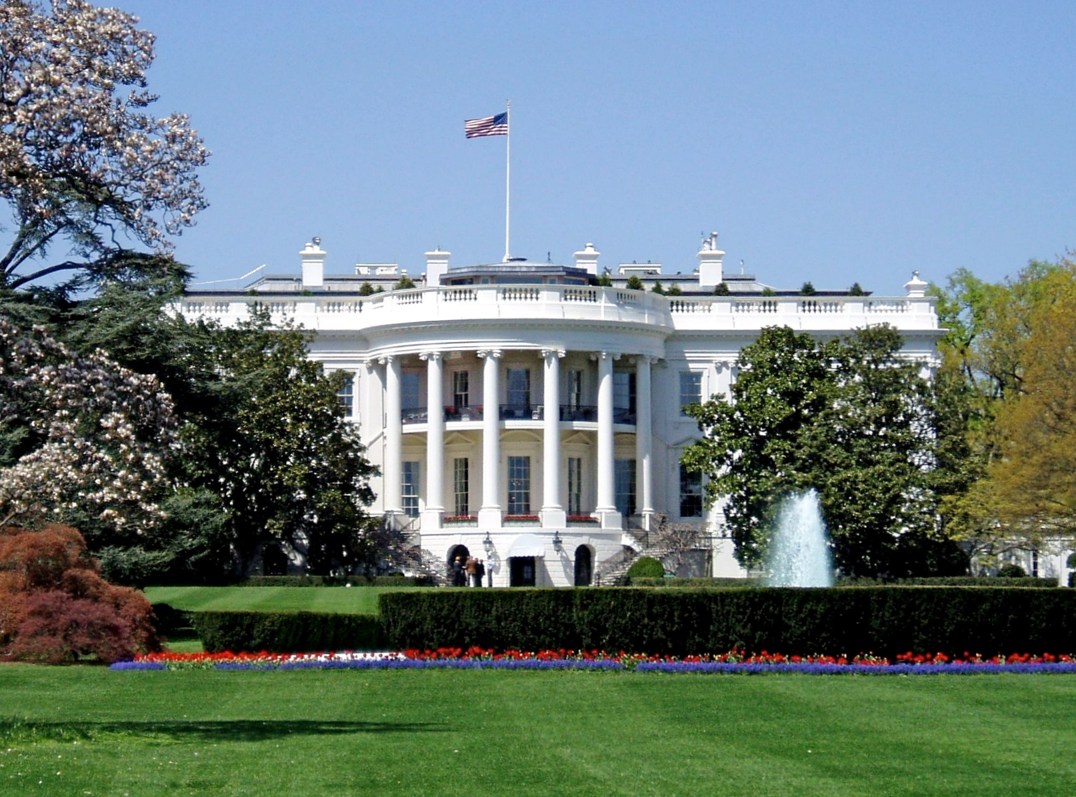

Slide 10
The White House is one of the world's most famous buildings.
First president, George Washington, selected the site for the White House in 1791.
White House Trivia
There are 132 rooms, 35 bathrooms, and 6 levels in the Residence. There are also 412 doors, 147 windows, 28 fireplaces, 8 staircases, and 3 elevators.
At various times in history, the White House has been known as the "President's Palace," the "President's House," and the "Executive Mansion." President Theodore Roosevelt officially gave the White House its current name in 1901.
The White House kitchen is able to serve dinner to as many as 140 guests and hors d'oeuvres to more than 1,000.
The White House requires 570 gallons of paint to cover its outside surface.

Slide 11
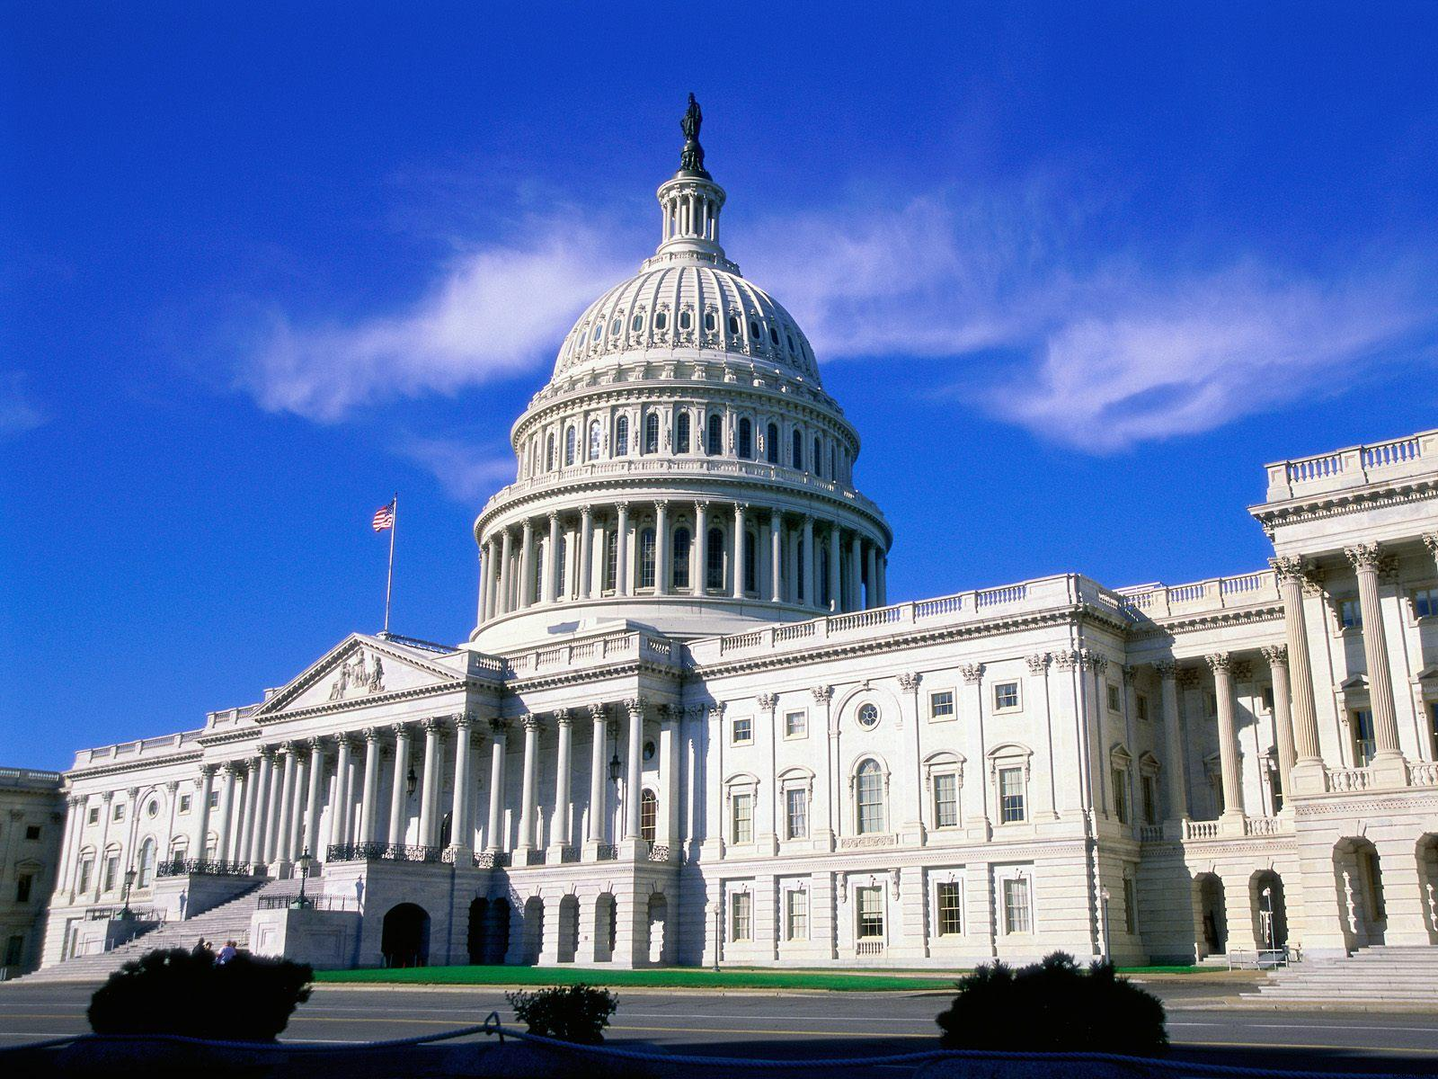
The United States Capitol

Slide 12
The United States Capitol is the meeting place of the U.S. Congress, the legislature of the U.S. federal government.
Though it has never been the geographic center of the federal district, the Capitol is the origin by which the quadrants of the District are divided and the city was planned.

Slide 13
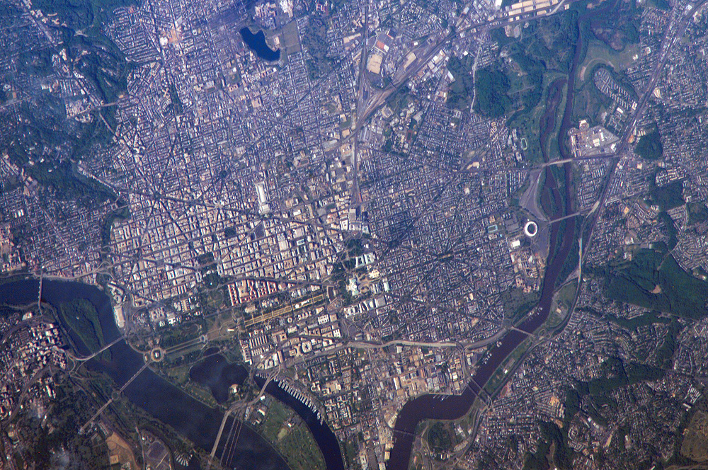

Slide 14
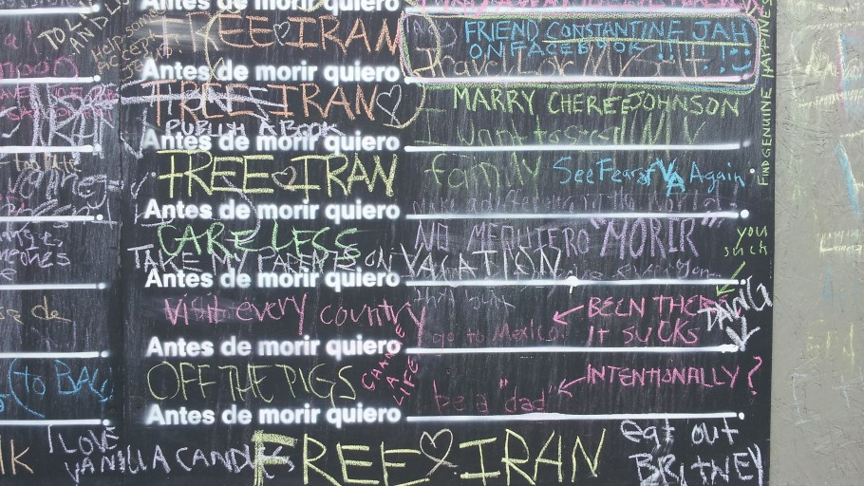
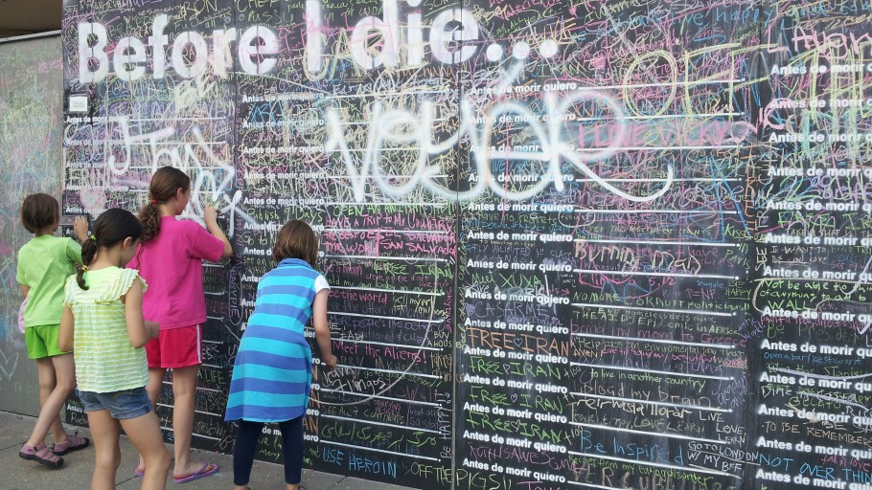
Before I Die in Washington, DC
Sophie Miller and Dan Blah created this wall at the corner of 14th

Slide 15
