Slide 1
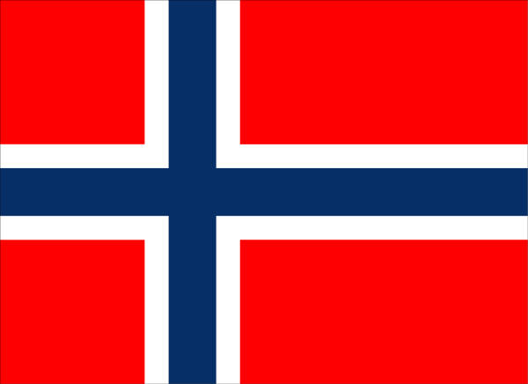
Christmas in Norway

Slide 2
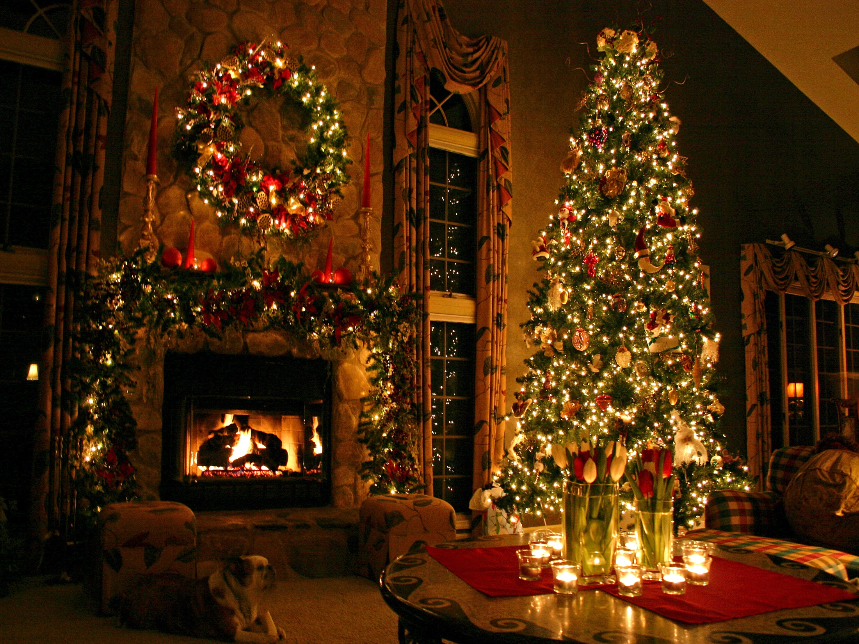

Slide 3
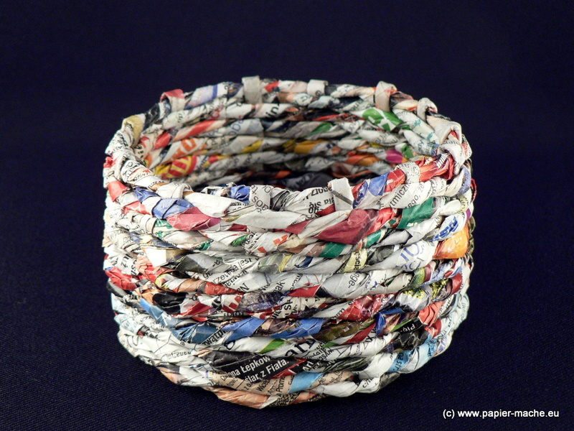

Slide 4
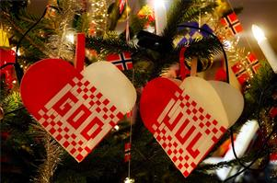

Slide 5
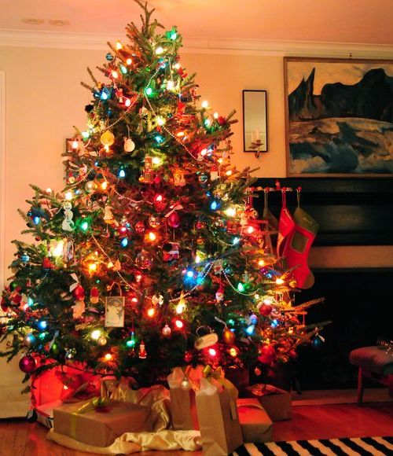
Colored lighting is becoming popular, but white lights are more like the candles they are supposed to represent. Christmas trees became common in Norway from around 1900. The custom of having Christmas trees is originally from Germany.

Slide 6
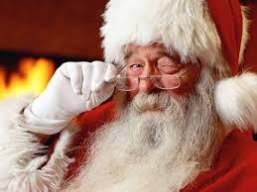
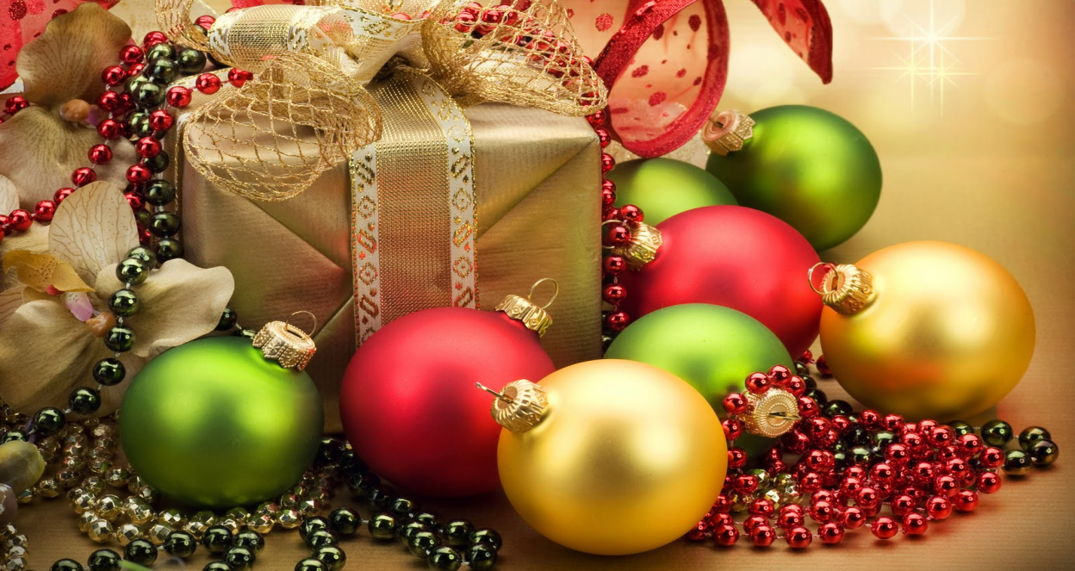
Christmas Eve is the time when presents are exchanged.
Christmas Eve is the time when presents are exchanged. The gifts are sometimes brought by Santa Claus (called 'Julenissen' in Norway)

Slide 7
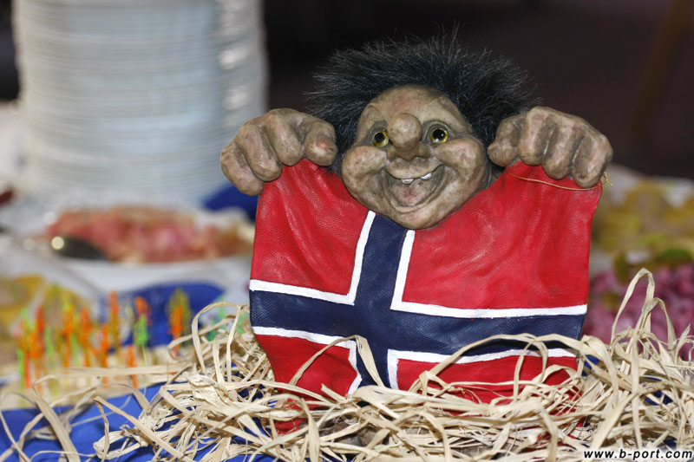
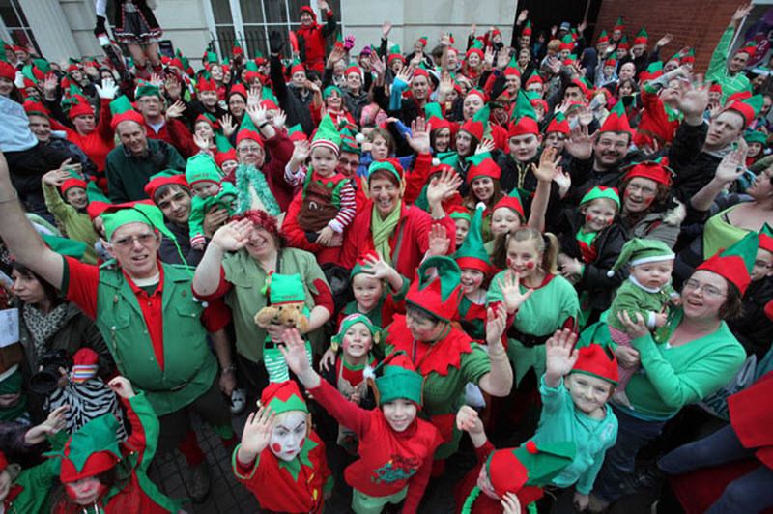
Present are also brought by the small gnomes called 'Nisse'. There are also hobgoblins (Nisse) decorations. Children pick up the presents from under the Christmas Tree and read the cards on the presents out loud.

Slide 8
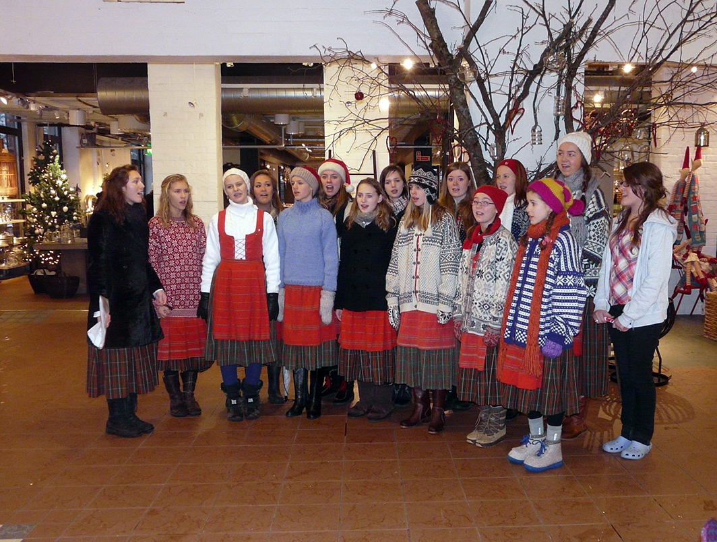
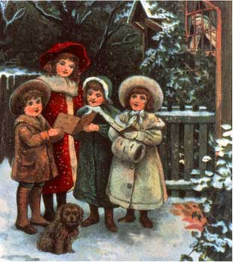
In some parts of Norway, children like to go carol singing and most children do! Often children will dress up as characters from the Christmas Story, such as the Shepherds and Wise Men, and go singing from house to house in their local neighbourhood. Sometimes they carry with paper stars on them.

Slide 9
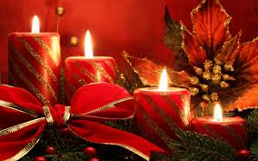
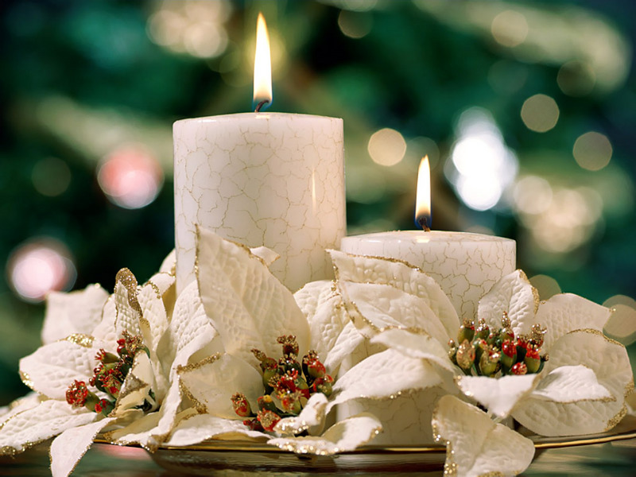
Christmas candles
Another tradition in parts of Norway is that families light a candle every night from Christmas Eve to New Year's Day.

Slide 10
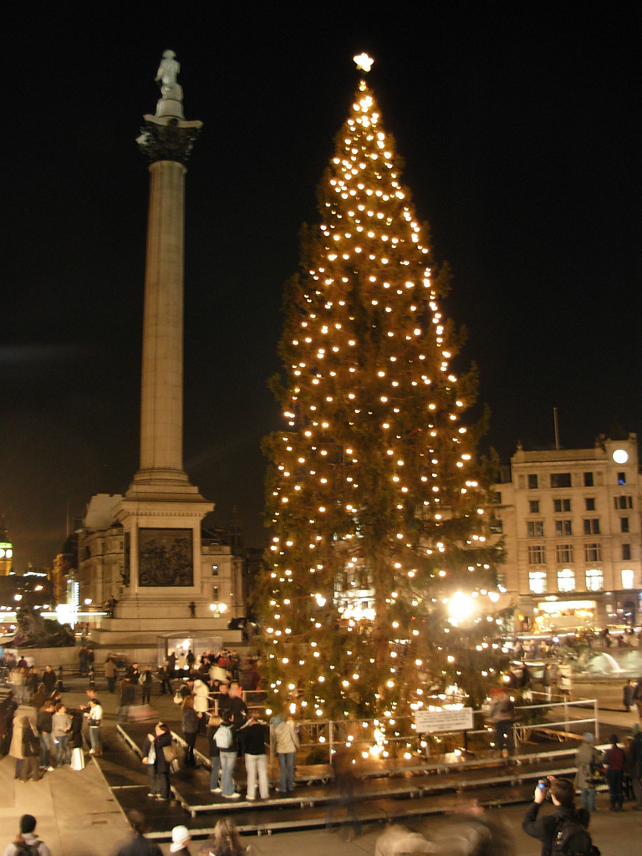
Christmas wasn't celebrated in Norway until about 1000 or 1100, when Christianity first came to the area. Before this people celebrated jul or jòl in the middle of winter. It was a celebration of the harvest gone and a way of looking forward to the spring. Lots of beer (juleol) was brewed and drunk in honour of the old pagan scandinavian gods.

Slide 11
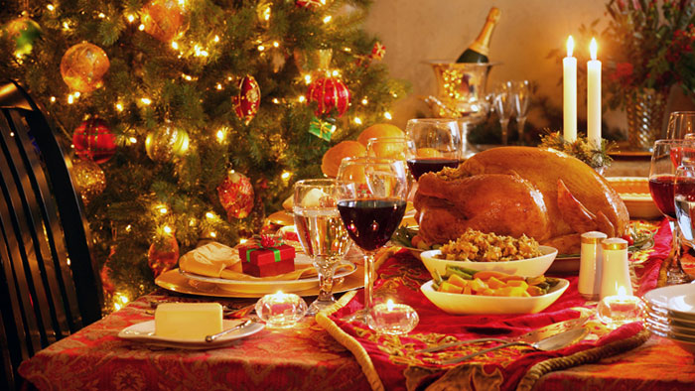
Christmas Dinner

Slide 12
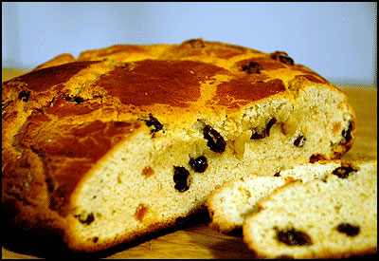
'Julekake'

Slide 13
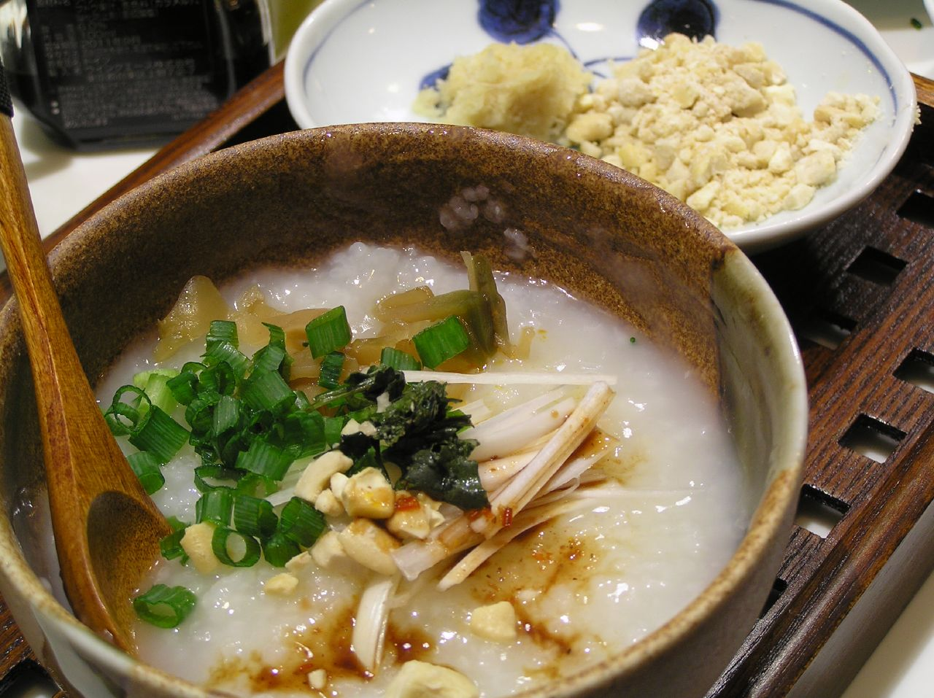
Rice
Porridge

Slide 14
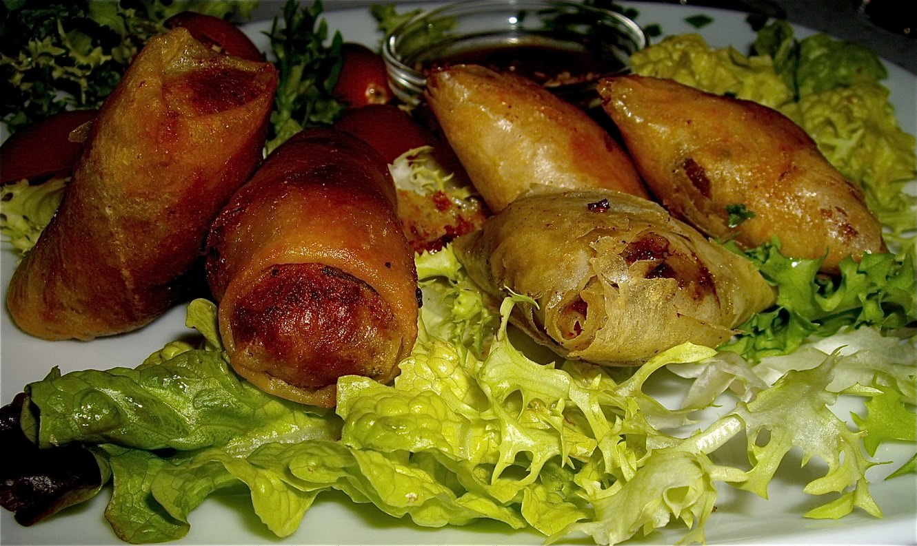
Mutton ribs served with 'surkal'

Slide 15
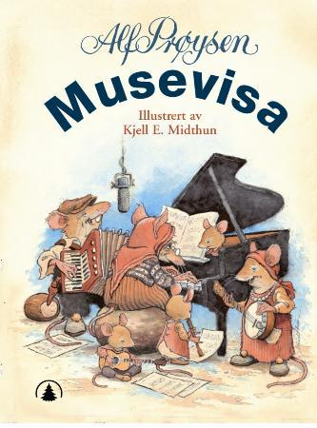
A very popular song at Christmas time in Norway is the Musevisa (The Mouse Song). The words were written in 1946 by Alf Prøysen. The tune is a traditional Norwegian folk tune. It tells the story of some mice getting ready for Christmas and the Mother and Father mice warning their children to stay away from mouse traps! It became popular very quickly and is now as popular as ever in Norway.

Slide 16


