Slide 1
Myra Bradwell
Підготувала учениця 11-У класу
Чупилка Тетяна

Slide 2
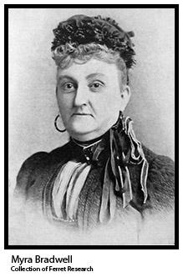
Myra Bradwell
Myra Colby Bradwell (February 12, 1831 – February 14, 1894) was a publisher and political activist. She attempted to become the first woman to be admitted to the Illinois bar, but was barred by the Illinois Supreme Court and the U.S. Supreme Court. The Illinois Supreme Court finally granted her a law license in Illinois in 1890.

Slide 3
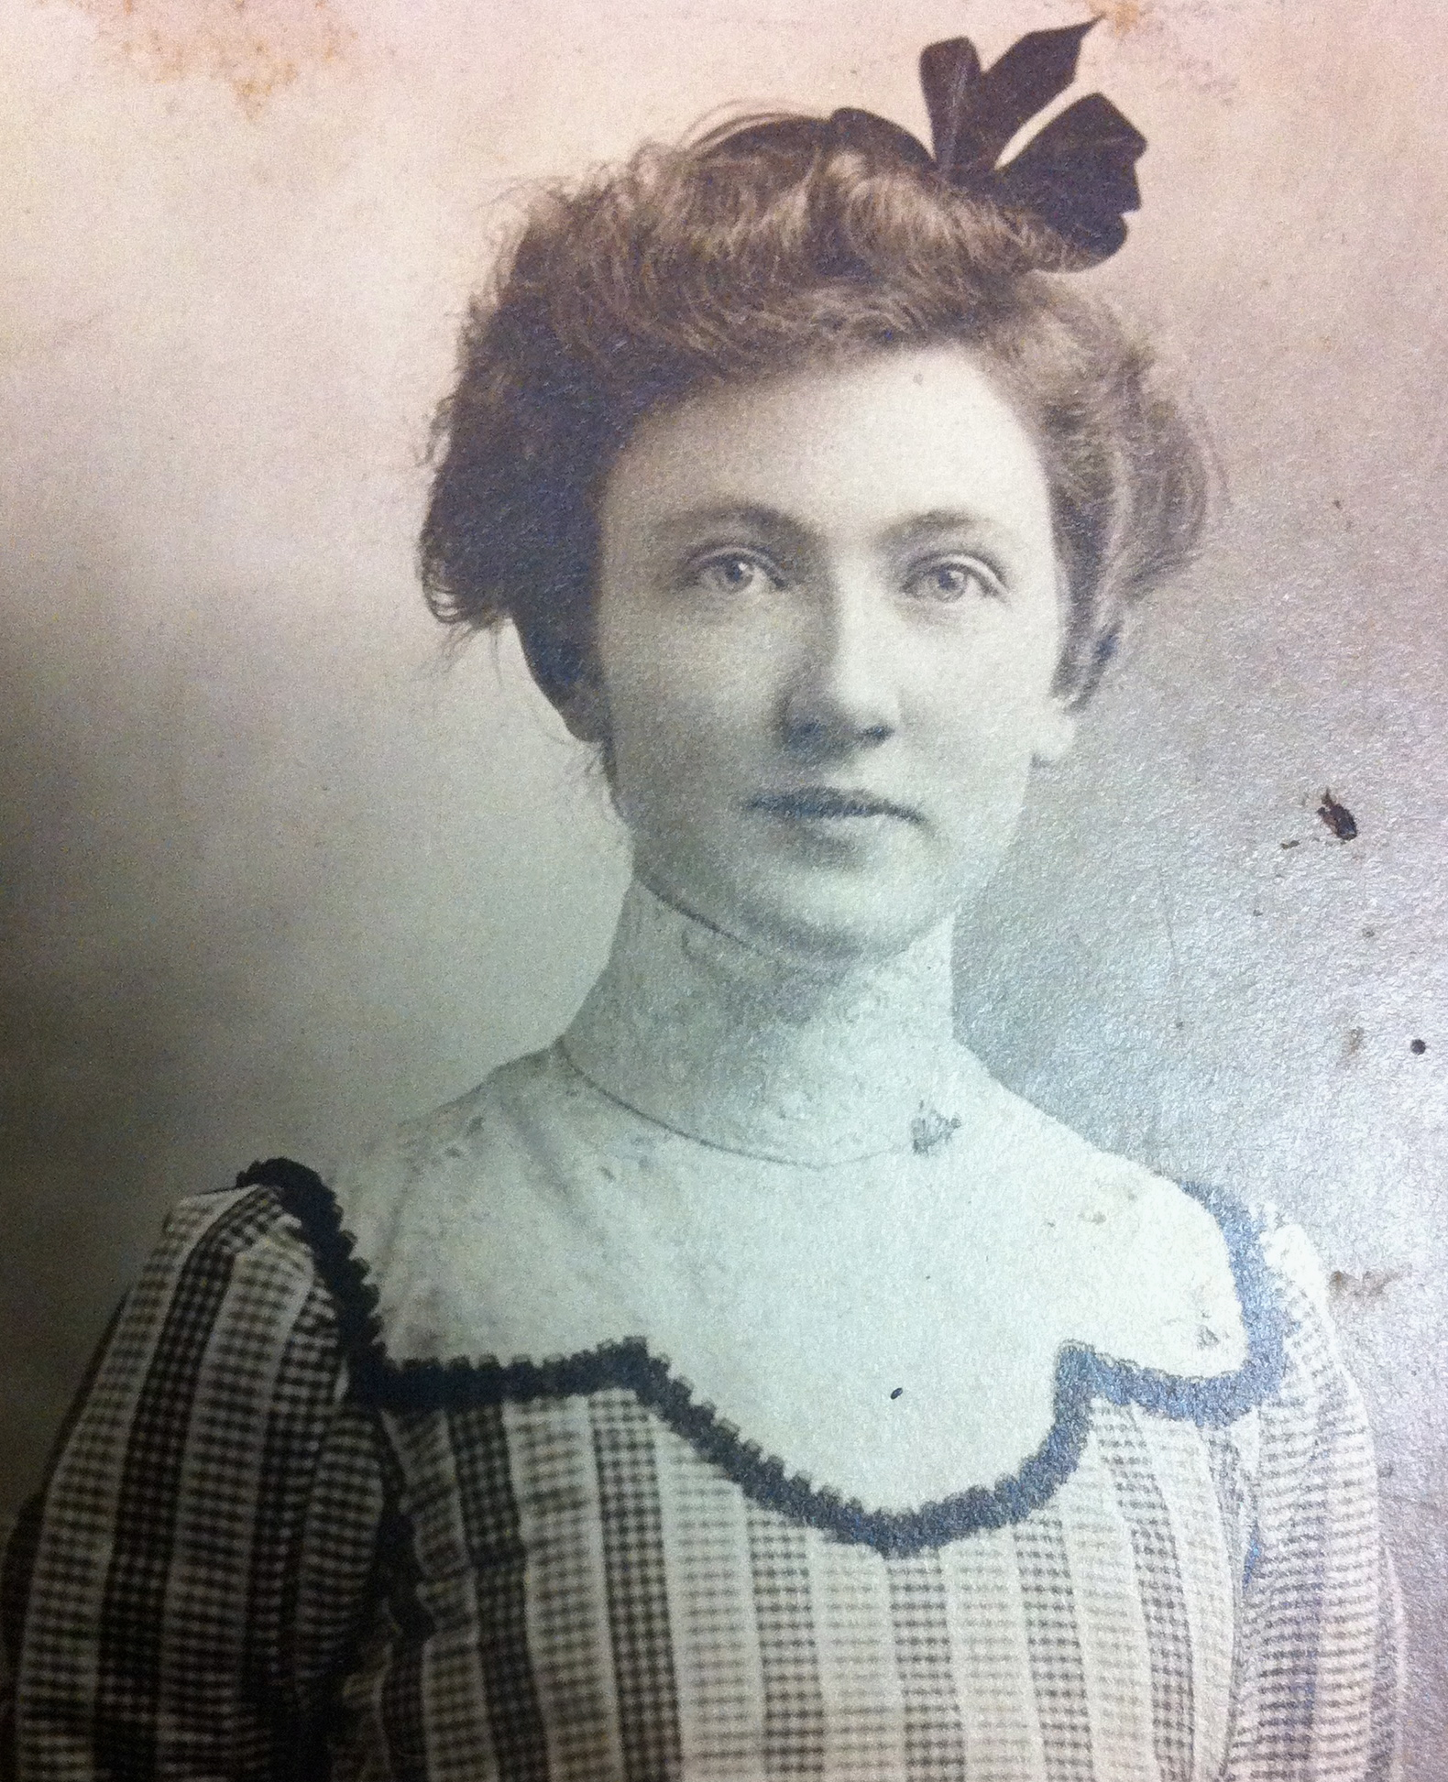
Life
Myra Colby was born on February 12, 1831 in Manchester, Vermont. She attended schools in Kenosha, Wisconsin, and later enrolled in Elgin Female Seminary in Illinois. She completed her formal education by age 24. She became a school teacher after she graduated .In 1852, Myra Colby married James B. Bradwell and she became Myra Colby Bradwell. James Bradwell was the head of a private school and Myra Bradwell became a teacher in that school. In 1855 they moved to Chicago, where James Bradwell was admitted to the Chicago Bar. He became a successful lawyer, judge, and in 1873 he was elected to the General Assembly.

Slide 4
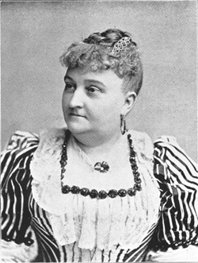
James Bradwell and Myra Bradwell started her formal law training when her husband was accepted to the Illinois Bar. There she apprenticed as a lawyer in her husband's office. There were some complications that came up during her rise to becoming a lawyer. She had four children, and two of them died at an early age. She raised funds to help aid the wounded soldiers during the American Civil War. She was also a member of the Northwestern Sanitary Commission. In 1868, she founded the Chicago Legal News, and with her husband's legal help, she was able to serve as both editor and business manager of the paper. It was the most widely circulated legal newspaper in the United States (Mezey).

Slide 5
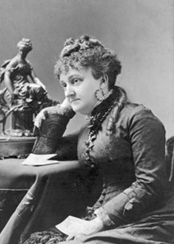
She also became an active member in the women's suffrage movement, serving as Secretary of the Illinois Women Suffrage Association. Bradwell made no further proceedings to gain her license. In 1890, the Illinois Supreme Court acted on its own motion and approved her original application. In 1892, she received her license to practice before the United States Supreme Court.

Slide 6
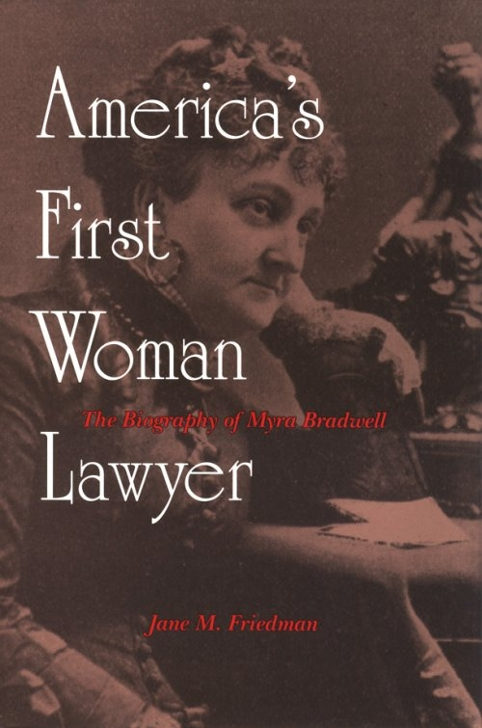
Myra Bradwell died of cancer on February 14, 1894, just four years after she was admitted to the bar. Her daughter, Bessie Bradwell Helmer, continued what her mother started. Bessie Bradwell became a lawyer, as did Thomas Bradwell, her son.

Slide 7
Thank you for your attention!

