Slide 1
Tourism
Great Britain and Ukraine
in

Slide 2
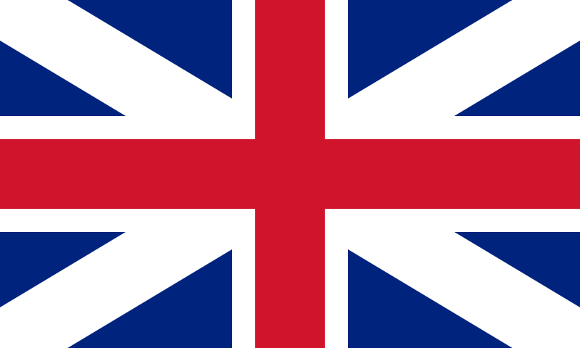
Universities

Slide 3
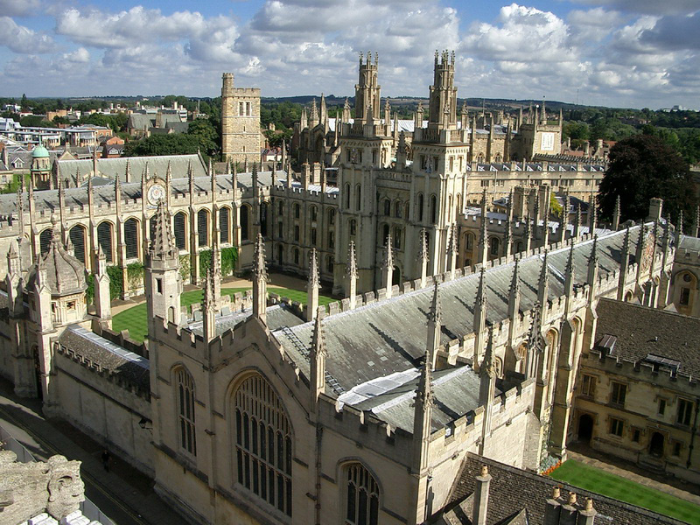
Oxford University

Slide 4
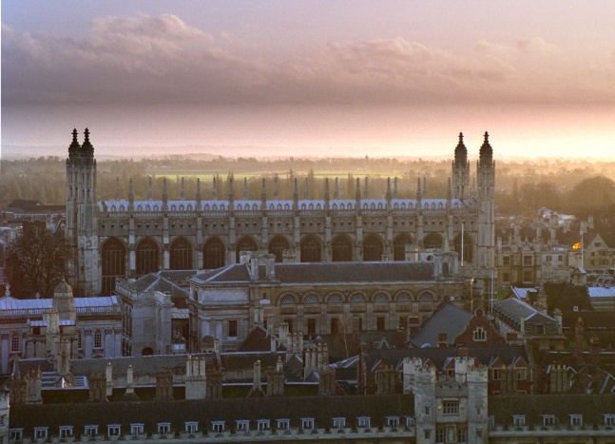
Cambridge University

Slide 5
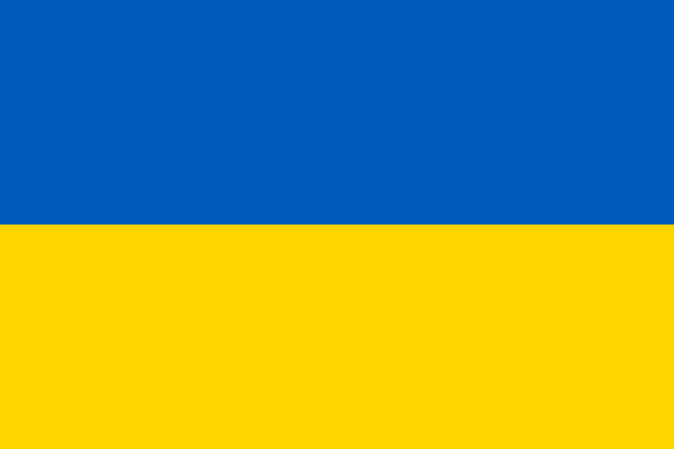
University

Slide 6
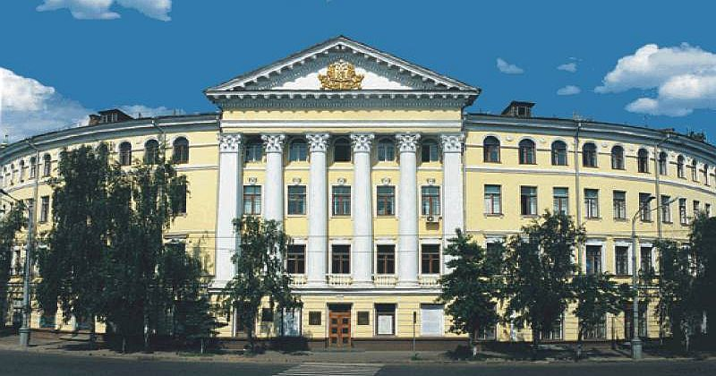
Kyiv-Mohyla Academy

Slide 7
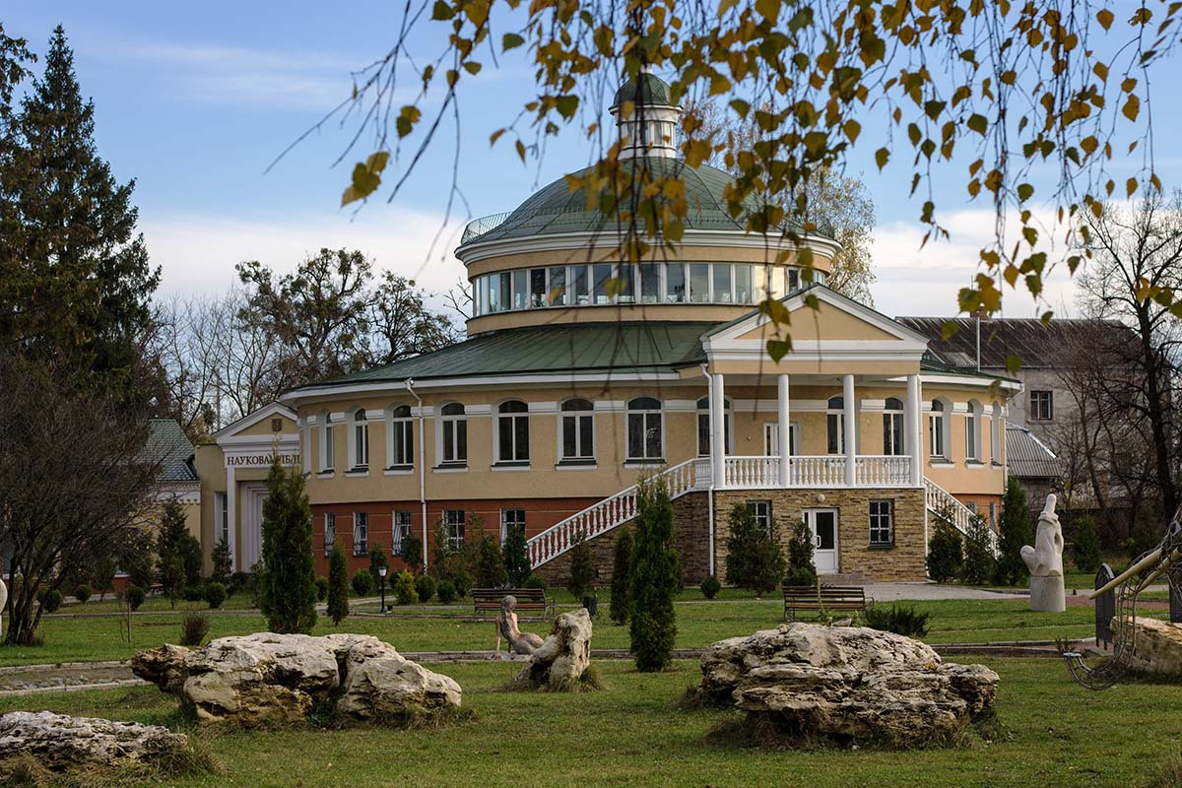
Ostrog Academy

Slide 8
Palaces and Castles

Slide 9
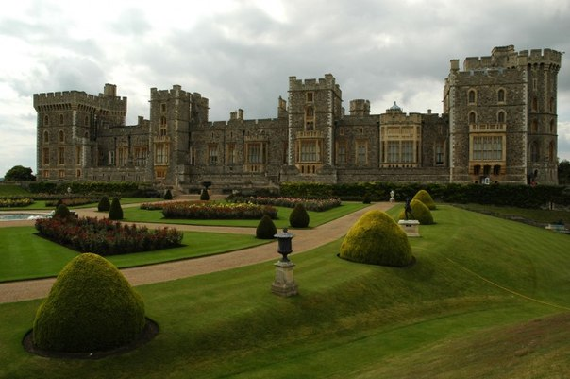
Windsor Castle

Slide 10
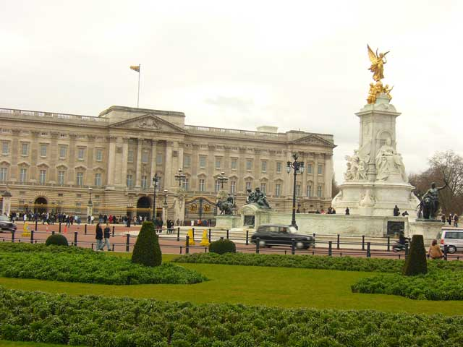
Buckingham Palace

Slide 11
Palaces and Castles

Slide 12
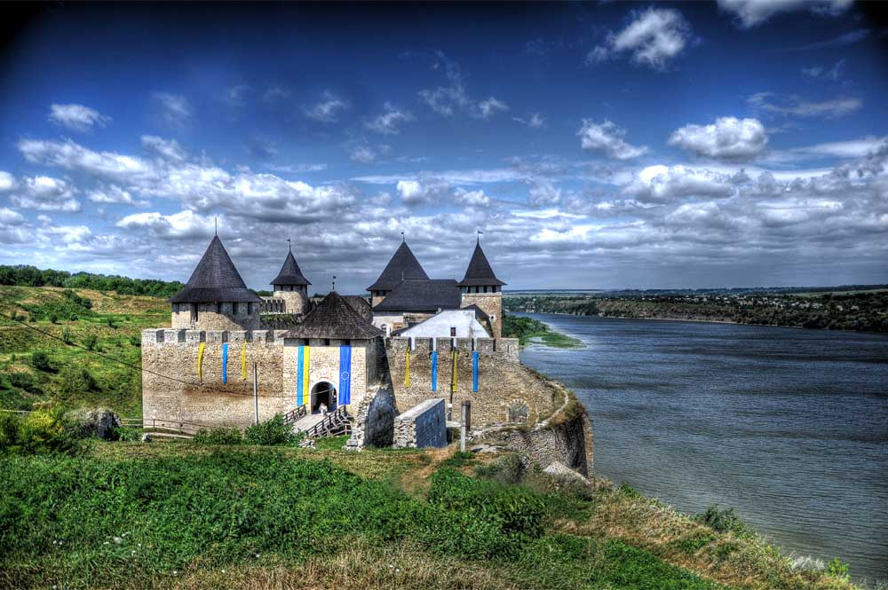
Hotinskaya fortress

Slide 13
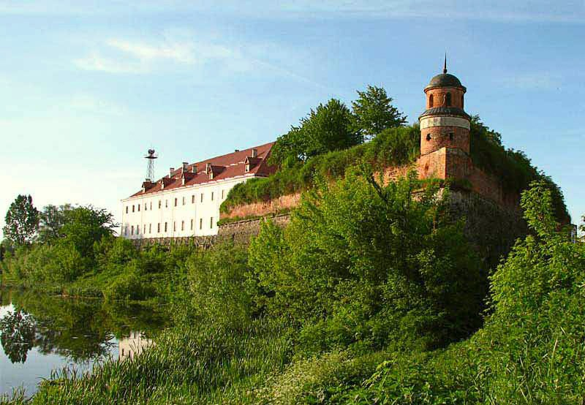
Dubno castle

Slide 14
Museums

Slide 15
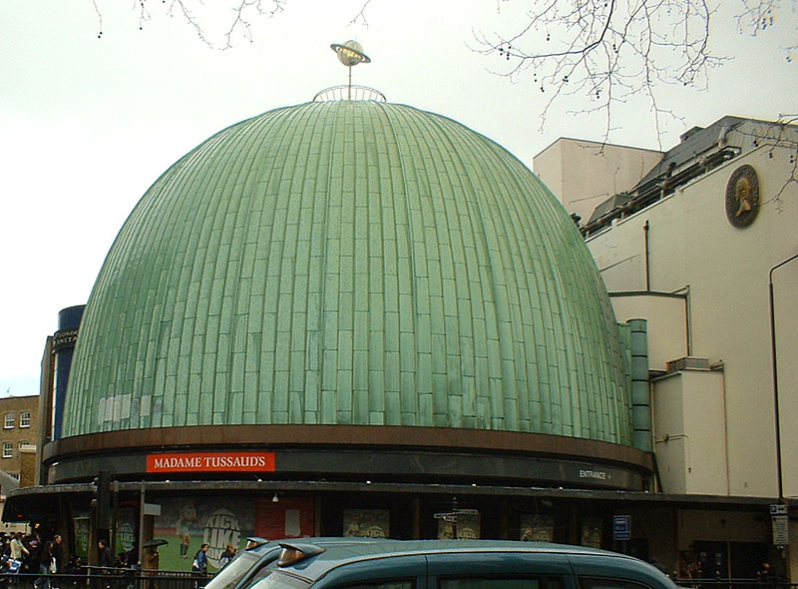
Museum Madame Tussaud’s

Slide 16
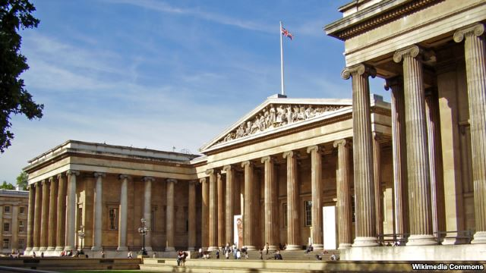
Contemporary British Museum

Slide 17
Museums

Slide 18
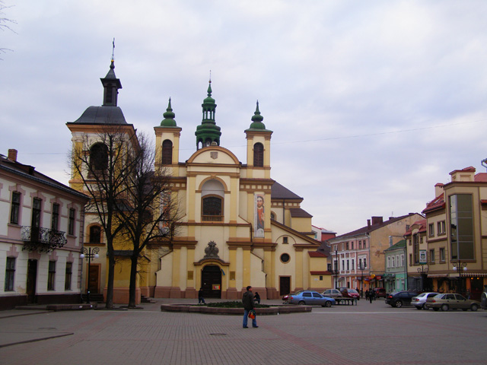
Ivano-Frankivsk Museum of Art

Slide 19
Entertaining

Slide 20
