Slide 1
Deruny
(Ukrainian Potato Pancakes)

Slide 2
Ingredients:

Slide 3
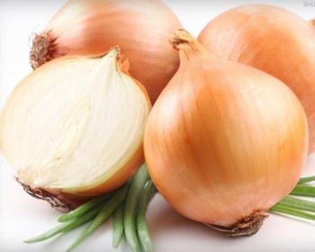
1 large onion, grated

Slide 4
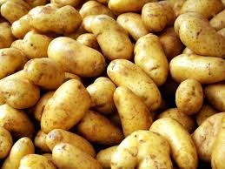
6 potatoes, peeled and grated

Slide 5
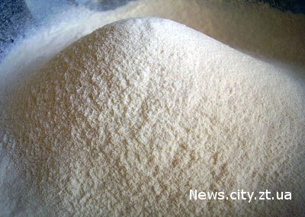
2 tbsp plain flour

Slide 6

2 eggs

Slide 7
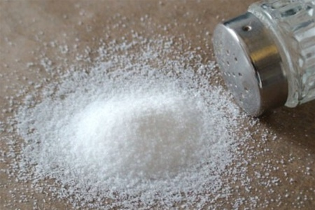
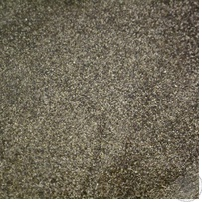
3/4 tsp freshly-ground black pepper
2 tsp salt

Slide 8
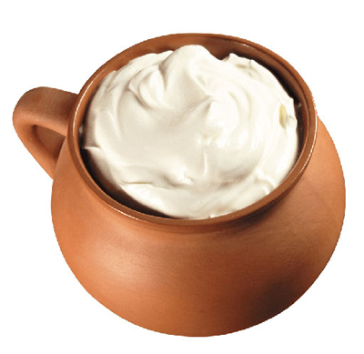
600ml sour cream
300ml cream

Slide 9
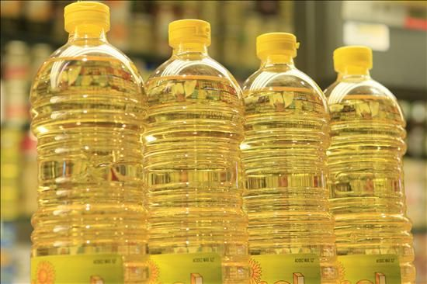
oil for frying

Slide 10
Preparation:
Combine the onion, potatoes, flour, eggs, salt and black pepper in a food processor and render to a smooth purée (you can also do this in a bowl with a hand blender. Heat oil in a large frying pan or skillet and when hot drop large tablespoons of the potato mixture into the oil. Cook until browned on one side (About 4 minutes) then turn over and cook on the other side. When done, drain on kitchen paper and place in an oven to keep warm as you cook the remainder of the mixture. When done, whisk together the sour cream and cream. Serve the potato pancakes warm with a generous dollop of the cream mixture.

Slide 11
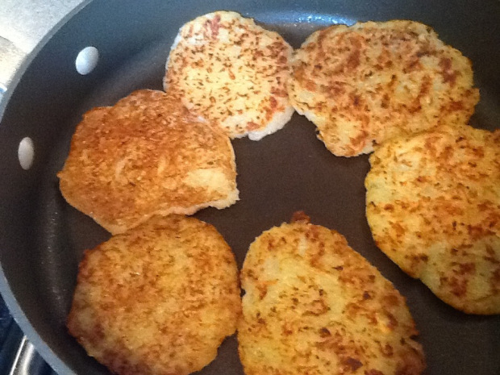

Slide 12
