Slide 1
Indianapolis
Also known as Circle City, I-Town, INDY, and The Heart of America. The capital of Indiana.

Slide 2
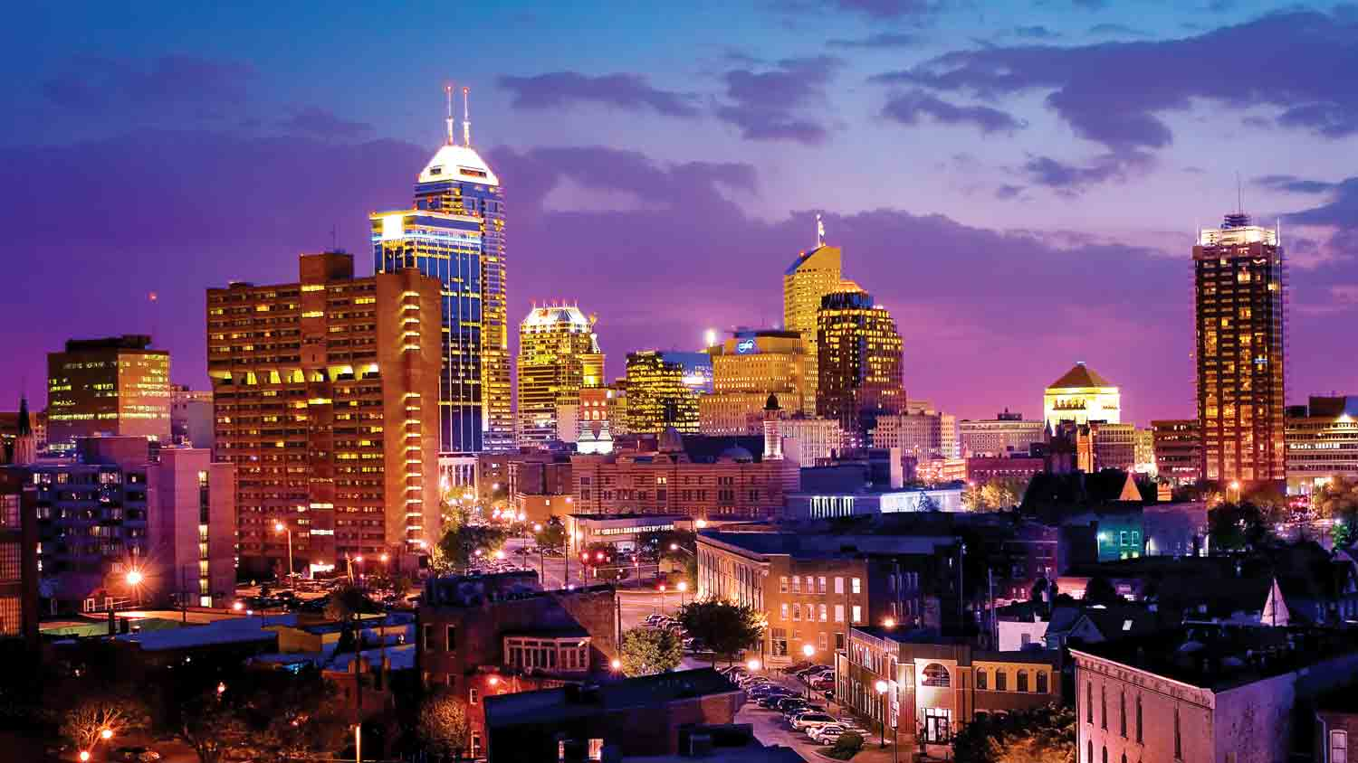
The city of Surprise
The city
The night by Indy
Indianapolis is the capital and most populous city of the U.S. state of Indiana, and also the county seat of Marion County. It is the 12th largest city in the United States and the 29th largest metropolitan area in the United States.

Slide 3
A city to entertain yourself
Both Forbes and Livability.com rank Indianapolis as one of the best downtowns in the United States citing "more than 200 retail shops, more than 35 hotels, nearly 300 restaurants and food options, movie theaters, sports venues, museums, art galleries and parks" as attractions. Greater Indianapolis has seen moderate growth among U.S. cities.

Slide 4
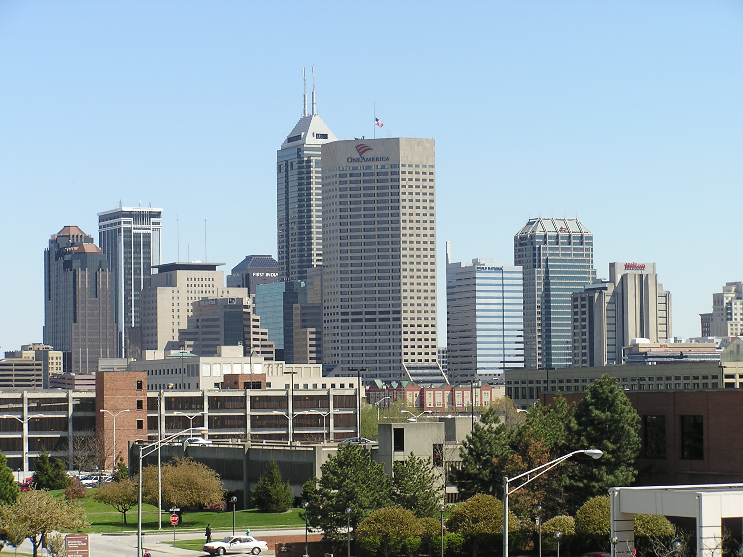
Downtown Indianapolis

Slide 5
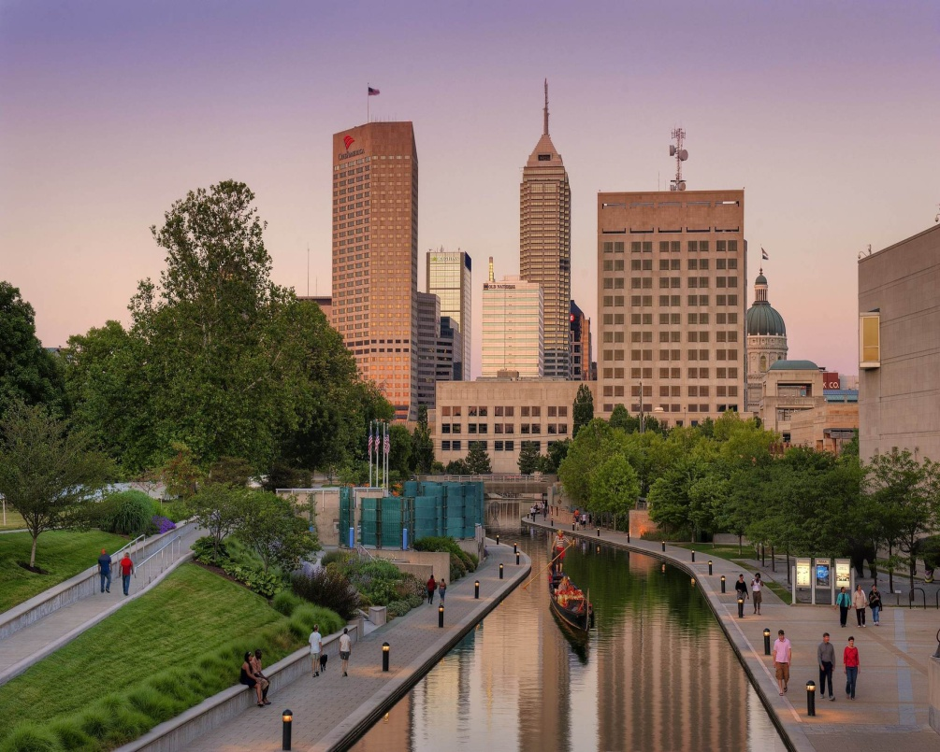
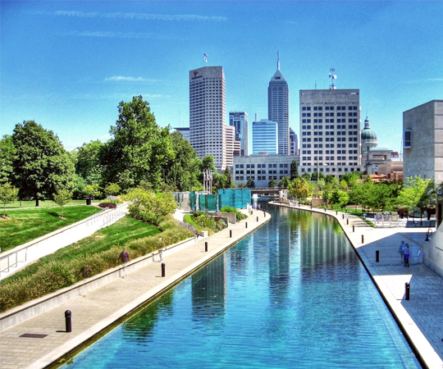
The city’s canals
5 pm
12 am

Slide 6
Theaters, museums, galleries
Indianapolis is home to the following theaters, offering plays, Broadway productions, concerts, and other live performances.
It also has a wide variety of museums and galleries which appeal to art lovers, car enthusiasts, sports fans, history buffs, and science and technology brain acts.

Slide 7
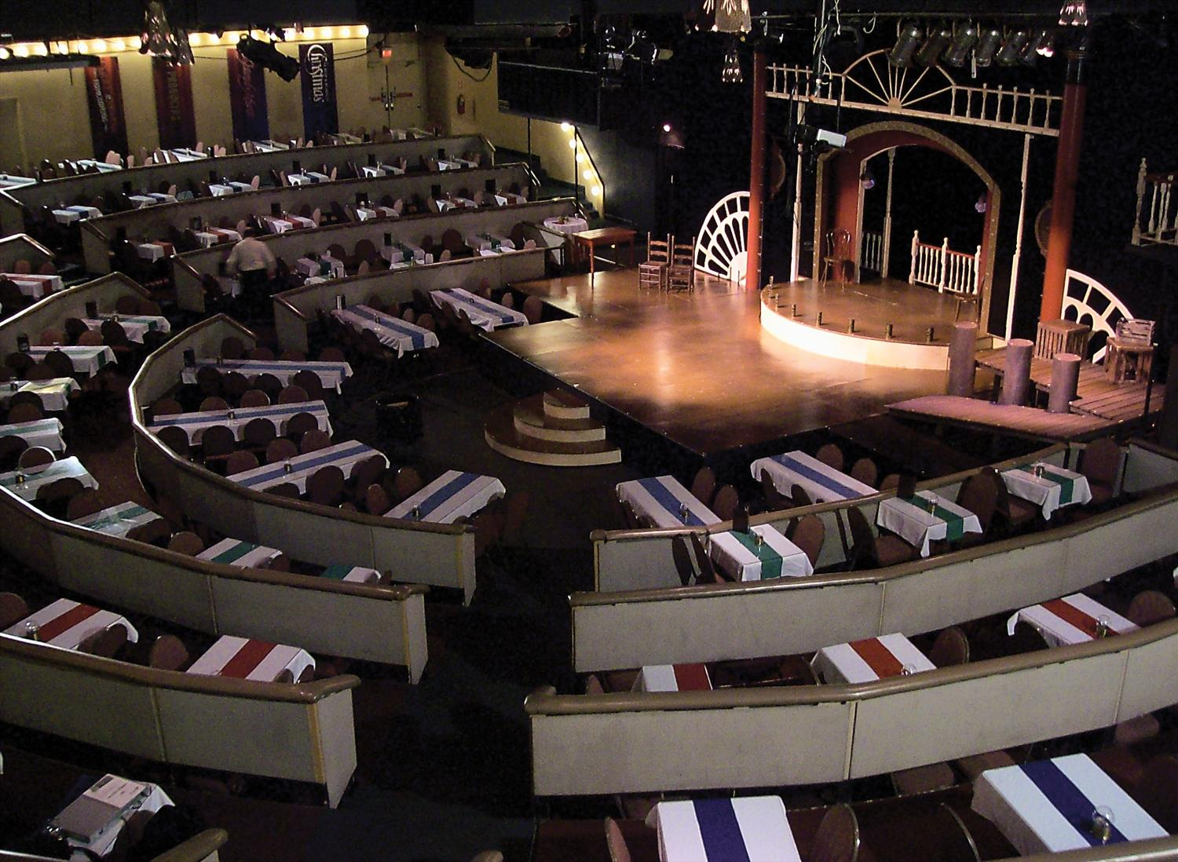
Beef & Boards Dinner Theatre

Slide 8
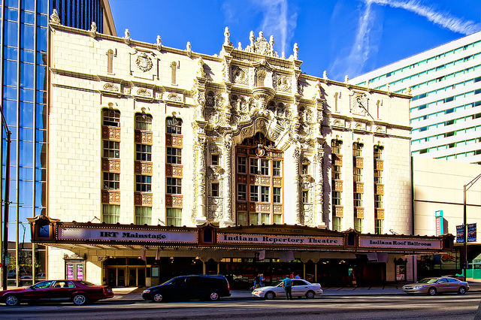
Indiana Repertory Theatre

Slide 9
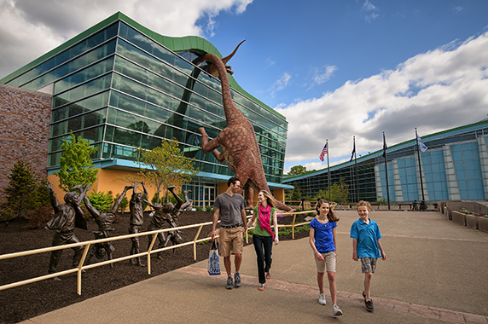
The Children's Museum of Indianapolis

Slide 10
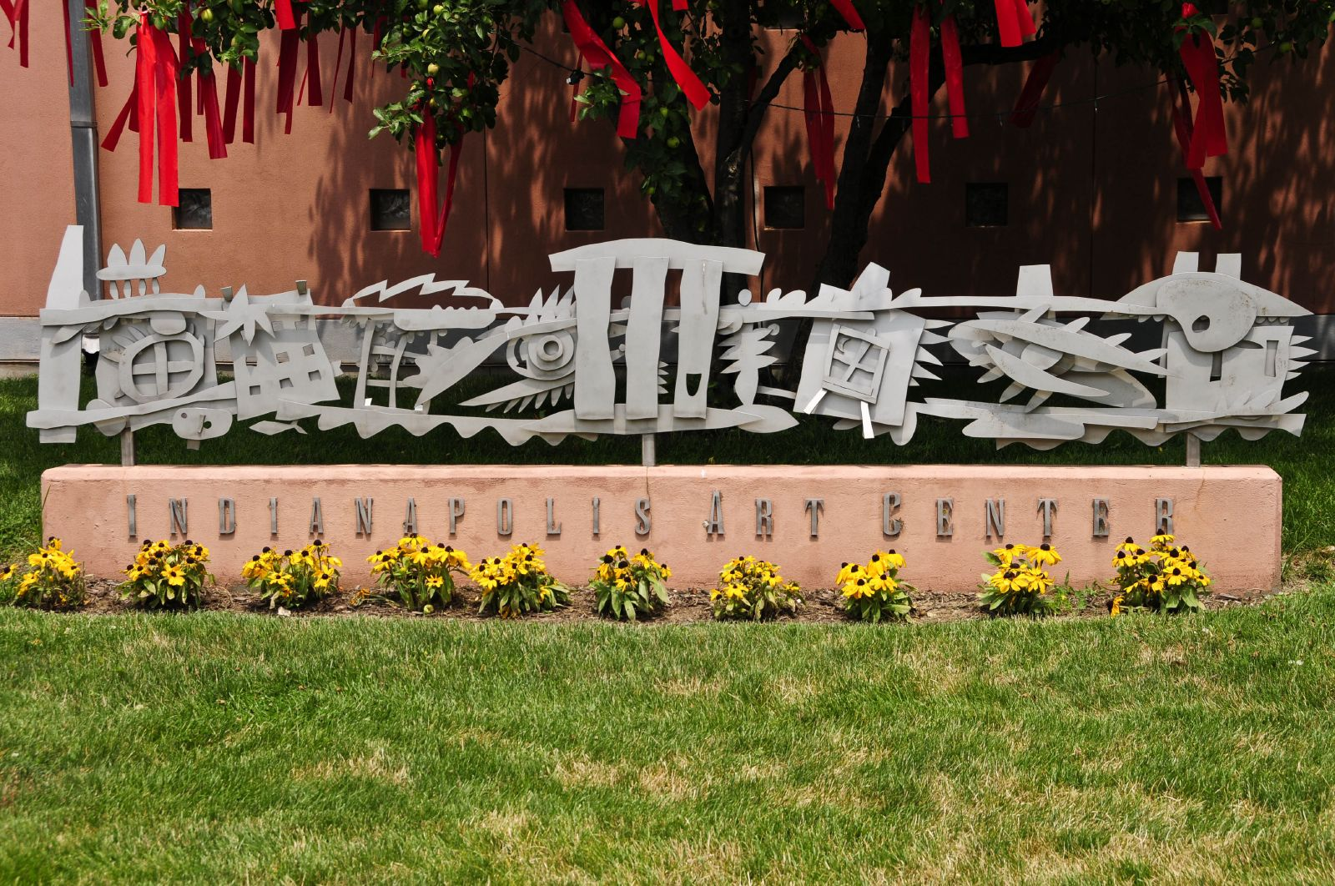
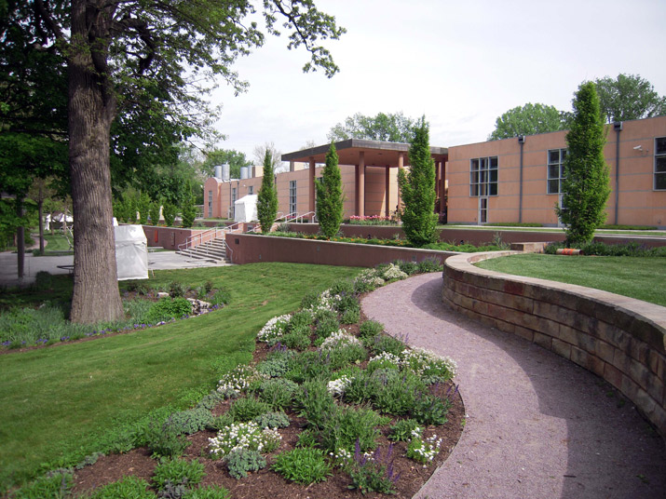
Indianapolis Art Center

Slide 11
Festivals and events
The International Violin Competition of Indianapolis, Indy Jazz Fest, and the DCI World Championships are all held in Indianapolis.
The Indianapolis Symphony Orchestra has hosted an annual outdoor summer concert series at Conner Prairie called Marsh Symphony on the Prairie since 1982, featuring a variety of musical styles.
The city has an arts community that includes many fairs celebrating a wide variety of arts and crafts. They include the Broad Ripple Art Fair, Talbot Street Art Fair, Carmel Arts Festival, Indian Market and Festival, and the Penrod Art Fair.
Every May since 1957, Indianapolis has held the 500 Festival, a month of events including a mini marathon and a festival parade, the latter being the day before the Indianapolis 500.

Slide 12
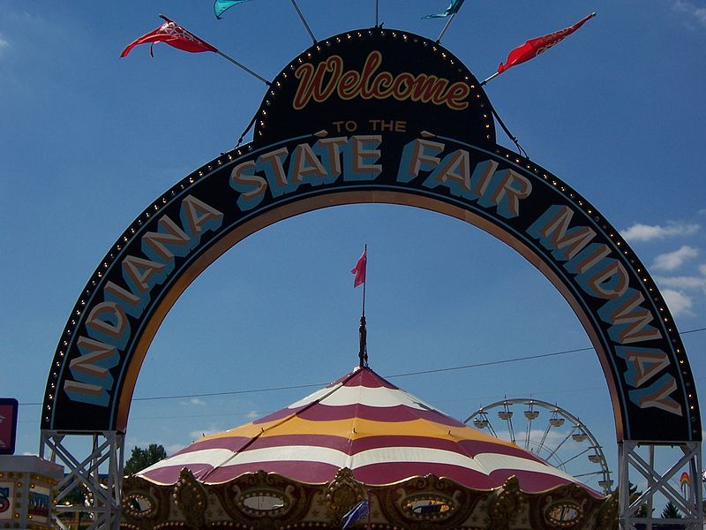
Indiana State Fair
Indianapolis is also home to the Indiana State Fair as well as the Heartland Film Festival, the Indianapolis International Film Festival, the Indianapolis Theatre Fringe Festival, the Indianapolis Alternative Media Festival, and the Midwest Music Summit.

Slide 13
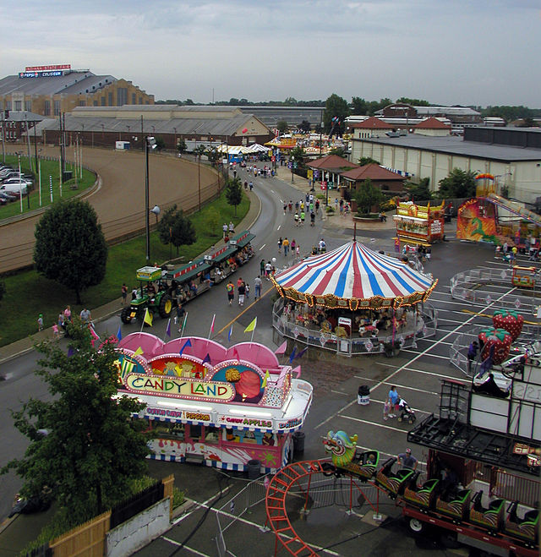
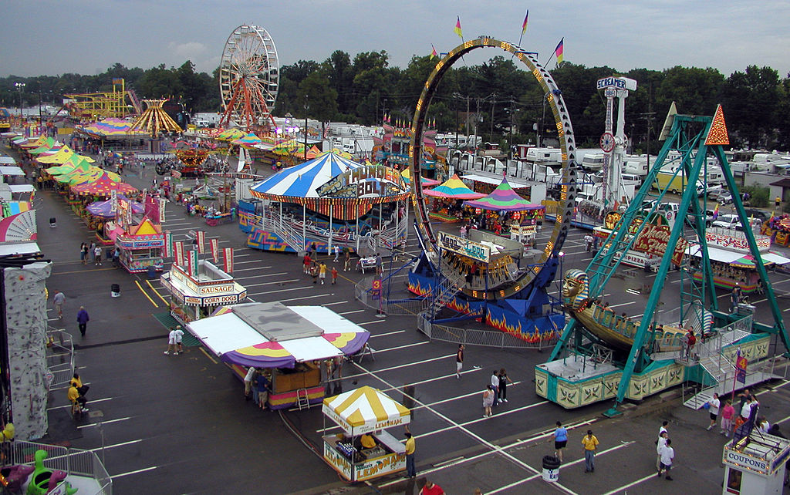
Having fun with children

Slide 14
The Circle City Classic
The Circle City Classic is one of America’s top historically African-American college football games. This annual football game, held during the first weekend of October, is the showcase event of an entire weekend. The weekend is a celebration of cultural excellence and educational achievement while showcasing the spirit, energy and tradition of America’s historically black colleges and universities.

Slide 15

CCC in 2014

Slide 16
Sports in Indianapolis
Indianapolis is the home to 10 professional sports teams. The city is also the home to two National Collegiate Athletic Association collegiate teams. Two teams from the four major American sports, the Indianapolis Colts and Indiana Pacers, are located in Indianapolis.
The headquarters of the NCAA, the main governing body for U.S. collegiate sports, is located in Indianapolis, as well as the National Federation of State High School Associations.

Slide 17
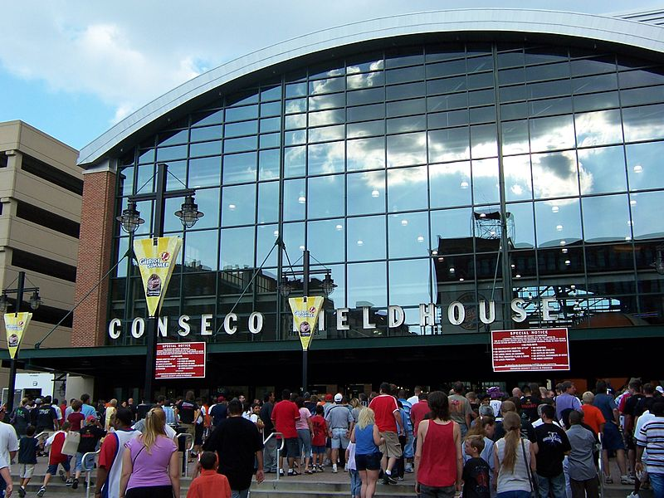
National Associations
A number of minor league-level teams also play in the city. The Indiana Fever Women's National Basketball Association (WNBA) started play in 2000, and are under the same ownership as the Pacers NBA team. The Indianapolis Indians are the second oldest minor league baseball team, having played in the city since 1902, and are currently members of the Triple-A International League The Indiana Ice ice hockey team began play in the United States Hockey League (USHL) in 2004.
The Indianapolis AlleyCats were formed in 2012 as one of the founding teams of the American Ultimate Disc League (AUDL).

Slide 18
Education
Higher education
Indianapolis is the home of Butler University, Indiana University-Purdue University Indianapolis (IUPUI), Ivy Tech Community College of Indiana, Indiana Tech (4 satellite campuses), Lincoln College of Technology, Marian University, Martin University, Oakland City University–Indianapolis, The Art Institute of Indianapolis, Vincennes University Aviation Technology Center, the University of Indianapolis, theUniversity of Phoenix, and WGU Indiana.
Primary and secondary education
Indianapolis has eleven unified public school districts (eight township educational authorities and three legacy districts from before the unification of city and county government), each of which providing primary, secondary, and adult education services within its boundaries. The boundaries of these districts do not exactly correspond to township (or traditional) boundaries, but rather cover the areas of their townships that were outside the pre-Unigov city limits.

Slide 19
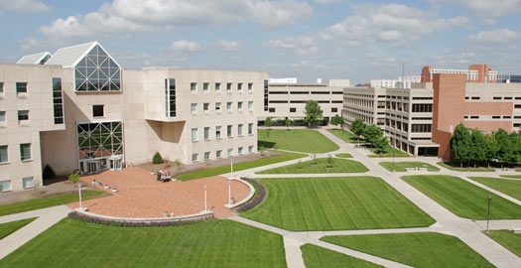
Indiana University-Purdue University Indianapolis

Slide 20
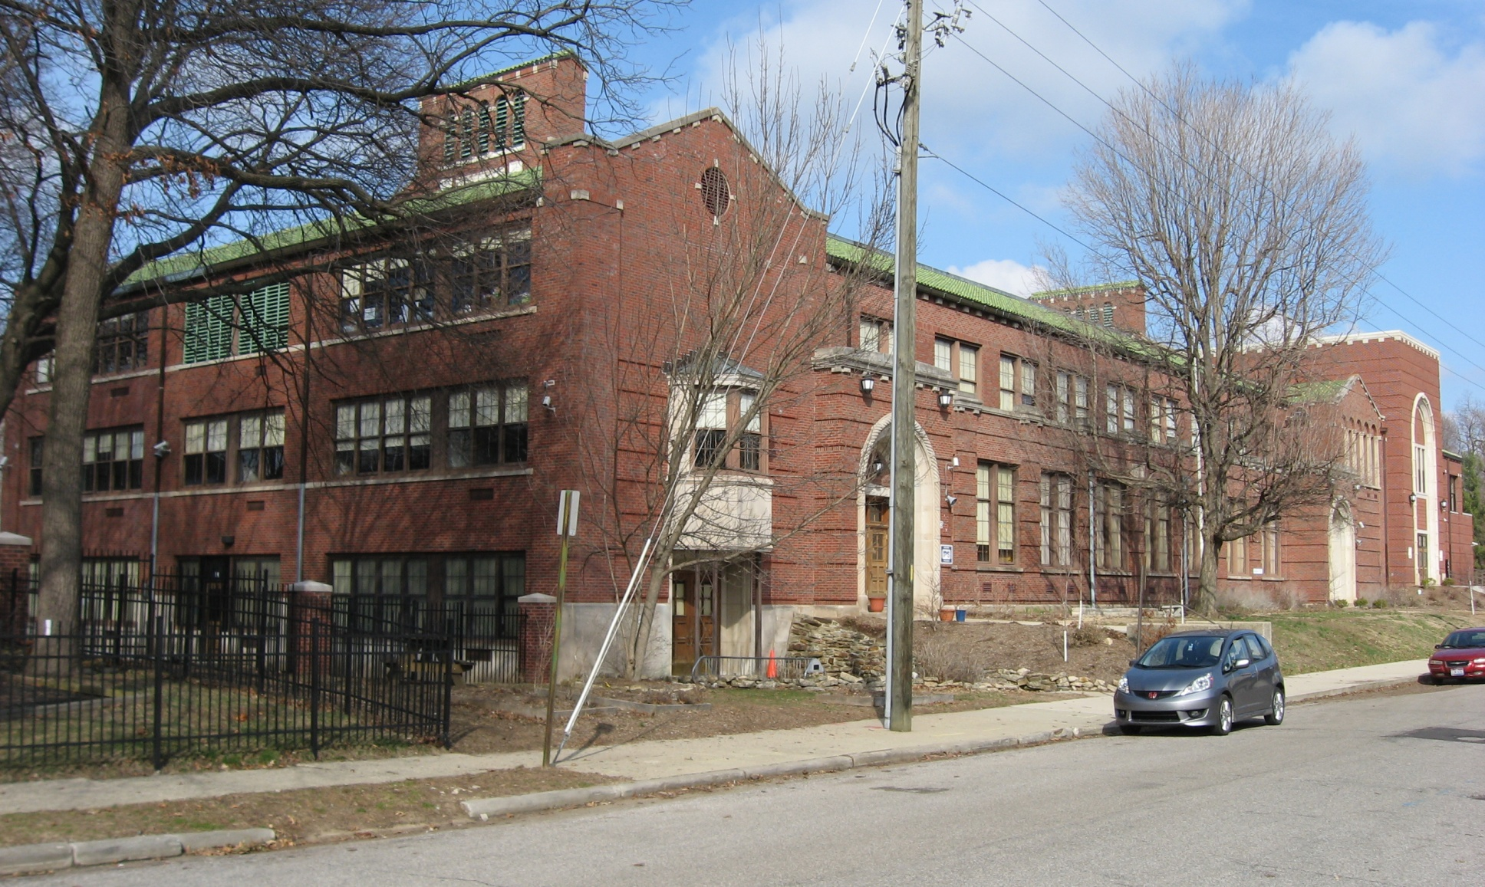
Indianapolis public school

Slide 21
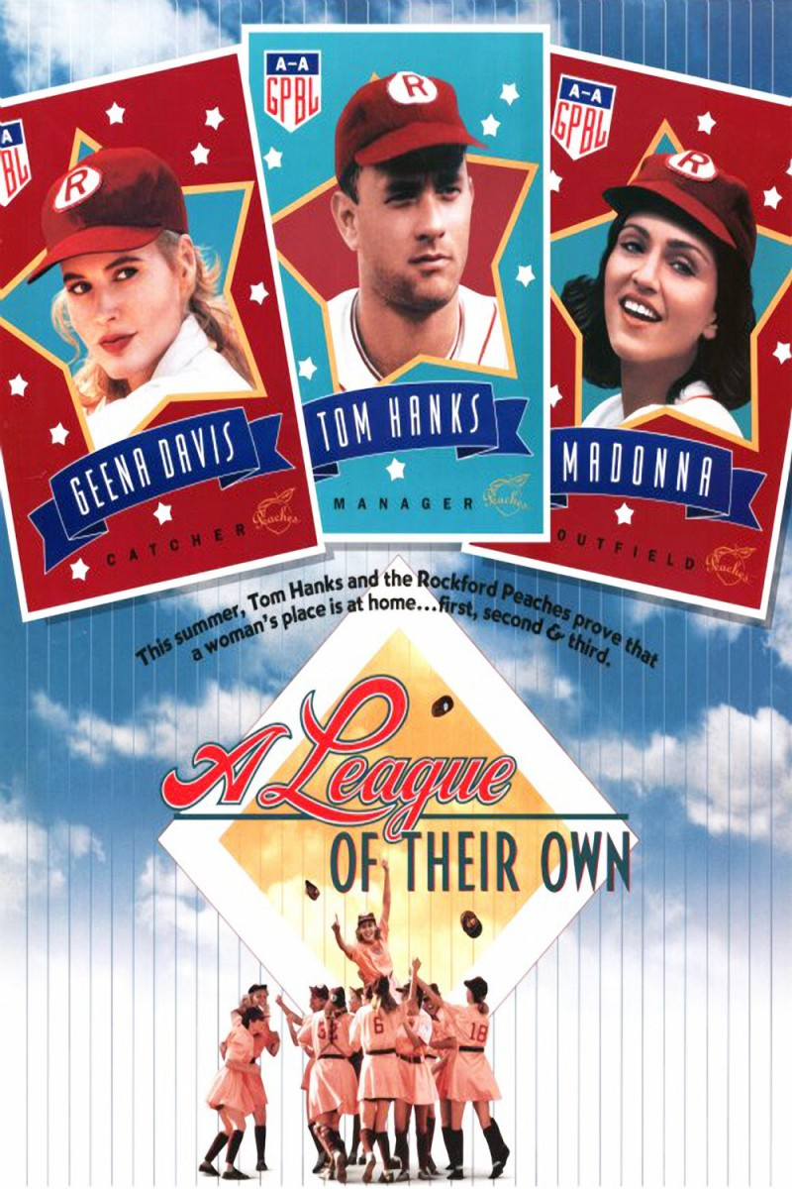
Some facts about Indiana
The movies “Hoosiers,”, “Breaking Away”, and “A League of Their Own”, were filmed in Indiana. • The movie “A Christmas Story” takes place in northern Indiana.

Slide 22
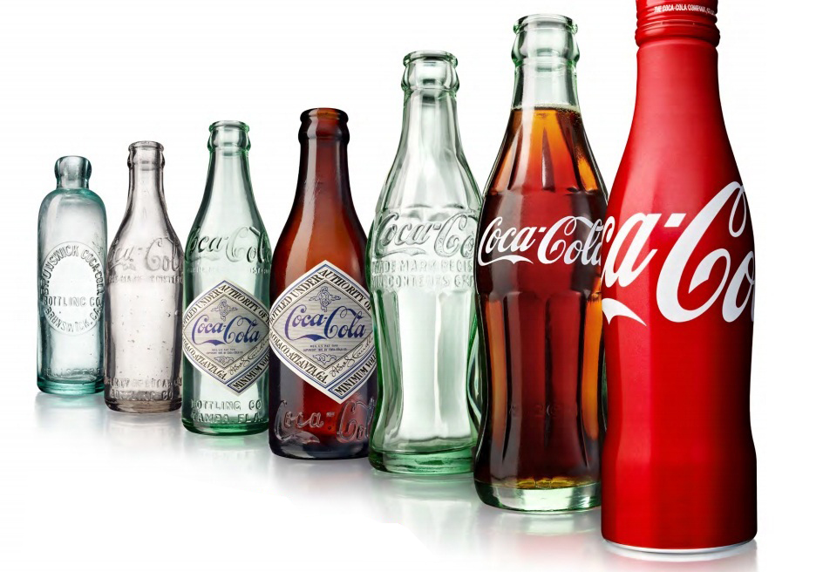
Coca-cola bottle
The Coco-Cola bottle was designed in Terre Haute, Indiana.

Slide 23

Popcorn-producing state
Indiana is the top popcorn-producing state in the nation.

Slide 24
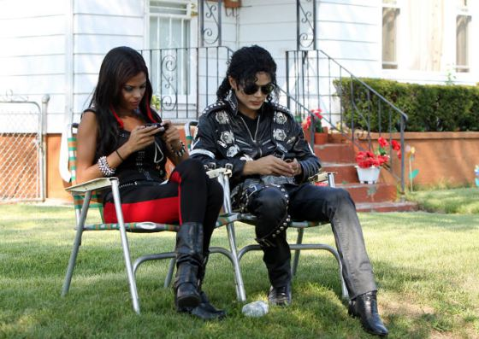
The greatest fame
Michael Jackson and The Jackson Five got their start in Gary, Indiana

Slide 25
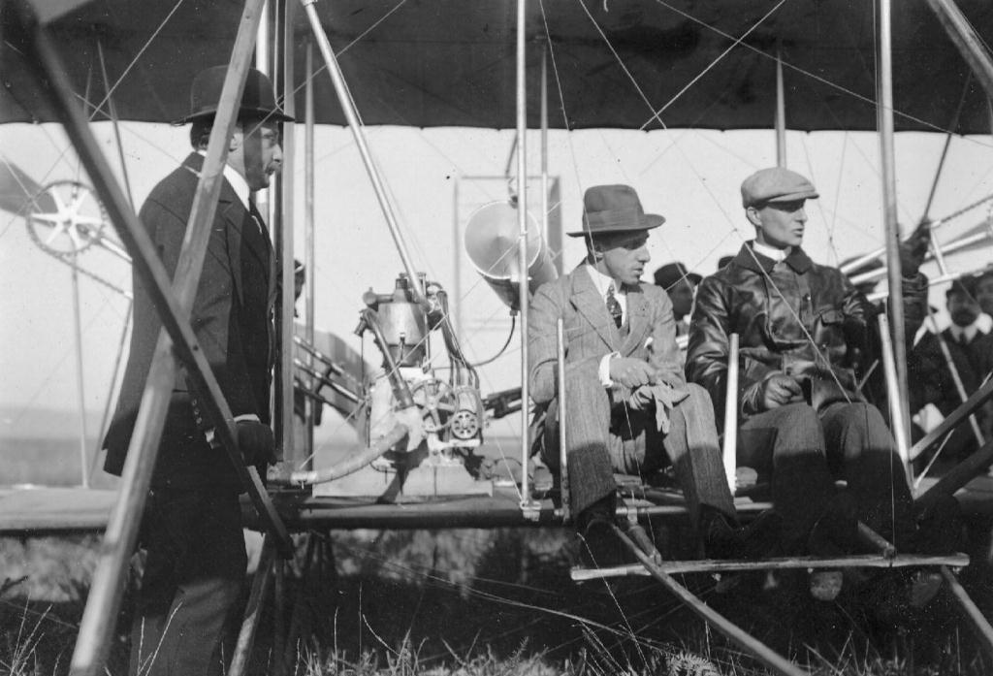
Wright brothers
Wilbur and Orville Wright, inventors, are from Millville, Indiana

Slide 26

Some restrictions
Alcohol sales are prohibited on Sunday (except for restaurants).

Slide 27
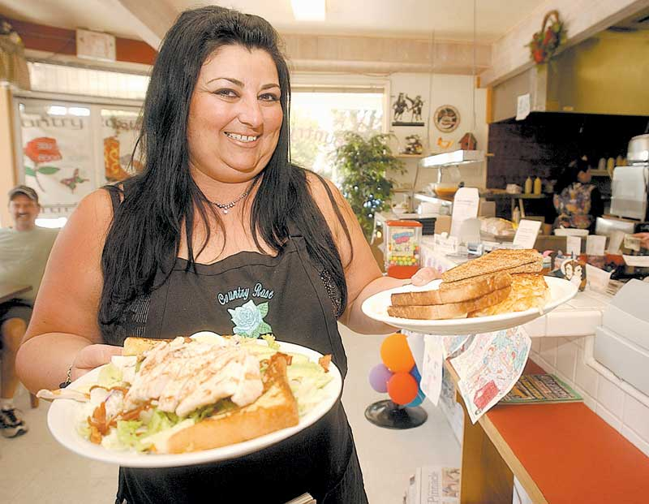
…and some dumb laws.
Waitresses may not carry drinks into a restaurant or bar.

Slide 28
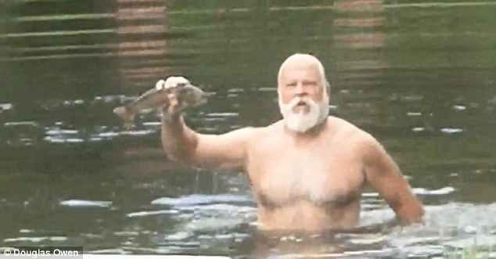
What about fish?
No one may catch a fish with his bare hands.

Slide 29
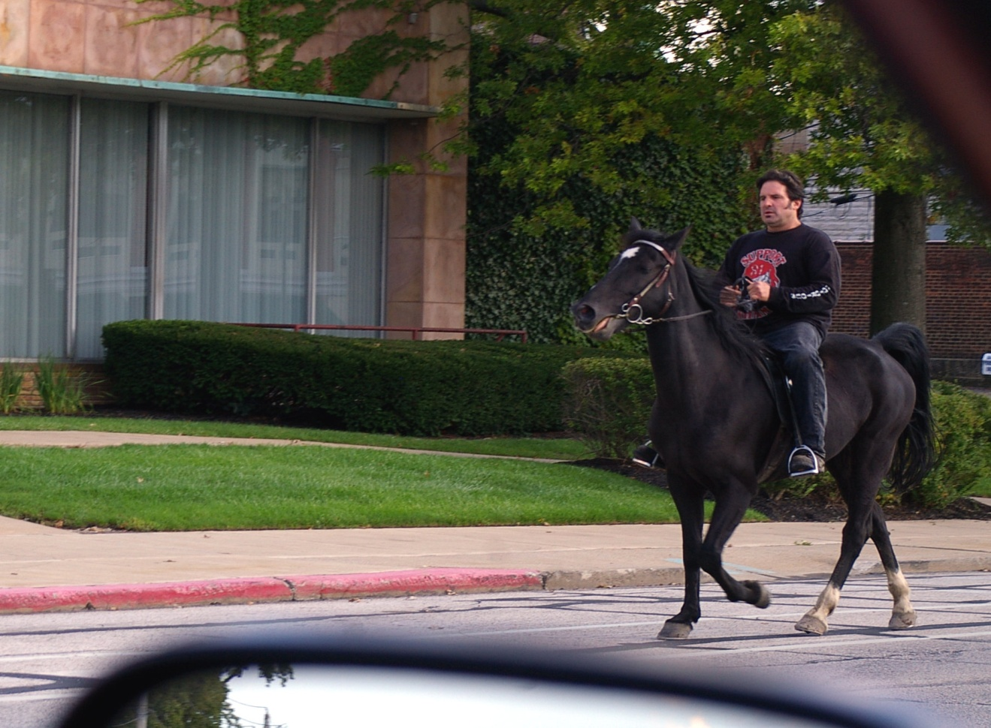
…or a horse?
It is against the law to pass a horse on the street.

Slide 30
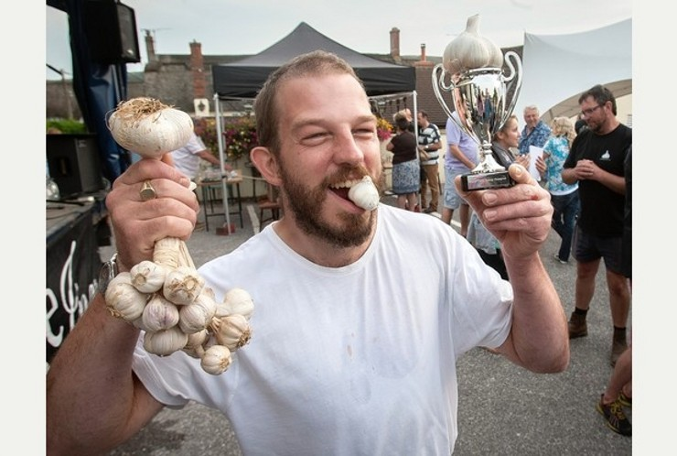
Garlic time
Within four hours of eating garlic, a person may not enter a movie house, theater, or ride a public streetcar.

Slide 31
The conclusion
Is Indianapolis perfect? Nope. Could and should it try harder? Yes. Should it seek to get more people and, thus, more perspectives involved? Of course. Should, it keep in mind that it is competing globally for human capital and private investment? Yes again.
But like many, non-global Midwestern cities, Indianapolis will have to make choices and compromises. In so doing, it will pursue a strategy that’s different from other places, and those differences won’t appeal to all.
Ricky Nelson once sang, “You can’t please everyone, so you got to please yourself.” I’m pleased to look at it this way: For some, Moby Dick was just a whale; for me, the parking garage is just a parking garage, but a new urban grocery and more downtown housing that is incremental progress.

