Slide 1
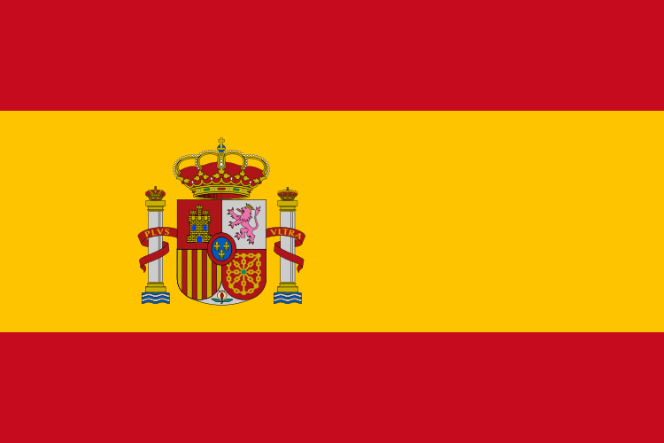
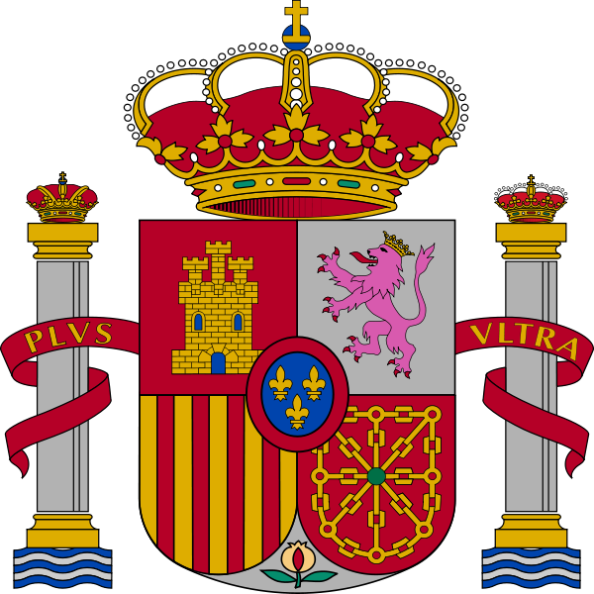
Kingdom of Spain

Slide 2
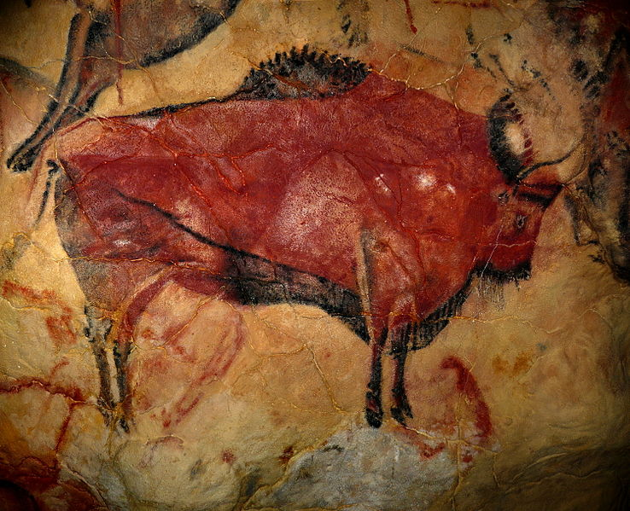
The origins of the Roman name Hispania, from which the modern name España was derived, are uncertain and are possibly unknown due to the inadequate evidence. Hispania may derive from the poetic use of the term Hesperia, reflecting the Greek perception of Italy as a "western land" or "land of the setting sun" (Hesperia, Ἑσπερία in Greek) and Spain, being still further west, as Hesperia ultima
Altamira Cave paintings, in Cantabria

Slide 3
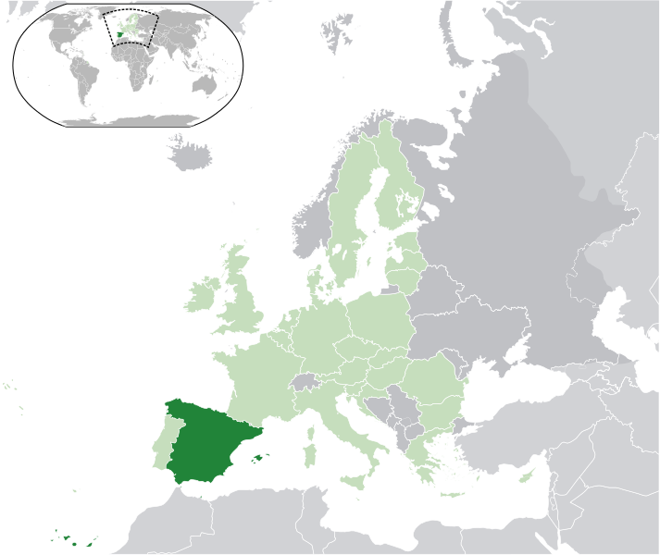

Slide 4
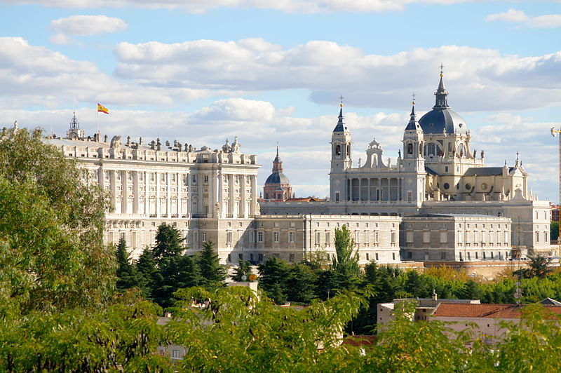
Royal Palace and Santa María la Real de La Almudena

Slide 5
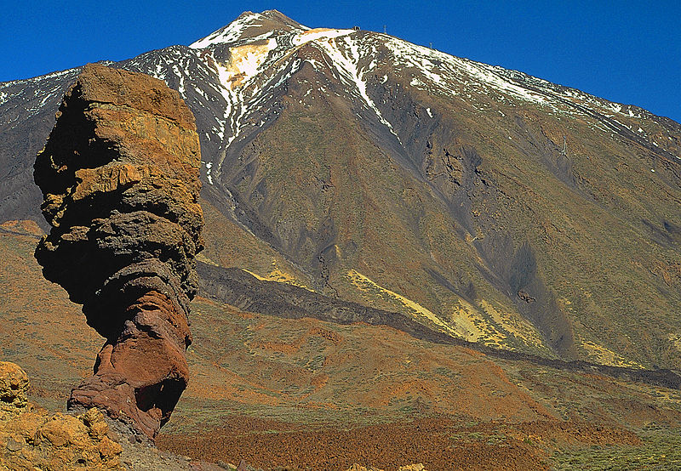
Mt. Teide, Tenerife, Canary Islands, is Spain's tallest mountain

Slide 6
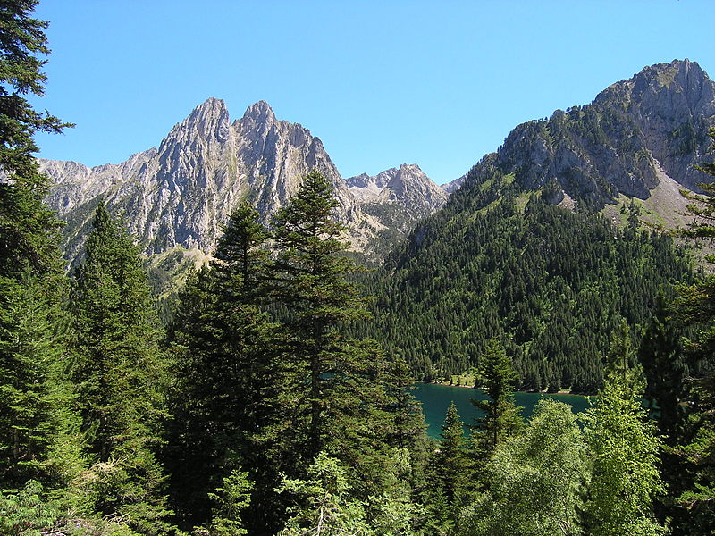
Sant Maurici National Park in the Pyrenees.

Slide 7
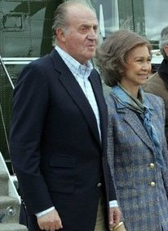
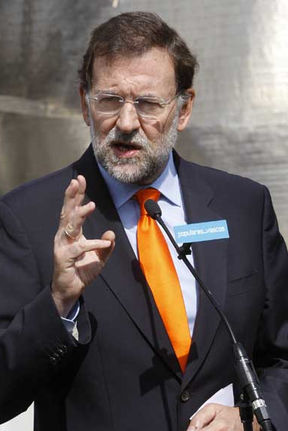
HM Juan Carlos I King of Spainand HM Queen Sofía of Spain.
Mariano Rajoy, Prime minister

Slide 8
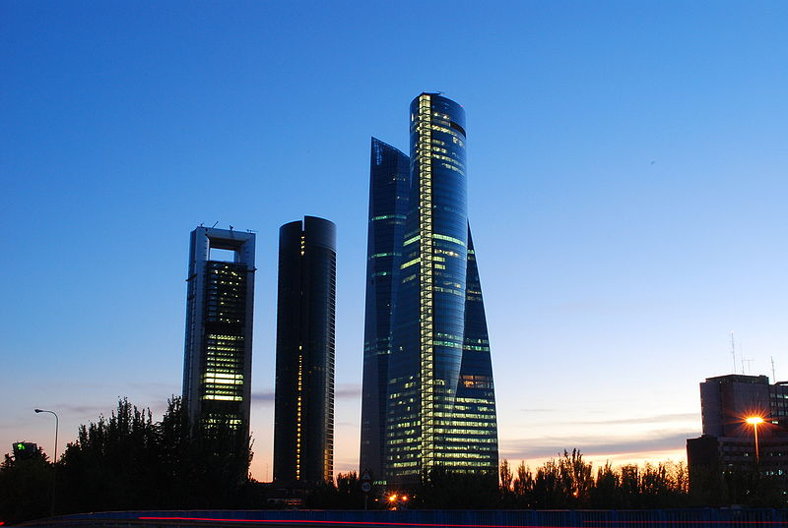
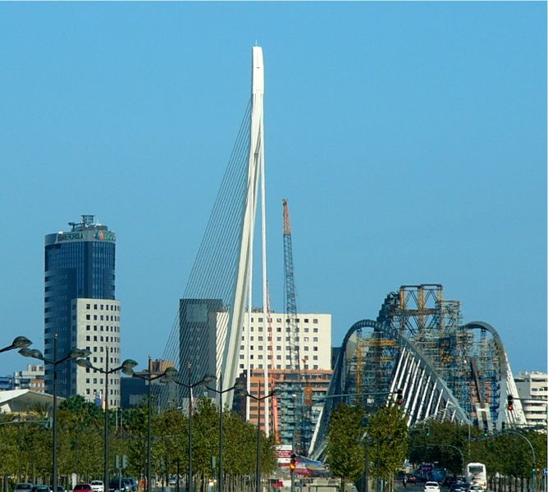
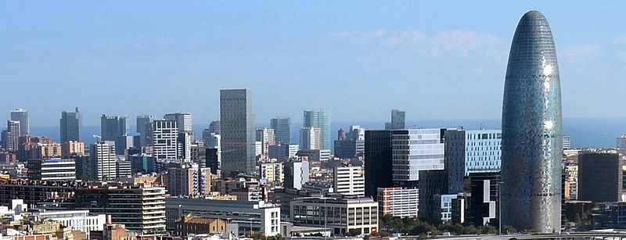
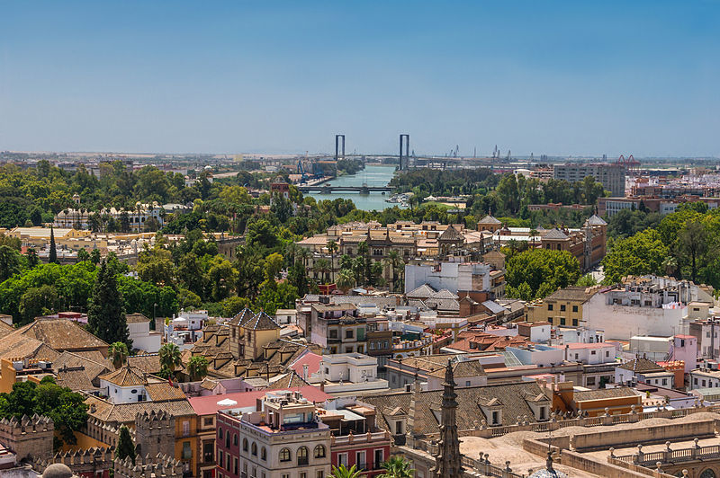

Slide 9
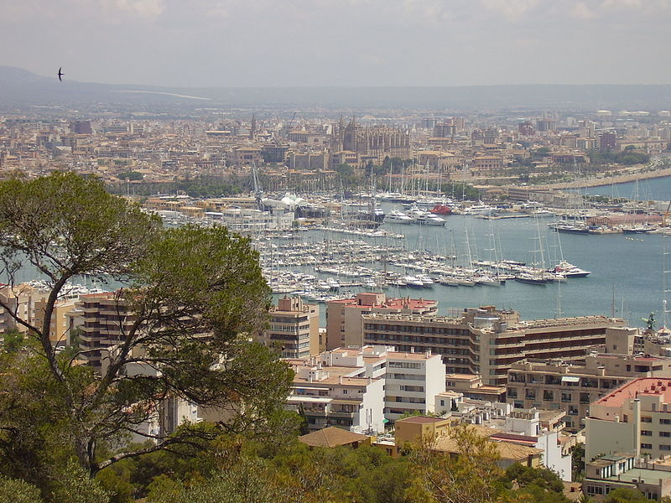
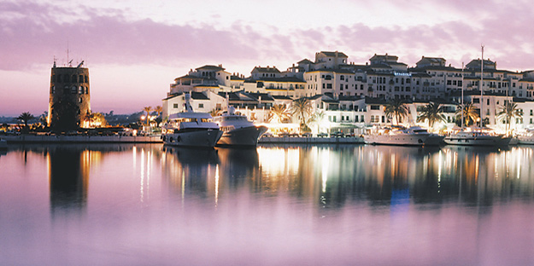
Palma de Mallorca where an important population of Germans live.
Marbella, Málaga, where Britons —who are the third immigrant community in Spain— reside in large numbers.

Slide 10
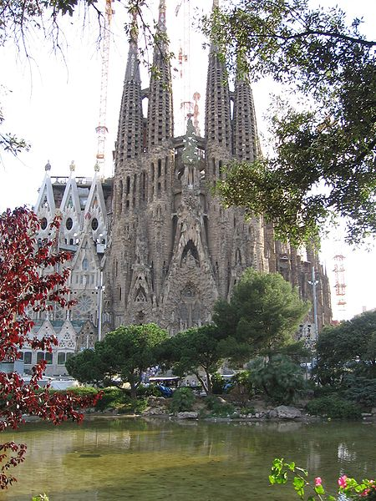
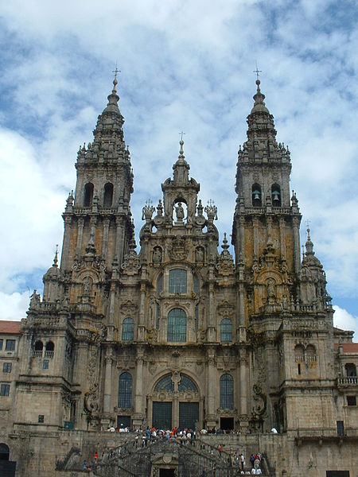
Santiago de Compostela Cathedral, A Coruña; terminus of the Way of St. James
Sagrada Família ofAntoni Gaudí, Barcelona.

Slide 11
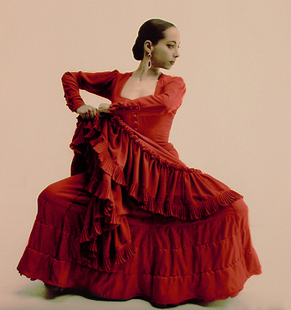
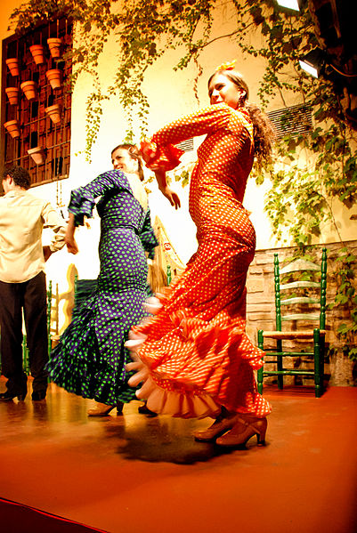
Flamenco is an Andalusian artistic form that evolved from the Seguidilla

Slide 12
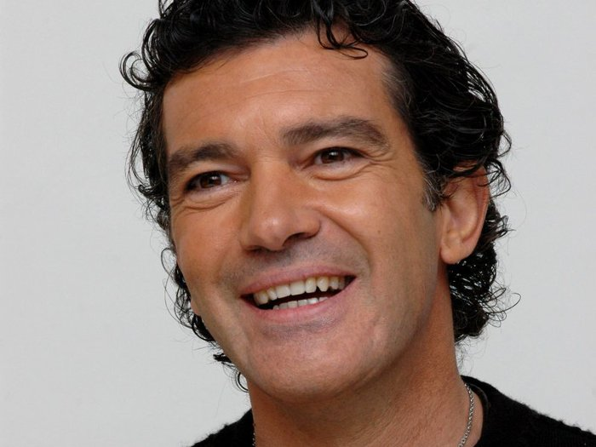
Antonio Banderas
Penélope Cruz
Javier Bardem

Slide 13
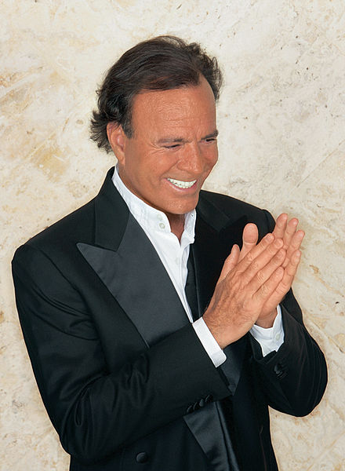
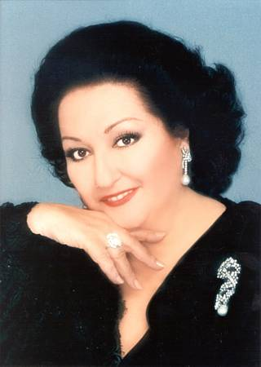
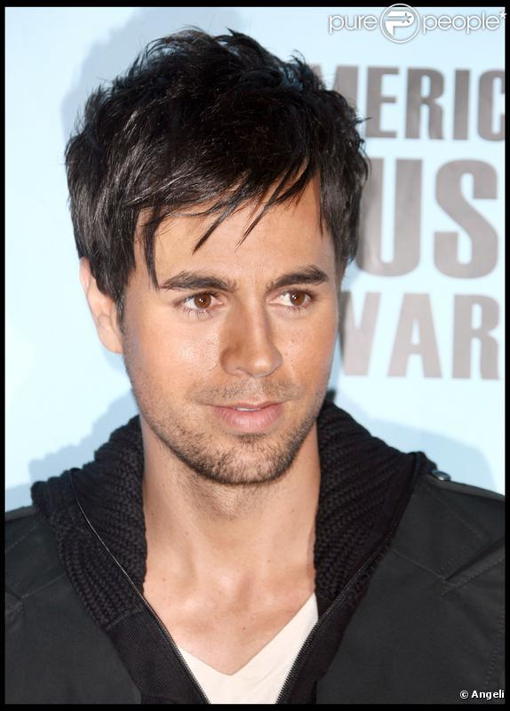
Julio Iglesias
Montserrat Caballé
Enrique Iglesias

Slide 14
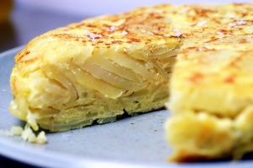
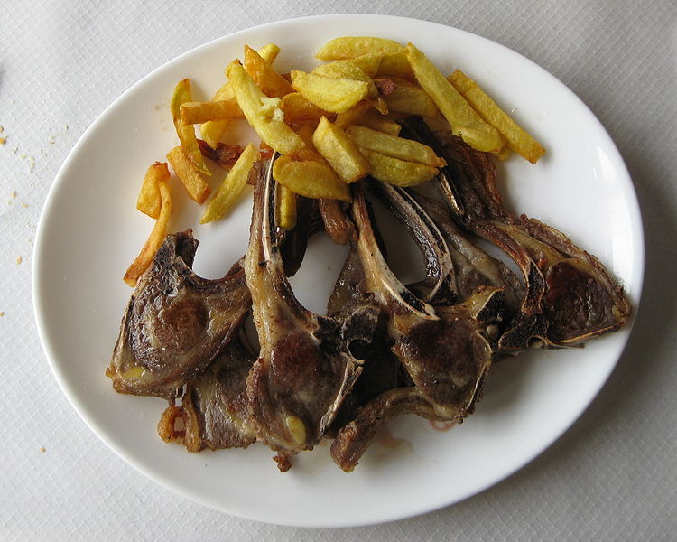
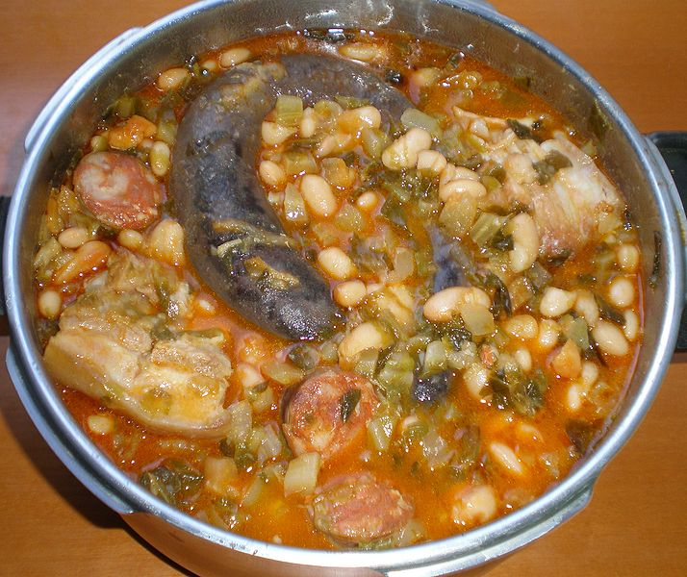
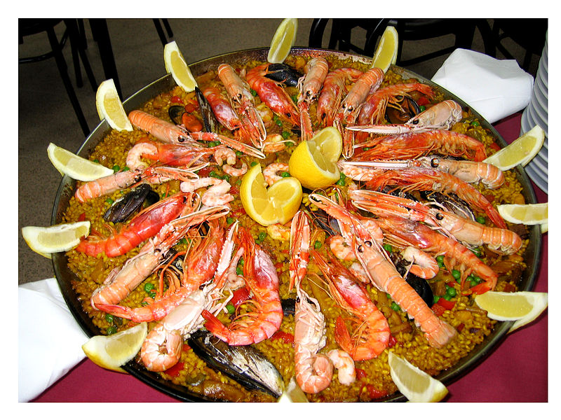
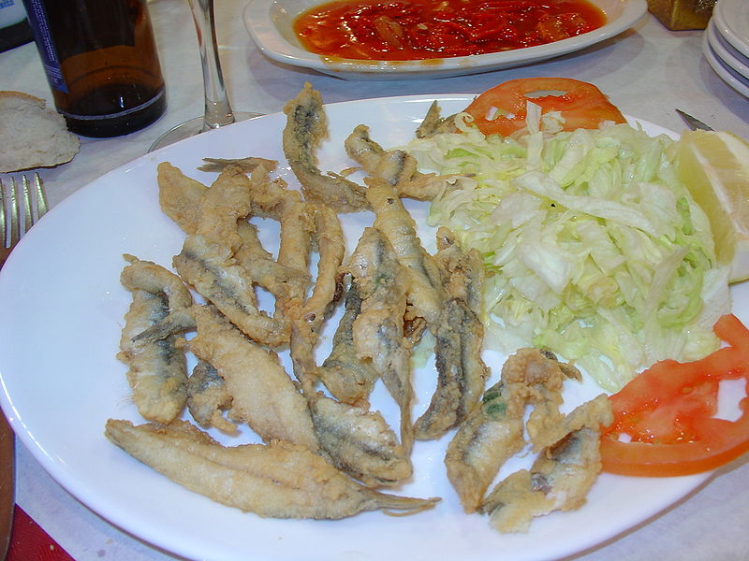
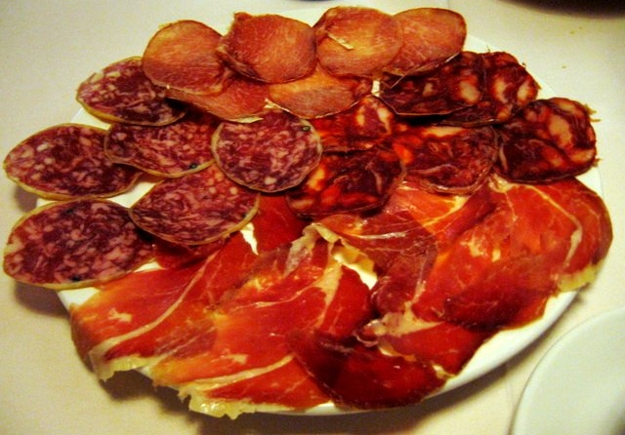

Slide 15
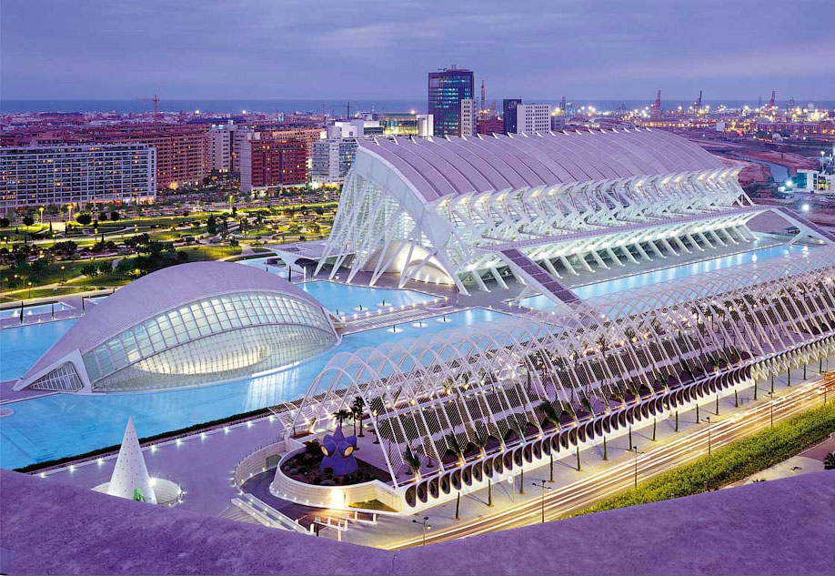
Ciutat de les Arts i les Ciències, Valencia

Slide 16
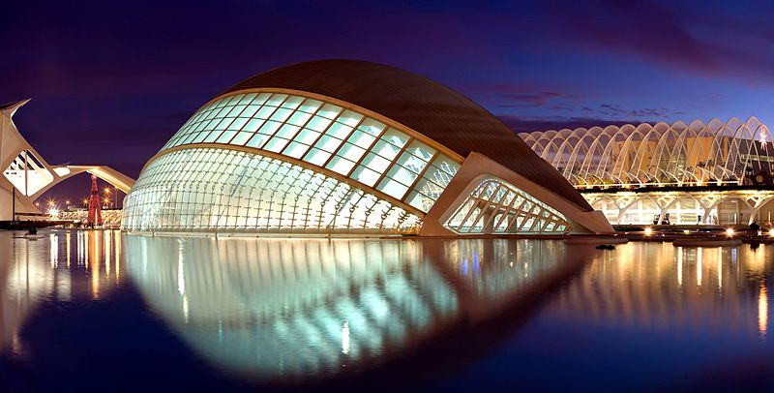
The City of Arts and Sciences is an entertainment-based cultural and architectural complex in the city of Valencia, Spain. It is the most important modern tourist destination in the city of Valencia.
Designed by Santiago Calatrava and Félix Candela, the project underwent the first stages of construction in July 1996 and the finished "city" was inaugurated April 16, 1998 with the opening of L'Hemisfèric. The last great component of the City of Arts and Sciences, El Palau de les Arts Reina Sofia, was presented on October 9, 2005, Valencian Community Day.
L'Hemisfèric

Slide 17
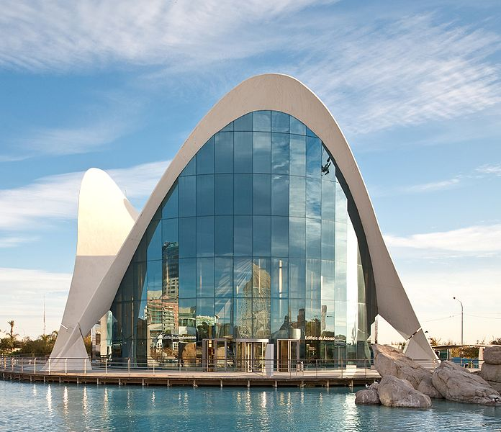
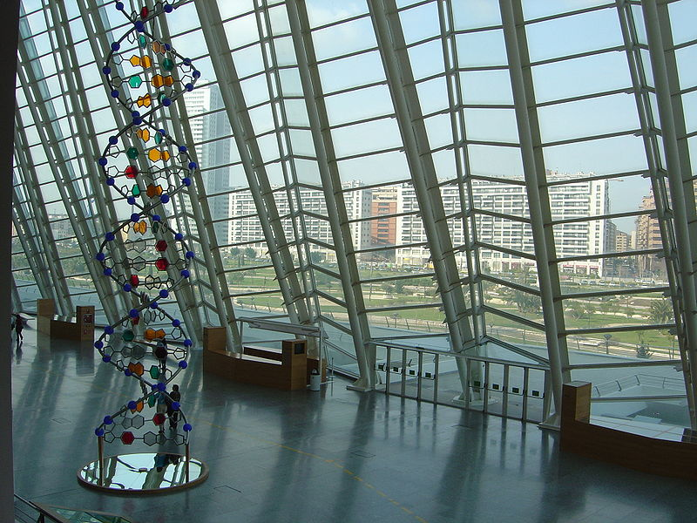
L'Oceanogràfic
El Museu de les Ciències Príncipe Felipe

Slide 18
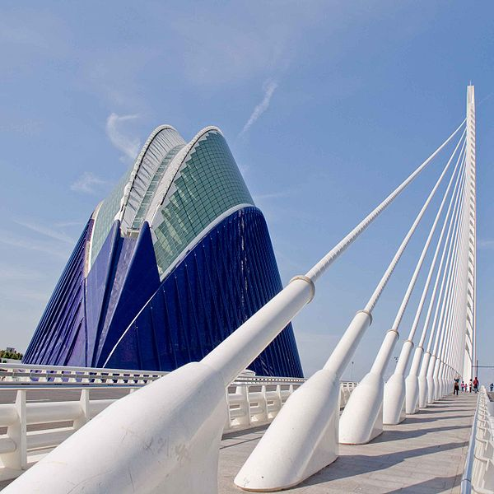
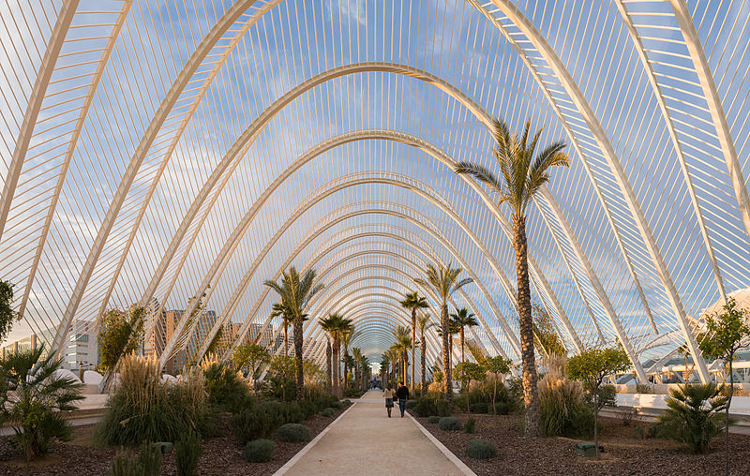
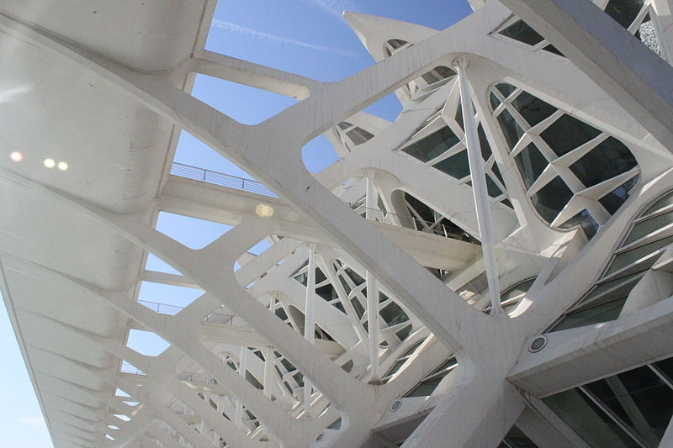
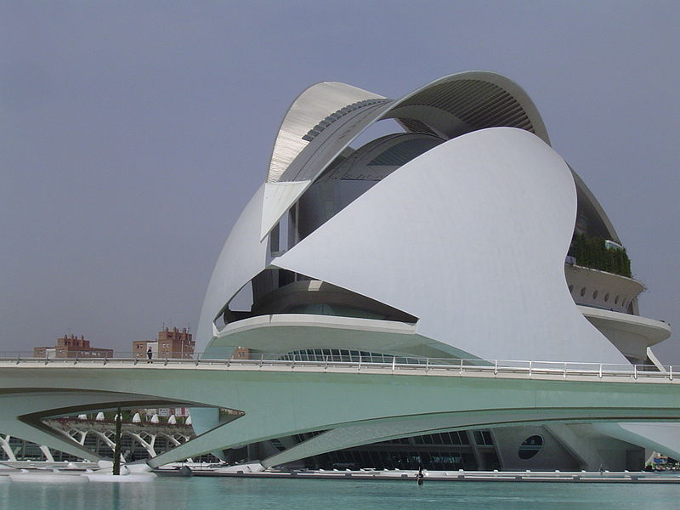

Slide 19
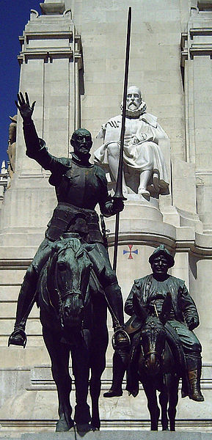
Bronze statues of Don Quixote and Sancho Panza, at thePlaza de España in Madrid

Slide 20
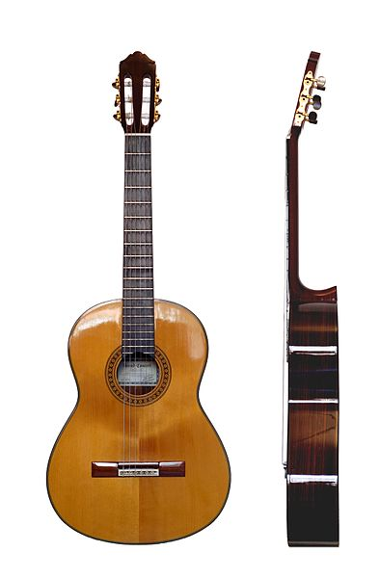
The modern classical guitar and its baroque predecessor originated in Spain

Slide 21
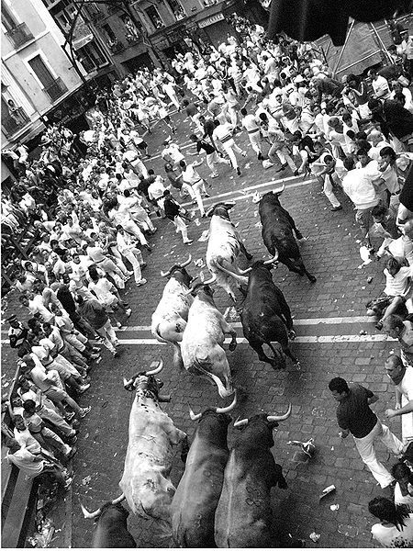
San Fernim
Running of the Bulls (encierro)

Slide 22
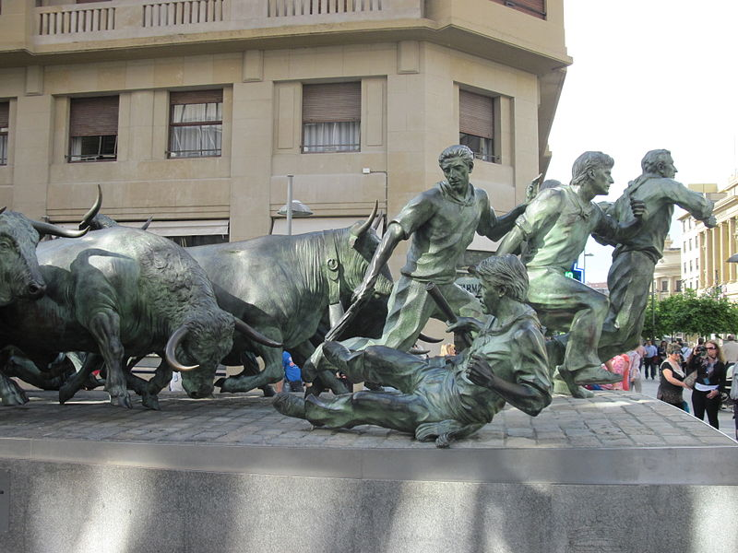
Monument in Pamplona

Slide 23
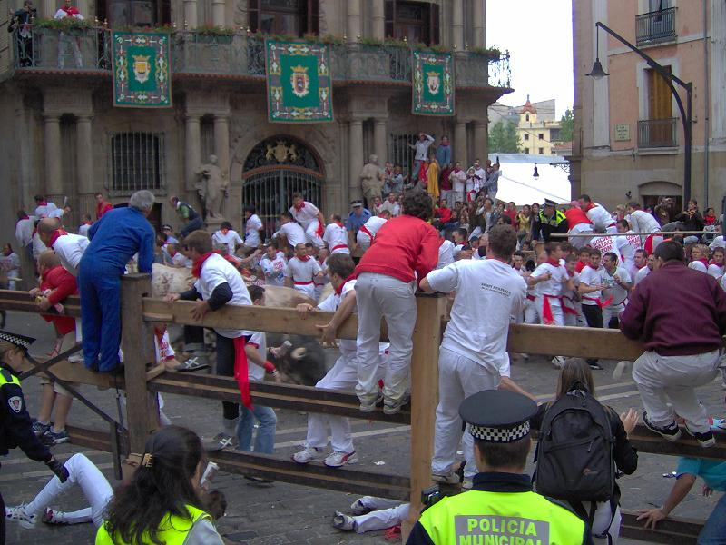
Pamplona, 7 July 2005. People climb to the fences as the bulls run by and cross the Town Hall Plaza

Slide 24
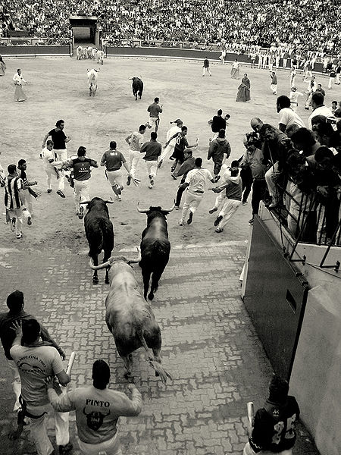
Pamplona, 2007. Bulls following some runners enter the bull ring, where the event ends. The bulls can be seen in the foreground and background of the picture.

Slide 25
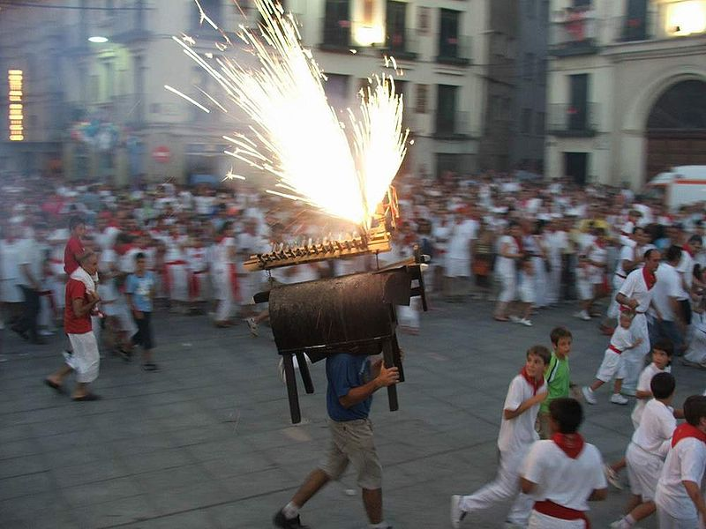
Fire bull and children running from it.

Slide 26
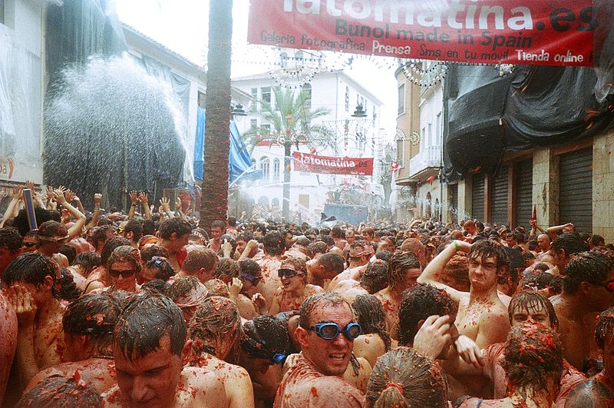
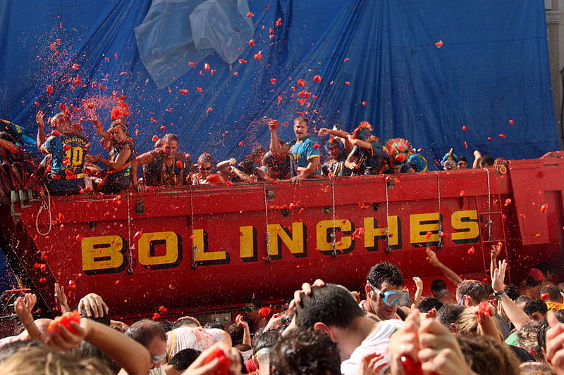
La Tomatina
La Tomatina is a festival that is held in the Valencian town of Buñol, a town located 30 km from the Mediterranean, in which participants throw tomatoes and get involved in this tomato fight purely for fun. It is held on the last Wednesday of August, during the week of festivities of Buñol.

Slide 27
And

Slide 28
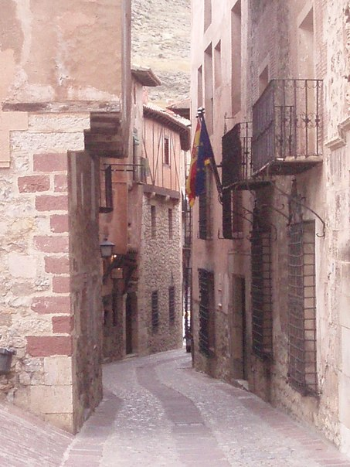
My photos in Spain

Slide 29
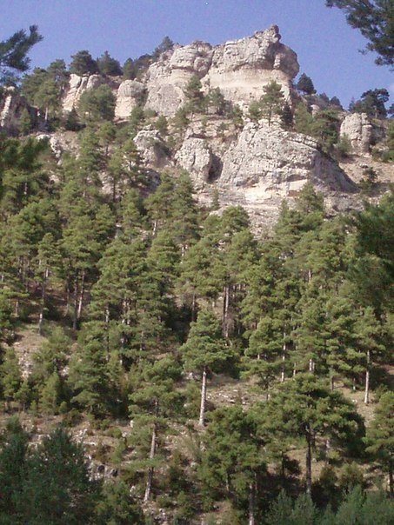
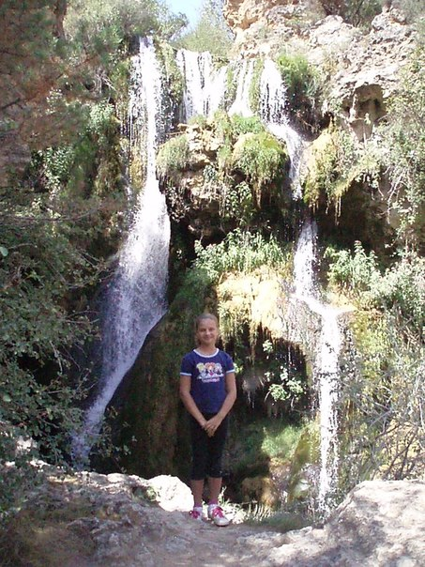
Teruel

Slide 30
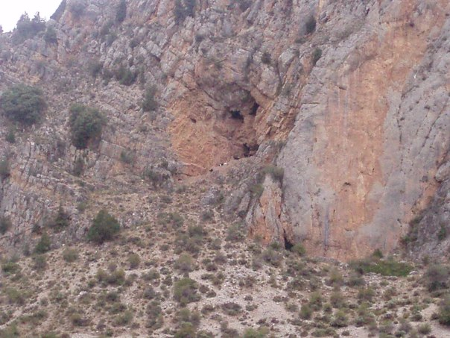

Slide 31
Teruel
Albaracin

Slide 33
Vilanova D’Alcolea, San Antoni

Slide 34
Castellon de la Plana

Slide 35
Valencia Airport

Slide 36
Thank you for your attention !
Skakalova Olexandta
11-a

