Slide 1
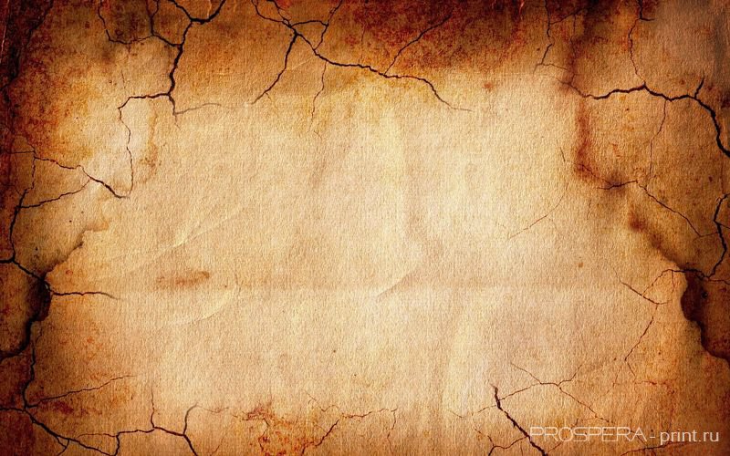
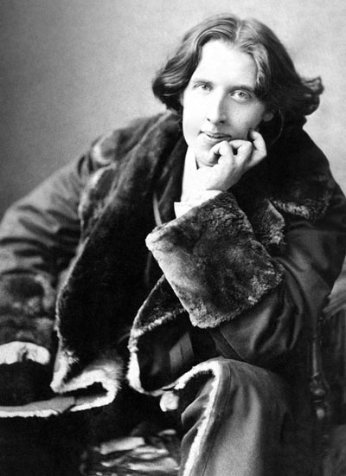
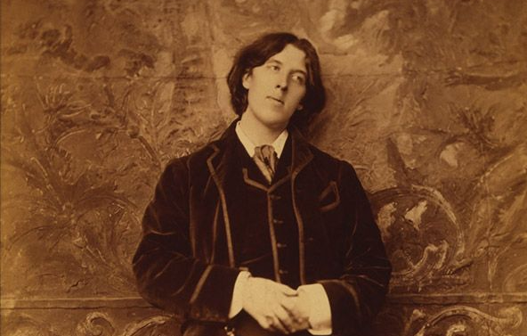
Oscar Wilde

Slide 2
Oscar Wilde was an Anglo-Irish playwright, novelist, poet, and critic. He is regarded as one of the greatest playwrights of the Victorian Era.

Slide 3
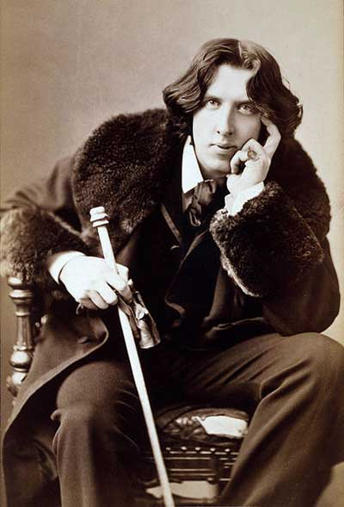
Birth name: Oscar Fingal O`FlahertieWills Wilde
Birth date: October 16, 1854
Birth place: Dublin, Ireland
Nationality: Irish

Slide 4
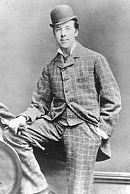
Educated: Trinity College (Dublin), Magdalen College (Oxford)
Father: Sir William Wilde (eye doctor)
Mother: Jane Francesca Elgee (poet and journalist)
Siblings: brother William, sister Isola
Spouse: Constance Lloyd
Children: two sons - Cyril and Vyvyan
Occupation: Playwright, novelist, poet, editor, critic
Period: Victorian era (1837–1901)
Literary movement: Aestheticism
Oscar Wilde at Oxford

Slide 5
1854 Born in Dublin
1864 - 1871 Attends Portora Royal School, Enniskillen
1871 - 1874 Attends Trinity College, Dublin
1874 - 1879 Attends Magdalen College, Oxford
1878 Wins New digate Prize for Ravenna (poem)
1881 Publishes his first collection of poetry – Poems
1882 Lectures in the United States and Canada.
Writes his first play - Vera, or the Nihilists (was not a success)
1883 Lectures in Britain and Ireland. Writes his second unsuccessful play, The Duchess of Padua

Slide 6
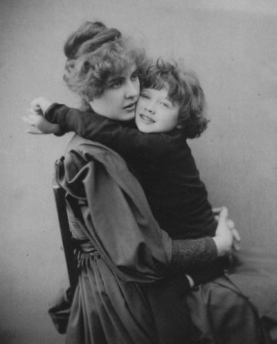
1884 Marries Constance Lloyd
1885 His son, Cyril, is born
1886 His son, Vyvyan, is born
1887-1889 Edits Womans World magazine
1888 Publishes The Happy Prince and Other Tales
1889 -1890 Publishes several essays
1891 Publishes two collections of short stories – Lord Arthur Saviles Crime and other Stories, and A House of Pomegranates. Publishes The Picture of Dorian Gray, his first and only novel. Begins his friendship with Lord Alfred Douglas – Bosie.

Slide 7
1892 Writes two plays: Lady Windermere's Fan (great success) and Salome
1893 Writes A Woman of No Importance
1894 Writes The Importance of Being Earnest
1895 Writes An ldeal Husband. At the height of his theatrical success, he sues Bosie`s father for libel, which leads to his own arrest for homosexual offenses. He is found guilty for the crime of sodomy and sentenced to two years of hard labor.
1897 While in prison, he writes De Profundis
1898 Writes his best known poem, The Ballad of
Reading Gaol. His wife, Constance, dies.
1900 Dies of cerebral meningitis in Paris.

Slide 8
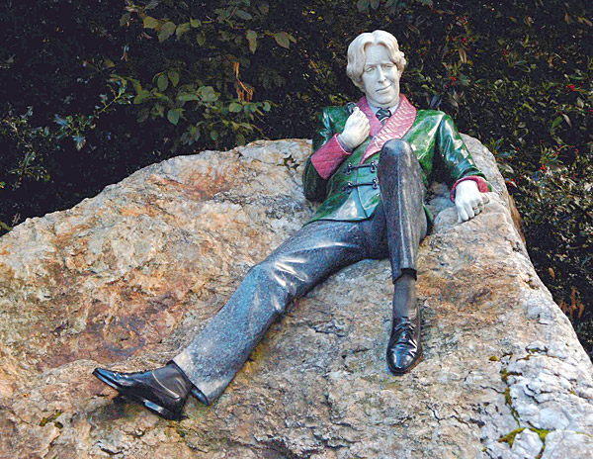
Monuments in Dublin of Oscar Wilde

Slide 9
Literary Works
1878: Ravenna
1881: Poems
1888: The Happy Prince and Other Tales
1889: The Decay of Lying
1891: The Picture of Dorian Gray
1891: Lord Arthur Savile’s Crime and Other Stories
1891: Intentions
1891: Salome

Slide 10
1892: The House of Pomegranates
1892: Lady Windermere’s Fan
1893: A Woman of No Importance
1893: The Duchess of Padua
1894: The Sphinx
1895: An Ideal Husband
1895: The Importance of Being Earnest
1898: The Ballad of Reading Gaol

Slide 11
The Picture of Dorian Gray
The Picture of Dorian Gray is the only published novel by Oscar Wilde, appearing as the lead story in Lippincott's Monthly Magazine on 20 June 1890,printed as the July 1890 issue of this magazine. Wild later revised this edition, making several alterations, and adding new chapters; the amended version was published by Ward, Lock, and Company in April 1891.
There were moments when he looked on evil simply as a mode through which he could realize his conception of the beautiful. – Narration
And mind you don’t talk about anything serious. Nothing is serious nowadays. At least, nothing should be. – Dorian Gray
I am tired of myself tonight. I should like to be somebody else. – Dorian Gray
I love scandals about other people, but scandals about myself don’t interest me. They have not got the charm of novelty. – Dorian Gray

Slide 12
The novel tells of a young man named Dorian Gray, the subject of a painting by artist Basil Hallward. Basilis impressed by Dorian's beauty and becomes infatuated with him, believing his beauty is responsible for a new mode in his art. Dorian meets Lord Henry Wotton, a friend of Basils, and becomes enthralled by Lord Henrys world view. Espousing a new hedonism, Lord Henry suggests the only things worth pursuing in life are beauty and fulfillment of the senses. Realizing that one day his beauty will fade, Dorian (whimsically)expresses a desire to sell his soul to ensure the portrait Basil has painted would age rather than he. Dorian swish is fulfilled, plunging him into debauched acts. The portrait serves as a reminder of the effect each act has upon his soul, with each sin displayed as a disfigurement of his form, or through a sign of aging. The Picture of Dorian Gray is considered a work of classic gothic fiction with a strong Faustian theme.

Slide 13
In a letter, Wilde said the main characters were reflections of himself: "Basil Hallward is what I think I am: Lord Henry is what the world thinks me: Dorian is what I would like to be—in other ages, perhaps “
The main characters are:
Dorian Gray – a handsome and narcissistic young man who becomes enthralled with Lord Henrys idea of a new hedonism. He begins to indulgein every kind of pleasure, moral and immoral.
Basil Hallward – an artist who becomes infatuated with Dorian. Dorian helps Hallward realize his artistic potential, as Basils portrait of Dorian proves to be his finest work. A devout Christian with conservative values, he is later murdered by Gray.
Lord Henry "Harry" Wotton – an imperious and decadent dandy who is a friend to Basil initially, but later becomes more intrigued with Dorian's beauty. Extremely witty, he is seen as a critique of Victorian culture at the end of the century, espousing a view of indulgent hedonism. He conveys to Gray his world view, and Dorian becomes corrupted as he attempts to emulate him, though Basil points out to Harry that "You never say a moral thing, and you never do a wrong thing."

Slide 14
Other characters include:
Sibyl Vane – a beautiful and talented, but poor, actress and singer, with whom Dorian falls in love. Her love for him ruins her acting ability, as she no longer finds pleasure in portraying fictional love when she is experiencing love in reality. She commits suicide after learning that Dorian no longer loves her. Lord Henry likens her to Ophelia.
James Vane – Sibyls brother, a sailor who leaves for Australia. He is extremely protective of his sister, especially as their mother cares only for Dorian's money. He is hesitant to leave his sister, believing Dorian will harm her and promises to take vengeance if any harm should befall his sister. After Sibyls death he becomes obsessed with killing Dorian and begins to stalk him. He dies in a hunting accident. His pursuit of revenge against Dorian Gray for the death of his sister emulates the role of Laertes, Ophelia's brother in Hamlet.
Alan Campbell – a chemist and once-time friend of Dorian; he ended their friendship when Dorian's reputation began to come into question. Dorian blackmails him into disposing of Basils body; Campbell later commits suicide. Lord Fermor – Lord Henrys uncle, who informs his nephew about Dorian Grays lineage.
Victoria, Lady Wotton – Lord Henrys wife, who only appears once in the novel. Her husband treats her with disdain; she later divorces him.

