Slide 1

United Kingdom of Great Britain
DOs and DON’Ts for tourists

Slide 2
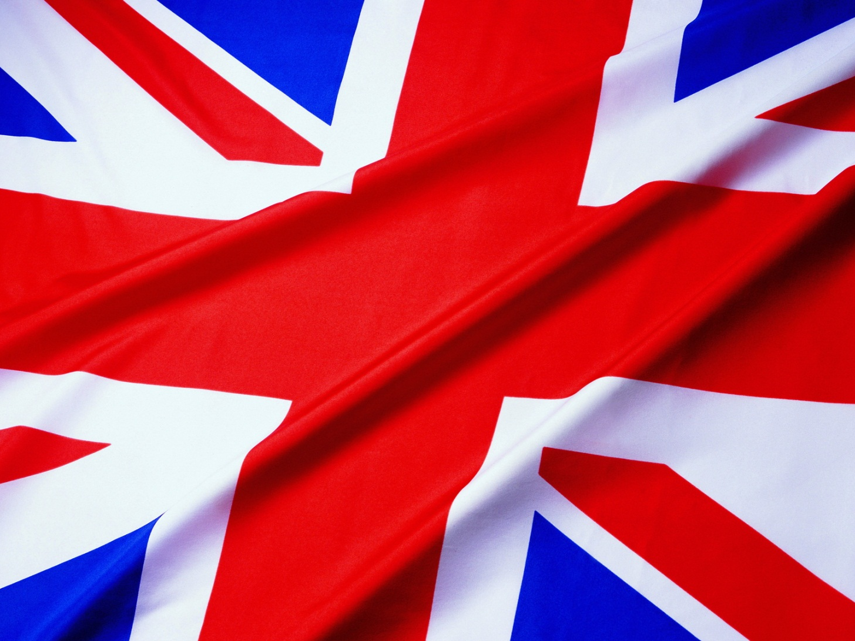
The English are said to be reserved in manners, dress and speech. British People are famous for politeness, self-discipline and especially for sense of humor.

Slide 3

UK Donts

Slide 4
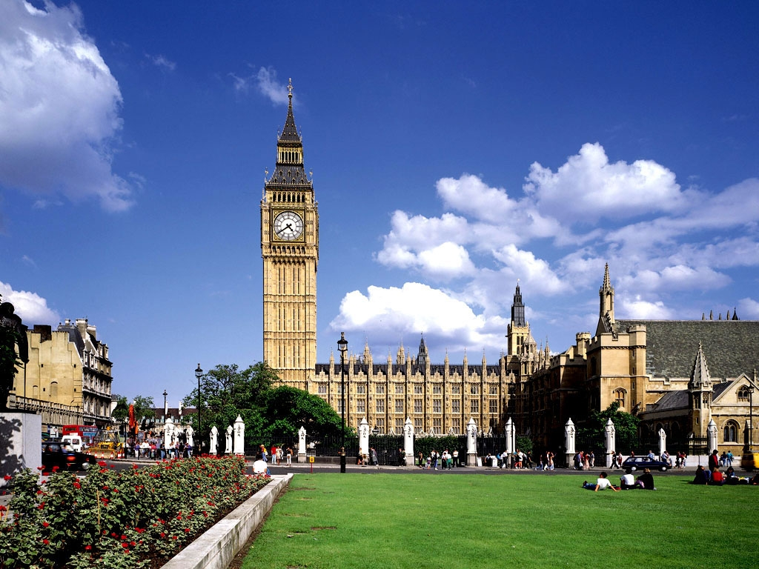
Do not use first names, unless you are asked to. Use last names with appropriate courtesy titles such as ”Mr”, ”Mrs”, ”Ms” or academic or professional title. The title Sir is reserved for only those who have been knighted. You have to address the person as Sir and his first name.
Do not talk loudly in public. When in Scotland make an effort to speak in a low, moderate tone of voice. Talking too loudly in public is sometimes considered offensive and embarrassing.
Do not pick your nose in public. Use a handkerchief instead. Do not spit. Spitting in the street is considered very bad manner.

Slide 5
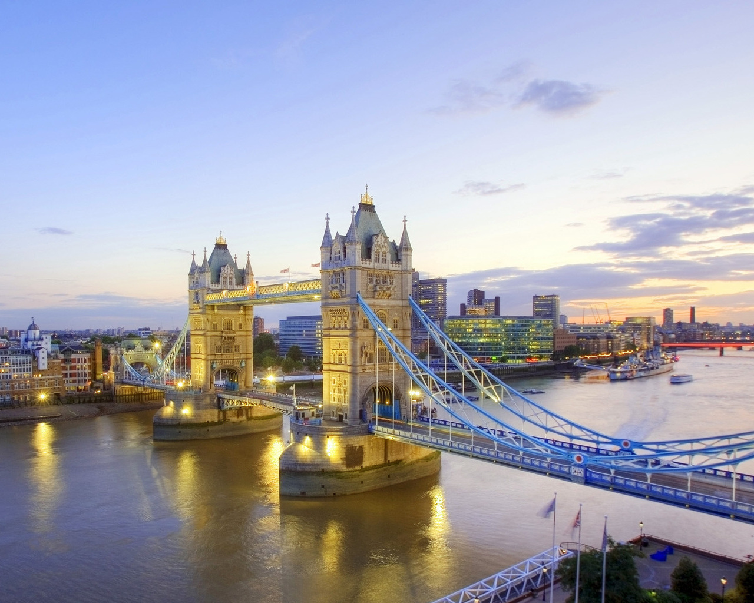
Do not throw any rubbish or cigarette puffs on the floor in the street or anywhere.
Do not stare. Privacy is highly regarded in the UK. It is impolite to stare at anyone in public.
Do not greet people with a kiss. Kiss is normally used between close friends and relatives.
Do not burp in public. If you can not stop a burp from bursting out, cover your mouth with your hand and say ‘excuse me’ afterwards.
Do not pass wind in public. Go somewhere private and let it out. If you accidentally pass wind in company say ‘pardon me’.
Do not be offended when you are called by different ‘affectionate’ names, such as dear, honey, love, mate, guy, son, etc, this is quite normal.

Slide 6

Do not wear hats inside buildings if you are a man. It is impolite for men to wear hats indoors including restuarants and churches.
Do not chew with your mouth open. No one wants to see food being chewed or hearing it being chomped on. It is impolite to have your elbows on the table while you are eating.
Do not reach over someone’s plate for something, ask for the item to be passed. Do not take food from your neighbours’ plate. Never pick food out of your teeth with your fingernails.
Do not blow your nose on a napkin (serviette). Napkins are for dabbing your lips and only for that.

Slide 7

UK Dos

Slide 8
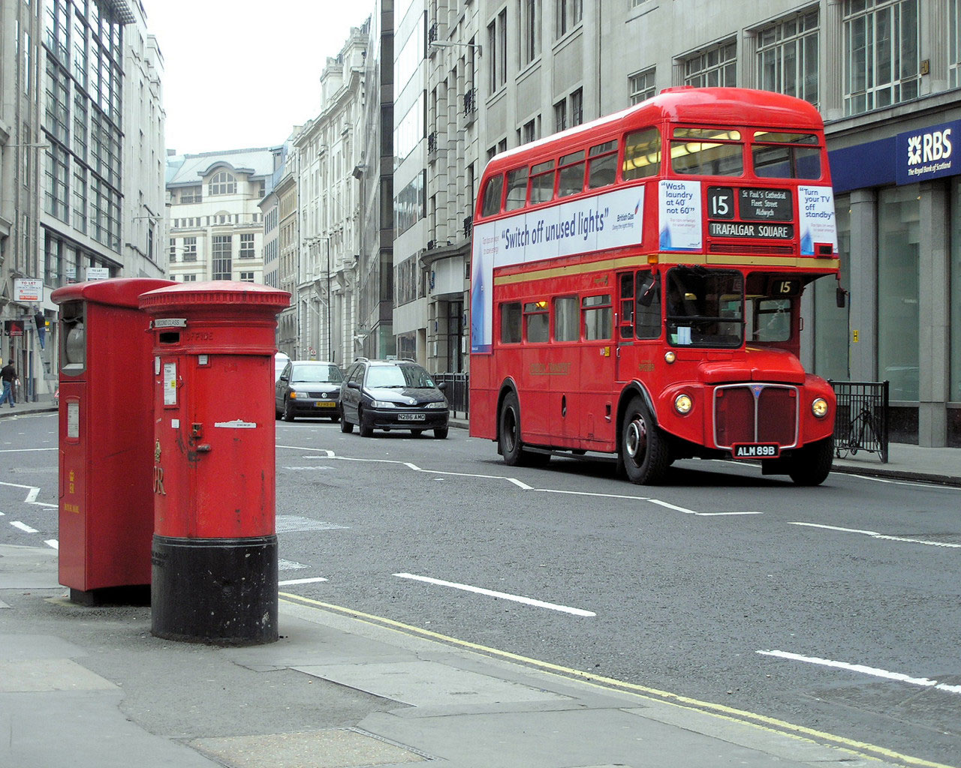
Do eat with fork in the left hand and the knife in the right. The British pay much attention to good table manners. Even young children are expected to eat properly with knife and fork.
Do maintain reserve and grunt hello when greeting someone for the first time. British people are quite reserved. Handshake is the most common form of greeting and is customary when you are introduced to somebody new. Kiss is normally used between friends and relatives. In Britain one kiss is generally enough.
Do get familiar with the word of ‘cheers’ which are quite commonly used instead of ‘thank you’ and ‘good bye’.
Do bring a gift for the host and hostess when being entertained at someone’s home. A bottle of wine, bunch of flowers or chocolates are all acceptable.

Slide 9

Do wait until your host starts eating or indicates you should do so if you are a guest. It is impolite to start eating before everyone has been served unless your host says that you do not need to wait.
Do chew and swallow all the food in your mouth before taking more or taking a drink. Never talk with food in your mouth. Always say thank you when served something. It shows appreciation.
Do break off a piece of bread before buttering when eating rolls. It is good manners to take some butter from the butter dish with your bread knife and put it on your side plate, then butter pieces of the roll using this butter.

Slide 10
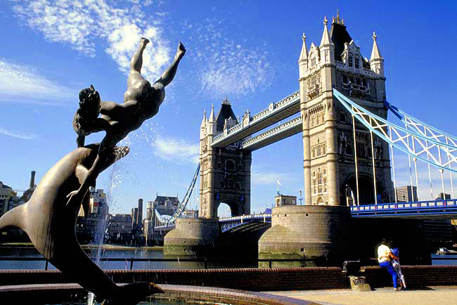
Do place your knife and folk together on your plate to let others know that you have finished eating.
Do be punctuating. British people place considerable value on punctuality. They are very time conscious, If you are unable to keep an appointment, it is expected that you call the person you are meeting. Some general tips follow.
Do stand in line if there is a queue, and wait patiently for your turn. ‘Queue jumping’ is frowned upon.

Slide 11
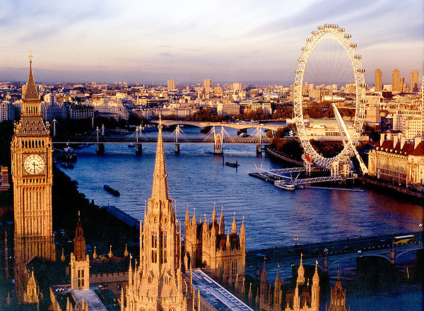
Do say “Excuse Me” if someone is blocking your way and you would like them to move out of your way.
Do cover your mouth with your hand when yawning or coughing.
Do say sorry if you accidentally bump into someone. They probably will too, even if it was your fault! This is a habit and can be seen as very amusing by an ‘outsider’.
Do drive on the left side of the road.
Do open doors for other people. Men and women both hold open the door for each other. It depends on who goes through the door first.
Do stand on the right-hand side of an escalator while travelling on the Tube, so that others can pass over from left-hand side.
Do pay for drinks at the counter as you order them in pubs and other types of bars Do buy one back when your new friends and someone buys you a drink at the pub.

