Slide 1
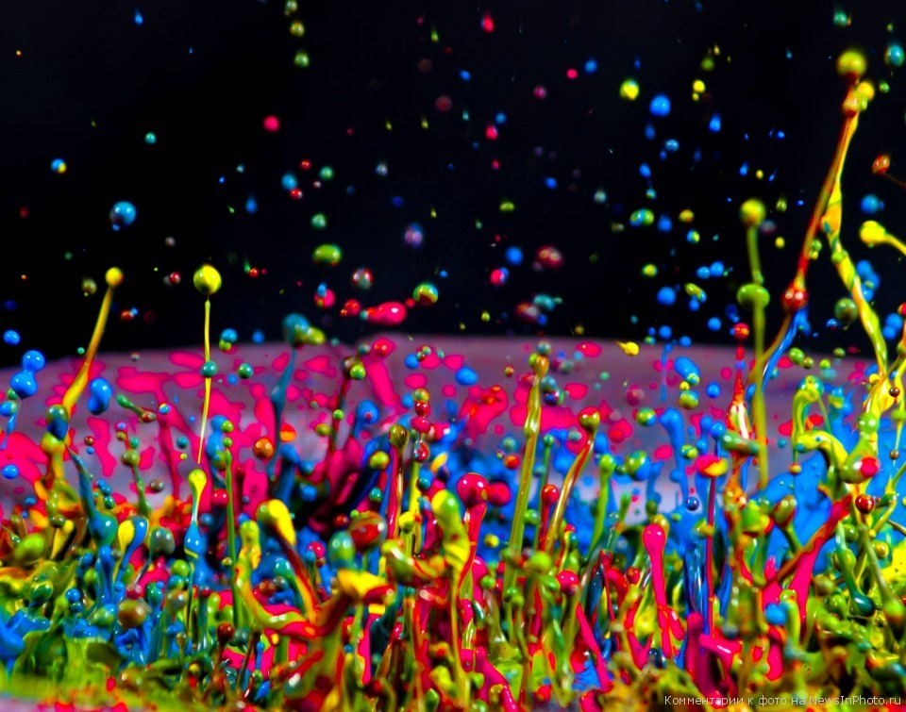

I’ve been creating music since when I was a child. It's an inseparable part of my life.
Jared Leto

Slide 2
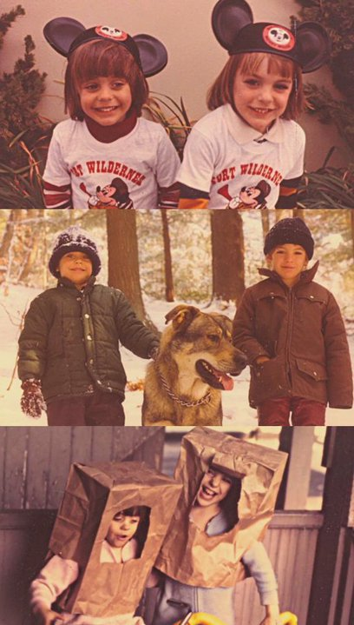
Jared Leto was born in Bossier City, Louisiana, the son of Constance Leto His mother has Cajun ancestry. "Leto" is a stepfather's surname. Leto has two younger half-brothers from his father's second marriage and his older brother Shannon.
"I was raised around a lot of artists, musicians, photographers, painters and people that were in theater."

Slide 3
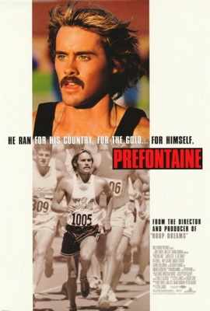
In 1992, Leto moved to Los Angeles to pursue a musical career, intending to take acting roles on the side. He found minor roles on television shows but his first break came in 1994, after he was cast opposite Claire Danes as Jordan Catalano, her love interest, in the short-lived but well-reviewed ABC teen drama My So-Called Life. In 1997, Leto starred in the biopic Prefontaine in which he played the role of Olympic hopeful Steve Prefontaine. For the preparation of the role, Leto immersed himself in the runner's life, training for six weeks and meeting with members of his family and friends. He bore a striking resemblance to the real Prefontaine, also adopting athlete's voice and upright running style. His portrayal received positive reviews from critics and is often considered his breakthrough role.

Slide 4
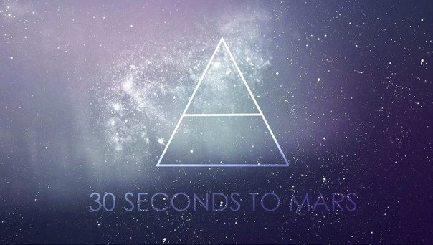
In 1998, Leto founded Thirty Seconds to Mars along with his older brother Shannon Leto. The band's name, said Leto, "has little to do with space, the universe or anything like that. It is a name that works on several different levels. Most importantly, it is a good representation of our sound. It's a phrase that is lyrical, suggestive, cinematic, and filled with immediacy. It has some sense of otherness to it.“
Jared wrote the majority of their songs. Before the album was released, Puddle of Mudd invited Thirty Seconds to Mars to open a six-week tour for them in the spring of 2002.The band later embarked on a North American tour to support Incubus.

Slide 5
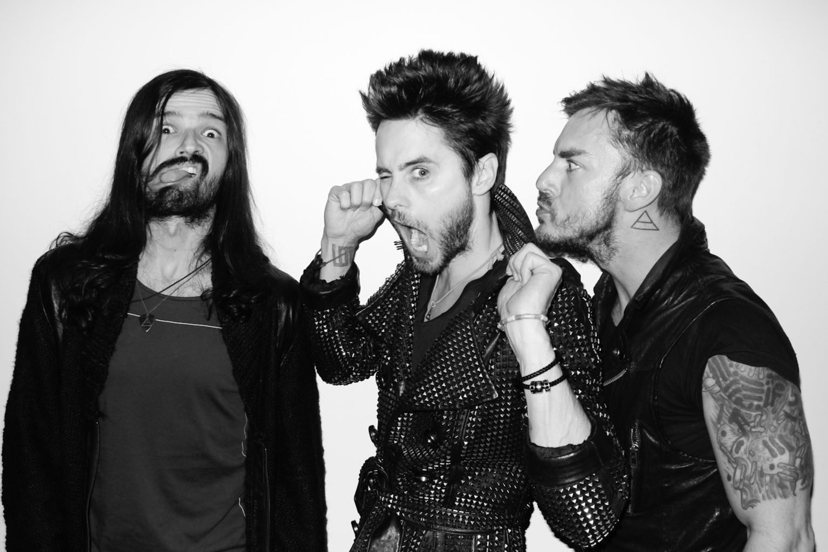
Thirty Seconds to Mars released the self-titled debut album in 2002, produced by Bob Ezrin, Brian Virtue and the band itself. It received generally positive reviews, and was compared to Pink Floyd, Tool, and Brian Eno. The album debuted and peaked at number 107 on the Billboard 200 and number one on the Top Heatseekers. It produced two singles, "Capricorn (A Brand New Name)" and "Edge of the Earth", which reached the top ten on the UK Rock Chart. The former also became a Mainstream Rock top 40 hit and reached number one on the Heatseekers Songs. Over the years, the album has sold more than two million copies worldwide. In 2003, Solon Bixler left the band due to issues primarily related to touring and was replaced by Tomo Milicevic. Thirty Seconds to Mars toured extensively opening concerts for bands such as Our Lady Peace, Sevendust, and Chevelle, and took a slot on the 2003 Lollapalooza tour.

Slide 6

It took three years to record A Beautiful Lie, with the bandmates traveling to four different continents to work with Leto on his film sets. A Beautiful Lie differs notably from the band's self-titled debut album, both musically and lyrically. Whereas the eponymous concept album's lyrics focus on human struggle and astronomical themes, A Beautiful Lie's lyrics are more personal and the music introduces intense screaming vocals and synth effects. "On the first record I created a world, then hid behind it", Leto said. "With A Beautiful Lie, it was time to take a more personal and less cerebral approach. Although this record is still full of conceptual elements and thematic ideas it is ultimately much more wrapped around the heart than the head. It's about brutal honesty, growth, change. It's an incredibly intimate look into a life that is in the crossroads. A raw emotional journey. A story of life, love, death, pain, joy, and passion. Of what it is to be human."

Slide 7
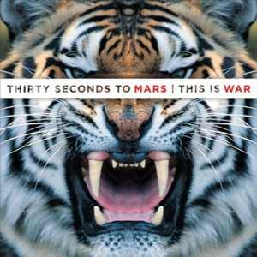
This Is War
Leto described the band's third album, This Is War, as a concept album, saying it was created in an "intense two-year period, where it felt like the whole world was falling apart and massive changes were going on." In a bid to involve their fans for This Is War, Thirty Seconds to Mars held The Summit where they invited fans to provide backing vocals and percussion. At the first, in Los Angeles, people showed up from all over the world, so they repeated The Summit in eight countries and extended the event digitally. The band also invited fans to submit close-up shots of their faces in order to make 2,000 different individual covers for the album. The album and the singles got top stages in world’s charts.
Leto directorial debut film, Artifact, a documentary about Thirty Seconds to Mars battle against record label Virgin Records and the making of This Is War, premiered at the 2012 Toronto International Film Festival on September 14, 2012, and won the BlackBerry People's Choice Documentary Award.

Slide 8
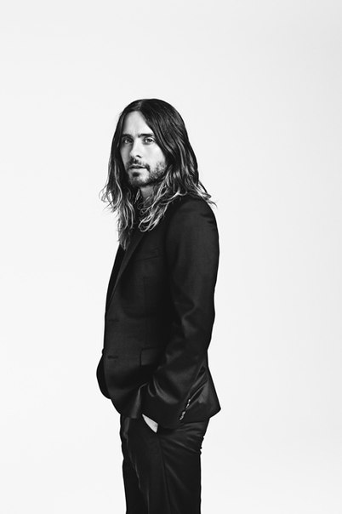
Leto attended the Amnesty International campaign to support human rights, marking the 60th anniversary of the United Nation's Universal Declaration of Human Rights. As part of the campaign, he also made a short film.
In June 2008, Leto and his bandmates joined Habitat for Humanity to work on a home being repaired and renovated through the Habitat for Humanity of Greater Los Angeles Area's "A Brush With Kindness" program.
After the 2010 Haiti earthquake, Leto and his bandmates raised $100,100 for Haitian relief. The charity auction included concert tickets, an exclusive backstage meet and greet, and dinner with the band. Thirty Seconds to Mars has also supported the people of Haiti through the Echelon Project "House for Haiti" and the Hope for Haiti Now: A Global Benefit for Earthquake Relief.

Slide 9
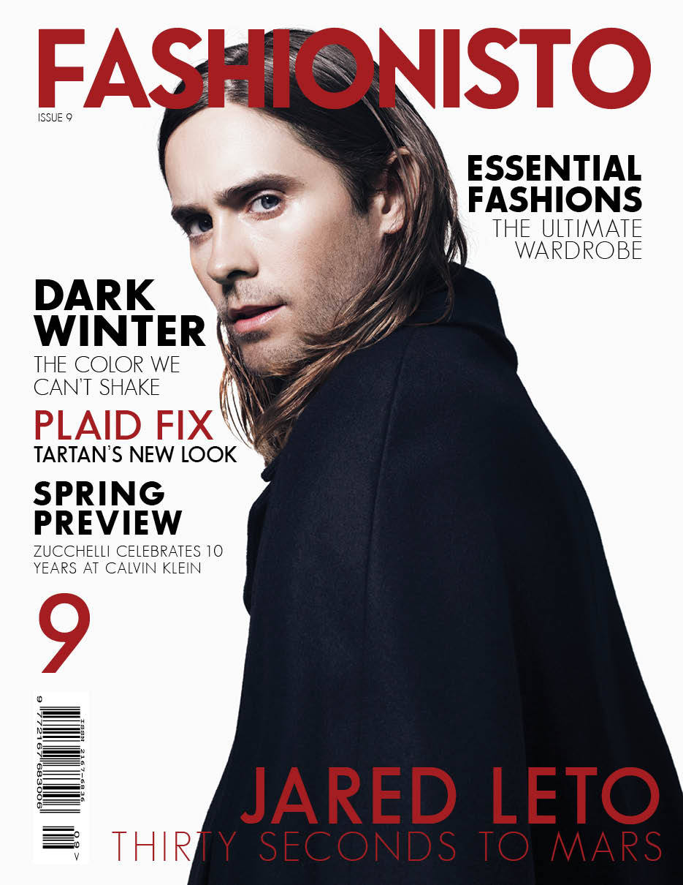
Leto was twice named one of People magazine's "50 Most Beautiful People" in 1996 and 1997, and was listed among the "Teen Idols of the '90s". He appeared on People's "Hottest Bachelors" in 2006 and 2007, and "Best Chests" in 2009.Leto was nominated several times as one of the "Sexiest Vegetarians" by PETA. He won a Chainsaw Award for Prince of Darkness in 2006. In 2011, he was nominated the NME Award for Hottest Man and TRL Award for Best Look. In year 2012 Jared Leto has been placed one of 100 most creative people in business by Fast Company on 72nd position.

Slide 10
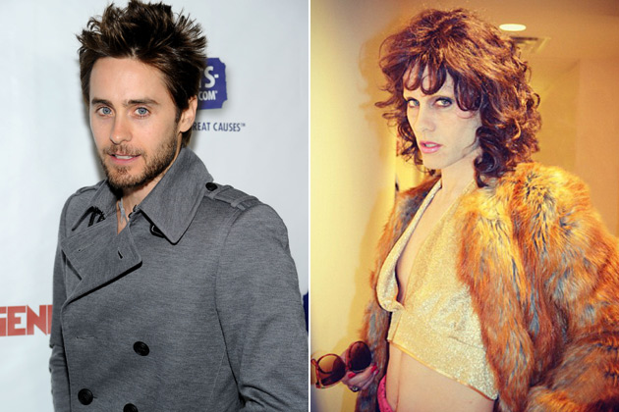
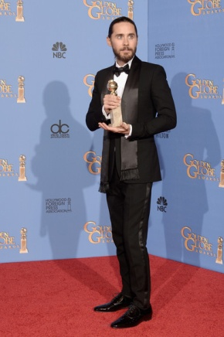
Jared got Golden Globe for Dallas Buyers Club. He was also nominated for an Oscar.

Slide 11

Thank you for your attention!

