Slide 1
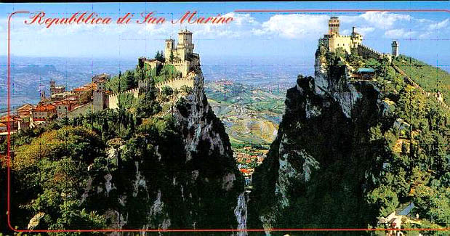
san marino
By Marina Samchuk

Slide 2
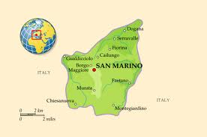
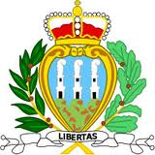
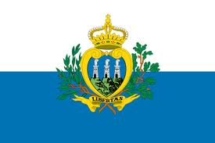
Officially named: The Lightest Republic of San Marino Capital: San Marino Motto: (Latin. Libertas) "Freedom" Anthem: "Inno Nazionale della Repubblica" Based on September 3 301 The official language: Italian The largest city: Serravalle Catholic religion

Slide 3
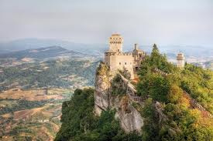
History The legendary foundation of San Marino refers to the beginning of the IV century. According to legend, in 301 AD, a member of one of the first Christian communities from the island of Rab in the Adriatic Sea (present-day Croatia) stonemason Marino's friends took refuge in the Apennines, on top of Monte Titano. Thus, formally of San Marino is considered to be an independent state from September 3, 301 years. In fact, based on an independent settlement can only speak from the VI century, when Italy was divided into many independent and dependent territories. In the first century of its existence, San Marino was under the protectorate of the neighboring Duchy of Urbino, but in 855 gained independence. Heads of state, according to tradition, are the two captains-regent, elected for six months. San Marino is often called the world's oldest republic.
October 8, 1600 adopted a constitution. During the First World War, the Republic of San Marino has become an ally of the Entente. During the Second World War, the republic declared its neutrality, but it did not save her from a two-week occupation. In 1951, the government of San Marino made the decision to open a casino and build a powerful television and radio station. Italy protested and announced a blockade of San Marino. Small state had to give.

Slide 4
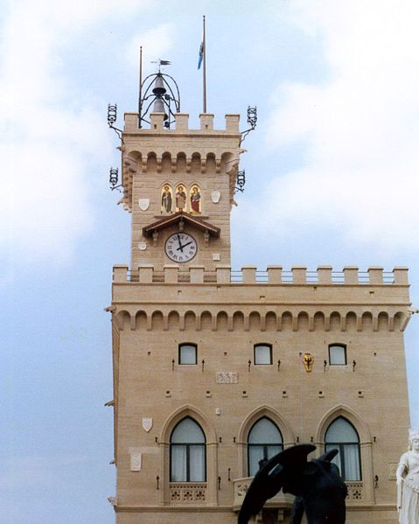
The political system In San Marino, there is a republican form of government. The heads of state are the two captains-regent appointed by the Grand and General Council. Captains Regent are elected for a period of 6 months, from April 1 to October 1 and October 1 to April 1 of each year. They perform the functions of head of state and the exercise of executive power. Large General Council is the parliament of the Republic, it is composed of 60 members, elected by popular vote by proportional representation for a period of 5 years. Arengo, or the Assembly of Heads of families in ancient times was the supreme authority, currently Arengo reserved the right to modify the statutes of the Republic and the "right of petition." This latter law is used to this day - the Captains Regent receive numerous requests, provided by citizens on the first Sunday after the 1st of April and after the 1st of October. Filed a petition must necessarily be examined for 6 months.
Political parties in San Marino
The San Marino Christian Democratic Party (SMHDP) - founded in 1945;
The San Marino Socialist Party (SMSP) - founded in 1986;
The Democratic Party - formed as a result of the conversion in April 1990 in San Marino Communist Party;
San Marino, the Communist Party of Revival;
The San Marino National Alliance;
People's Alliance in San Marino Democrats.
The Parliament Building

Slide 5
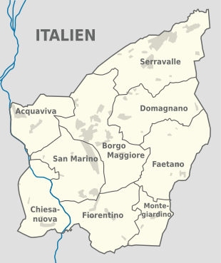
Administrative division
The territory of San Marino is divided into 9 regions, which are called "Castelli» (castelli; letters. "Fortress tower"):
Akkvaviva
Borgo Maggiore
Domagnano
Chiesanuova
Monte Giardino
San Marino
Serravalle
Faetano
Fiorentino

Slide 6
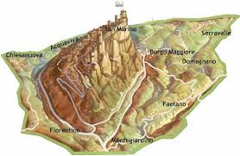
Geographical location
The area of ​​the country is 60.57 km ². The country is located in the south-western slope of the three-headed mountain massif of Monte Titano (738 m above sea level), rising above the rolling plains of the foothills of the Apennines. Rock formations occupy almost 80% of the country's arable land accounts for 16.6% of the area. At the foot of Monte Titano are several castles and villages that lie in the zone of elevated plains.
The climate is subtropical, Mediterranean. The average summer temperature is +24 ° C, in winter about +4 ° C. In this case, due to the elevated position of the country, even in very hot weather is cool, but at night in winter the temperature can drop to -6 ° C. Annual precipitation is 800-900 mm per year, mostly - in the autumn-winter period. In winter, snow rarely falls, but he kept long.
The total length of roads in the state is 104 km.

Slide 7
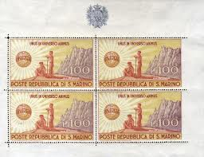
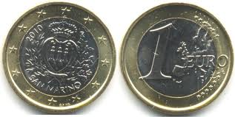
Economy
As of 2008 36.4% of the national production sector is introduced. Banking and insurance account for 18.6%, the government sector - 14.3%, trade - 8.6%, services - 11.3%, construction - 5.5%. Inbound tourism plays a significant role in the economy, the tourism industry in the State involved to 2 million people annually, and more than 3 million tourists visit the country every year.
Agriculture San Marino, a former long time the main branch of the economy of San Marino, in modern times is sheep farming, cultivation of grain crops, viticulture, winemaking

Slide 8
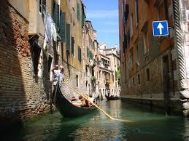
Culture The historic center of San Marino and the mountain of Monte Titano in July 2008, a UNESCO World Heritage Site. Since 1985, the San Marino functioning university. Since 1983, in San Marino, opened the International Academy of Sciences San Marino - an international scientific and educational organization with headquarters in the Slovak town of Komarno. The working languages ​​of the Academy are German, English, French, Italian and Esperanto. The Academy of Sciences of San Marino international awards academic degrees: bachelor's, master's, doctor and doctor highest level.

Slide 9
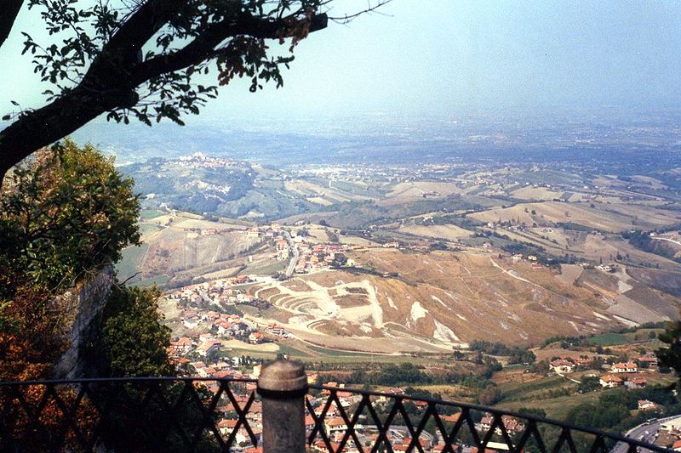
Population The state's population - 32,075 (July 2011). More than 16% of the population under the age of 15 years, 67% - from 15 to 64 years. The median age of the republic - 39.6 years. Population growth in 2003 was nearly 1.4%, the birth rate - 10.49 per 1,000 people., Mortality - 7.86 per 1,000 people., The infant mortality rate - 5.97 per 1,000 live births. The average life expectancy of 81.43 years. About 80% of the population - sanmarintsy, 19% - the Italians. More than 13 thousand citizens living abroad. A large number of sanmarintsy lives outside the country, mainly in Italy and France, the USA and Argentina.
Official language - Italian, population speaks Italian. 93% of the population belong to the Roman Catholic Church.
San Marino has more than 30 settlements. The country's capital city of San Marino (4.6 million inhabitants) is situated on the western slopes of Monte Titano, just below its summit. The city government buildings are located, there are monuments, museums. Transactions are carried out in Borgo Maggiore (5.2 million), located at 185 m below the capital. The largest settlement - Serravalle (9.2 million). The number of inhabitants in all the other towns did not exceed 1,000.

Slide 10
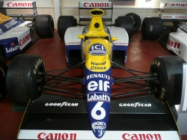
Attractions The San Marino Car Museum
The San Marino Car Museum) - one of the most popular tourist sites of this small European country.
In the Automobile Museum of San Marino you will see a collection of more than 100 vintage cars and motorcycles. Here there are both traditional cars and motorcycles period of the 1900s and the current models of the day.
There are several models of Formula I. The museum is extremely popular with tourists, as it is possible to witness the variety of classic cars, as well as many famous modern models.

Slide 11
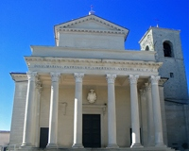
Basilica del Santo was built in the XIX century on the foundation that was there once Romanesque parish church. Here you will find a rich collection of priceless paintings and sculptures, for example, the statue of Saint Marino - work Tavolini Adamo, a student of Canova. The holidays open until 11.00 pm On weekdays, open until 17.00 pm (in summer to 18.00 pm)

Slide 12
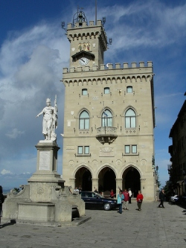
National Palace (Palazzo Pubblico) - this is the city hall of San Marino, as well as the building of the Government. It hosts the official ceremony. In addition, it houses several critical public institutions, such as Parliament, the Congress and the State Council of the Twelve. The detachment of the Border Guard Patrol Services, Rocca is a guard of honor at the State Palace on Freedom Square - Changing of the Guard ceremony takes place every hour from 8.30 to 18.30 and during the summer months, or, to be precise, from mid-May to late September.

Slide 13
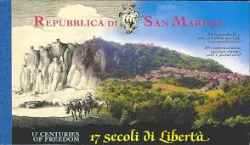
Thank you for your attention!

