Slide 1
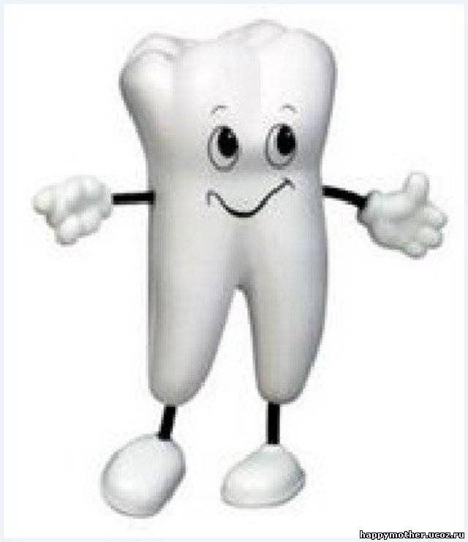
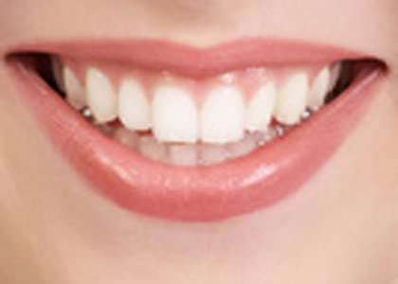
Teeth
Performed:
Lubomir Kovalchuk

Slide 2
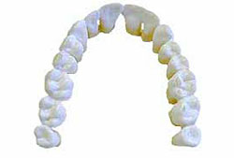
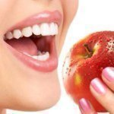
Teeth - bone formation in the oral cavity of vertebrates, and are used to rozkushuvannya chewing food, and to attack and defense.

Slide 3
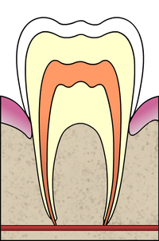
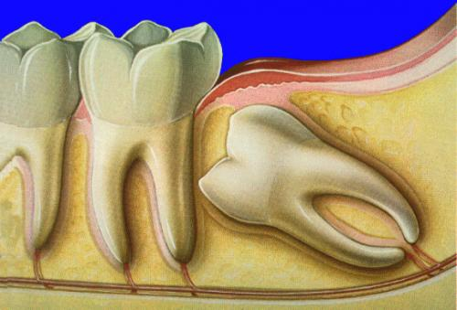
They are located in the cells of the jaws and communicating with their connections, which are a kind of shock absorbers during chewing. In 32 adult teeth: two incisors, one canine, two premolars and three molars on each side of each jaw.

Slide 4
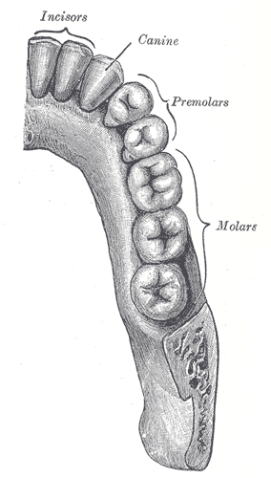
Cutters have cutting edge to nibble food, canines tear food and lowercase molars crush and grind it. Due to the increased surface grinding food digestive enzymes that facilitate digestion.

Slide 5
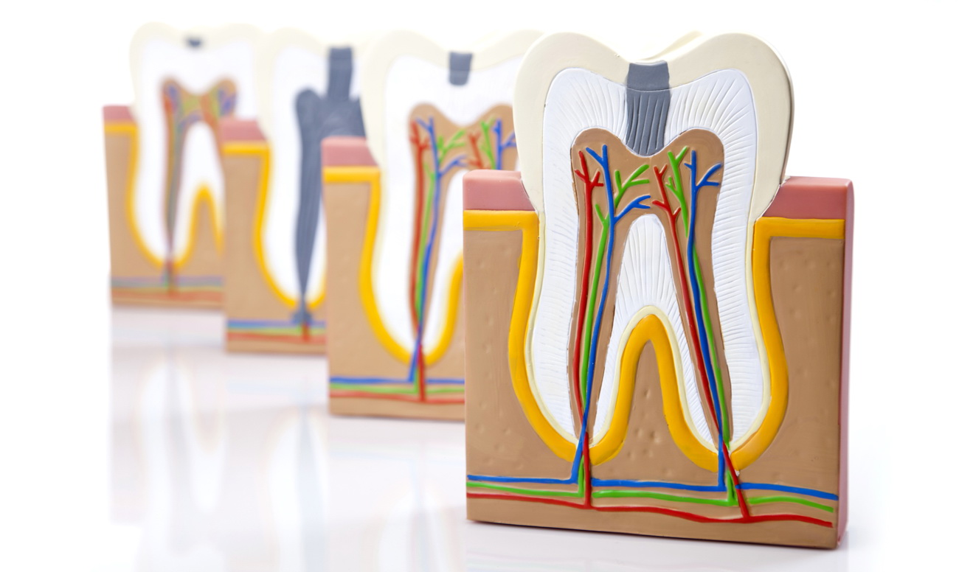
The structure of the tooth - anatomy - isolated crown, neck and root.

Slide 6
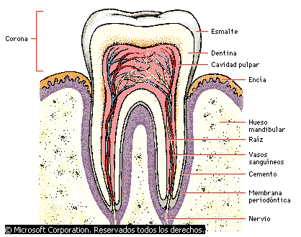
Crown - this is the part which is partially or completely protrudes above the gum after eruption. External hard dental crown is covered with enamel, comprising a compound florets. Under it is a dense substance similar to bone (dentin). The root is surrounded by a layer of special material - dental cement, by which it is attached to the jaw bone

Slide 7
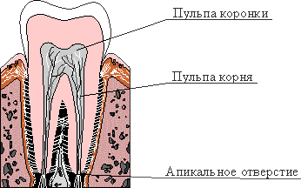
inside the tooth cavity filled with pulp formed by loose connective tissue that contains blood vessels and sensory nerves.

Slide 8
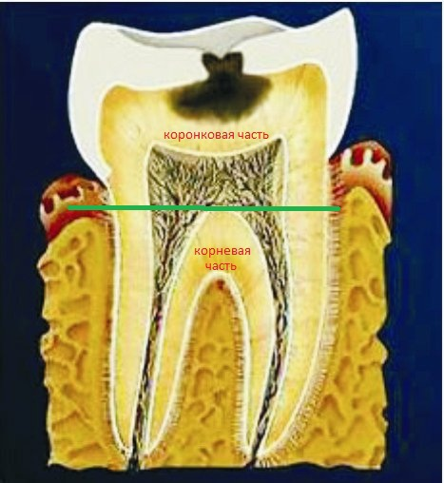
Caries
Cavities - pathological process is the gradual destruction of bone tissue or teeth.

Slide 9
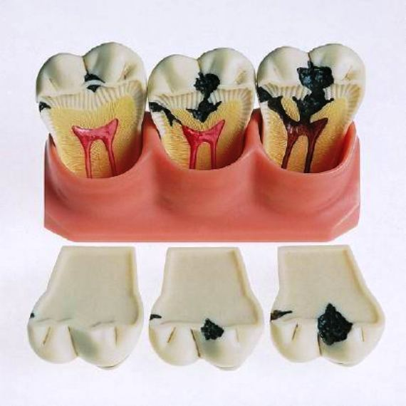
Reason dental bone - dystrophic or infection in the bone or nadkostnytsi, leading to necrosis of bone sections with subsequent absorption or rejection of dead mass and bone formation defect. Cavities can accompany some specific inflammatory processes (eg, tuberculosis, syphilis)

Slide 10
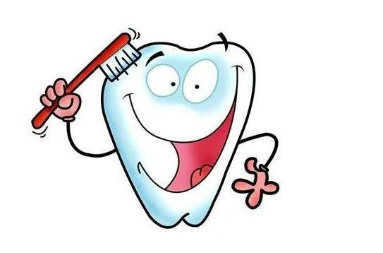
Thank you!

