Slide 1

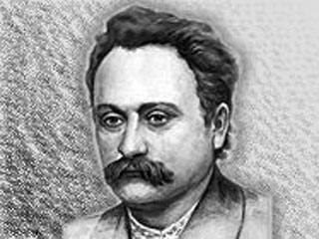
Ivan Franko
підзаголовок

Slide 2
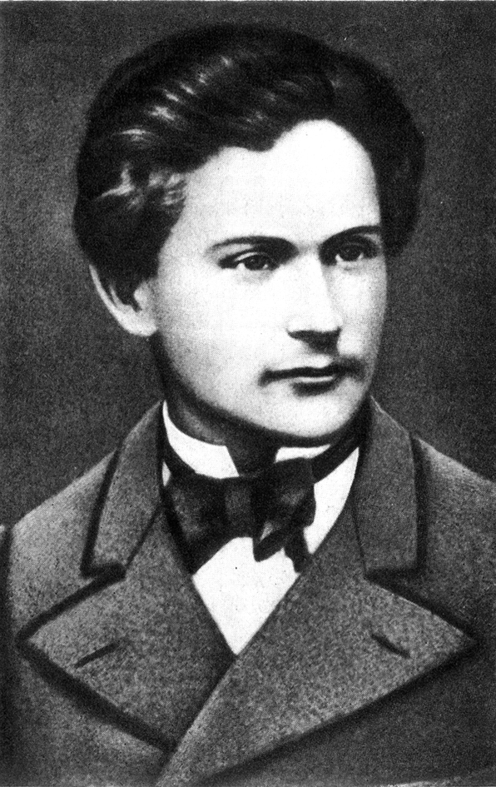
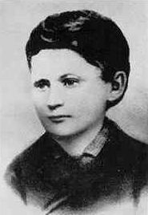
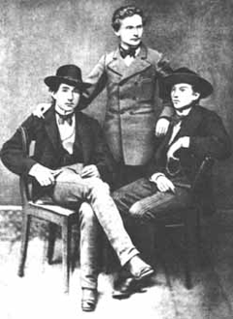
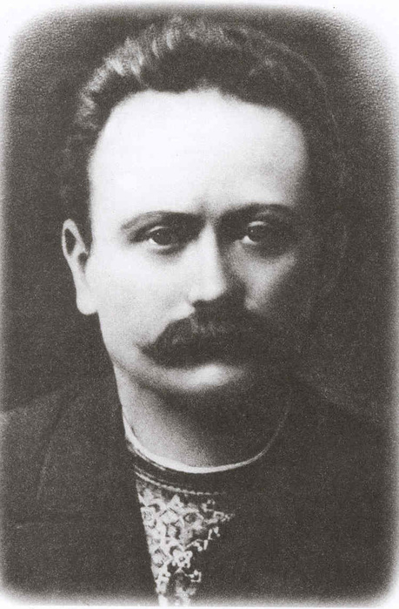
Заголовок
One of the innovators of all genres of literature was Ivan Franko. He raised the post-Shevchenko Ukrainian poetry of the late 19th and early 20th century to new heights. He did the same in prose. We always remember the volume of poetry «Heights and Depths», the novel «Boryslav is laughing», the drama «Stolen Happiness», etc. He devoted much attention to translations from foreign languages. His merits as a thinker and scholar were great in many fields: the history and theory of literature, folklore, political economy, history, ethnography.
підзаголовок

Slide 3
Заголовок
Ivan Yakovych Franko was a Ukrainian poet, writer, social and literary critic, journalist, interpreter, economist, political activist, doctor of philosophy, ethnographer, the author of the first detective novels and modern poetry in the Ukrainian language.
підзаголовок

Slide 4
Заголовок
These two sonnets were written while Franko was still a schoolboy, seventeen years of age. In the first one, the poet has in mind one of the many grave mounds or funeral barrows on the steppe beneath which lie the bones of those who fell in battle against the Tatars or other invaders. To him the ancient and anonymous folk songs represent the soul of his people with its perennial resurgence from the disasters of the past. The second one came as the result of his acquaintance with Kotlyarevsky's burlesque of Virgil's Aeneid which appeared in 1798. Its importance lies in the fact that Kotlyarevsky was the first writer in modern times to use the speech of the Ukrainian people as a literary medium and hence he is regarded as the father of modern Ukrainian literature.
підзаголовок

Slide 5
Заголовок
FOLK SONG
Behold the spring which gushes from that grave
And gurgles o'er the steppe in tear-like stream!
On its clear surface doth the moonlight gleam,
The beaming sun plays on its crystal wave.
From out earth's bosom pulse those waters clear.
The living movement sleeps not, knows no bound.
The quickening waters spread new life around
To thousands of Spring's children growing there.
That spring with its unceasing magic flow
Is like my people's soul—though wrapped in grief,
It still sings to the heart of long ago.
As that spring's source lies in earth's hidden parts,
So from mysterious depths do folk songs rise
With their pure fervour to inflame our hearts.
KOTLYAREVSKY
A mighty eagle on a snowy height
Sat gazing all around with his keen eye,
When lo, he started upwards towards the sky
And on his splendid pinions took his flight.
His sweeping wing brushed off a clod of snow;
It fell and started other clods downhill;
They gathered force and strength and size until
An avalanche went roaring down below.
So Kotlyarevsky happily once spoke,
Began to sing in our Ukrainian tongue—
Though what he sang then seemed to be a joke,
Yet in it lay an earnest great and strong.
That spark did not die out amongst our folk,
But blazed and warmed us all ere long.
підзаголовок

Slide 6
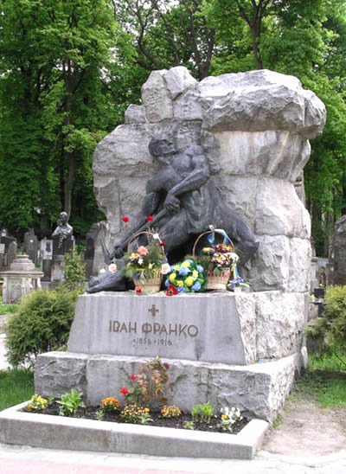
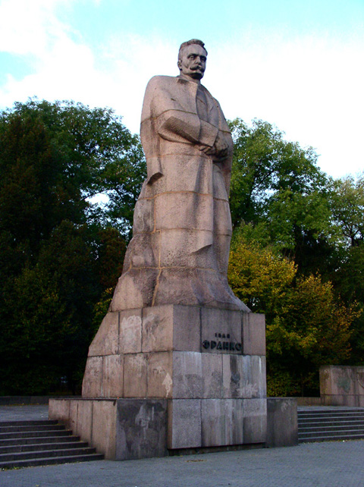
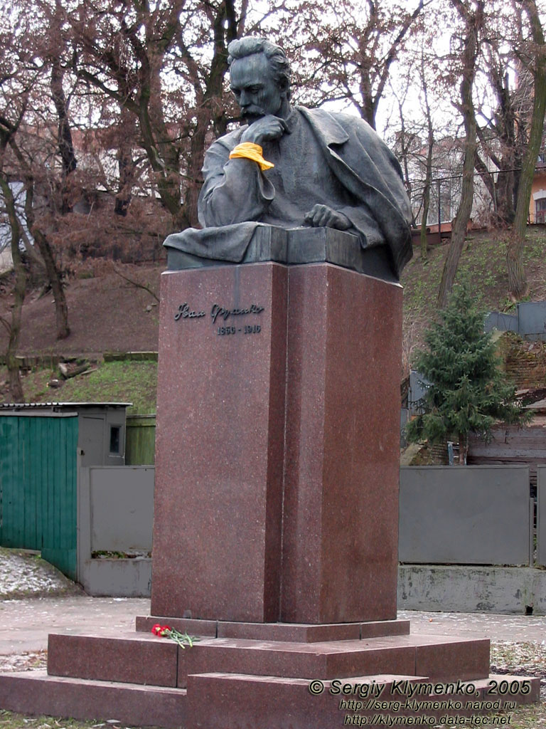
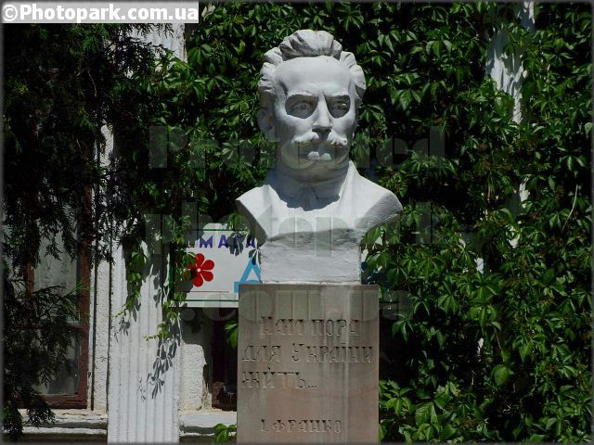
Заголовок
Today the memory of the great Ukrainian classic is honoured by his countrymen throughout our land.
His works are read and translated all over the world. They have been published in 19 languages and in editions totalling nine million copies.
The nature of Franko's works can be understood by quoting his own words: «I consider it's my duty to dedicate my life's work to the common people, I learned two Rules of life at a very early age: the first, a sense of duty to the people, the second, the necessity for constant work».
підзаголовок

Slide 7
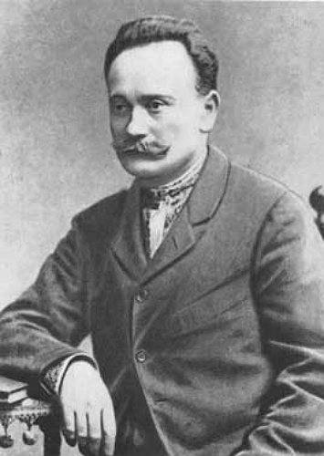

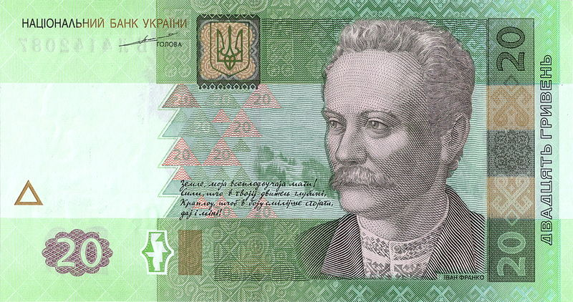
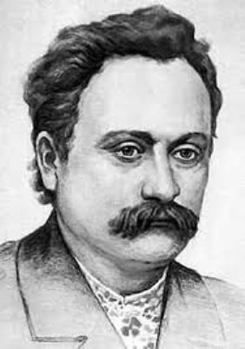
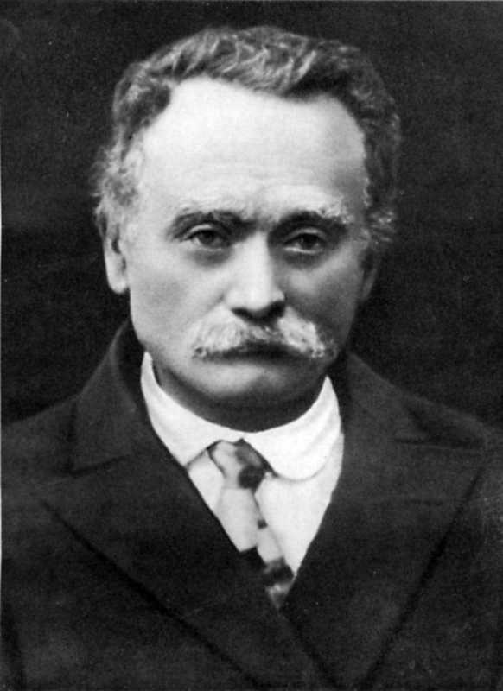
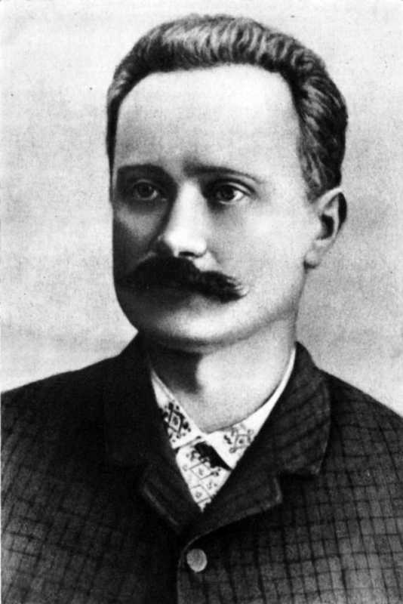
Заголовок
підзаголовок

