Slide 1
Christina Aguilera
Performed:
student of 11th class
Marta Mankina

Slide 2
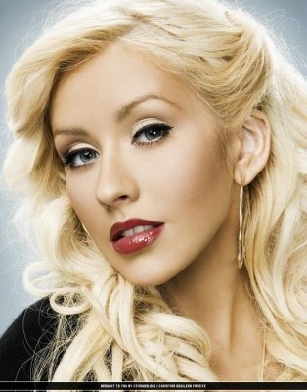
Biography:
Date of Birth: December 18, 1980 (zodiac Sagittarius)
Place of Birth: Staten Island, New York, USA
Activities: American pop singer.
Achievements: The winner of four awards "Grammy" awards and one Latin "Grammy". "Rolling Stone" named her one of the 100 Greatest Artists of All Time, so she became the youngest and the only representative of under 30 years.

Slide 3
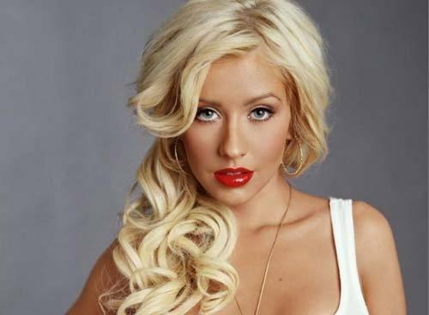
Christina Aguilera was born December 18, 1980 in New York. He is the author of his own songs, actress, producer and director. Multiple winner of the awards "Grammy." Christina Aguilera is considered the second best-selling singer decade after Madonna.

Slide 4
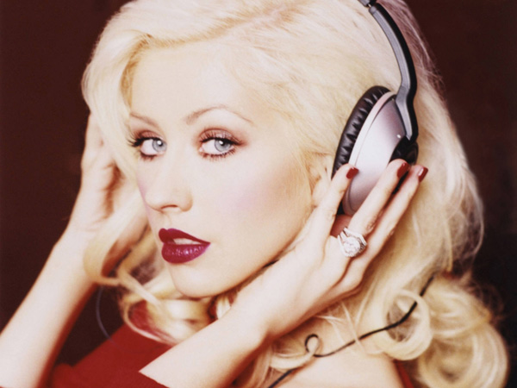
Aguilera started singing since childhood, has participated in many music competitions and talent shows . Specifically , in 1993, at the age of 13 passed the selection for the popular TV show Disney "New Mickey Mouse Club ," where she performed with Britney Spears and Justin Timberlake . After closing the show in 1994 began a solo career.

Slide 5
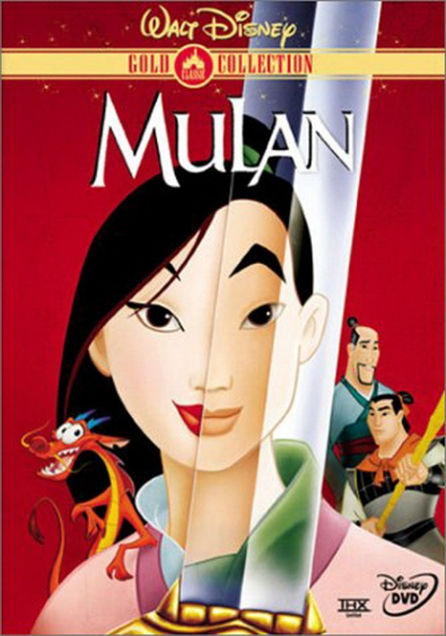
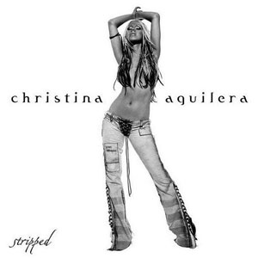
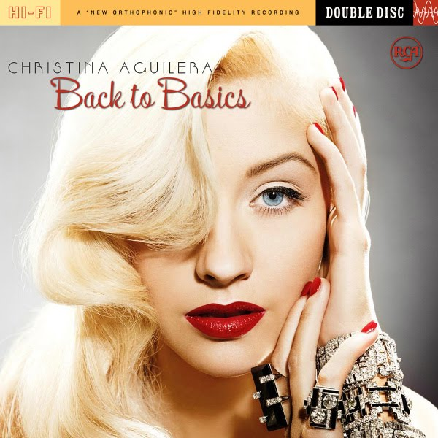
In 1998 he recorded the song Reflection to the animated film " Mulan ", and then signed a recording contract with RCA Records. Ever since released three full studio albums (Christina Aguilera, 1999 ; Stripped, 2002 ; Back to Basics, 2006) and a dozen singles. In 2008, Christina Aguilera is working on a fourth album , which is scheduled for release next year 2009 .

Slide 6
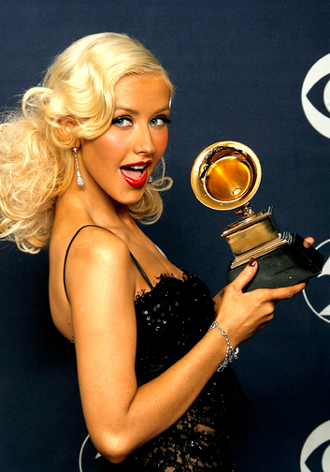
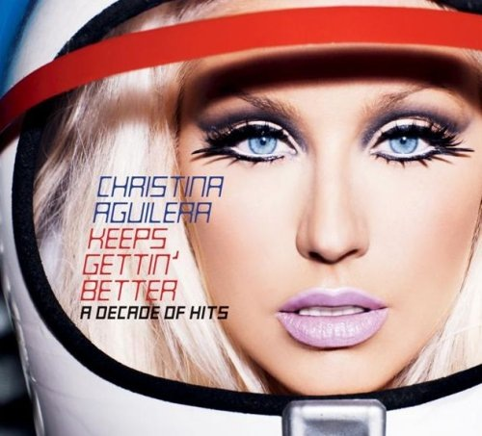
November 11, 2008 in the U.S. the album Keeps Gettin Better, which included the best hits by decade career. In May 2010, on the shelves of music stores with ' new album appeared «Bi-On-iC», but the tour in support of the U.S. was canceled due to poor album sales as well as tickets, although the official reason was the time in film productions . Christina Aguilera - 4 laureate awards " Grammy " and many other awards.

Slide 7
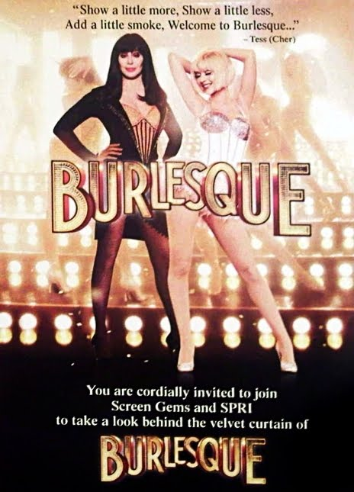
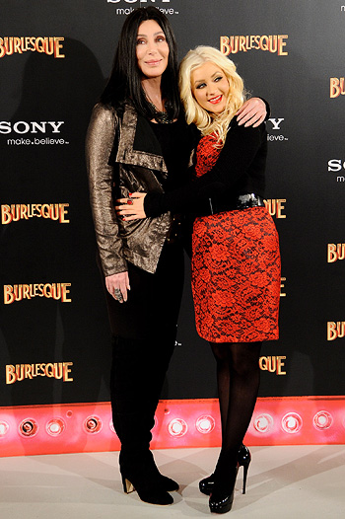
2010 singer made ​​her debut in the movie : alongside Cher played a major role in the musical film " Burlesque ."

Slide 8
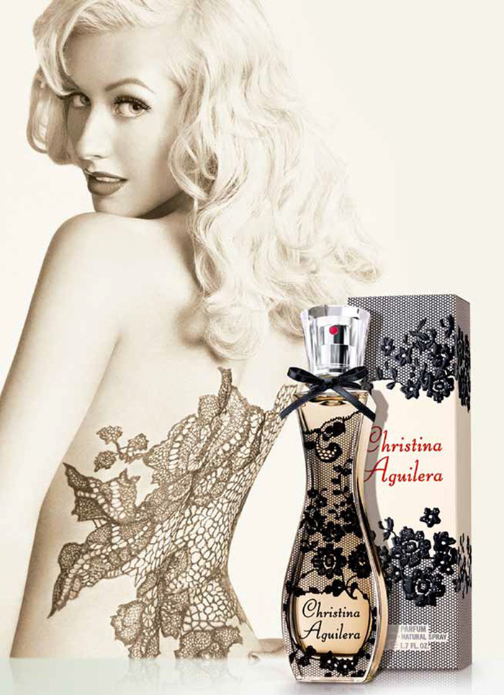
Own brand
In 2007, Christina Aguilera released her self-titled first fragrance "Christina Aguilera".

Slide 9
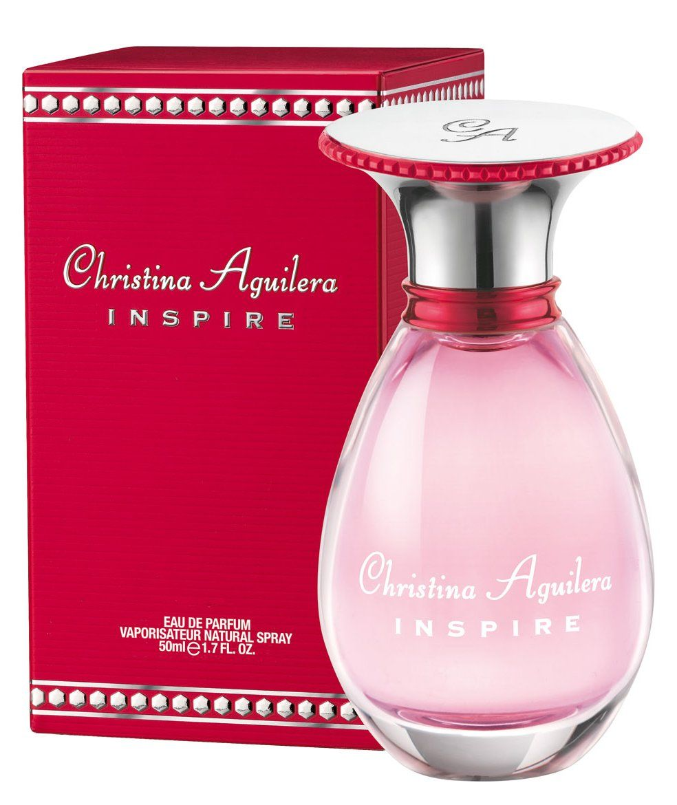
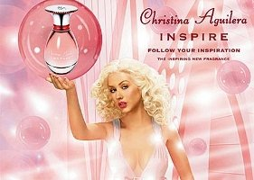
In 2008 came the next flavor of the singer "Inspire".

Slide 10
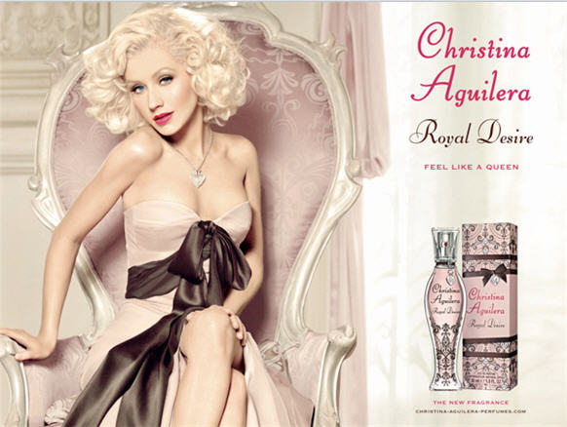
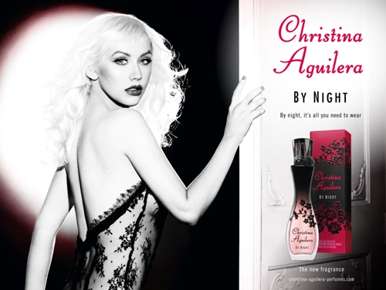
2009 was no exception. That's when Aguilera released the spirits "Christina Aguilera By Night". In 2010 went on sale perfume "Royal Desire".

Slide 11
Thank you! ☺

