Slide 1
British lifestyle
student completed 7-A class
Pysarenko Yulia

Slide 2
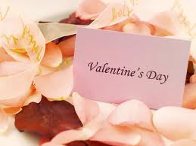
British Holidays
St. Valentine's Day, February 14
Valentine's Day - patron saint of lovers. On this day, lovers give each other special cards ("Valentine").

Slide 3
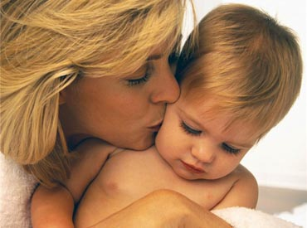
British Holidays
Mother's Day, March 26
In Victorian times, children were sent to work away from home at an early age, and the money earned by them are sent to the family budget. One day, the children were allowed to stay at home with their parents. They brought their mothers (and grandmothers), small gifts, such as flowers or bouquets of fresh eggs. Now, on this day children give their mothers and grandmothers bouquets of flowers and perform for them all the housework.

Slide 4

British Holidays
April Fool's Day, April 1
This holiday has appeared in the Middle Ages, though then he had some other kind: the day the servants become the masters and the masters servants. For centuries the tradition has changed, and now April 1 - the day of jokes and pranks.

Slide 5
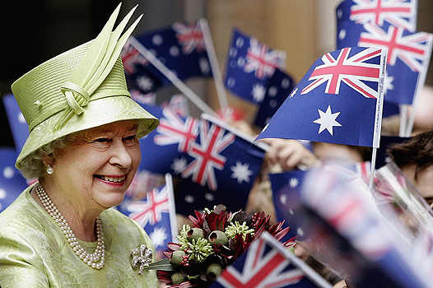
British Holidays
Birthday of Queen Elizabeth II, April 21
On this day, all the newspapers, radio and television stations congratulate the queen with her birthday.

Slide 6
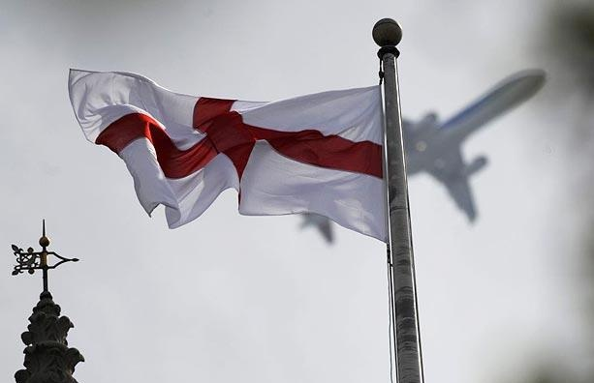
British Holidays
St. George's Day, April 23
Day of the patron saint of England, St George, which honored for what he had slain the dragon, which terrorized several English villages. In essence, this is the English version of St. Patrick's Day. On this day, raise the flag of England, known as the "Cross of St. George" (the St. George Cross). British wear red roses, symbol of England, for the holiday table, they prepare traditional English dishes such as roast beef and Yorkshire pudding, sausage rolls (toad-in-the-hole), etc. Also, on this day they sing English folk songs.

Slide 7
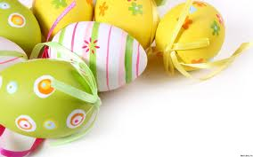
British Holidays
Easter (Easter), April
This day for many is more important religious holiday than Christmas. Many UK residents are present at the Easter service. Easter service on Saturday night for more than two hours, beginning at 9:30 pm and ending at midnight. After service, congratulate each other on the end of Lent and the beginning of the new year (by the way, to show the beginning of a new year and a new life, many of which is decorated with tree branches with swollen buds, daffodils and decorated eggs. After service, come home and eat buns (this is our way, and they have - Easter Simnel cake), which is a cake similar to Christmas, but decorated with marzipan, representing the 12 apostles of Jesus Christ.

Slide 8
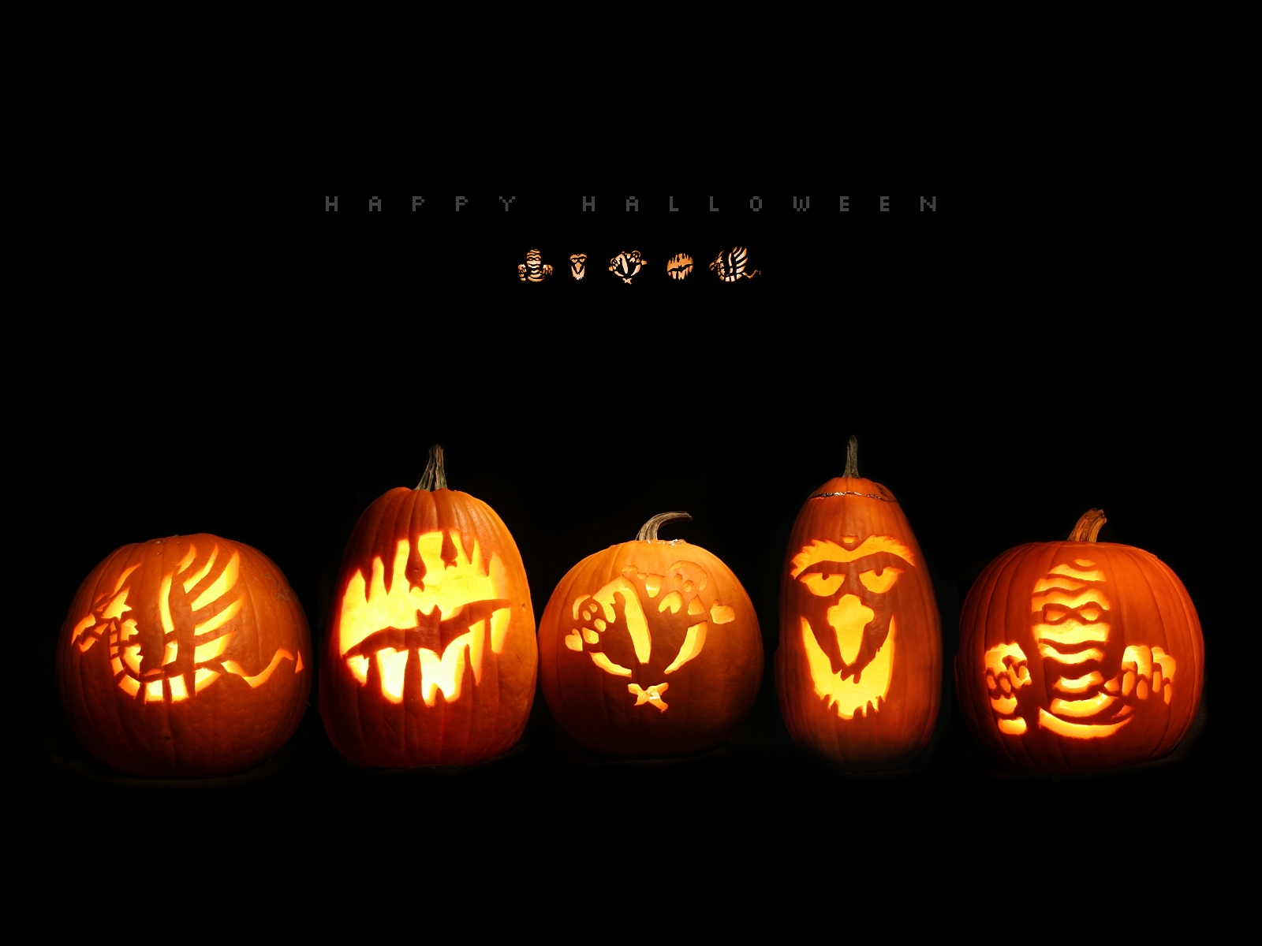
British Holidays
The evening before All Saints' Day, when the spirits and ghosts are released and roam the streets in search of people. In the old people in this day did not go outside and locked all the windows and doors to keep evil spirits to enter the house. Today is celebrated fun and noisy. Children dress up in costumes and monsters walk the neighbor's home, demanding sweets. Also on this day masquerades suit and put the window hollow gourd with carved eyes and mouth and a candle inside to scare away the spirits.

Slide 9

British Holidays
Boxing Day, December 26
The name of the holiday is not from boxing, but from the word 'box' (Boxes). Traditionally on this day in churches open boxes of donations and their contents given to the poor. Earlier in the day the servants to go home for a celebratory dinner with the family. At its core, the holiday is an additional weekend after Christmas.

Slide 10
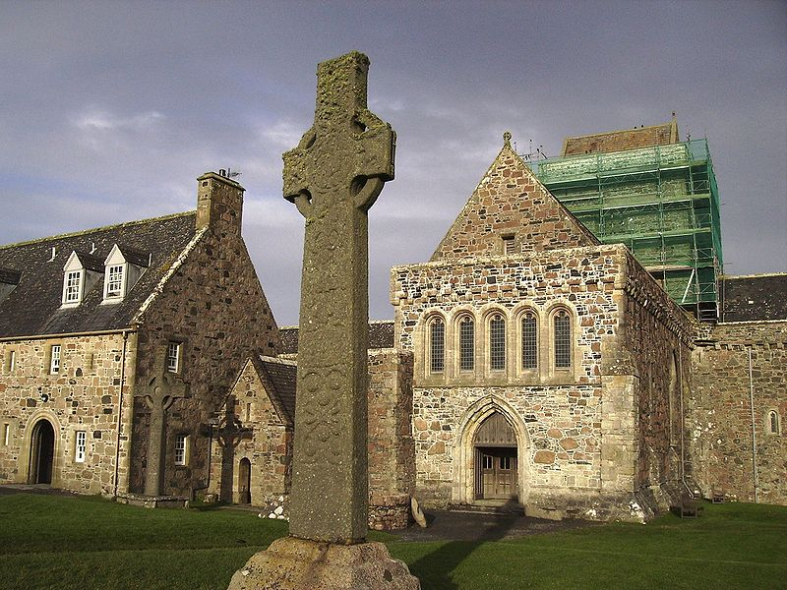

Religion
In the UK, free exercise of religion. Officially recognized in England the English Church, numbering more than 25 million believers, but the Scottish church has about one million members. There are a number of churches, of which the largest is Methodist, which has about half a million members.
Officials in the UK are considered recognized only two churches - is the English and Scottish.
In English schools as well as schools in Scotland and Wales is a compulsory subject, which studies the major world religions. Huge emphasis in the study of this course is given to Christianity and respect for different religions.
In English schools is mandatory to be performed daily prayers, though, when parents are against this measure, they can give them.

Slide 11
Culture
England - this is a country with a rich history and traditions. England is famous for various festivals and exhibitions, such as the Rochester sweeps festival, the festival of colors, festival of "The Beatles" in Liverpool, Robin Hood festival, music festivals, the Druids ceremony, the royal regatta. In England quite common gardening. In no other country is not so well-kept lawns, parks, lawns and gardens.
Traditional pursuits include sports, hunting and fishing. In the UK, a huge number of followers of field hockey, tennis, basketball and football. Today have become very popular horse riding, golf, fox hunting and polo. It is tradition and restraint in judgments, it is seen as respect for the other person.

Slide 12

A little bit about the tea ceremony
According to the English tea etiquette to have several varieties of tea. In the living room near the fireplace put the tea table, covered with a monochromatic cloth: blue or white. But this is not a simple tea party, and the whole ceremony, important elements of which are: a kettle with tea, tea pair, jug of hot water, milk or cream, dessert plates, fork and knife for each of the guests, a tea strainer with stand, teaspoons, sugar slices, sugar tongs and a woolen cover that fits over the kettle.

Slide 13
