Slide 1
Paradise Lost
Author - John Milton

Slide 2
Brief info
Paradise Lost is an epic poem in blank verse by the 17th-century English poet John Milton. It was originally published in 1667 in ten books, with a total of over ten thousand individual lines of verse. A second edition followed in 1674, changed into twelve books (in the manner of the division of Virgil's Aeneid) with minor revisions throughout and a note on the versification.
The poem concerns the Biblical story of the Fall of Man: the temptation of Adam and Eve by the fallen angel Satan and their expulsion from the Garden of Eden. Milton's purpose, stated in Book I, is to "justify the ways of God to men".[2] Paradise Lost is widely considered one of the greatest literary works in the English language.

Slide 3
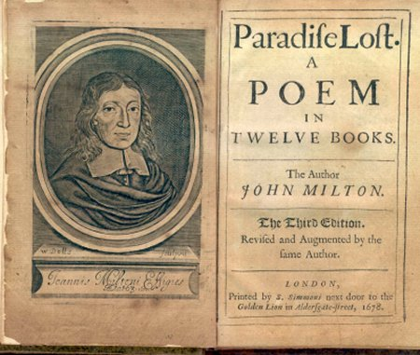

Slide 4
Characters

Slide 5
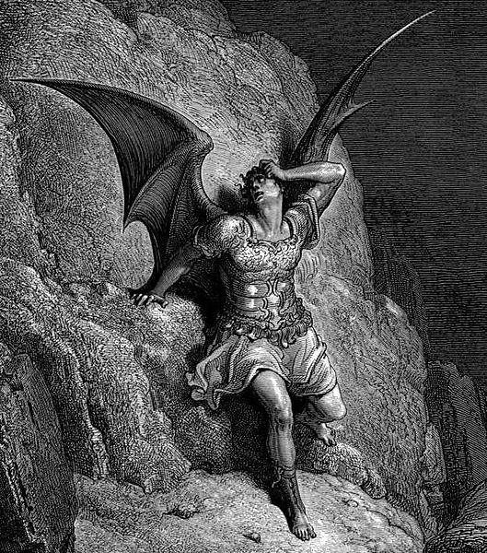
Satan
Satan is the first major character introduced in the poem. Formerly the most beautiful of all angels in Heaven, he's a tragic figure best described by the now-famous quote "Better to reign in Hell than to serve in Heaven".
Satan is deeply arrogant, albeit powerful and charismatic. Satan's persuasive powers are evident throughout the book; not only is he cunning and deceptive, but he also is able to rally the angels to continue in the rebellion after their agonizing defeat in the Angelic War. He argues that God rules as a tyrant and that all the angels ought to rule as gods.

Slide 6
Adam
Adam is the first human created by God. Though initially alone, Adam demands a mate from God. Considered God's prized creation, Adam, along with his wife, rules over all the creatures of the world and reside in the Garden of Eden. He is more intelligent and curious about external ideas than Eve. He is completely infatuated with Eve, which while pure in and of itself, eventually contributes to his reasons for joining Eve in disobedience to God.
As opposed to the Biblical Adam, this version of Adam is given a glimpse of the future of mankind (this includes a synopsis of stories from the Old and New Testaments), by the angel Michael, before he has to leave Paradise.

Slide 7
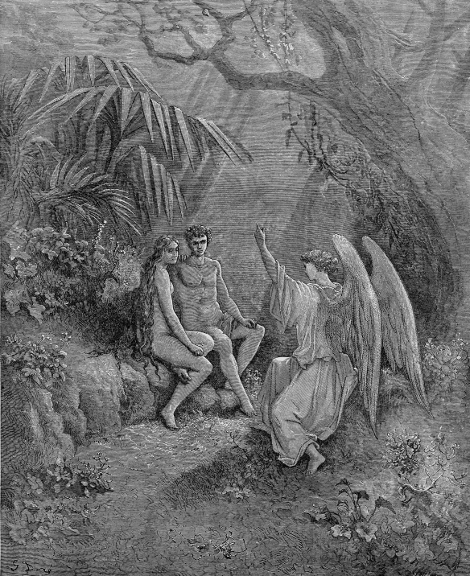
Angel Michael explained 'The Law of Temperance' to Adam, the first created man to face the threat of death.

Slide 8
Eve
Eve is the second human created by God, taken from one of Adam's ribs and shaped into a female form of Adam. In her innocence, she is the model of a good wife, graceful and submissive to Adam. Though happy, she longs for knowledge and, more specifically, self-knowledge. Eve is extremely beautiful and thoroughly in love with Adam, though may feel suffocated by his constant presence. One day, she convinces Adam that it would be good for them to split up and work different parts of the Garden. In her solitude, she is tempted by Satan to sin against God. Adam shortly follows along with her.

Slide 9
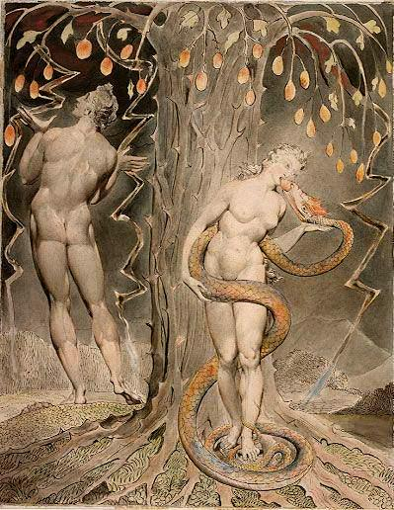
William Blake, The Temptation and Fall of Eve, 1808 (illustration of Milton's Paradise Lost)

Slide 10
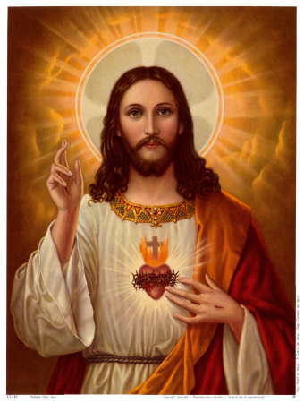
The Son of God
The Son of God is the spirit that will become Jesus Christ, though he is never named explicitly, since he has not yet entered human form. He is the ultimate hero of the epic and infinitely powerful, singlehandedly defeating Satan and his followers when they violently rebel against God and driving them into Hell. The Son of God tells Adam and Eve about God's judgment after their sin. However, he sacrificially volunteers to eventually journey to the World, become a man himself, and redeem the Fall of Man through his own death and resurrection. In the final scene, a vision of Salvation through the Son of God is revealed to Adam by Michael. Still, the name, Jesus of Nazareth, and the details of Jesus' story are not depicted in the poem.

Slide 11
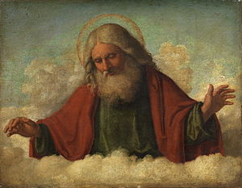
God the Father
God the Father is the creator of Heaven, Hell, the World, and of everyone and everything there is. He desires glory and praise from all his creations. He is an all-powerful, all-knowing, infinitely good being who cannot be overthrown by even the great army of angels Satan incites against him. The poem begins with the purpose of justifying the ways of God to men, so God often converses with the Son of God concerning his plans and reveals his motives regarding his actions. The poem portrays God’s process of creation in the way that Milton believed it was done, that God created Heaven, Earth, Hell, and all the creatures that inhabit these separate planes from part of Himself, not out of nothing.

Slide 12
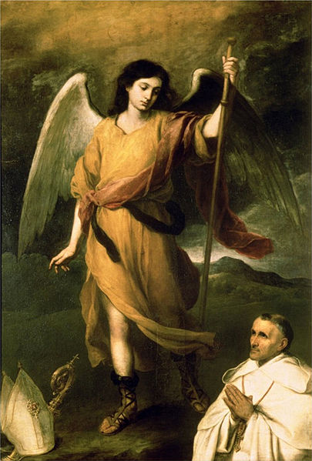
Raphael
Raphael is an angel who is sent by God to warn Adam about Satan's infiltration of Eden and to warn him that Satan is going to try to curse Adam and Eve. He also has a lengthy discussion with the curious Adam regarding creation and events which transpired in Heaven.

Slide 13
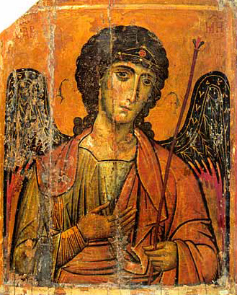
Michael
Michael is a mighty archangel who fought for God in the Angelic War. In the first battle, he wounds Satan terribly with a powerful sword that God designed to even cut through the substance of angels. After Adam and Eve disobey God by eating from the Tree of Knowledge, God sends the angel Michael to visit Adam and Eve. His duty is to escort Adam and Eve out of Paradise. But before this happens, Michael shows Adam visions of the future which cover an outline of the Bible, from the story of Cain and Abel in Genesis, up through the story of Jesus Christ in the New Testament.

