Slide 1
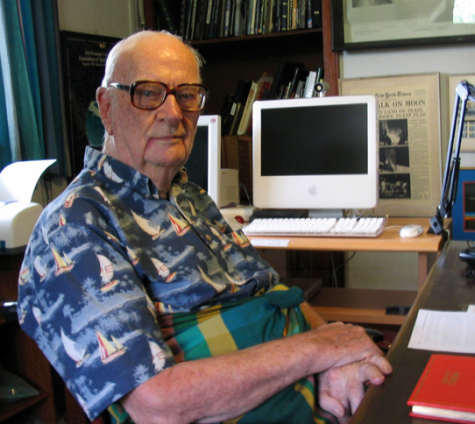
Sir Arthur Charles Clarke

Slide 2
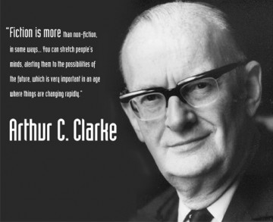
Who is Arthur C. Clarke
Sir Arthur Charles Clarke was a British science fiction writer and inventor, and futurist.
He is famous for his short stories and novels.

Slide 3
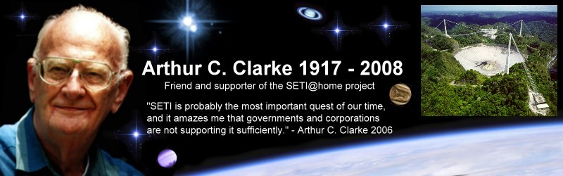
Life and works
Clarke was born in Minehead, Somerset, England.
While Clarke had a few stories published in fanzines, between 1937 and 1945, his first professional sale appeared in Astounding Science Fiction in 1946: "Loophole" was published in April.
Along with his writing Clarke briefly worked as Assistant Editor of Science Abstracts (1949) before devoting himself to writing full-time from 1951 onward.
In 1999, Clark received a knighthood from Queen Elizabeth II.

Slide 4
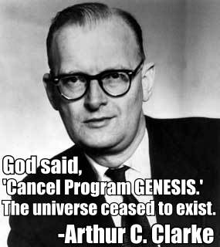
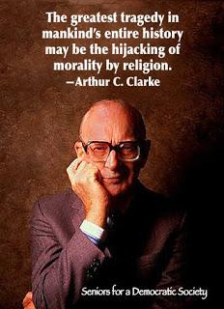
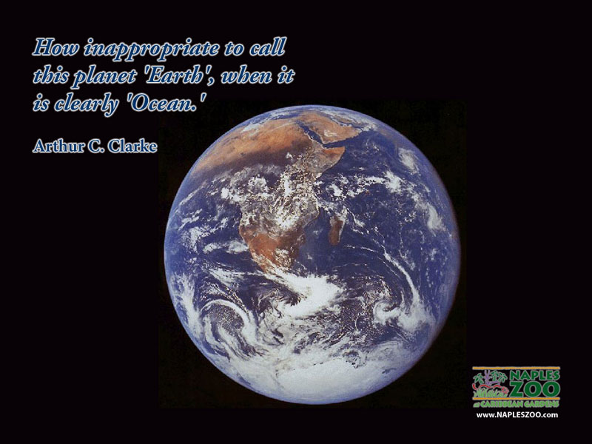
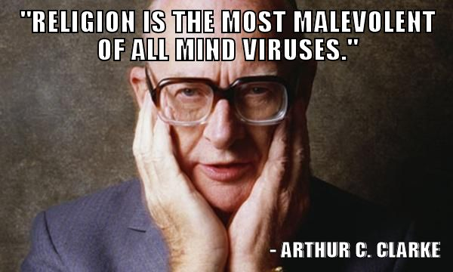
Quotes

Slide 5
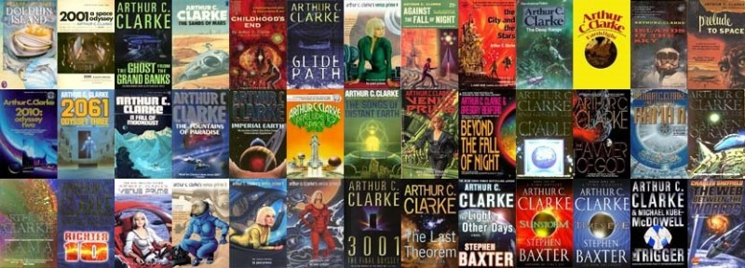
Books
Arthur C. Clarke wrote more than 200 novels

Slide 6
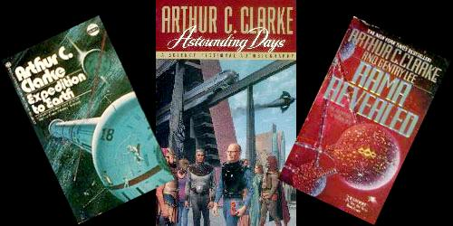
Novels
Among the novels by Arthur C. Clarke, best known are "Childhood's End" (1953), "The City and the Stars" (1956), "Rendezvous with Rama" (1973), "The Fountains of Paradise" (1979).

