Slide 1
Canada,
New Zealand, Australia

Slide 2
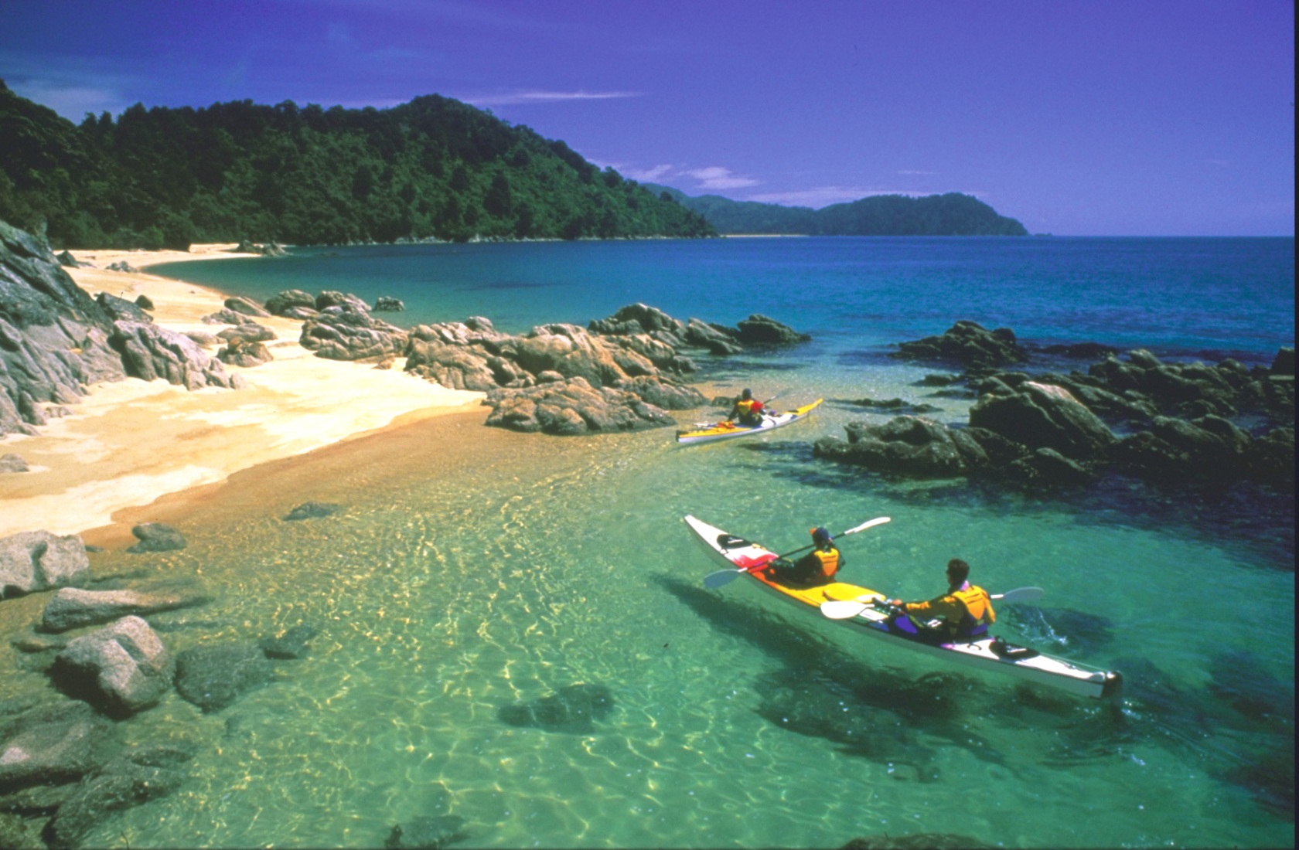
New Zealand

Slide 3
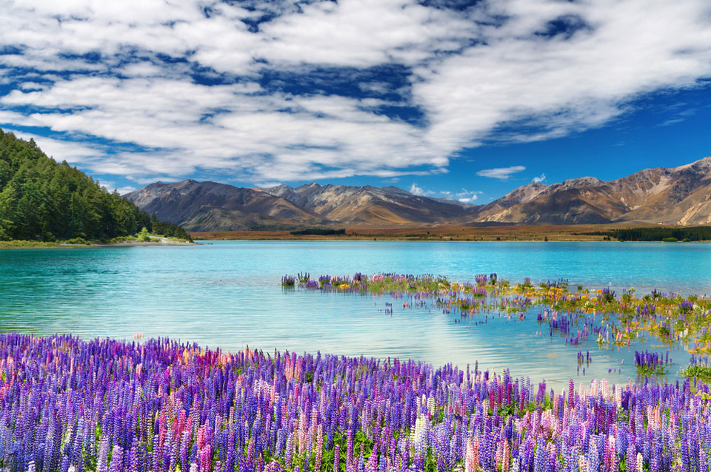
New Zealand is an island country in the southwestern Pacific Ocean. The country geographically comprises two main landmasses – that of the North Island, or Te Ika-a-Māui, and the South Island, or Te Waipounamu – and numerous smaller islands.

Slide 4
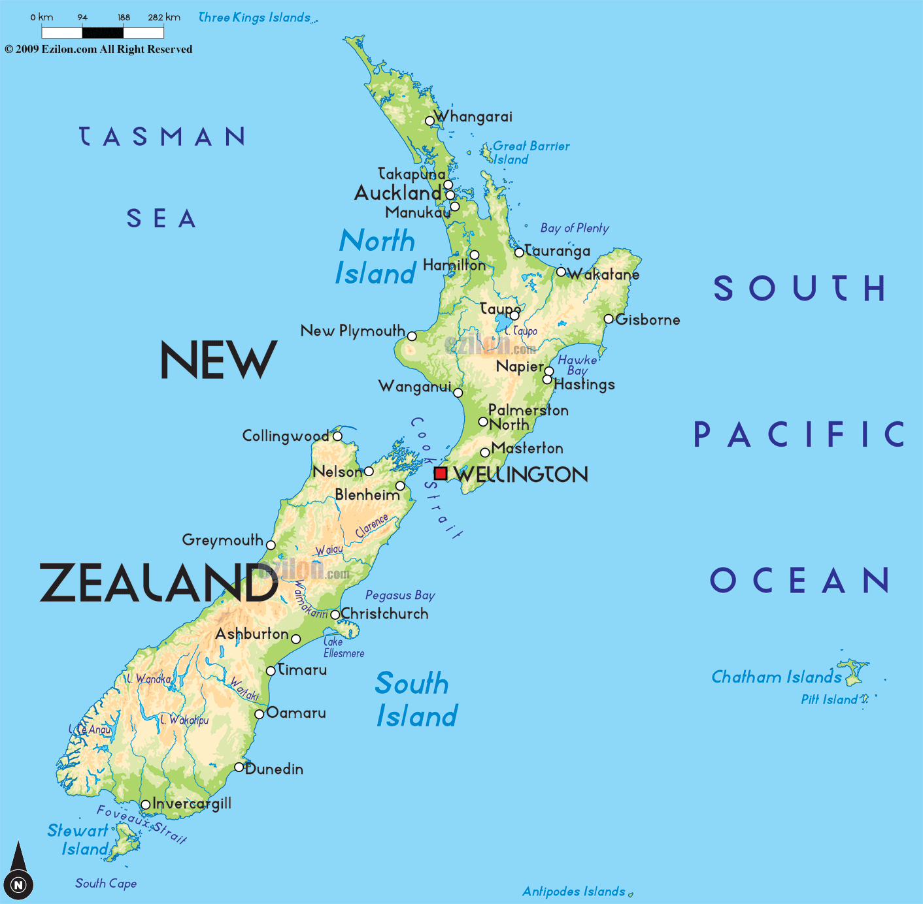
Population:4,509,461
Area: 268,021 km2

Slide 5
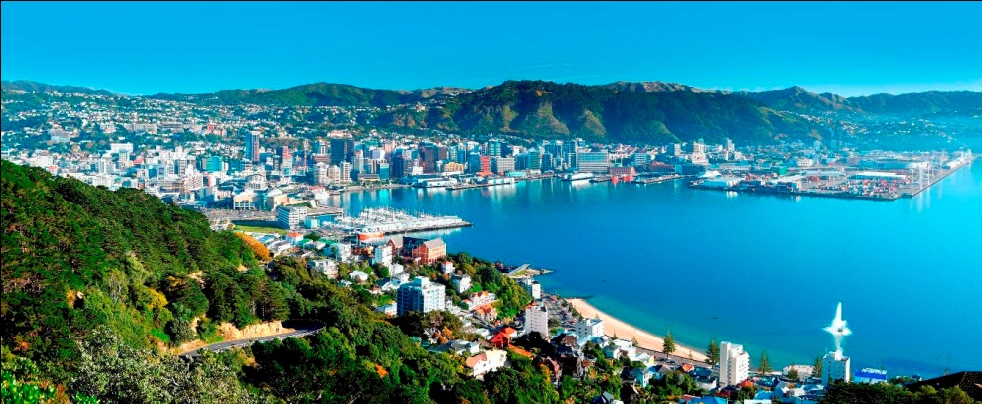
Capital: Wellington

Slide 6
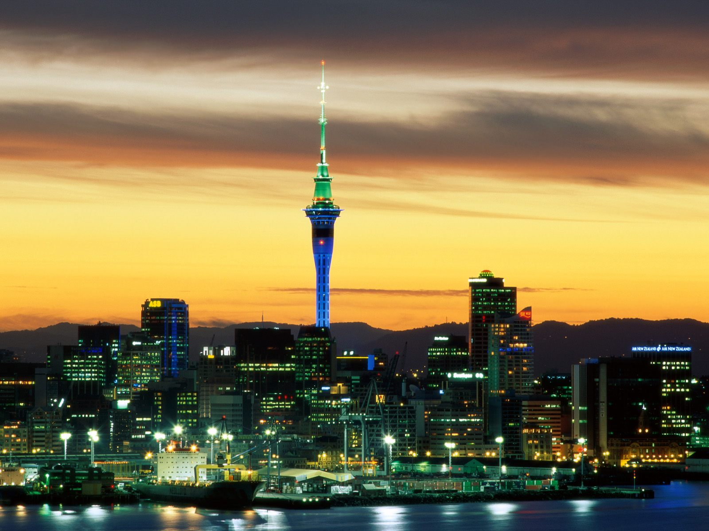
Largest city: Auckland

Slide 7
Official languages:

Slide 8
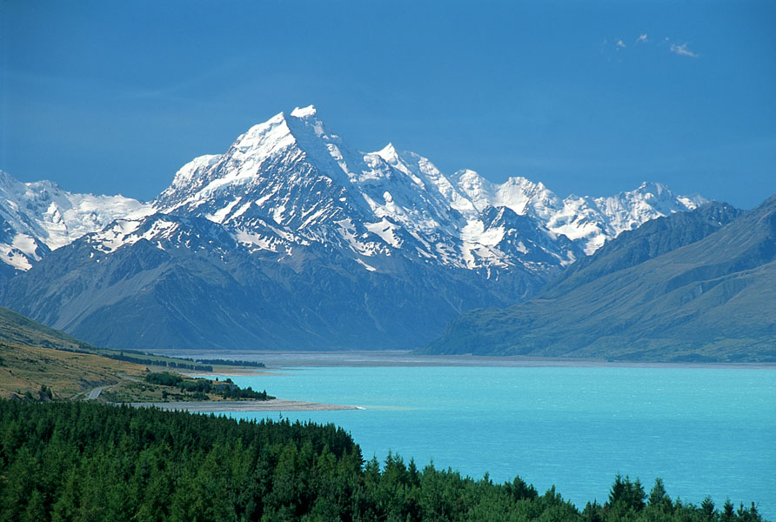
Highest point : Mount Cook at 3,754 metres

Slide 9
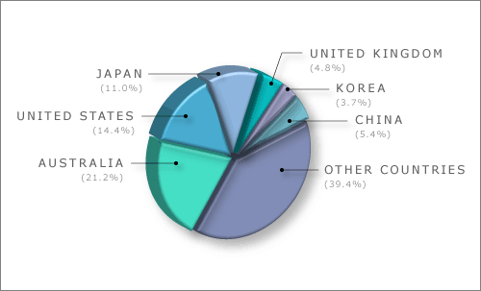
Economy: New Zealand is heavily dependent on international trade, particularly in agricultural products.

Slide 10
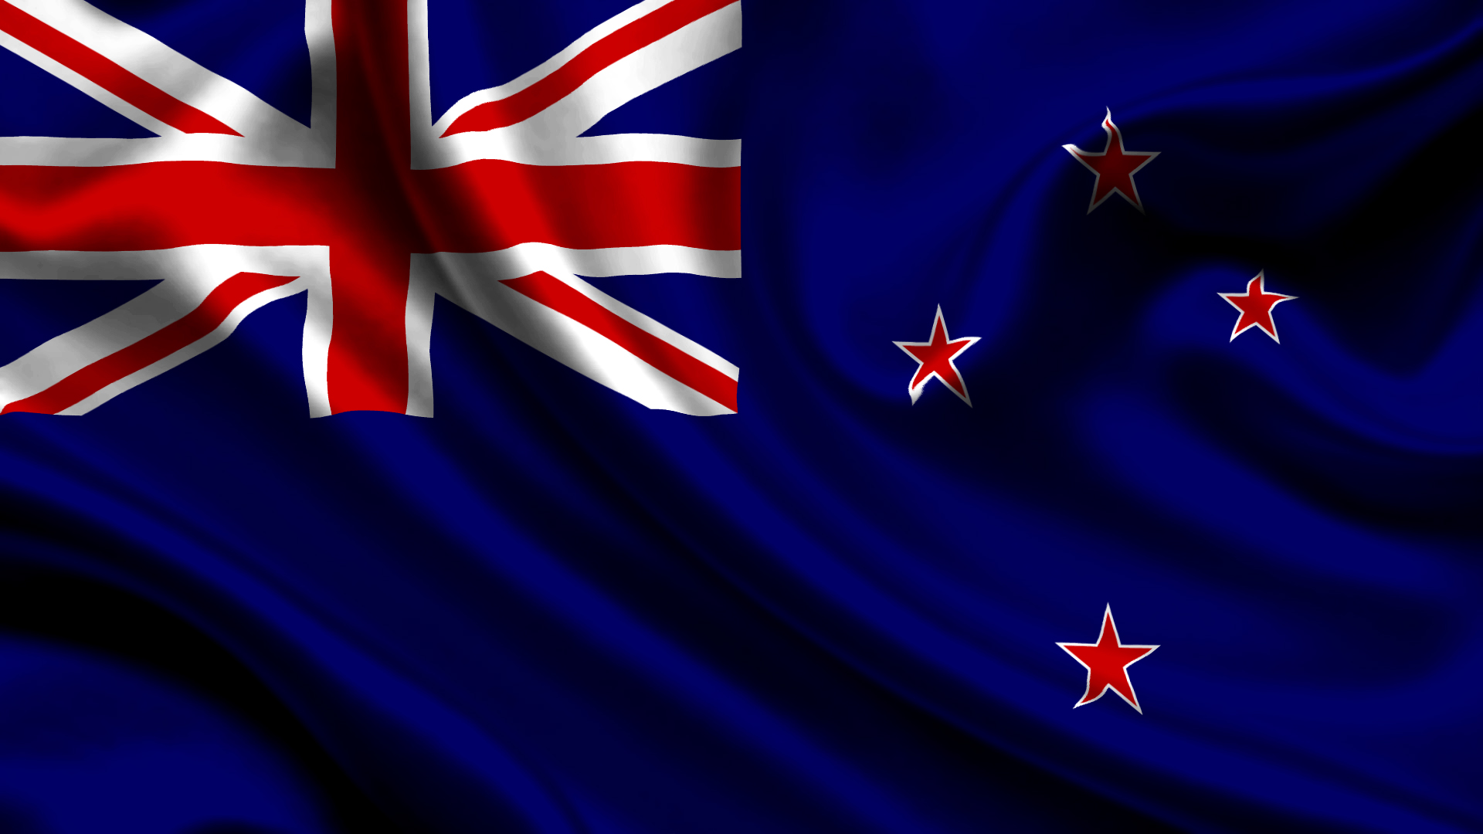

Slide 11
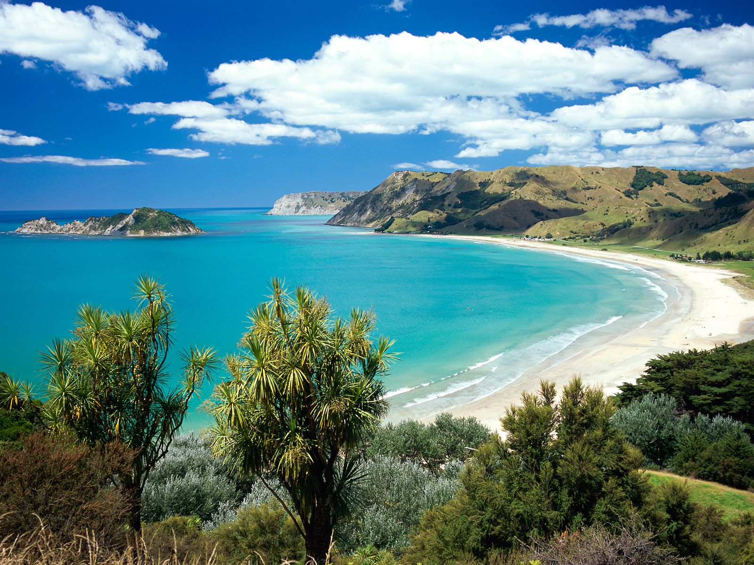

“God Defend New Zealand”

Slide 12
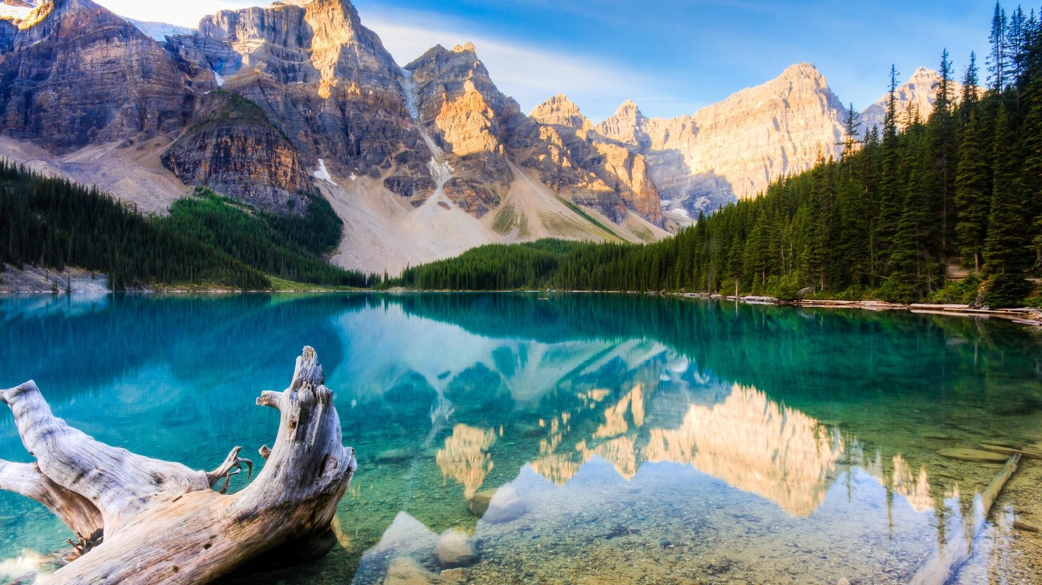
Canada

Slide 13
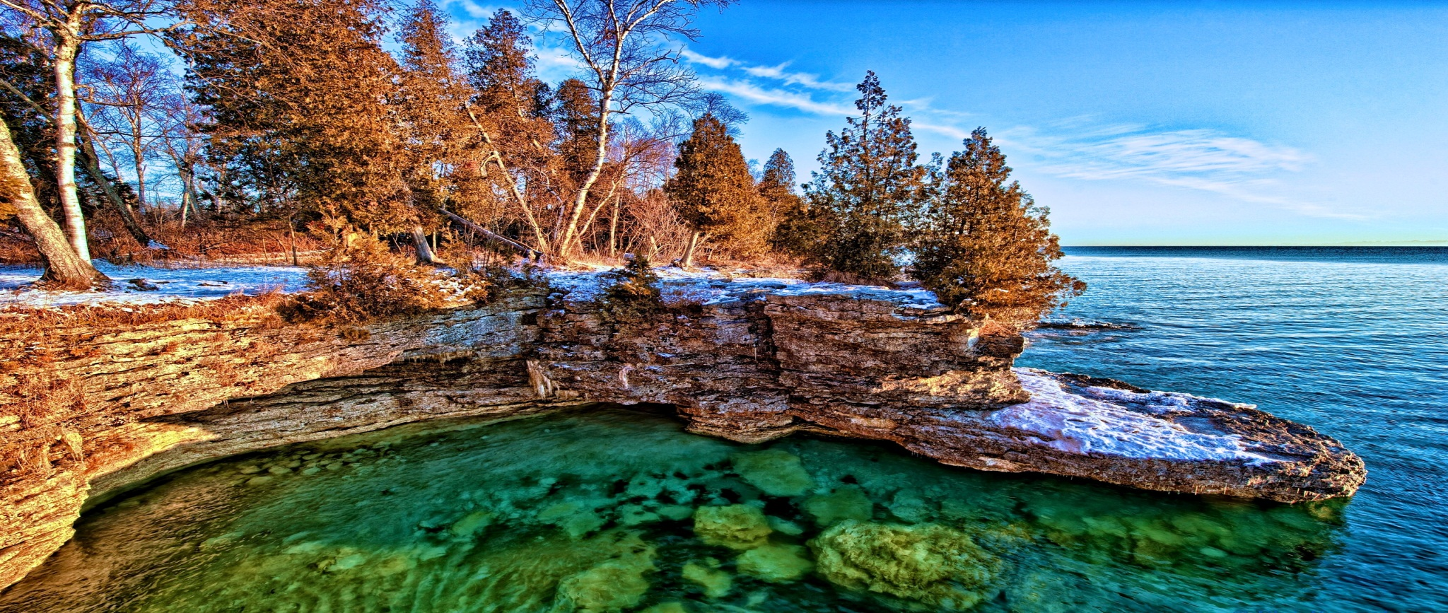
Canada is a country in North America consisting of 10 provinces and 3 territories. Located in the northern part of the continent.

Slide 14
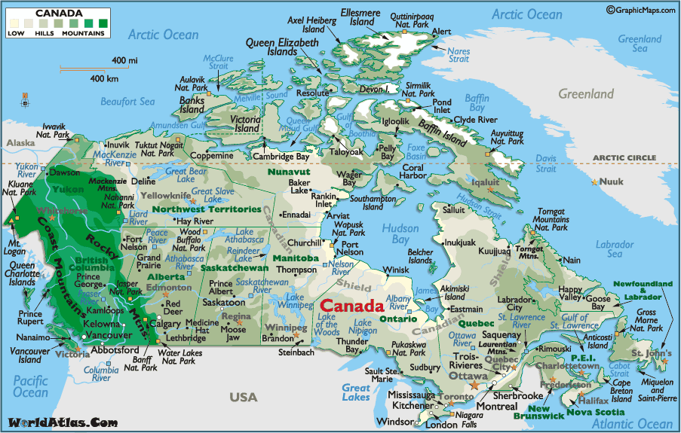
Population: 35,158,300
Area: Total 9,984,670 km2

Slide 15
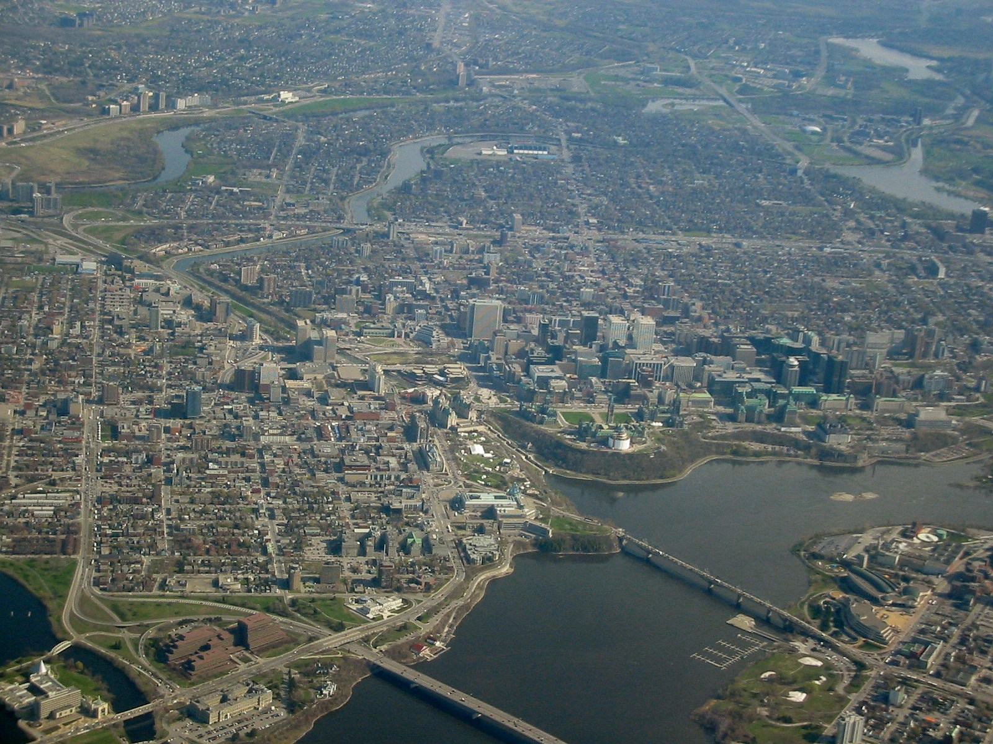
Capital: Ottawa

Slide 16
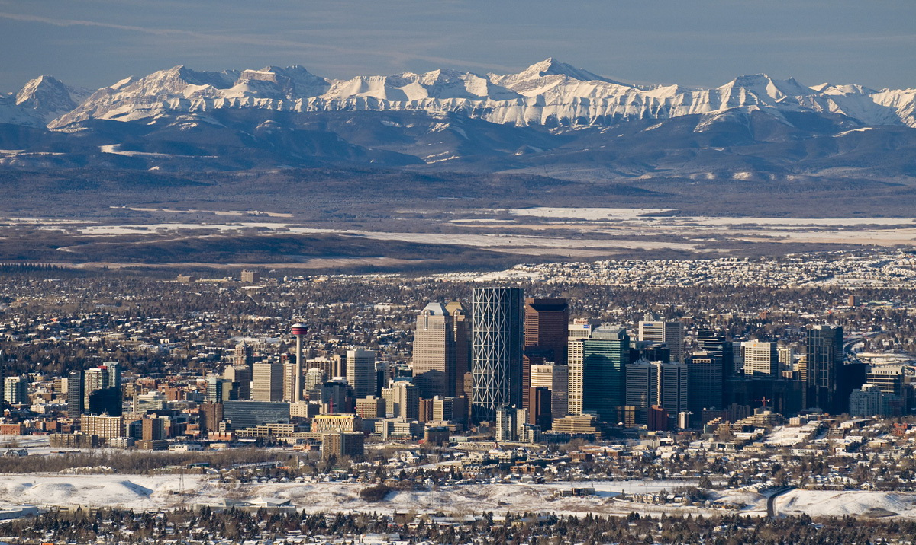
Calgary

Slide 17
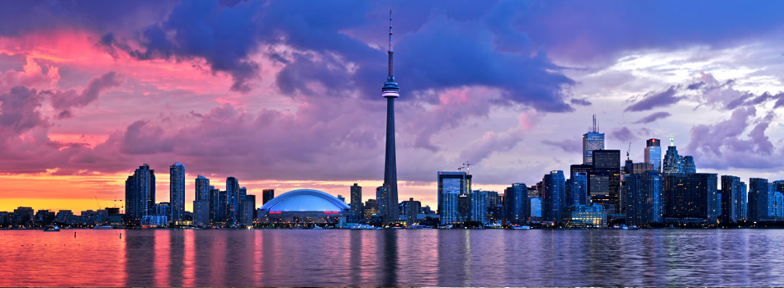
Toronto

Slide 18
Official languages:

Slide 19
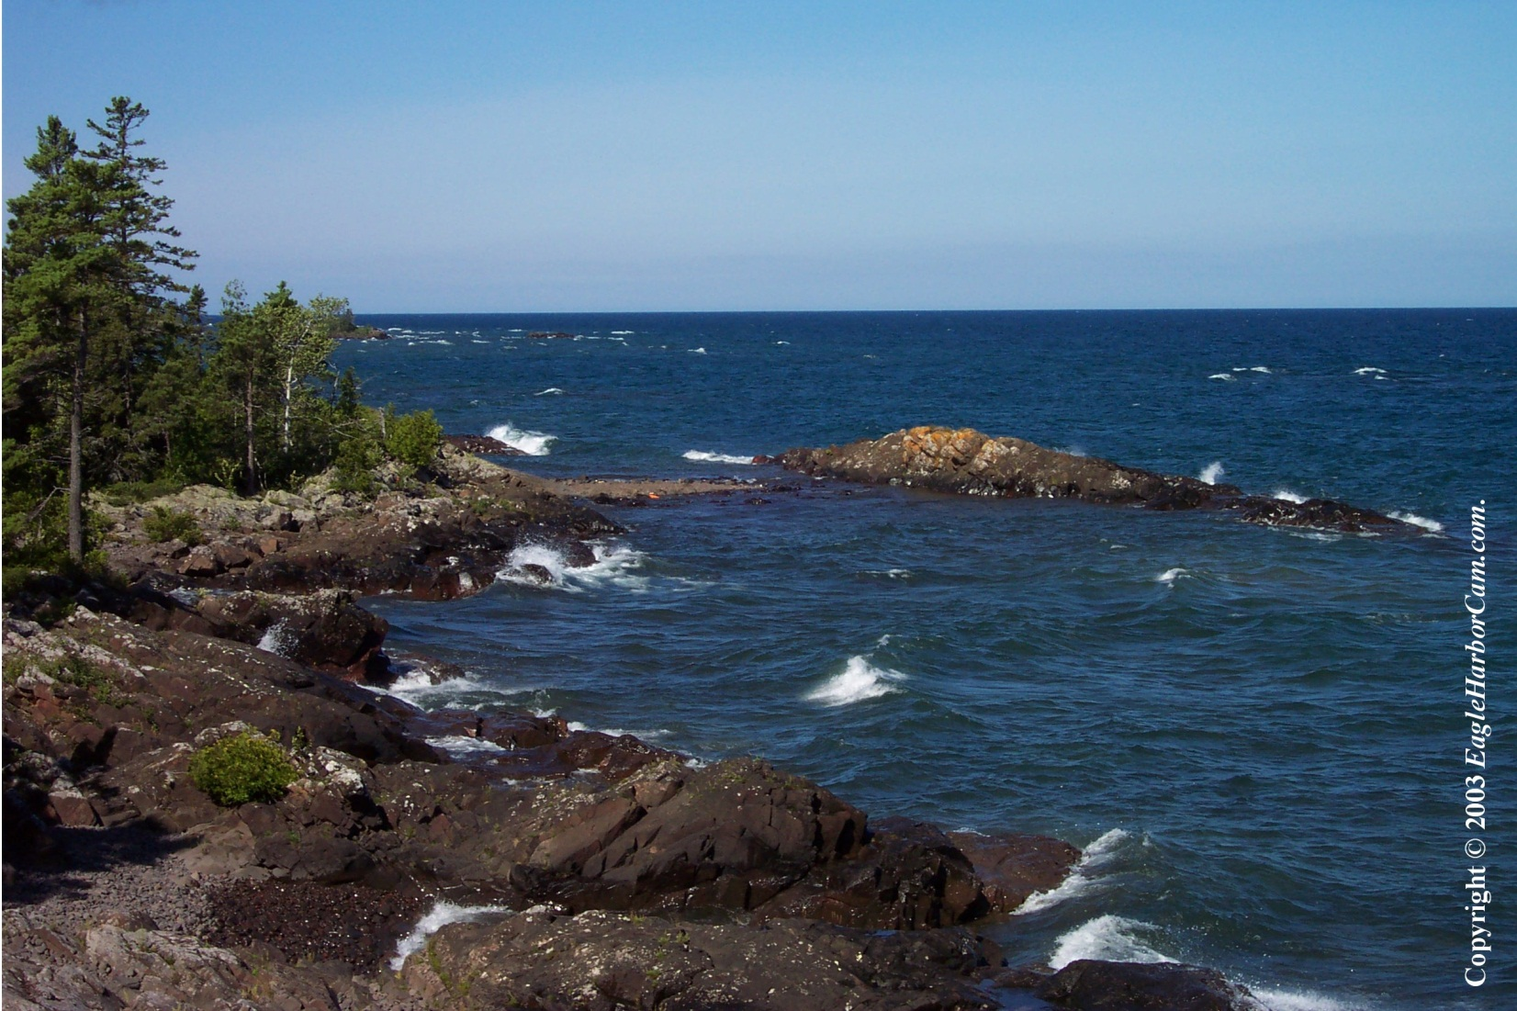
Lake Superior

Slide 20
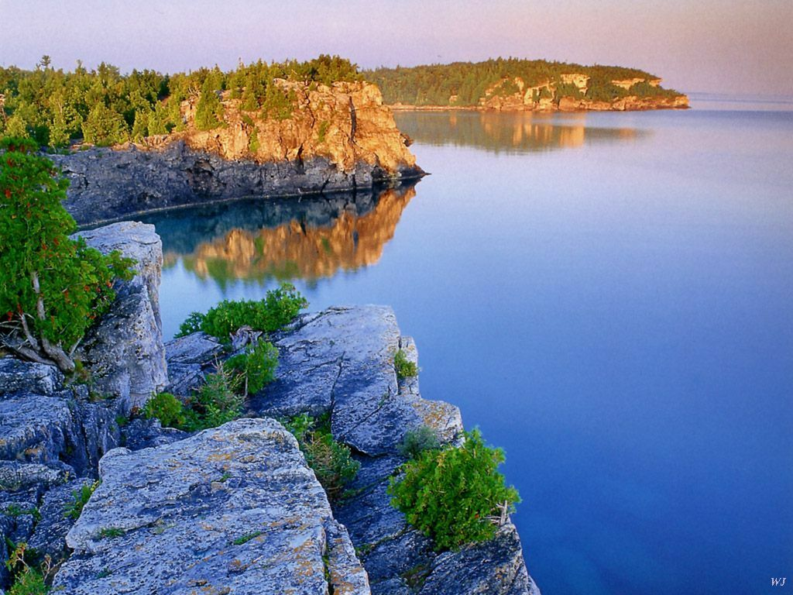
Lake Huron

Slide 21
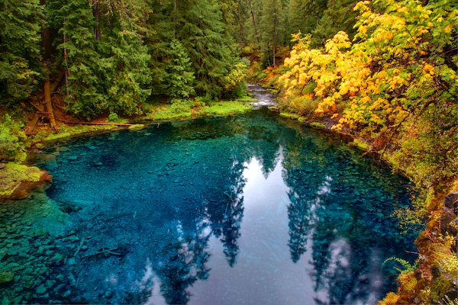
McKenzie river

Slide 22
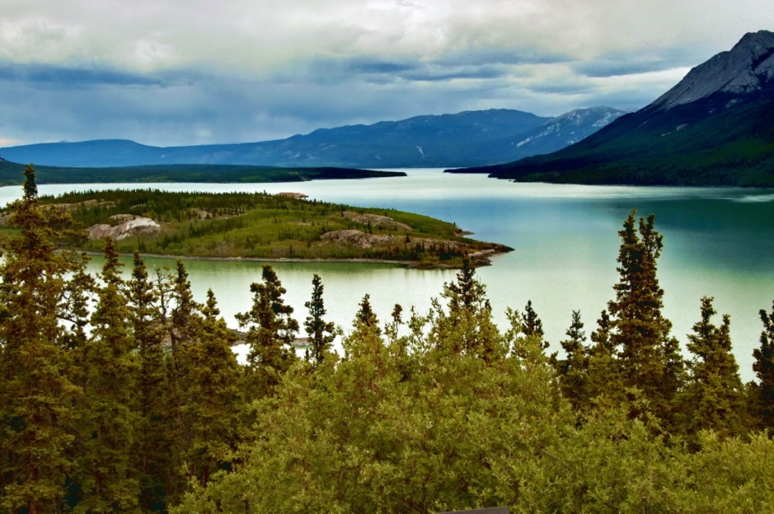
Yukon river

Slide 23
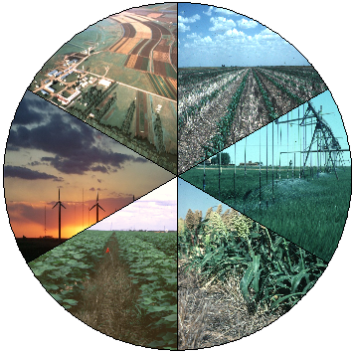
Economy: many industries such as cars electrical goods.

Slide 24
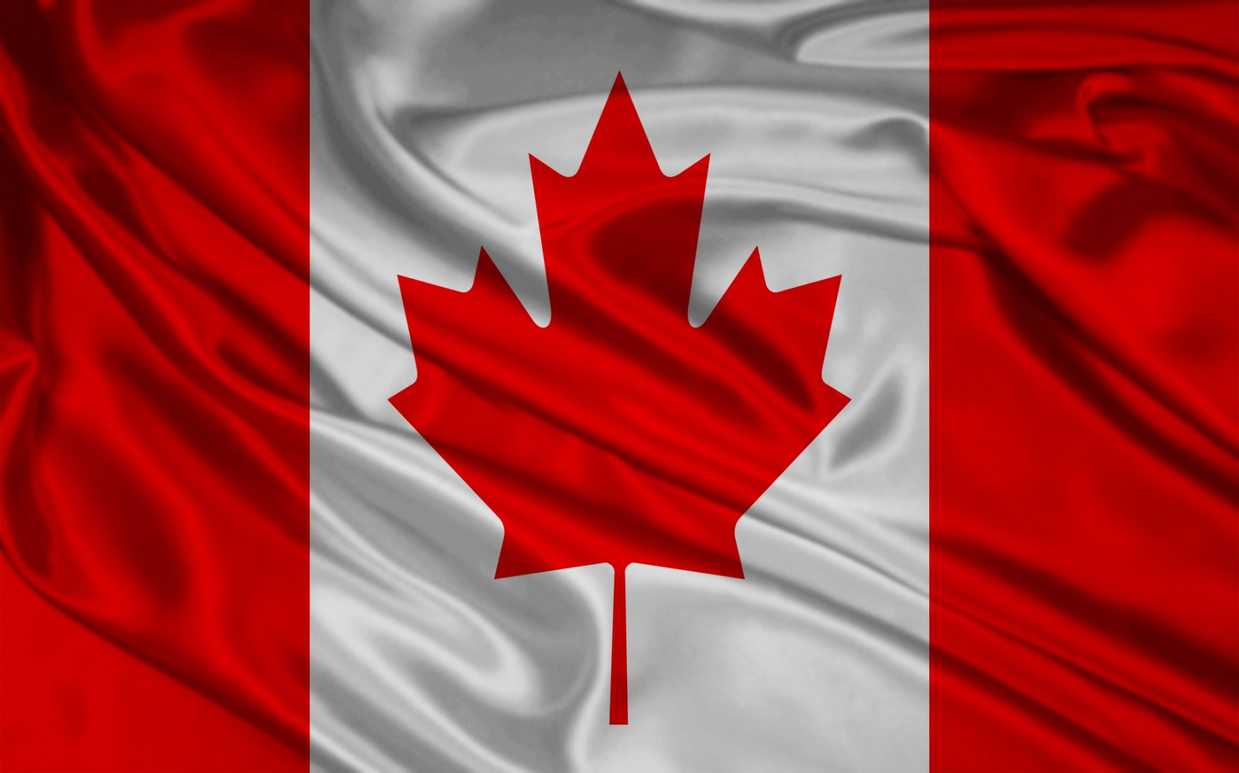

Slide 25
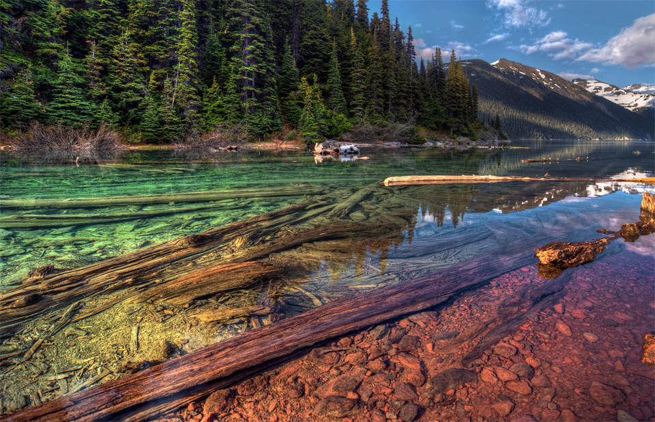
“O Canada”

Slide 26
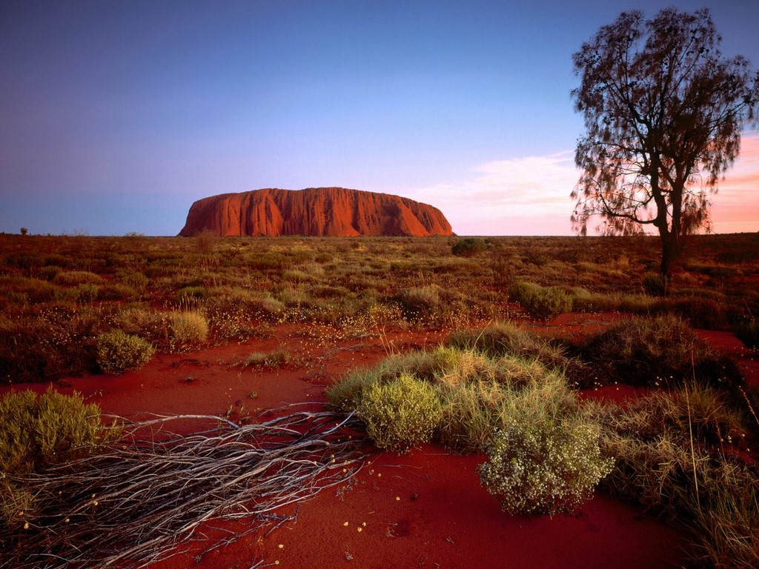
Australia

Slide 27
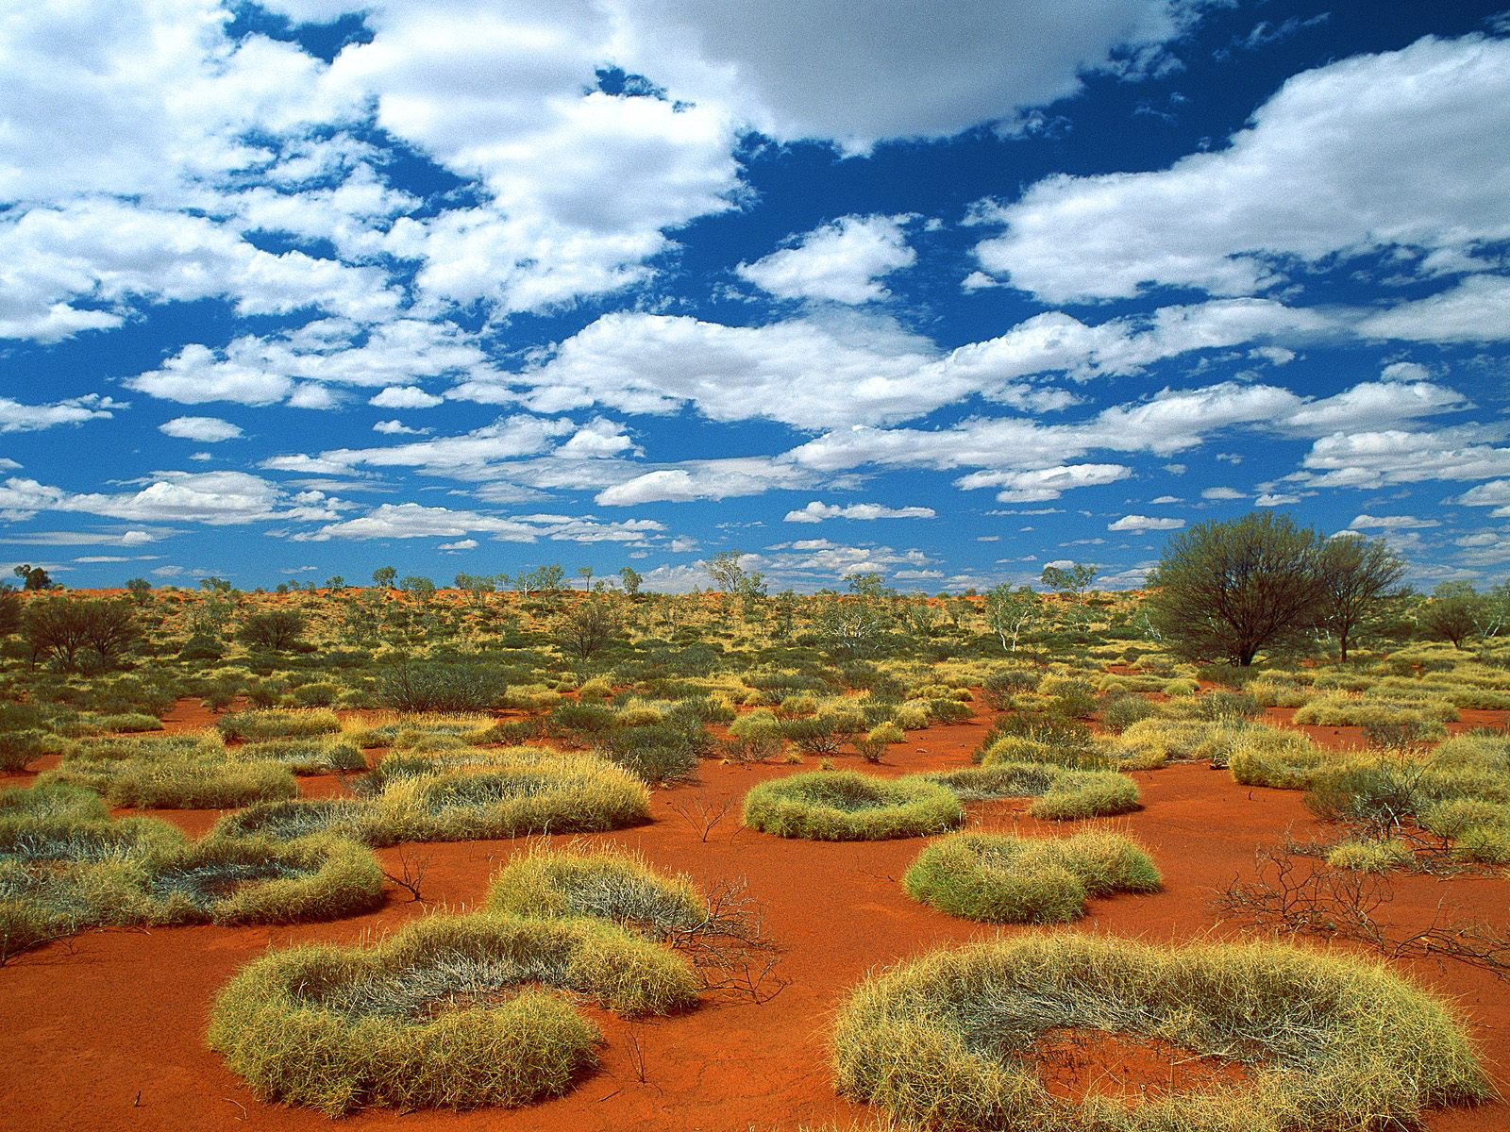
Australia officially the Commonwealth of Australia, is a country comprising the mainland of the Australian continent, the island of Tasmania, and numerous smaller islands.

Slide 28
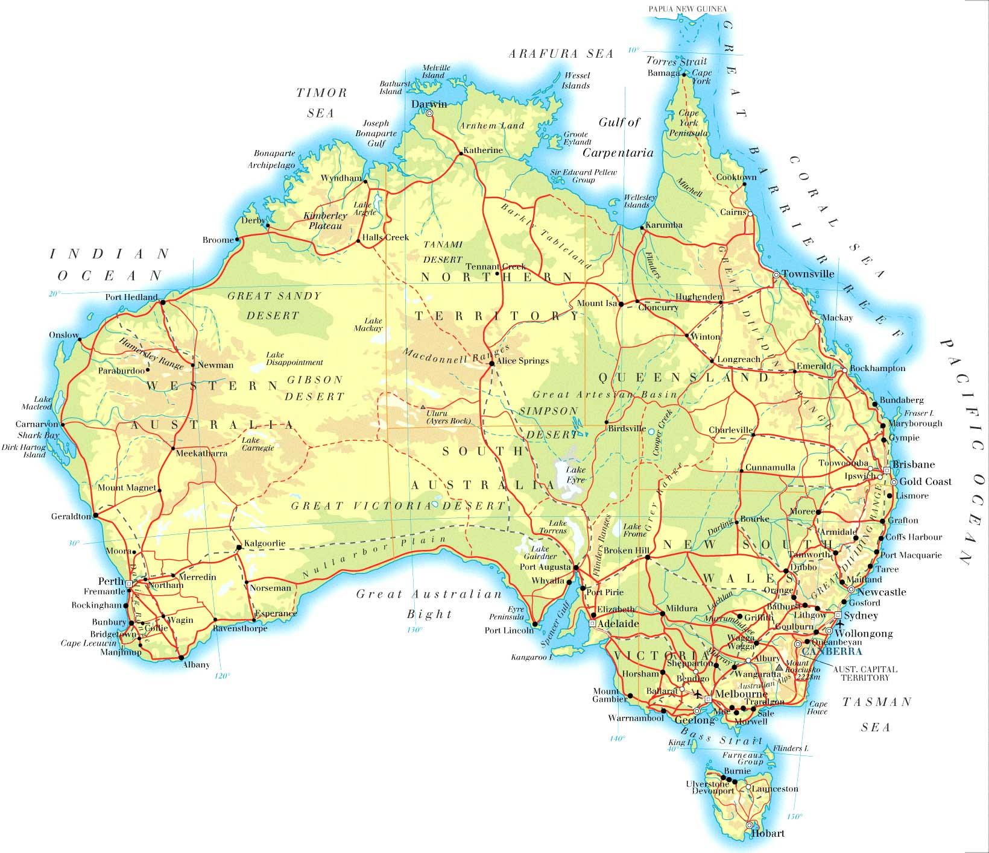
Population: 23,377,368
Area: Total 7,692,024 km2

Slide 29
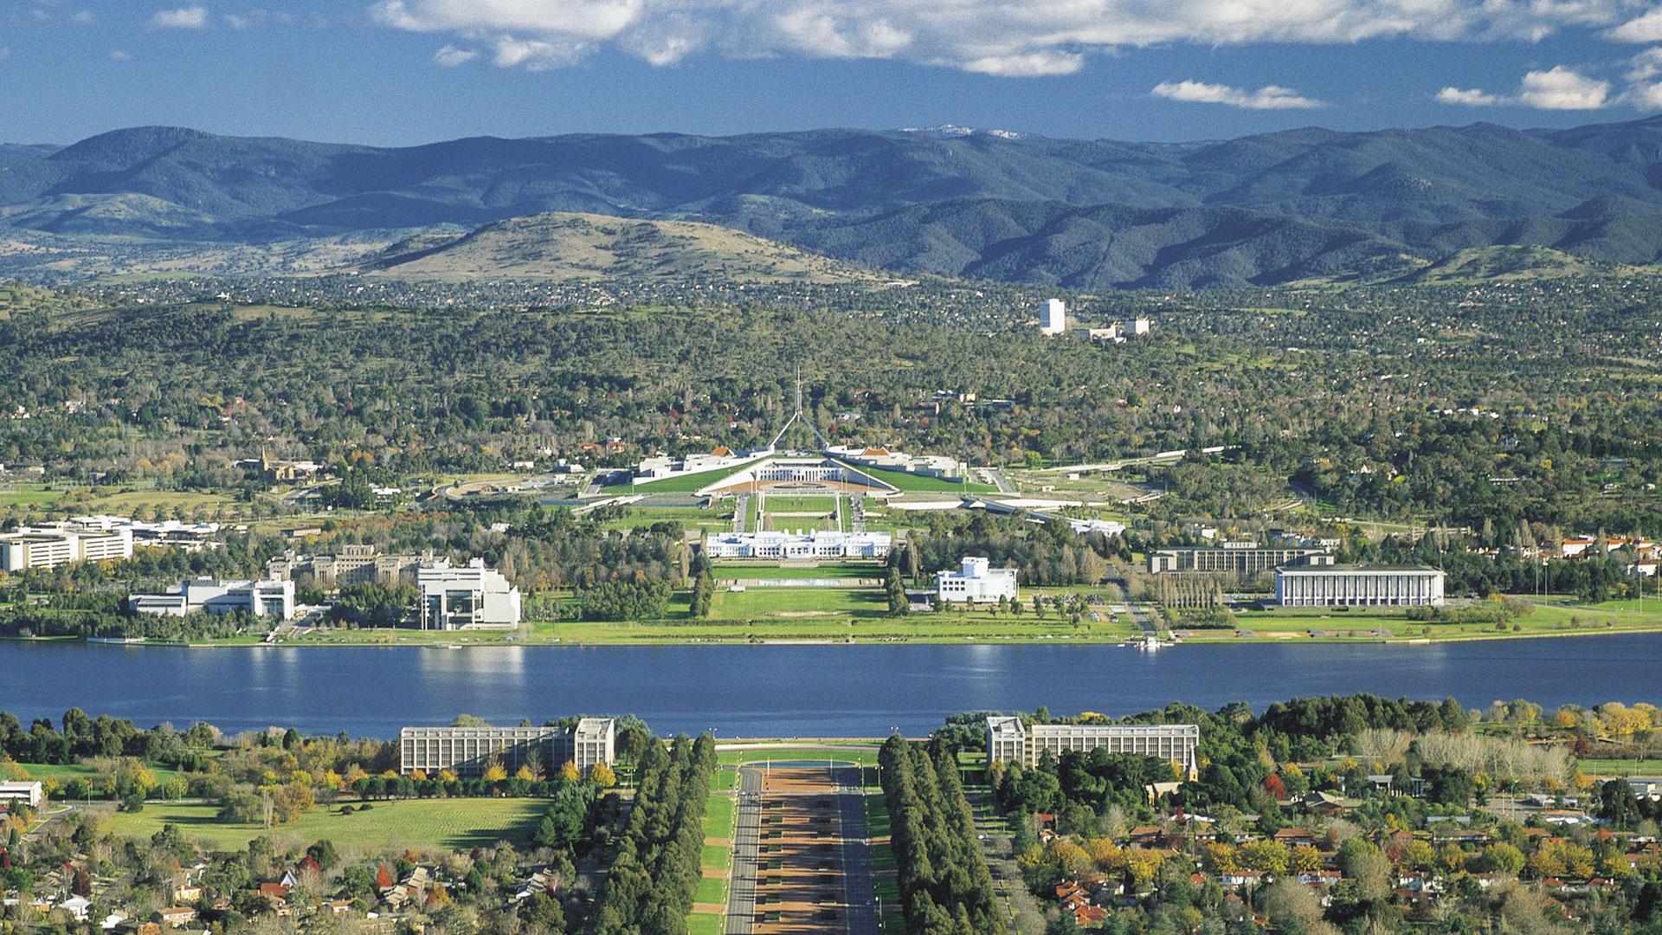
Capital: Canberra

Slide 30
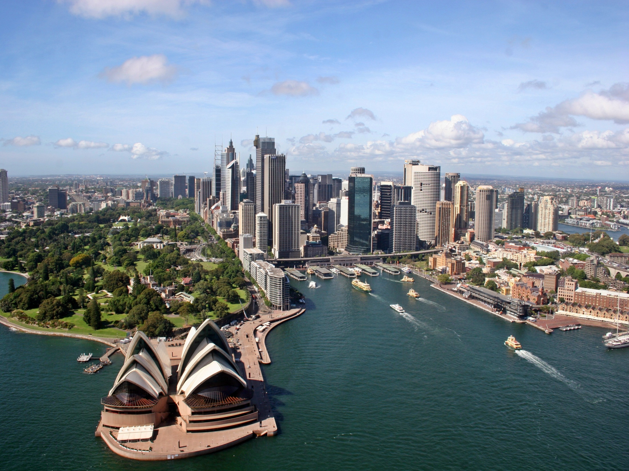
Sydney

Slide 31
National language: English

Slide 32
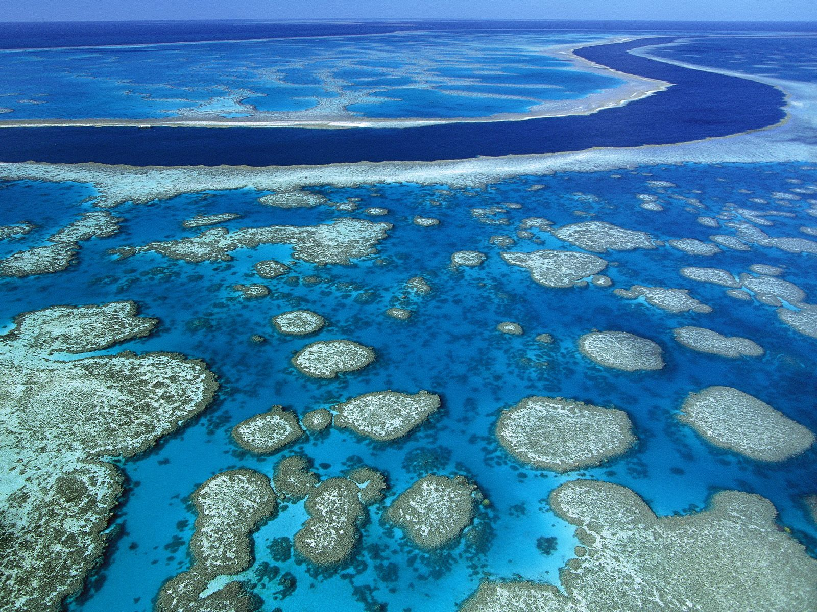
The Great Barrier Reef

Slide 33
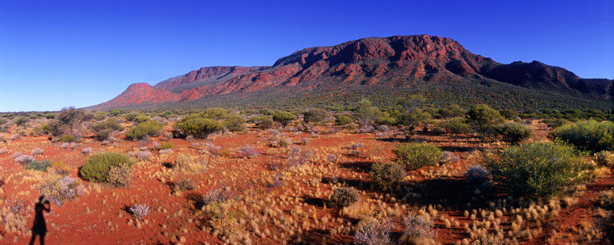
Mount Augustus

Slide 34
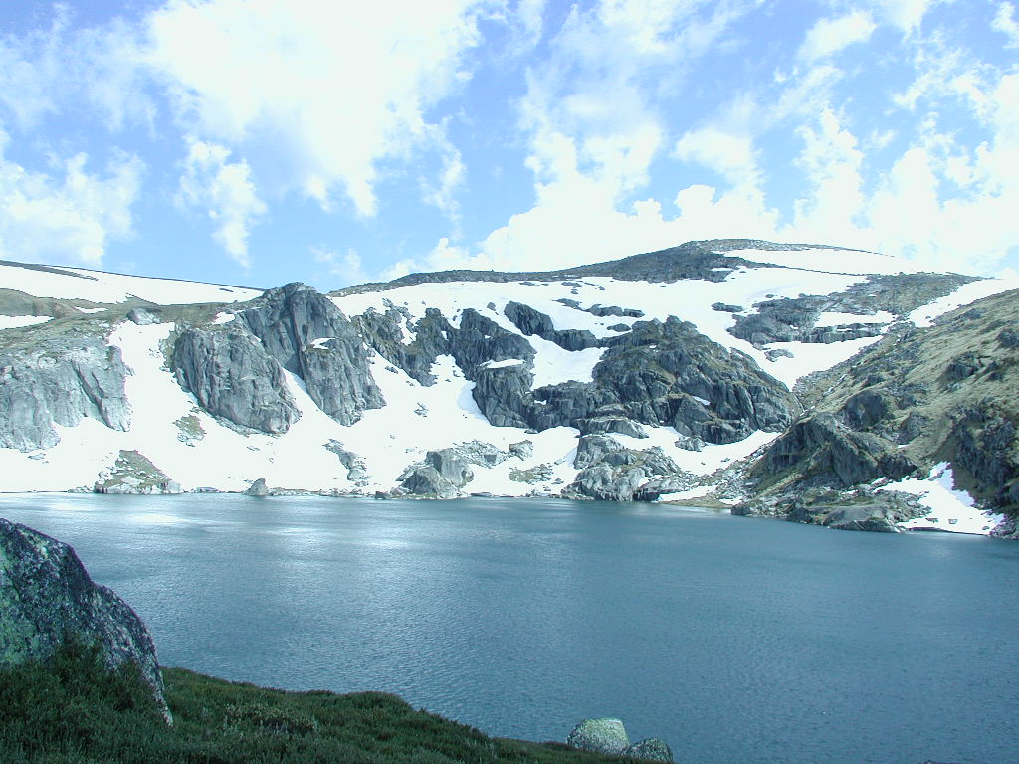
Mount Kosciuszko

Slide 35
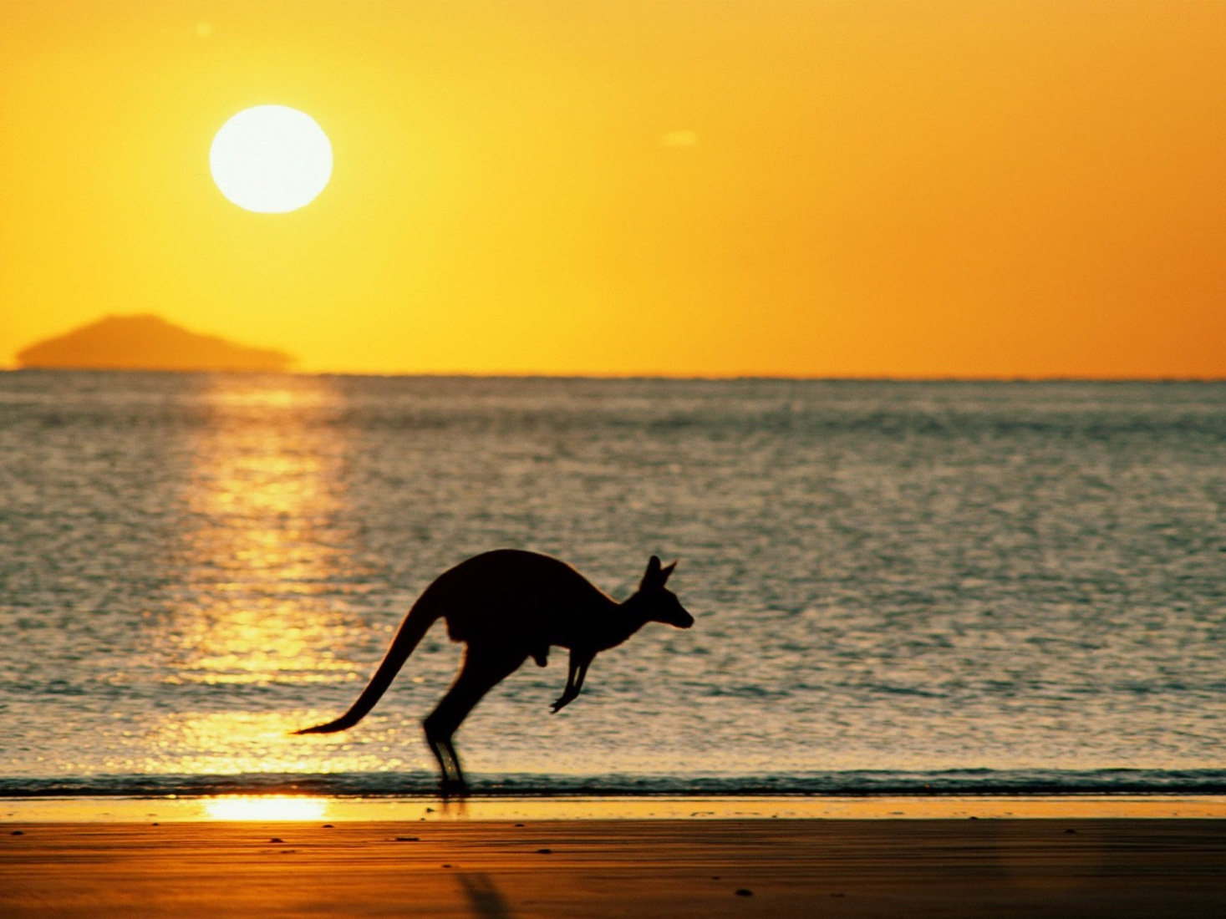
“Advance Australia Fair”

Slide 36


