Slide 2
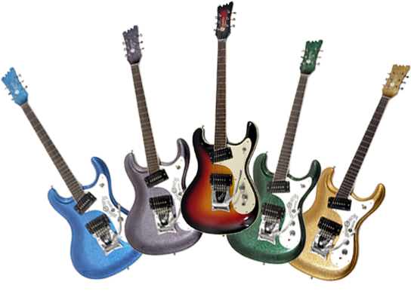
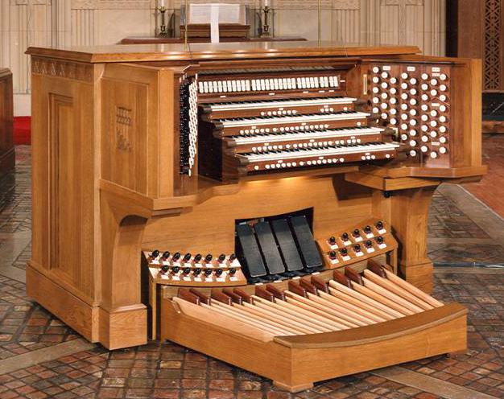
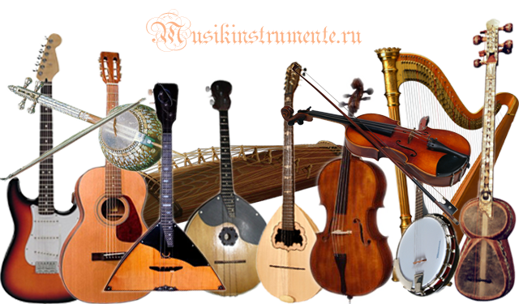
Instruments

Slide 3
First innovators
Gary Burton
Larry Coryell

Slide 4
Duster is considered to be one of the first fusion records

Slide 5
Miles Davis had a major influence on the development of jazz fusion

Slide 7
Stevie Ray Vaughan and Double Trouble

Slide 9
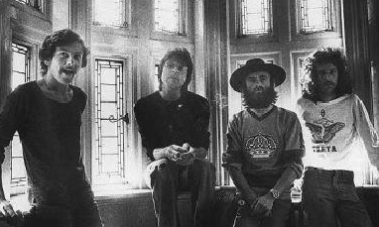
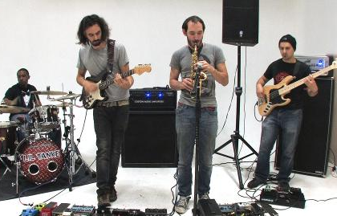
Return To Forever
Brand-X
Marbin

