Slide 1
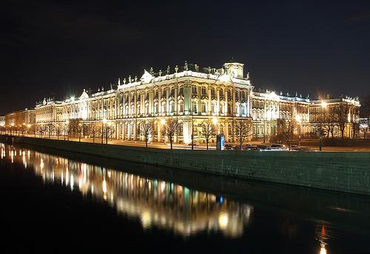
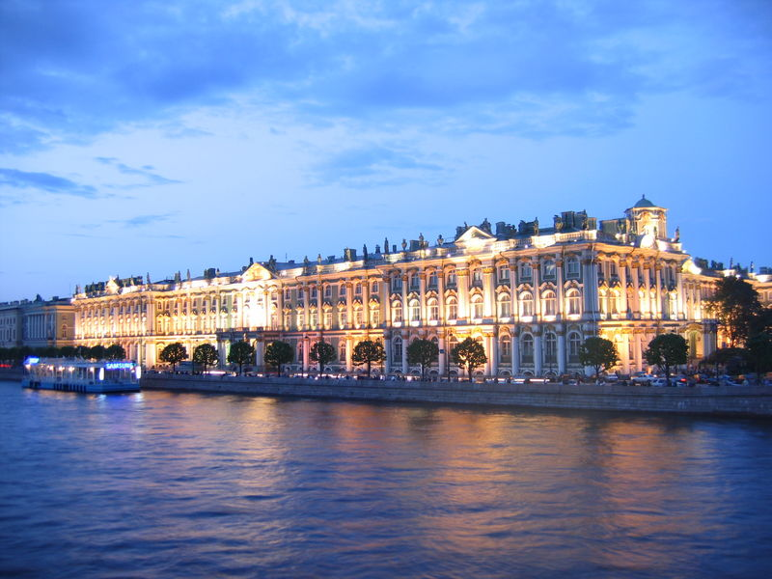
“Russian museum”
Project work
Helen Mulyarevich
Form 11-A
Lityn school №1

Slide 2
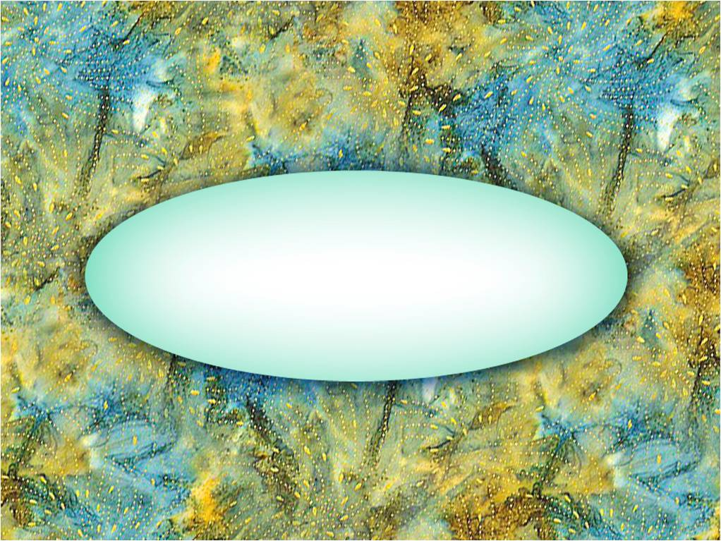
The Hermitage

Slide 3
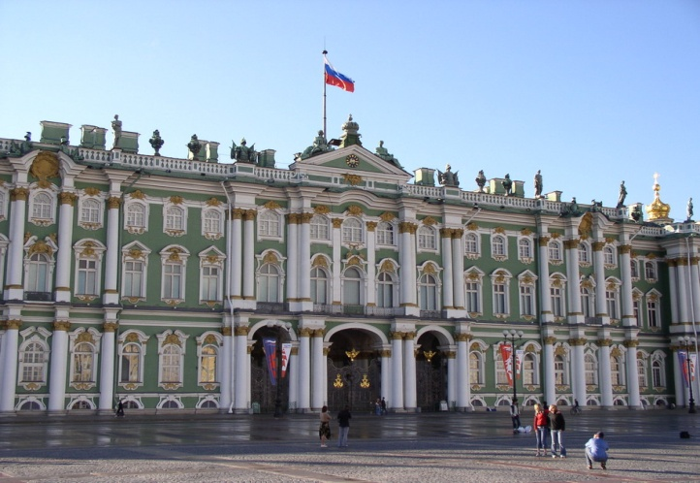
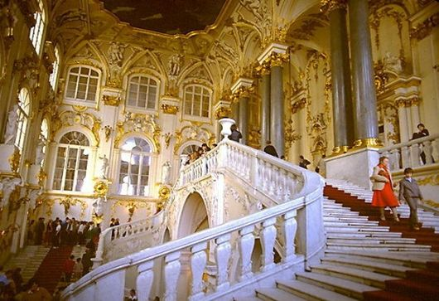
One of the world-wide known museums is the Hermitage. The word "Hermitage" means "a place of solitude". This name was given in the XVIII century by Catherine П to her private museum housed in a small building adjacent to the Winter Palace and accessible only to the chosen few.

Slide 4
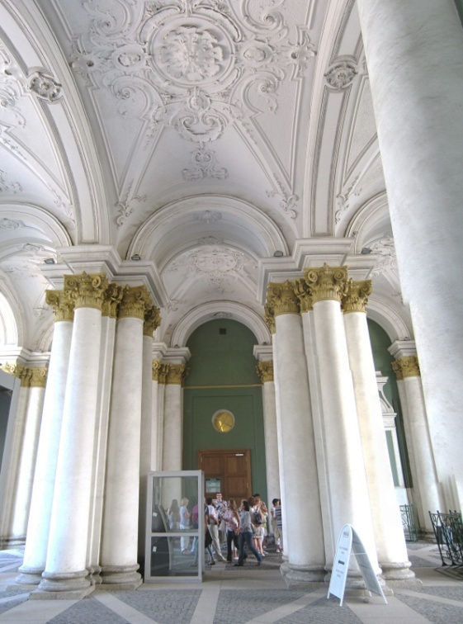
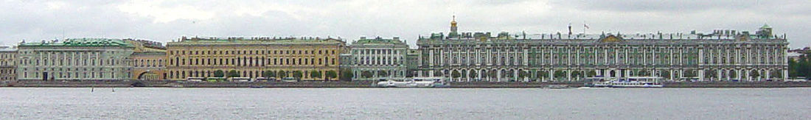
In the course of time, the Hermitage grew into one of the greatest museums of the world. At the present, the collections take up five interconnected buildings. The museum retains its old name.
The accumulation of artefacts let to the formation of new departments devoted to the culture and art of the Peoples of the East, of the Prehistoric culture, and of the Russian culture. Three other departments are those of Western European art, classical antiquities and numismatics.

Slide 5
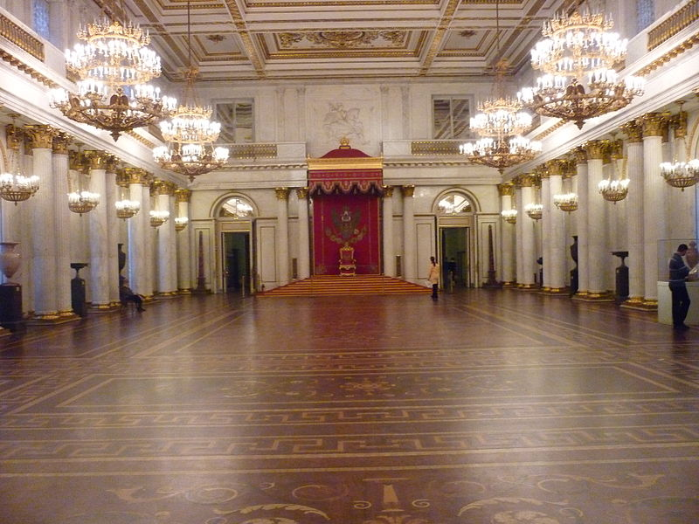
One of the rooms that impressed visitor the most is St. George Hall. The interior of the room is considered by experts to be a perfect example of the Classical Style. The room covers about 800 square metres, but does not seem enormous due to perfect proportions. It is decorated in the whitest marble and gilded bronze.
The Throne Hall was used for column assemblies. Members of the Tzar's family, when coming of age, took their oaths here.

Slide 6
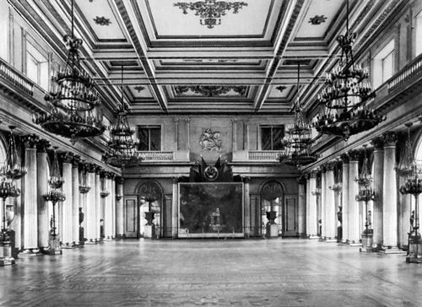

Slide 7
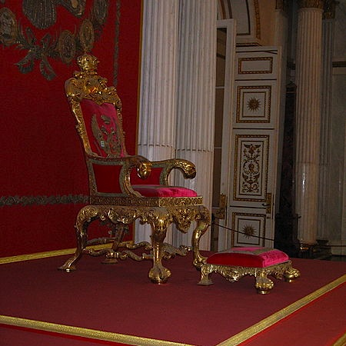

Slide 8
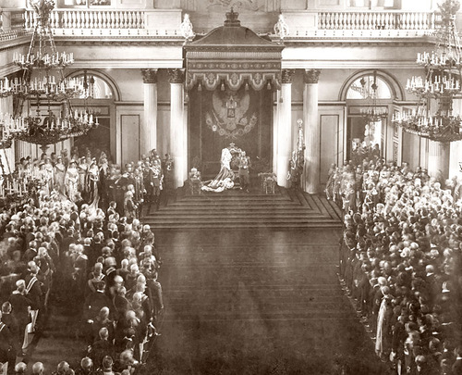

Slide 9
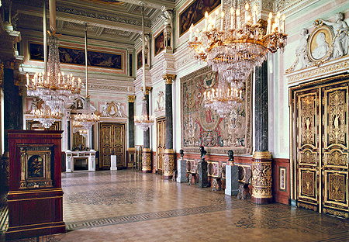
The Leonardo da Vinci Hall is one of the most gorgeous interiors. The hall is decorated in the style of 17 century French Baroque. The Hermitage possesses two, out of 12 or 14 works surviving from Leonardo.

Slide 10
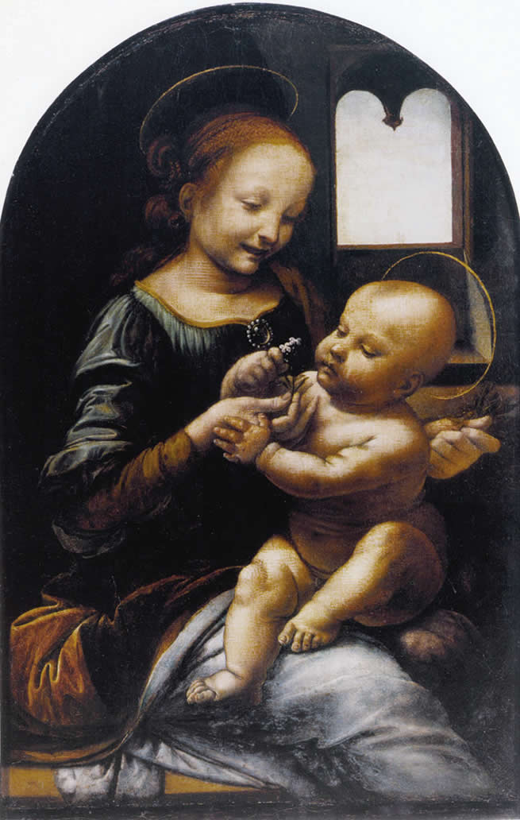
“Madonna Benua”

Slide 11
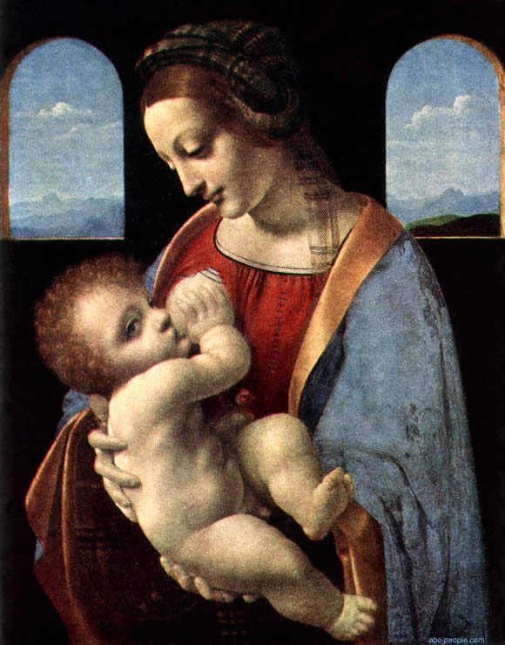
“Madonna Litta”

Slide 12
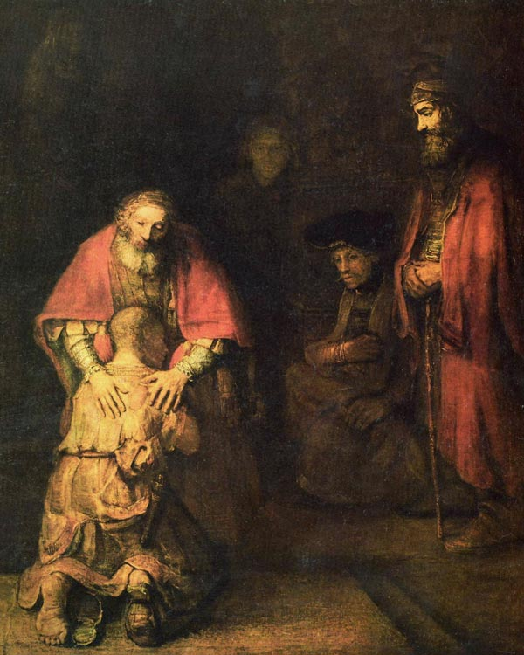
The Rembrandt collection is one of the most treasured possessions of the museum. It members 24 canvases.
The Return of the Prodigal Son

Slide 13
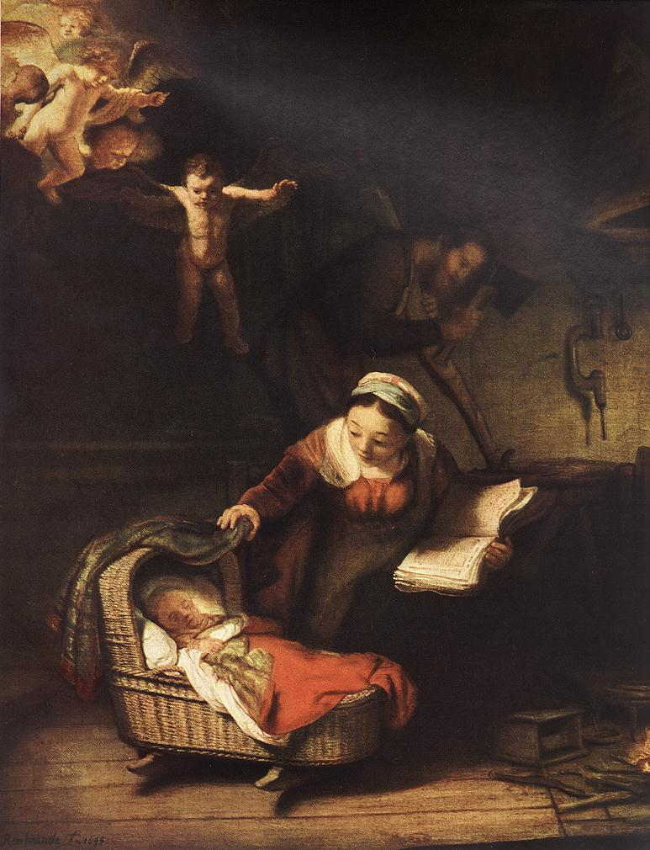
“The Holy Family”

Slide 14

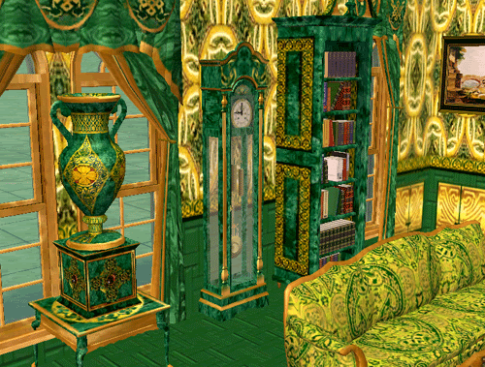
The Malachite Room reflects the style of 1889. The columns, pilasters, and floorlamps are veneered with thin plaques of rich green malachite. About two tons of malachite were used in decoration of the room.

Slide 15

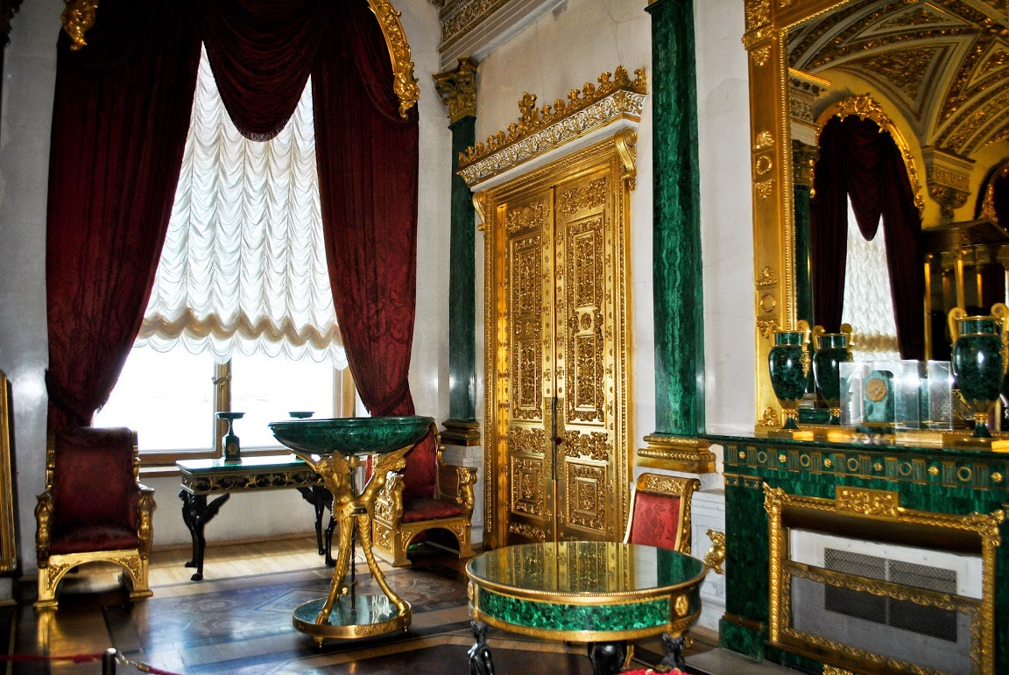

Slide 16
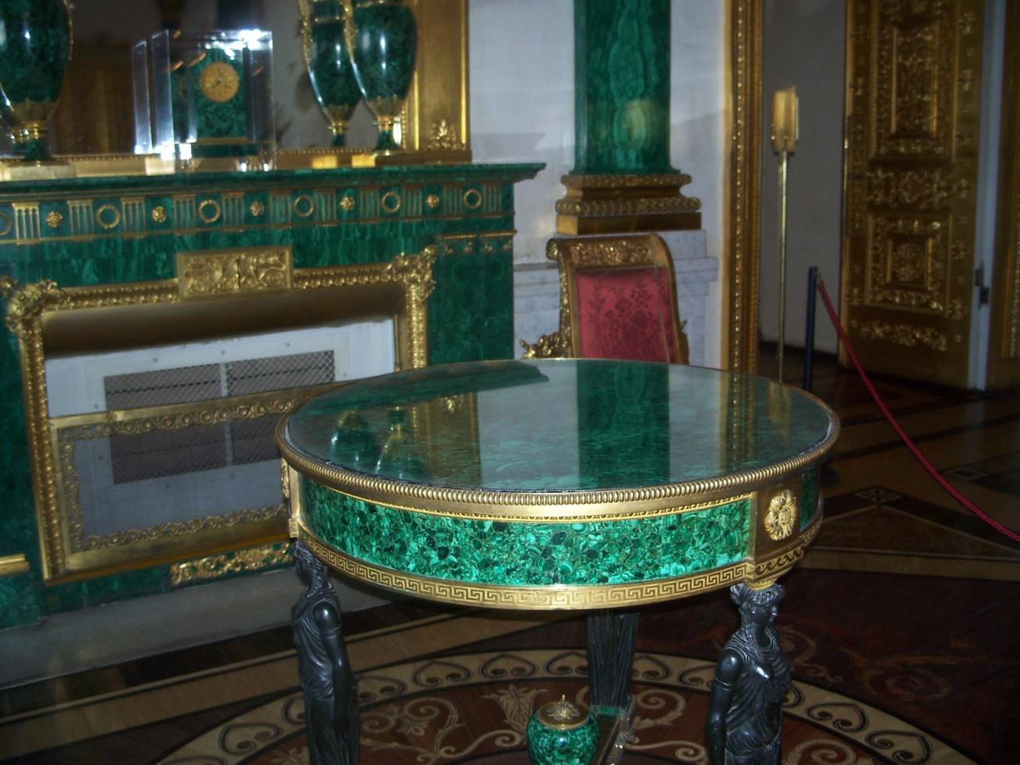

Slide 17

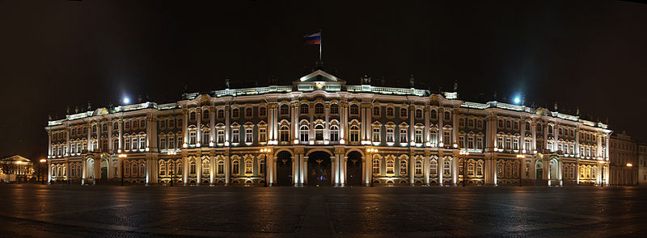
Thus, the Hermitage is a place where you can expand your horizons and learn more about the art !!!

Slide 18
Legal address:
Dvortsovaya Naberezhnaya, 34
190000
St Petersburg,
Russia

Slide 19
Contacts:
Telephone: (812)710-90-79
Fax: (812) 570-57-48
E-mail address: http://www.hermitagemuseum.org/

Slide 20
Thank you
for your attention!

