Slide 1

The history of the Olympic Games

Slide 2
Introduction
The Olympic Games were a series of athletic competitions among representatives of city-states of Ancient Greece. They were held in honor of Zeus, and the Greeks gave them a mythological origin. Historical records indicate that they began in 776 BC in Olympia. They continued to be celebrated when Greece came under Roman rule, until the emperor Theodosius I suppressed them in 394 AD as part of the campaign to impose Christianity as the state religion of Rome.

Slide 3
The Origin
To the Greeks it was important to root the Olympic Games in mythology. During the time of the ancient games their origins were attributed to the gods, and competing legends persisted as to who actually was responsible for the games' genesis. These origin of traditions have become nearly impossible to untangle, yet a chronology and patterns have arisen that help people understand the story behind the games. The earliest myths regarding the origin of the games are recounted by the Greek historian, Pausanias. According to the story, the dactyl Herakles and four of his brothers, Paeonaeus, Epimedes, Iasius and Idas, raced at Olympia to entertain the newborn Zeus. He crowned the victor with an olive tree wreath, (which thus became a peace symbol) which also explains the four year interval, bringing the games around every fifth year (counting inclusively).

Slide 4
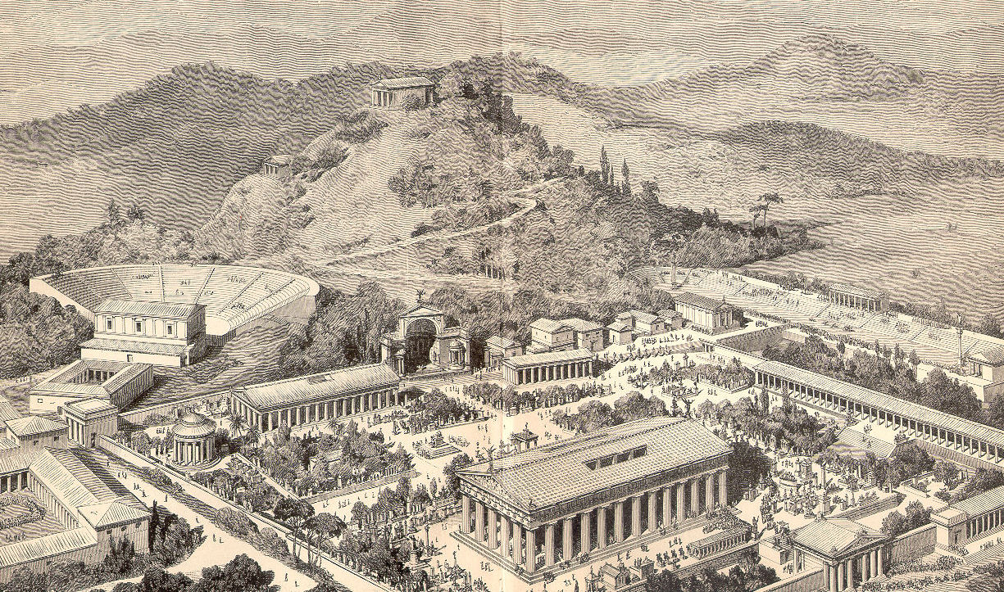
Olympia – the birthplace of the Games

Slide 5
The first Olympic Games
The games started in Olympia, Greece, in a sanctuary site for the Greek deities near the towns of Elis and Pisa (both in Elis on the peninsula of Peloponnesus). The first games began as an annual foot race of young women in competition for the position of the priestess for the goddess, Hera and a second race was instituted for a consort for the priestess who would participate in the religious traditions at the temple.

Slide 6
The attributes
During the celebration of the games, an Olympic Truce (laying down of arms) was enacted so that athletes could travel from their countries to the games in safety. The prizes for the victors were wreaths of laurel leaves.
The Olympics also featured religious celebrations and artistic competitions. The statue of Zeus at Olympia was counted as one of the seven wonders of the ancient world. Sculptors and poets would congregate each Olympiad to display their works of art to would-be patrons.

Slide 7
The participants
The ancient Olympics had fewer events than the modern games, and only freeborn Greeks were allowed to participate.
Victors at the Olympics were highly honored and praised, and their feats chronicled for future generations.

Slide 8
Thx 4 att3nt1on!

