Slide 1
Differences and similarities between transport in Britain and Ukraine

Slide 2
Differences

Slide 3
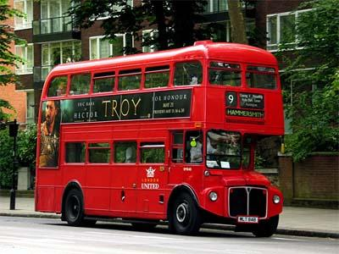
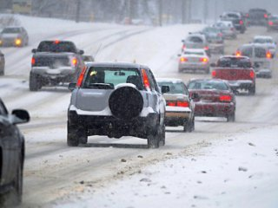
1
In the Britain drive on the left
In Ukraine, the right-hand traffic

Slide 4
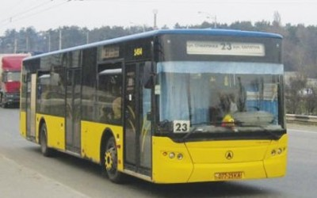
Britain buses are double-decker
Ukraine buses are mostly one-story
2

Slide 5
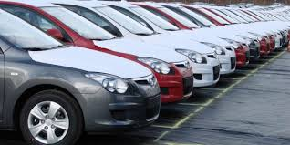
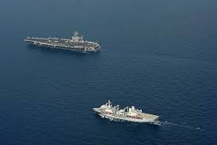
3
In Britain, a common water form of transport, because it is an island country
In Ukraine marine mode of transport is not as common, more use of land transport

Slide 6
Similarities

Slide 7

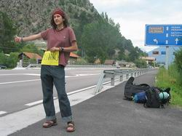
1
Hitchhiking is not adopted

Slide 8
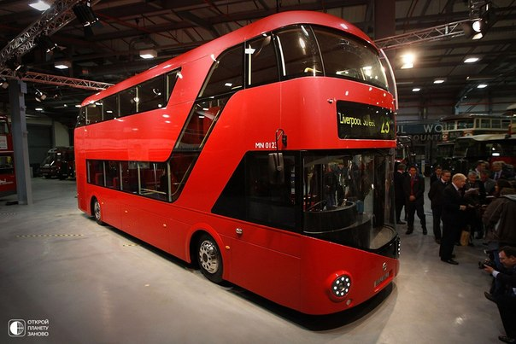
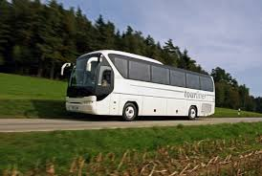
2
Bus is the cheapest way to travel around the country

Slide 9
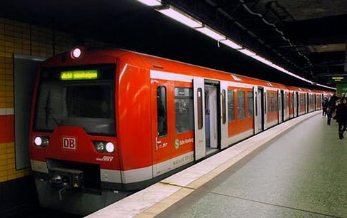
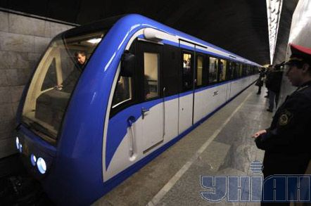
The fastest and convenient mode of transport is the metro
3

