Slide 1
William Makepeace Thackeray
18 July 1811 – 24 December 1863

Slide 2
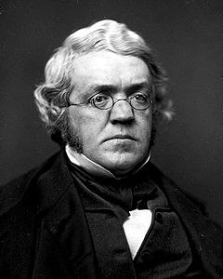
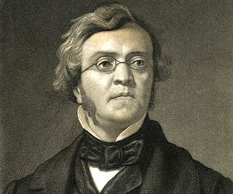
William Makepeace Thackeray was born on 18th July 1811 in Calcutta, India

Slide 3
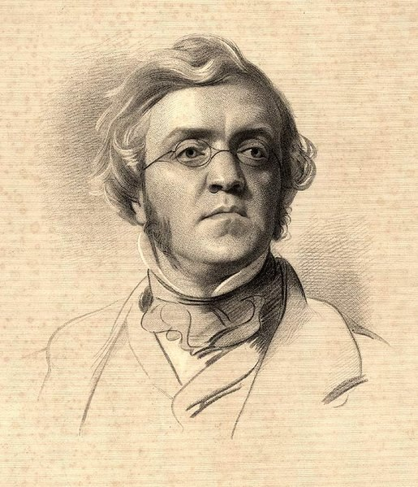
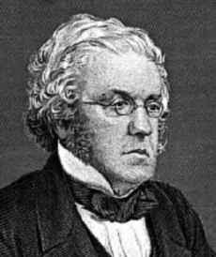
At the age of 5 he was taken to England after the death of his father and his school-years were not happy ones.

Slide 4
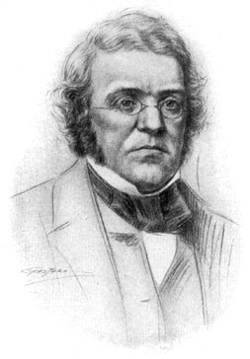
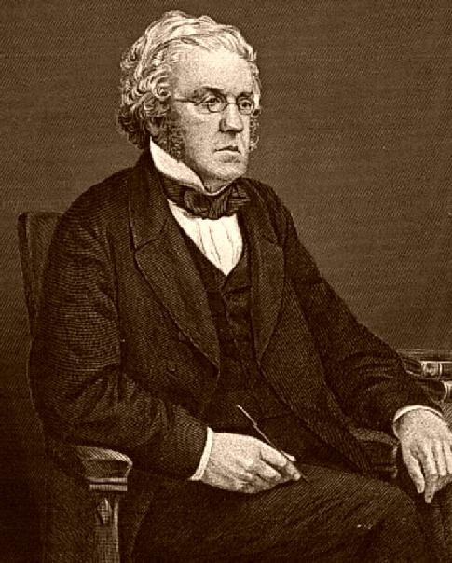
He went to Trinity College, Cambridge, where he made a lot of friends, but left without a degree. He visited Paris a lot and built up large gambling debts. On coming of age (21) he inherited a good fortune which made him independent and able to pay off his debts. But, unfortunately, a few years later the bank holding his money failed, and he was left penniless and needed to earn a living.

Slide 5
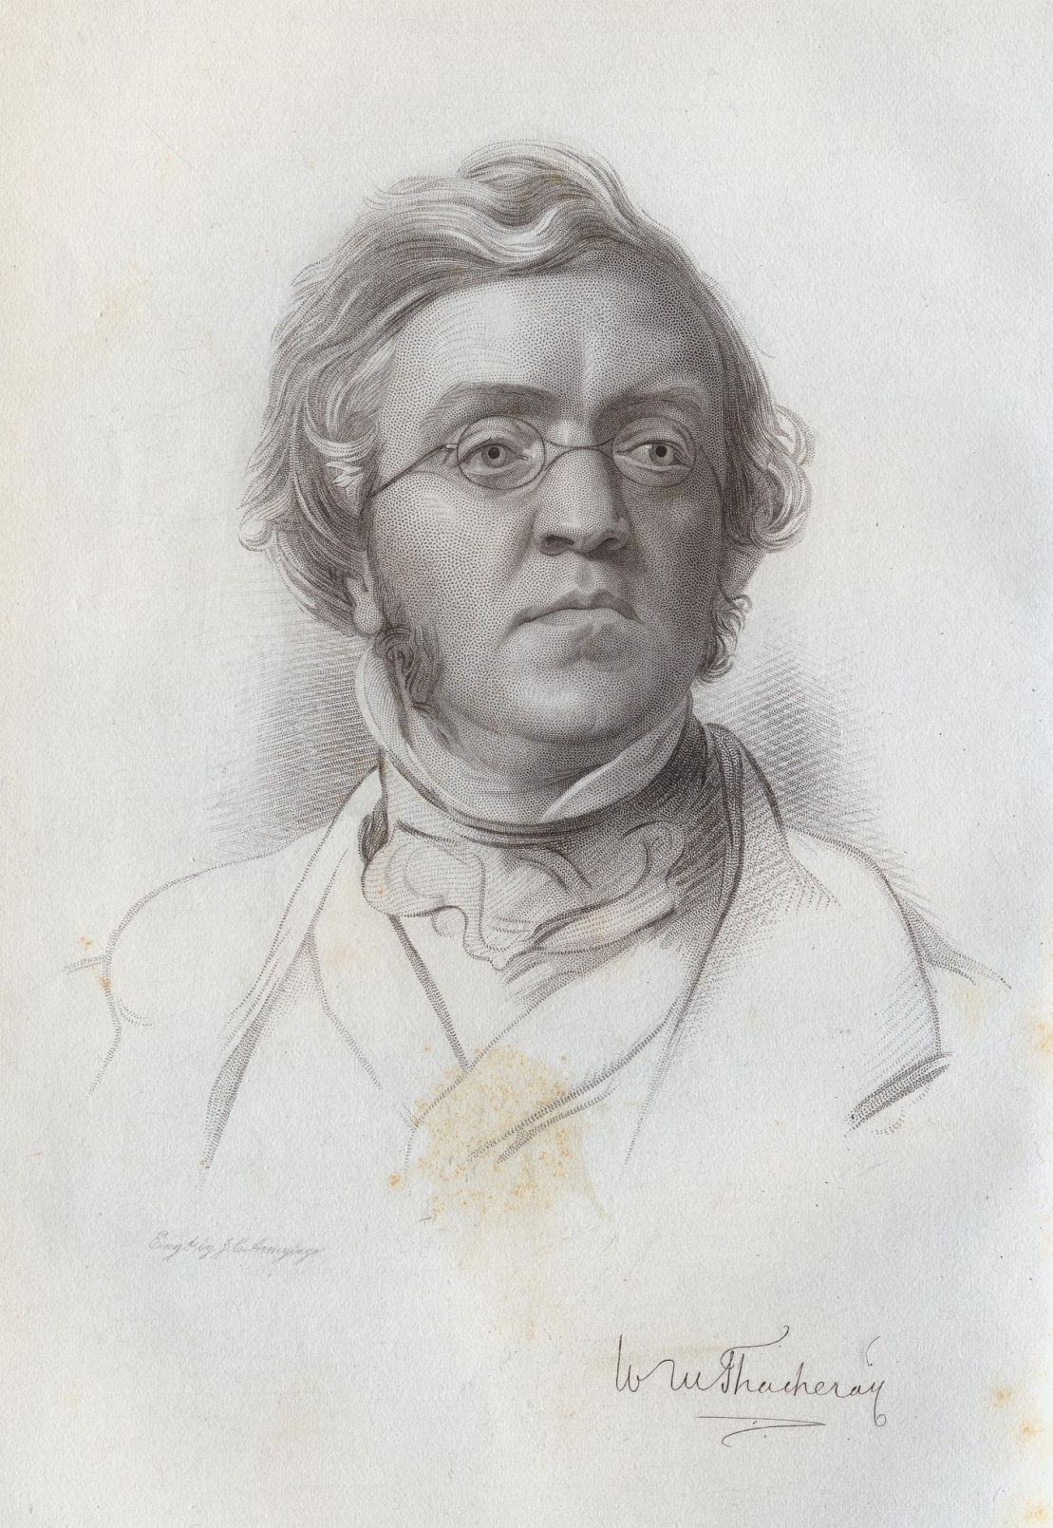
He married Isabella Gethin Shawe in 1836. They had 3 daughters born, but one died when only 8 months old.

Slide 6
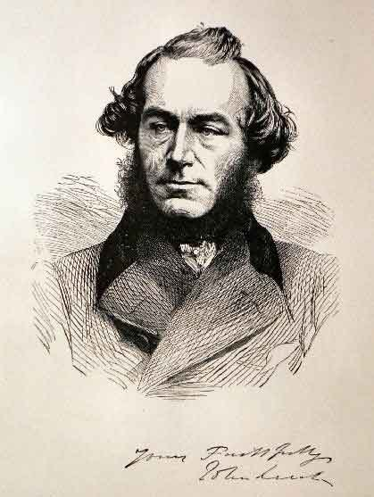
After 1840 the mental health of Isabella began to deteriorate and she eventually had to be put into full-time care. This meant that in fact he had no wife but he could not re-marry.

Slide 7
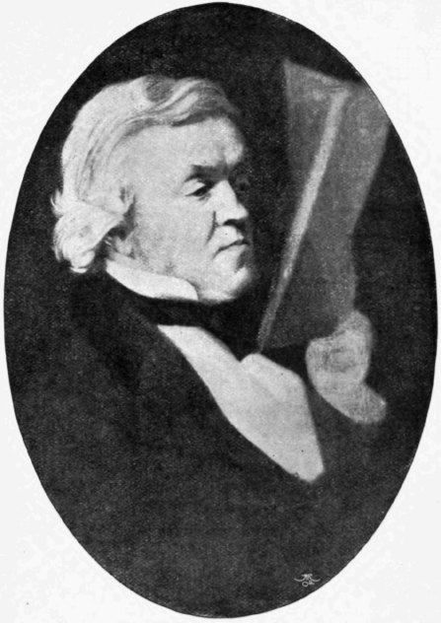
He formed a few attachments to other women, but the exact nature of these is not known with any certainty.

Slide 8
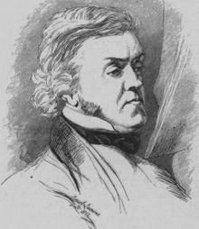
He had some natural ability as an artist, and attended art schools in London and Paris, but it was his writing that proved to be the only thing from which he could make a living.

Slide 9
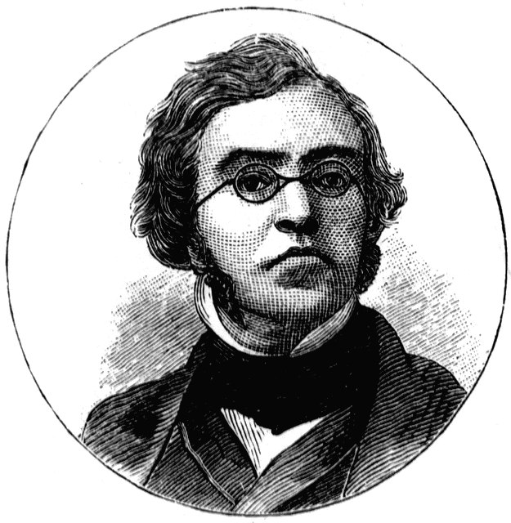
Progess in the literary world was not easy. It was only in about the last 10 years of his life that his financial life could be described as comfortable. Unfortunately he did not enjoy the best of health and suffered some very serious ilnesses.

Slide 10
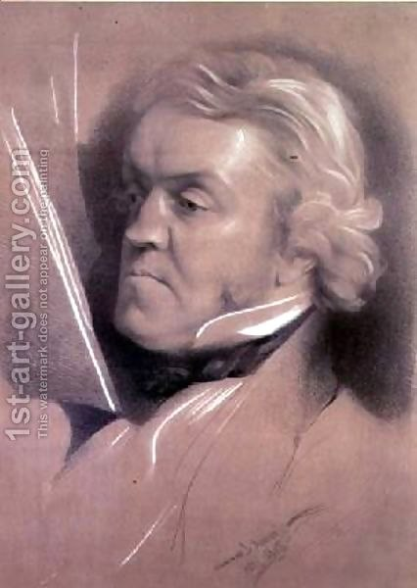
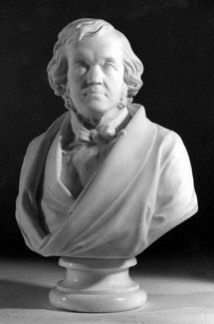
He died on 23rd December 1863 in London, aged 53.

Slide 11
Most of his work was originally published in serial form (as with Dickens) and gathered into a book-form a year or so later. Some of his better-known works are: 1848 Vanity Fair 1849 The History of Pendennis 1852 The Memoirs of Barry Lyndon 1852 The History of Henry Esmond 1854 The Newcombes 1855 The Rose and the Ring 1858 The Virginians

Slide 12
Made by Kseniya Klimenko Form 10-A

