Slide 1
List of most visited museums in the United Kingdom
Lemak Andriana
10 class

Slide 2
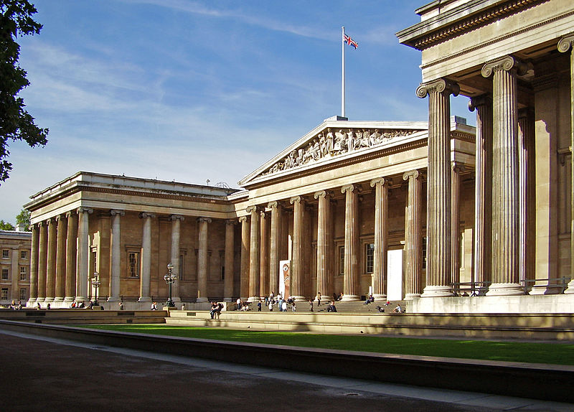
British Museum
The British Museum is a museum in London dedicated to human history and culture. Its permanent collection, numbering some 8 million works, is among the largest and most comprehensive in existence and originates from all continents, illustrating and documenting the story of human culture from its beginnings to the present.

Slide 3
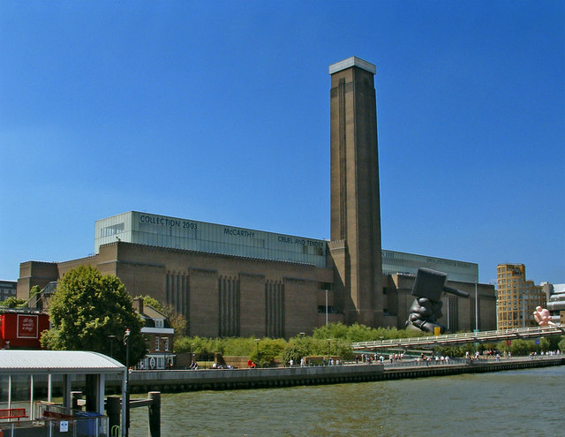
Tate Modern
Tate Modern is a modern art gallery located in London. It is Britain's national gallery of international modern art and forms part of the Tate group (together with Tate Britain, Tate Liverpool, Tate St Ives and Tate Online).It is the most-visited modern art gallery in the world, with around 4.7 million visitors per year.

Slide 4
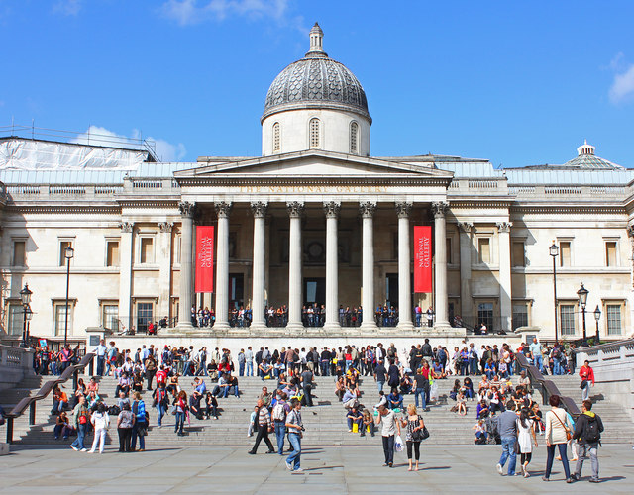
National Gallery
The National Gallery is an art museum on Trafalgar Square in London. Founded in 1824, it houses a collection of over 2,300 paintings dating from the mid-13th century to 1900. Its collection belongs to the public of the United Kingdom and entry to the main collection is free of charge.

Slide 5
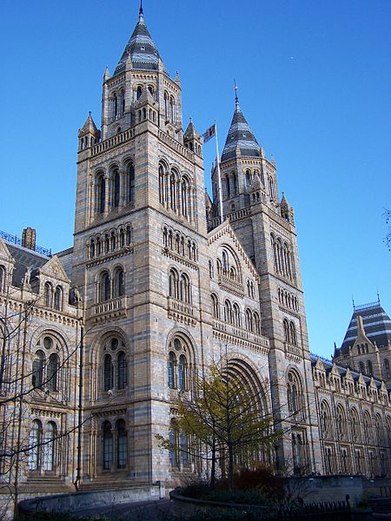
Natural History Museum
The Natural History Museum in London is a museum exhibiting a vast range of specimens from various segments of natural history . The museum is home to life and earth science specimens comprising some 70 million items within five main collections: botany, entomology, mineralogy, palaeontology and zoology. Like other publicly funded national museums in the United Kingdom, the Natural History Museum does not charge an admission fee.

Slide 6
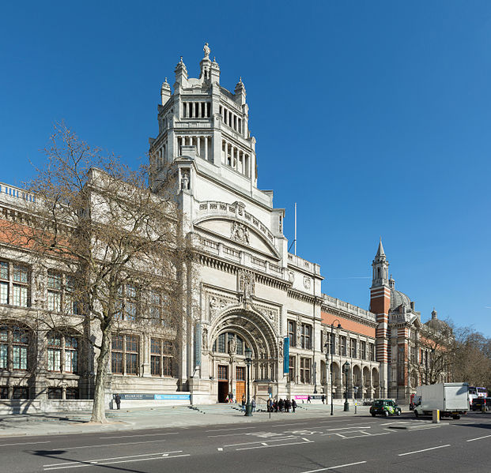
Victoria and Albert Museum
The Victoria and Albert Museum, is the world's largest museum of decorative arts and design, housing a permanent collection of over 4.5 million objects. It was founded in 1852 and named after Queen Victoria and Prince Albert. The V&A is located in the Brompton district of the Royal Borough of Kensington and Chelsea, in an area that has become known as "Albertopolis" because of its association with Prince Albert, the Albert Memorial and the major cultural institutions with which he was associated.

Slide 7
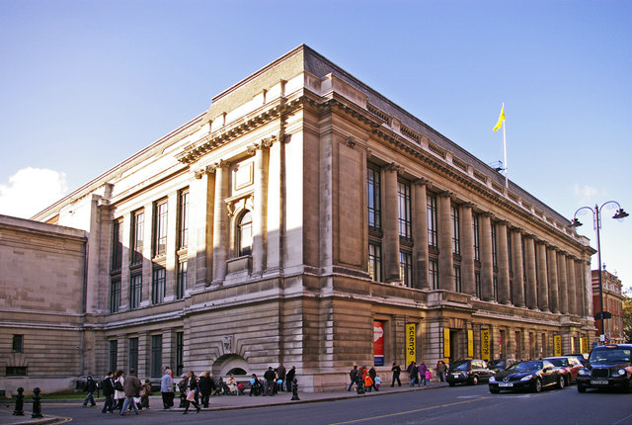
Science Museum
The Science Museum is one of three major museums on Exhibition Road in South Kensington, London. It was founded in 1857 and today is one of the city's major tourist attractions, attracting 2.7 million visitors annually.

Slide 8
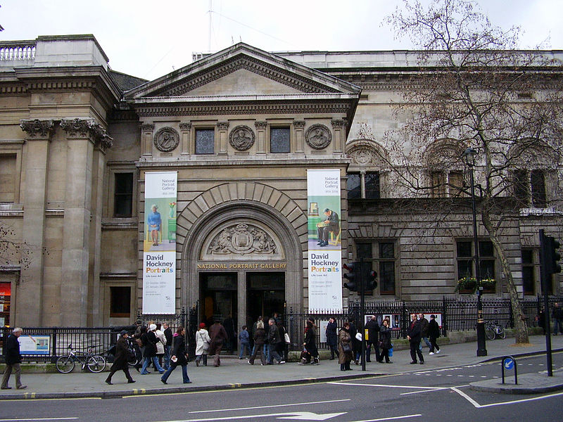
National Portrait Gallery
The National Portrait Gallery (NPG) is an art gallery in London housing a collection of portraits of historically important and famous British people. It was the first portrait gallery in the world when it opened in 1856.

Slide 9
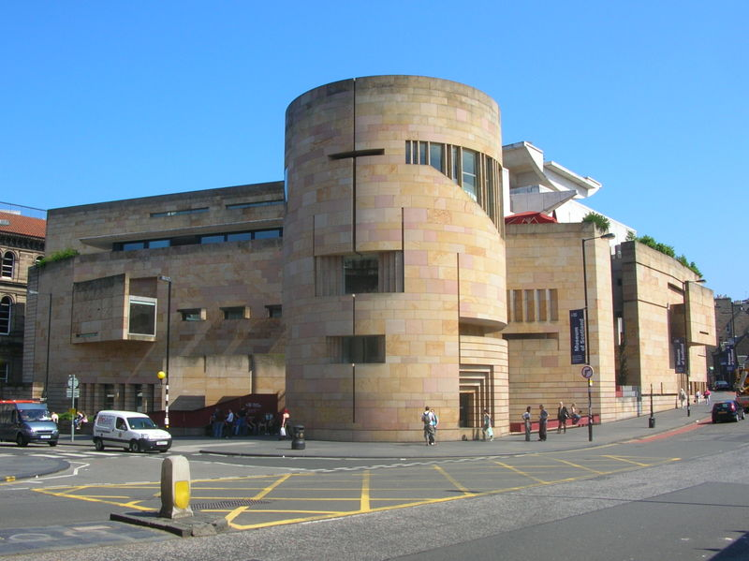
Museum of Scotland
National Museums Scotland was formed by Act of Parliament in 1985 [1], amalgamating the former National Museum of Antiquities of Scotland and The Royal Scottish Museum.

Slide 10
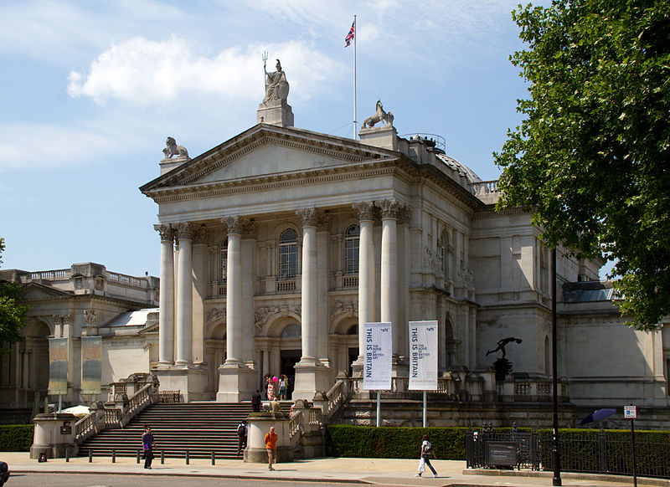
Tate Britain
Tate Britain is an art gallery situated on Mill bank in London. It is part of the Tate network of galleries in England, with Tate Modern, Tate Liverpool and Tate St Ives. It is the oldest gallery in the network, opening in 1897. It houses a substantial collection of the works of J. M. W. Turner.

Slide 11
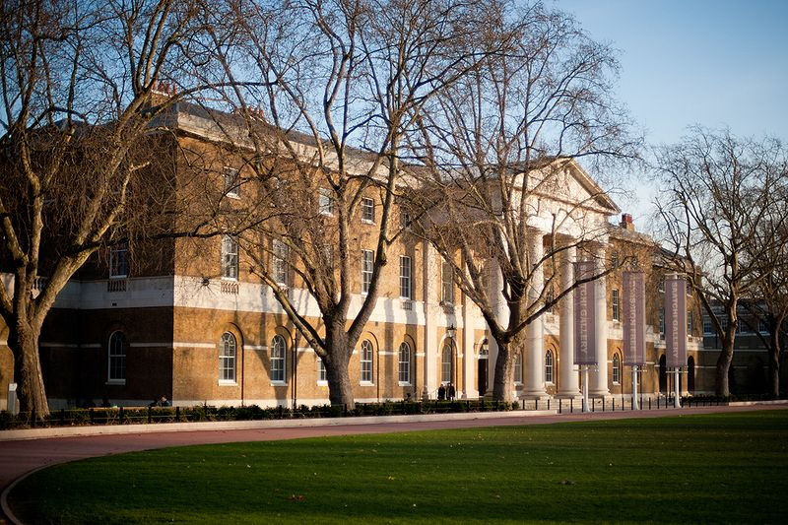
Saatchi Gallery
The Saatchi Gallery is a London gallery for contemporary art, opened by Charles Saatchi in 1985 in order to exhibit his collection to the public. It has occupied different premises, first in North London, then the South Bank by the River Thames, and finally in Chelsea, its current location. Saatchi's collection—and hence the gallery's shows—has had distinct phases, starting with US artists and minimalism, moving to the Damien Hirst-led Young British Artists, followed by shows purely of painting and then returning to contemporary art from America in USA Today at the Royal Academy in London.

Slide 12
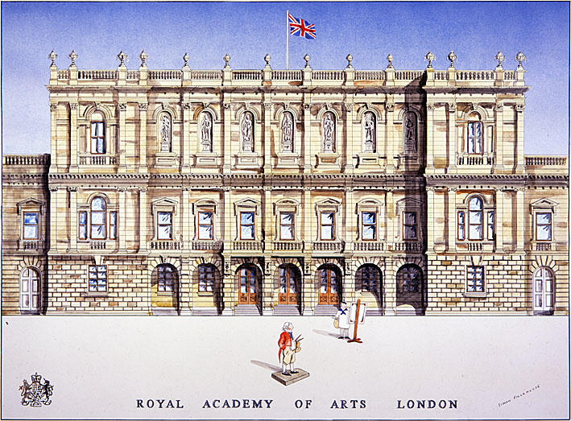
Royal Academy of Arts
The Royal Academy of Arts is an art institution based in Burlington House on Piccadilly in London. It has a unique position as an independent, privately funded institution led by eminent artists and architects; its purpose is to promote the creation, enjoyment and appreciation of the visual arts through exhibitions, education and debate.

Slide 13
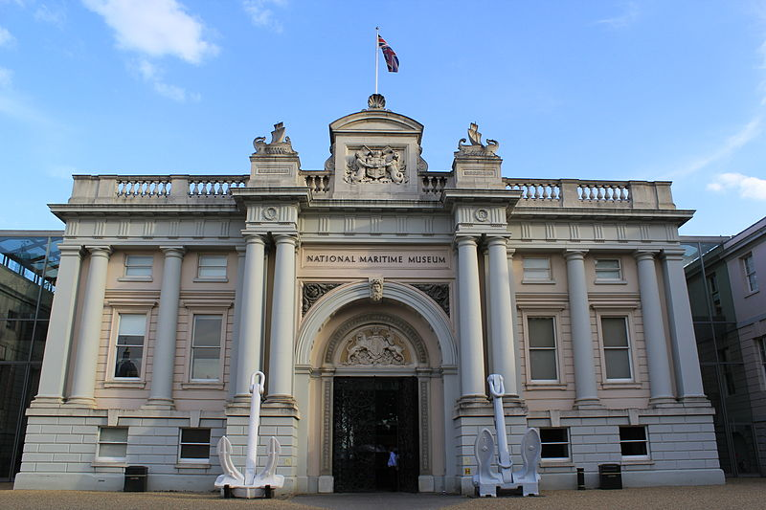
National Maritime Museum
The National Maritime Museum (NMM) in Greenwich, London, is the leading maritime museum of the United Kingdom and may be the largest museum of its kind in the world. The historic buildings form part of the Maritime Greenwich World Heritage Site, and it also incorporates the Royal Observatory, and 17th-century Queen's House.

Slide 14
Goodbye:*

