Slide 1
How to Cook a
Christmas Pudding ?
Підготував :
Учень 10 класу
Кійко Едуард

Slide 2

I Hope
You Like
☺

Slide 3

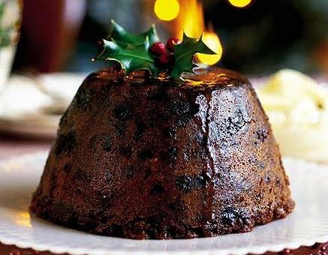
Christmas Pudding
No British Christmas is complete without a Christmas Pudding

Slide 4

To Cook a Christmas Pudding you need :
500 g / 1 lb currants
500 g / 1 lb raisins
500 g / 1 1b golden raisins
500 g / 1 lb bread crumbs
500 g / 1 lb brown sugar
250 g / 8 oz suet – get it from a butcher; if you can't find it, substitute with solid vegetable shortening
120 g / 4 oz mixed peel
120 g / 4 oz glace cherries, chopped
120 g / 4 oz almonds, chopped
grated rind of 1 lemon
grated rind of 1 orange
1 carrot, grated
1 apple, grated
6 eggs

Slide 5
Are you ready ?
Let’s begin !

Slide 6
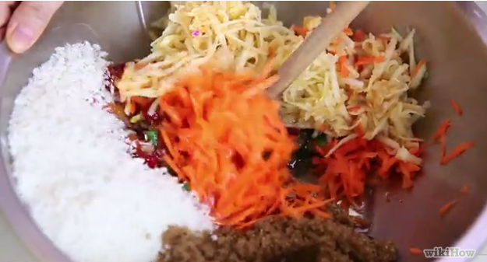
1-st Step
Mix all the ingredients

Slide 7
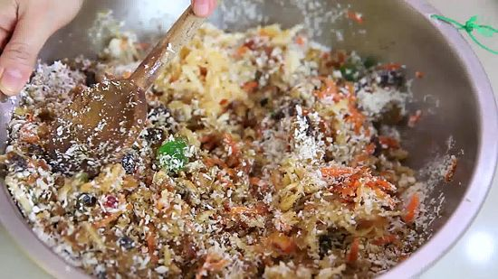
2-nd Step
Mix thoroughly with a wooden spoon.

Slide 8
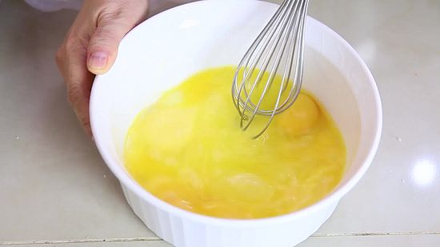
3-rd Step
Beat the eggs. Crack all six eggs into a bowl and beat them lightly with a fork.

Slide 9
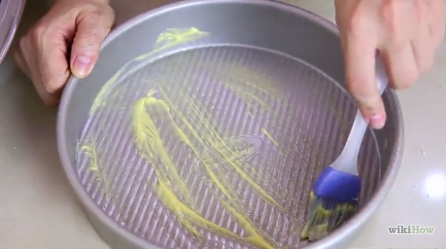
4-th Step
Grease the bowl. Coat the inside of the glass bowl with the knob of butter.

Slide 10
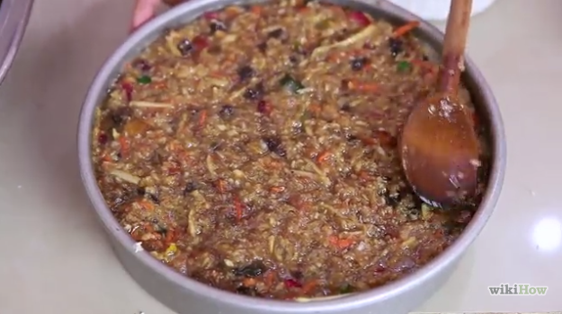
5-th Step
Transfer. Put the pudding mix into the bowl, pressing it down lightly and giving a final pat to make it level.

Slide 11
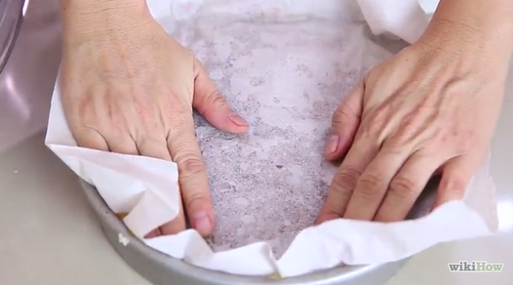
6-th Step
Cover and seal. Place the circular piece of parchment paper over the mix, and gently press it down and around the edges.

Slide 12
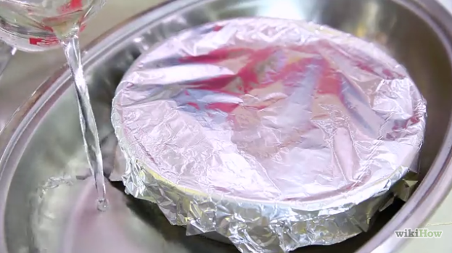
7-th Step
Make a Bain Marie. Place the bowl into the saucepan.

Slide 13
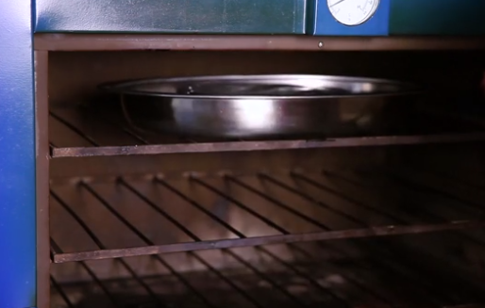
8-th Step
Cook the pudding. Place the saucepan onto a high heat and bring the water to a boil. Once it is boiling, turn it down to a gentle simmer and allow to simmer for roughly 4 hours.

Slide 14
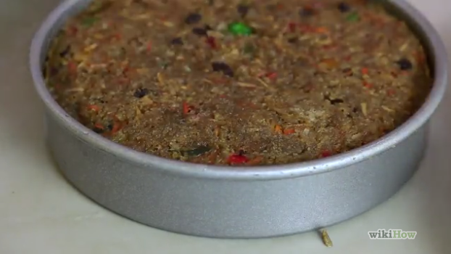
9-th Step
Remove the pudding from the heat after this time. Take off the tin foil.

Slide 15
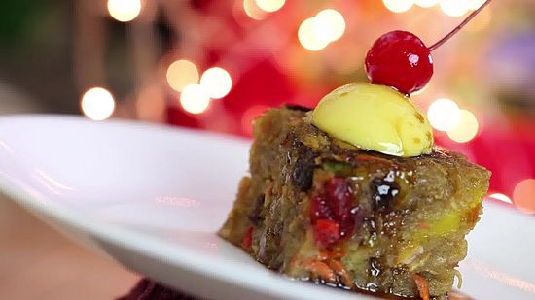
10-th Step
Serve. Your Christmas pudding is now ready to serve!

Slide 16
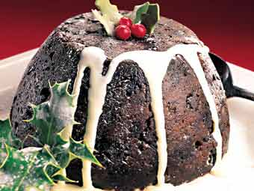
Our Christmas Pudding is Ready !
Bon Appetit !

Slide 17


And
Merry Christmas !

