Slide 1
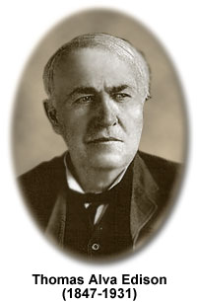

Slide 2
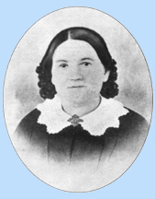
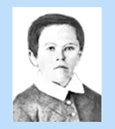
Early Years
Thomas Edison was born on Feb. 11, 1847
In 1854, his family moved to the vibrant city of Port Huron, Michigan
At age seven, Edison was taken out of school and home-schooled by his mother for the rest of his childhood.

Slide 3
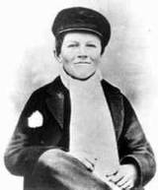
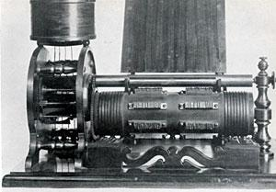
Thomas Edison: The Inventor
After holding a position as a full time Telegrapher, Edison arrived in Boston in 1868 where he changed his profession.
Edison received his first patent on an electric vote recorder.

Slide 4
Edison’s Inventions
Edison earned 1,093 United States patents, a record number for one person that still stands.
Some of his inventions include the Cylinder Phonograph, Kinetoscope, the incandescent lightbulb, alkaline battery and many others that changed society.

Slide 5
