Slide 1
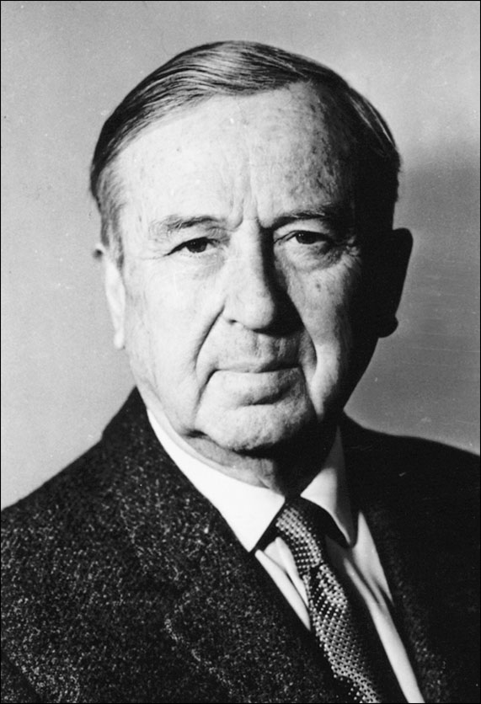
Mykola
Glushchenko
September 17, 1901, Novomoskovs'k, Dnipropetrovsk region - † 31 October 1977
Завалкевич Анастасія
Учениця 11-Б

Slide 2
Ukrainian Soviet artist
was educated in Germany
Famous Ukrainian leaders supported it. For example, Hetman P. Skoropadsky paid studying and Vladimir Vynnycenko helped organize the first solo exhibition of Berlin
eventually moved from Berlin to Paris, he opened an art studio in the street Volunteers, 23, is attended by representatives of Ukrainian and Russian emigration.

Slide 3
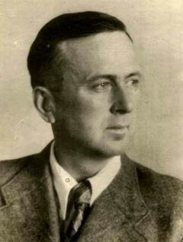
Interesting fact!
Soviet spy ("Jarema“)
He taught Hitler to draw

Slide 4
He had nearly 50 solo exhibitions and participated in over 200 group.
His works are in museums in Ukraine, Russia, France, USA, Canada and other countries.
People's Artist of Ukraine (1944).
Laureate of the State Prize of Ukraine Shevchenko (1972).
People's Artist of the USSR (1976).

Slide 5
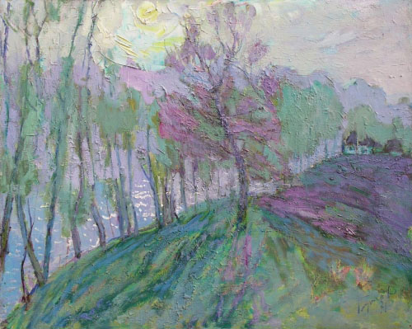
First green
90.000 $

Slide 6
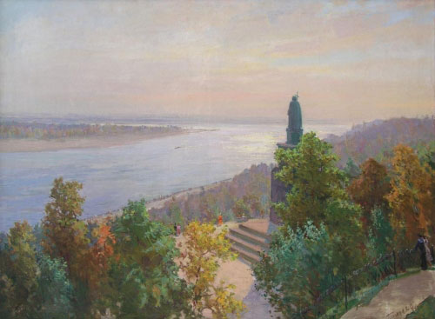
Vladimir Hill
120,000 $

Slide 7
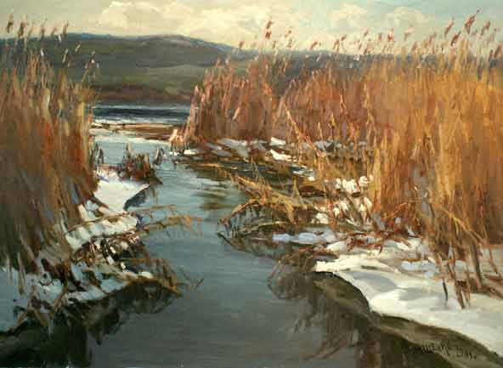

Slide 8
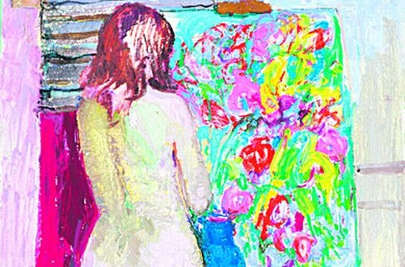

Slide 9
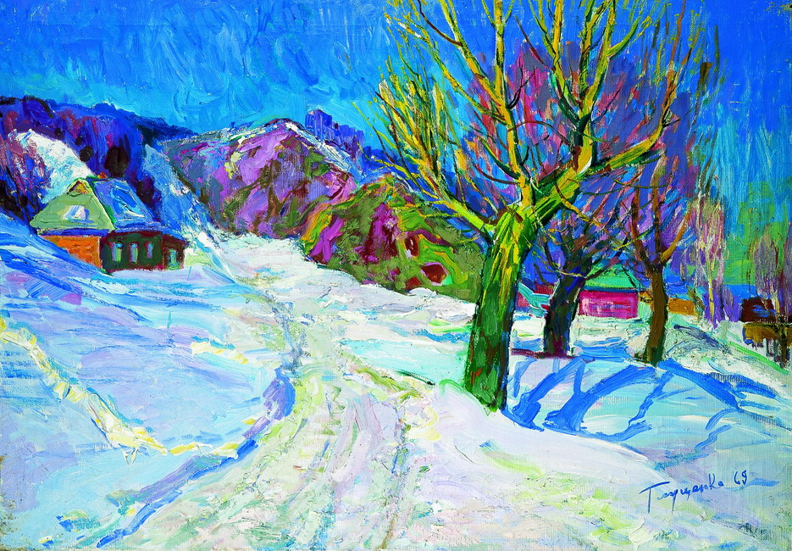
750.000 $

Slide 10
