Slide 1
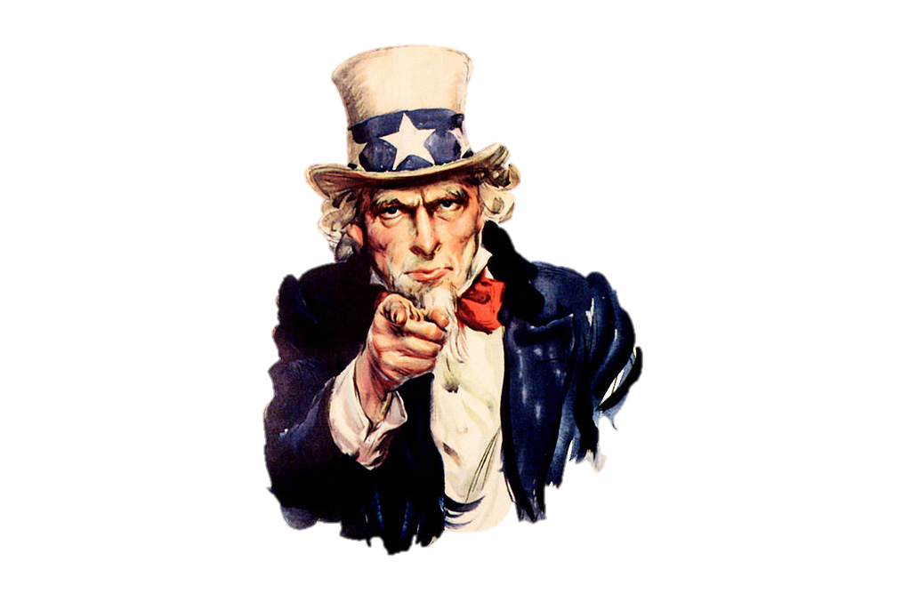
Uncle Sam
Stepanenko Lina

Slide 2
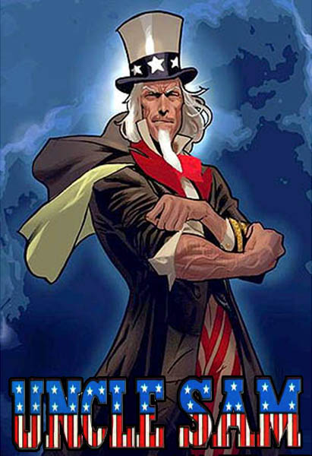
Uncle Sam is the cartoon embodiment of the government of the United States of America, a character who appeared in newspapers and magazines beginning in the first part of the 19th century. Uncle Sam is a name given to The United States Government. So it is located in Washington D. C.

Slide 3
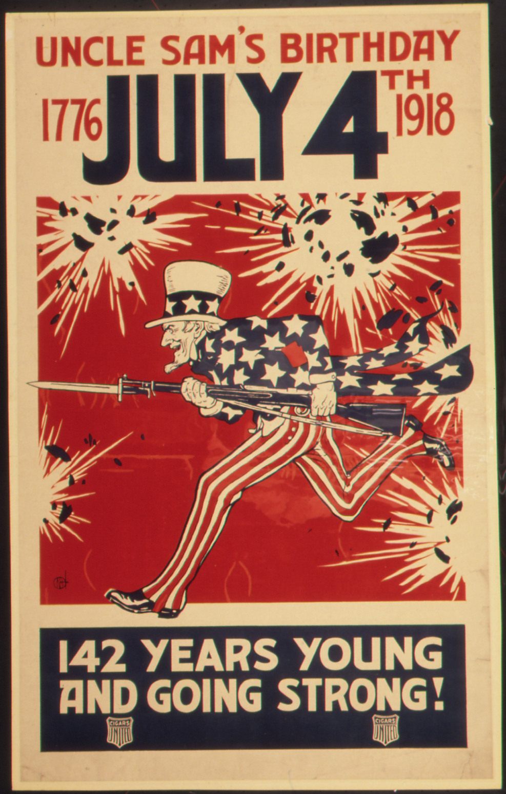
Uncle Sam was first mentioned in public print as early as 1813 and later was connected to Sam Wilson by the New York Gazette on May 12, 1830.
Uncle Sam was first portrayed in human form by cartoonist Frank Bellew in the March 13th, 1852 issue of the New York Lantern.

Slide 4
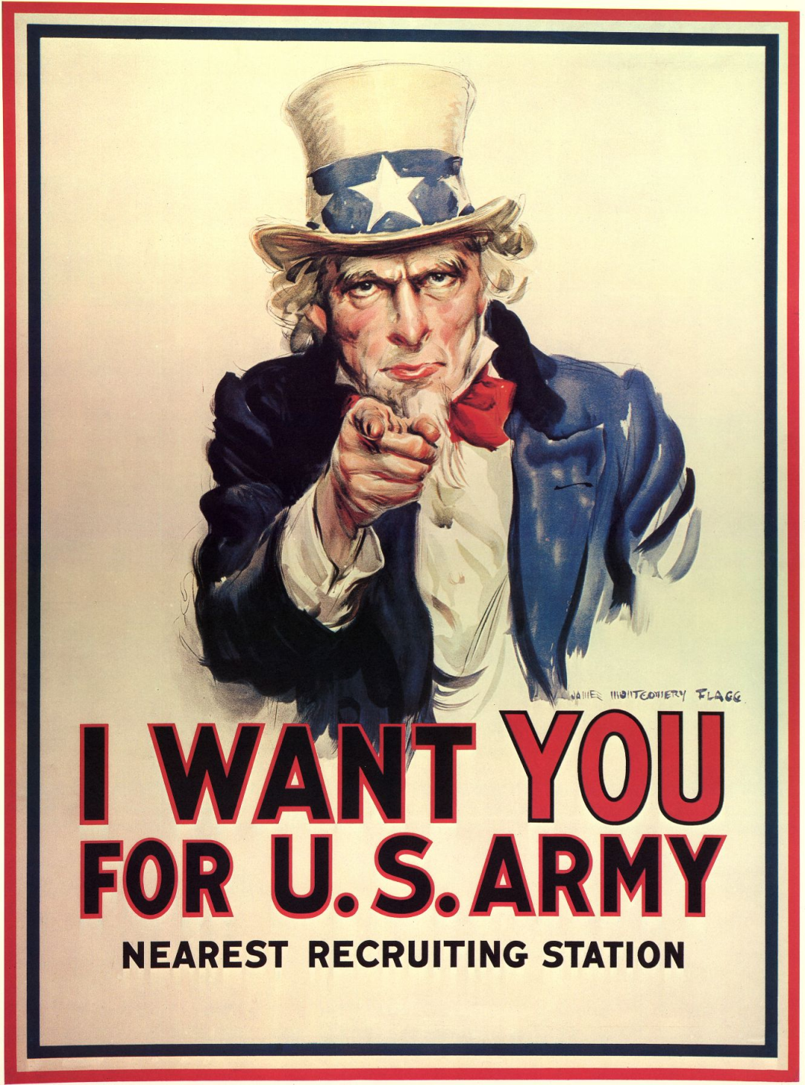
The famous recruiting image of the Uncle Sam during WWI that depicted a stern Uncle Sam pointing his finger and saying “I want you” was drawn by artist James Montgomery Flagg in 1917. This was based on a famous series of British war recruitment posters featuring Lord Kitchener and is now the standard image used to depict Uncle Sam.

Slide 5
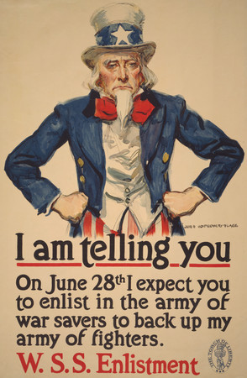
The “Abe Lincoln” look, along with the star spangled outfit, was the brain child of political cartoonist Thomas Nast in the late 1800s ( Nast also came up with the popular image of Santa Claus, the Republican Elephant, and the Democratic Donkey)

Slide 6
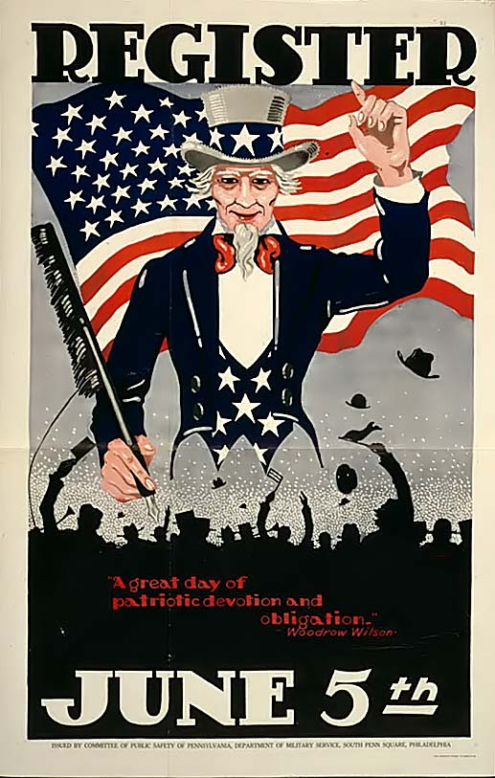
The Senate and the House of Representatives officially saluted Uncle Sam Wilson of Troy, New York, as the progenitor of America’s National symbol of Uncle Sam, including creating a national monument marking his birthplace in Arlington Massachusetts and his burial site in Oakwood Cemetery, Troy, New York.

Slide 7

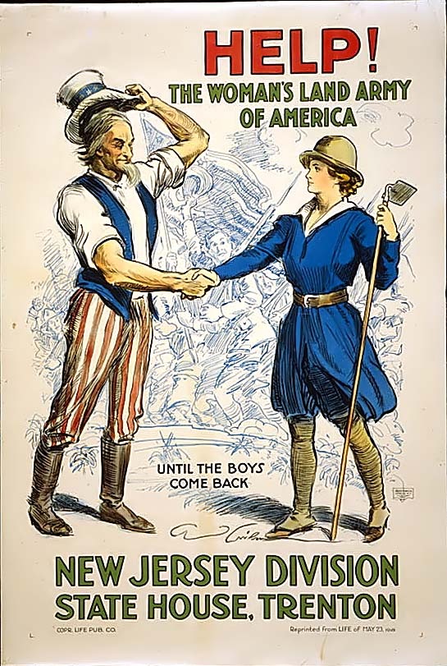


Slide 8
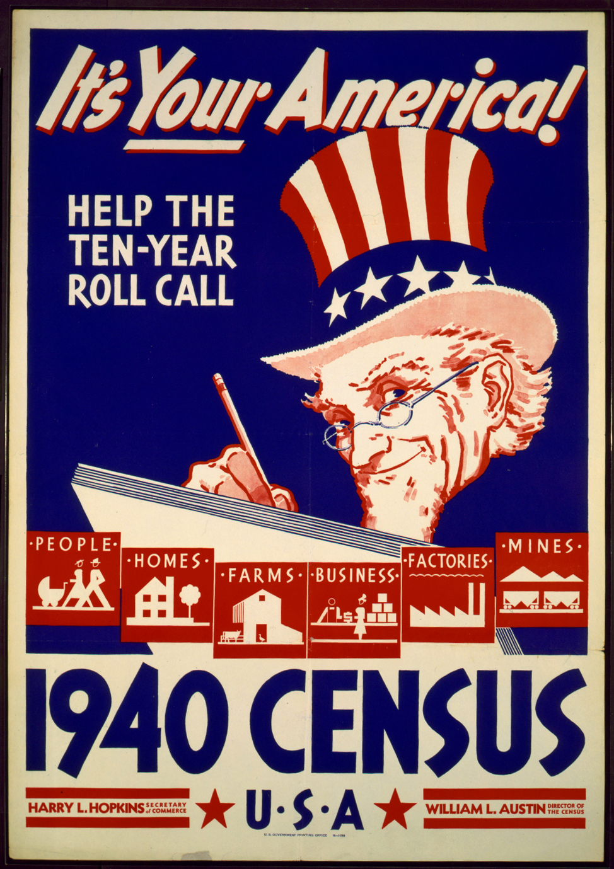
Is Sam Houston Uncle Sam?
‘Uncle Sam’ was a real person, Samuel Wilson, born September 13th, 1766 and died on July 31st, 1854.
Sam came from the American Revolution and some historians think he was a real person. It is thought he delivered food to Valley Forge. Well, over 100 years later Sam Houston was born. They are not connected. Uncle Sam showed up again in WW1 posters to convince men to enlist.

Slide 9
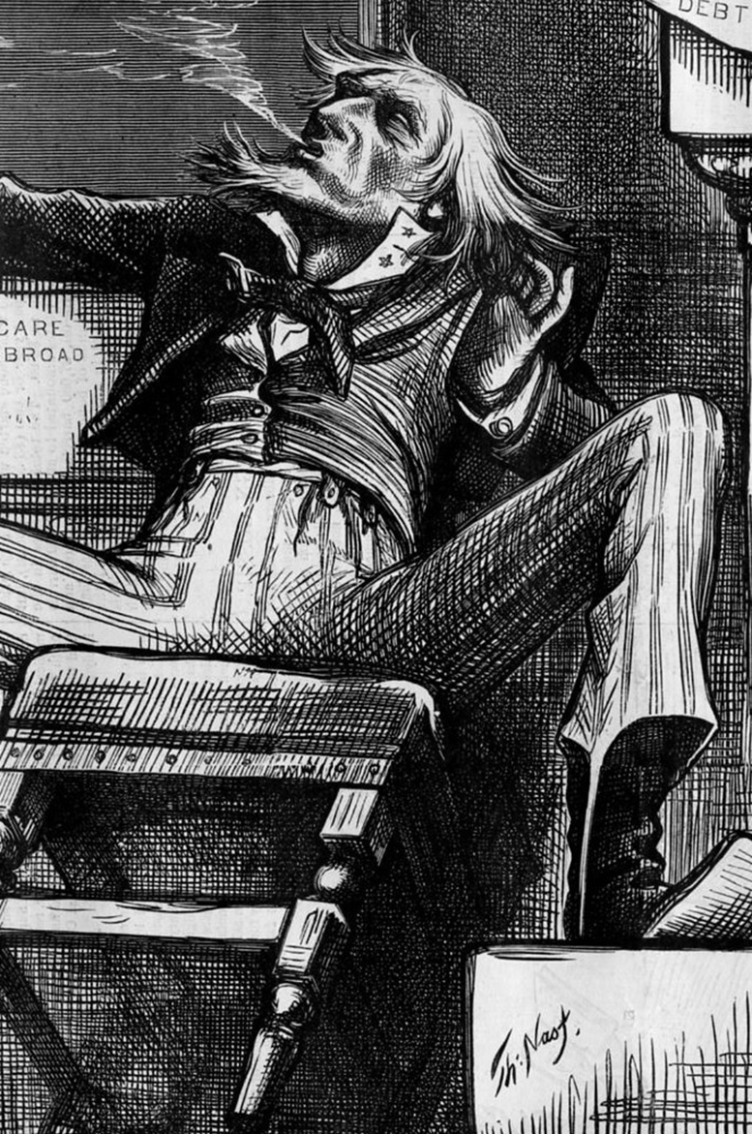
When did Uncle Sam die?
Samuel Wilson was a meat-packer from Troy, New York whose name is purportedly the source of the personification of the United States, known as "Uncle Sam." He died on 31 July 1854.
Uncle Sam, as the personification of the United States, the way John Bull is a personification of Great Britain, has not and cannot die because personifications do not live or die - they are symbols.

Slide 10
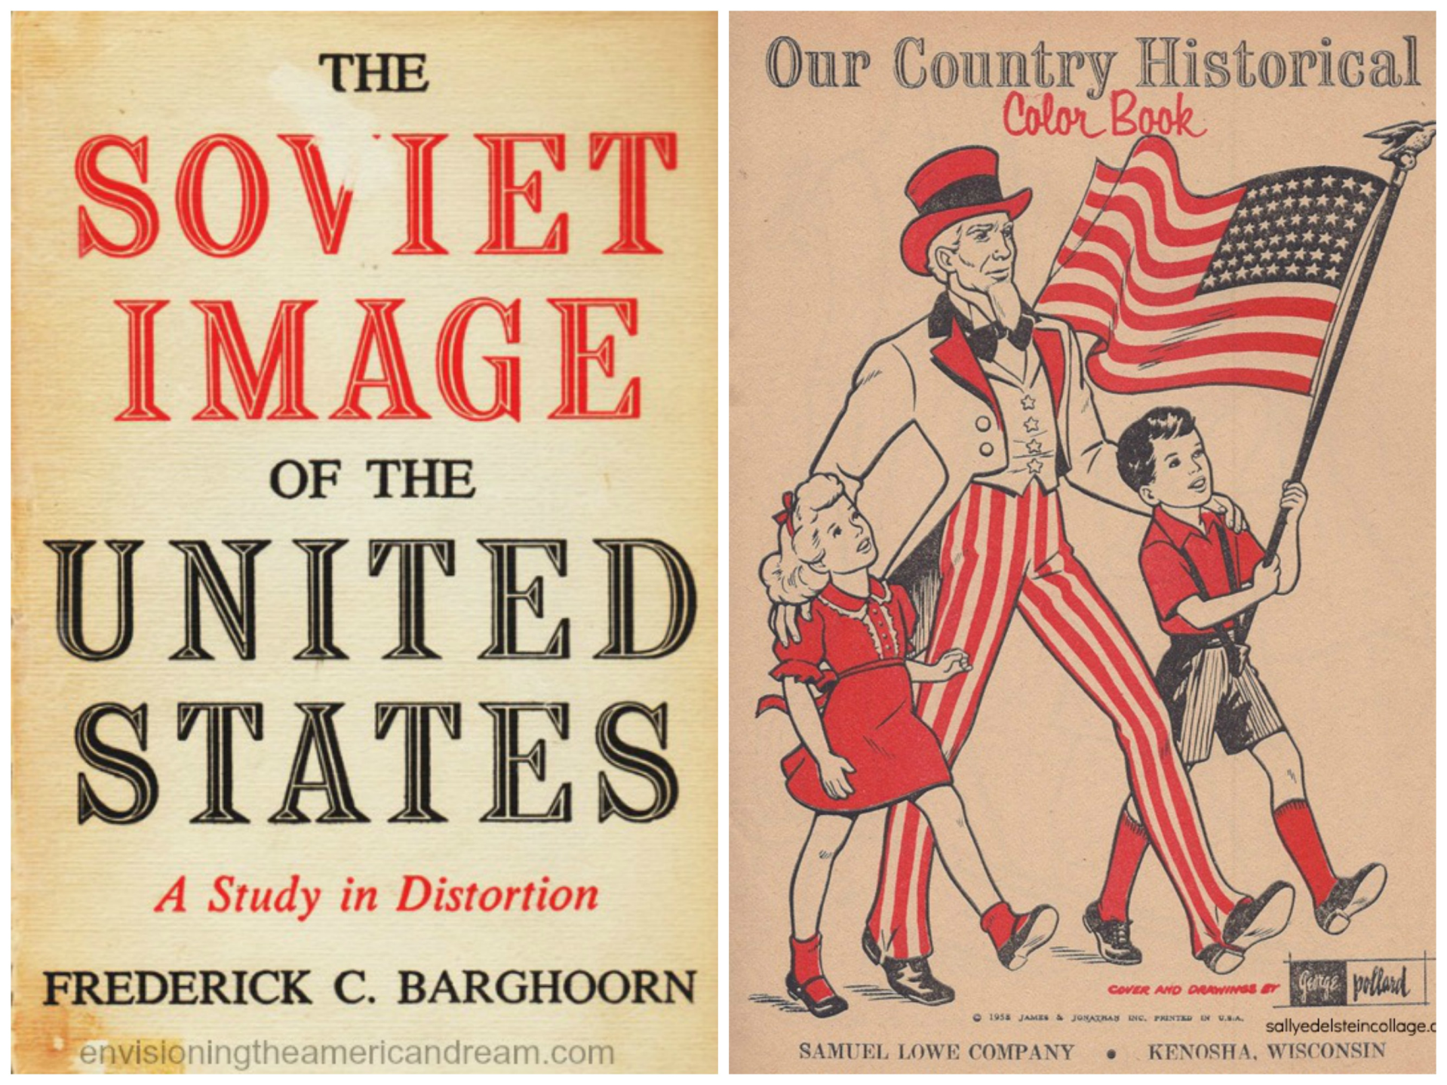

Slide 11
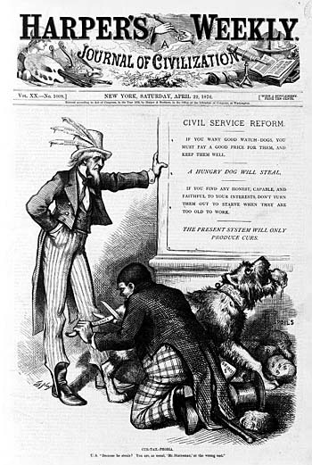
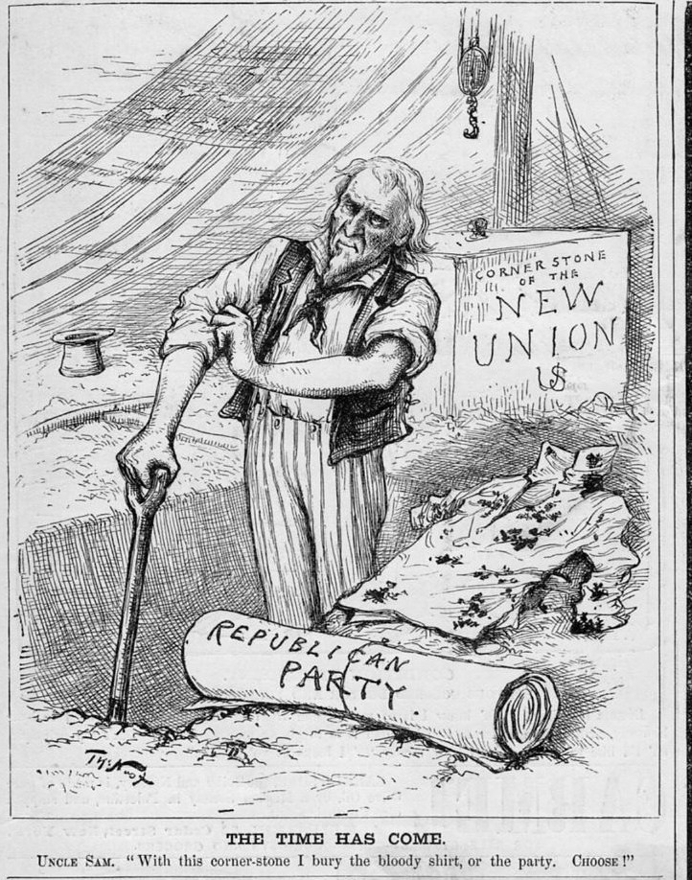

Slide 12
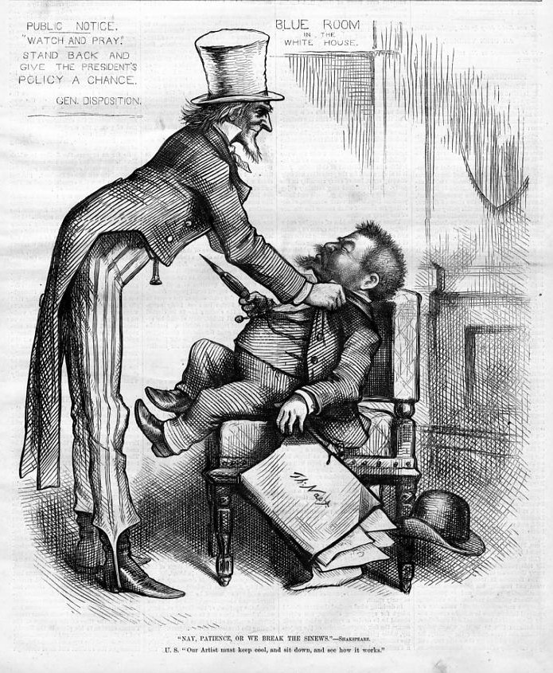
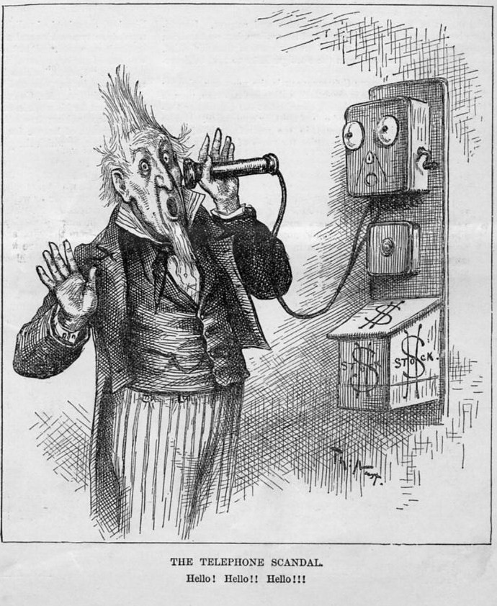

Slide 13
