Slide 1
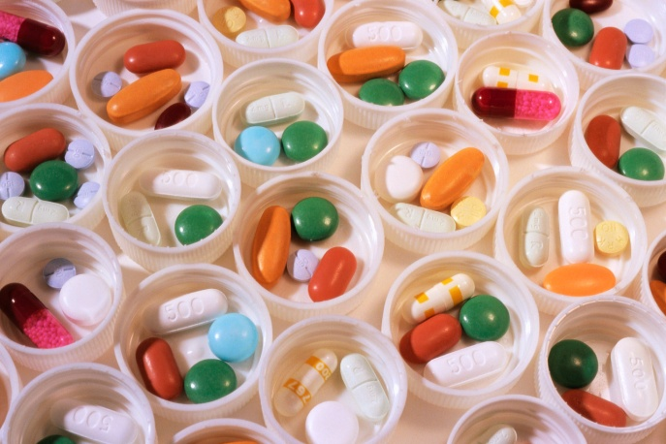

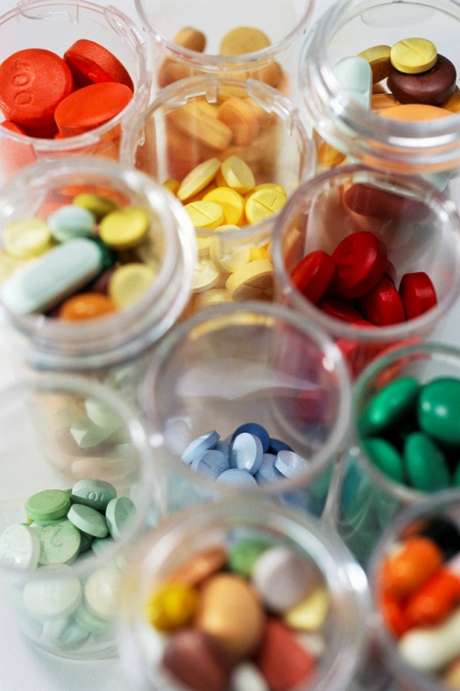
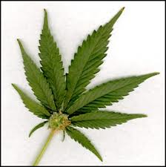
SAY NO TO DRUGS
The presentation
was prepared by
Halyna Bilyk

Slide 2
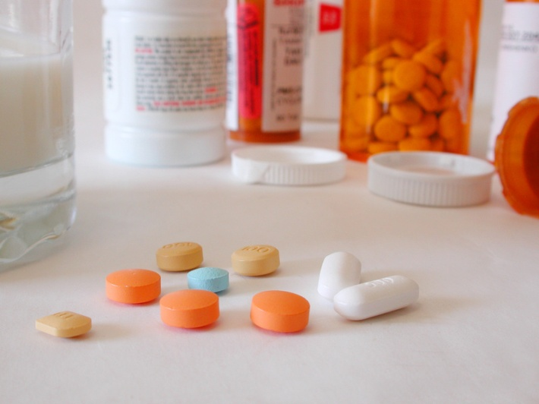
WHAT ARE DRUGS?
Drugs are chemical substances that affect both your mind and your body. The prolonged use of drug may lead to physical and/or psychological dependence. An overdose of any drug may lead to death.

Slide 3
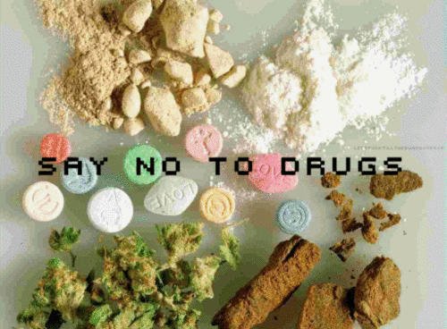

Slide 4
HELP YOURSELF
How to Help Yourself
Get educated
Know your facts
Take advantage of activities and events that do not involve alcohol or drugs
Choose to stay in control
Address possible underlying problems (such as a variety of anxiety concerns, depression, self esteem issues, trauma, family and relationship concerns)
Get help at the counseling office in: Nicol Hall 2nd floor room 4-1 (Beirut Campus) Student Center, ground floor (Byblos Campus)

Slide 5
HELP A FRIEND
How to Help a Friend
Get educated
Know your facts
If the friend is intoxicated stay with them
If you notice difficulty breathing, staying awake, body that feels too warm or too cold, lack of balance & eye contact and slurred speech call for help
If you notice on-going problem with drugs &/or alcohol address your concerns with your friend (for how to do that consult with your campus counselor)
Get help at the counseling office in: Nicol Hall 2nd floor room 4-1 (Beirut Campus) Student Center, ground floor (Byblos Campus)

Slide 6
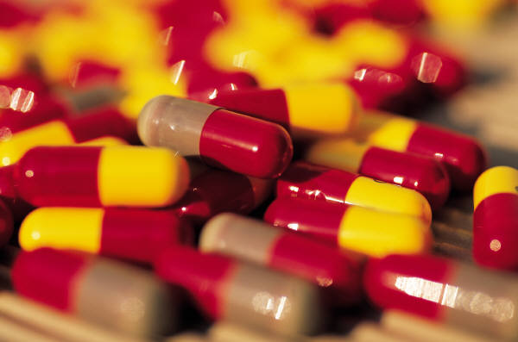
TYPES OF DRUGS, THEIR COMMON NAMES,
AND POTENTIAL HEALTH RISKS
The following list includes the various kinds of drugs, common names of drugs, and descriptions of the possible health risks. This list is not extensive, and other risks may be involved.

Slide 7
Drug/street name | Symptoms | Health Effects
Alcohol/beer, wine, wine coolers, whiskey, vodka, tequila, rhum, hard Liquor (1-12 hours effect) | Puffiness of face, redness of eyes, depression, disorientation, shallow respiration, nausea, cold & clammy skin, dehydration. Slurred speech. Impairs muscle coordination, memory & judgment. | Causes depression, aggression, slurred speech, muscular incoordination. Frequent use can lead to cirrhosis of liver, pancreatitis, brain disorders, vitamin deficiencies & malnutrition. Can lead to coma or death in large quantities.
Marijuana/pot, reefer, grass, THC, hash, hash oil, herb, cannabis (2-4 hours effect) | Euphoria, relaxed inhibitions, disoriented behavior, staring off into space, hilarity without cause. Time distortion. Bloodshot eyes, dry mouth & throat, increased appetite. Fatigue, hallucinations, depression. | Can impair memory perception & judgment by destroying brain cells. Raises blood pressure. Contains more known carcinogens (poisons) than Cigarettes.

Slide 8
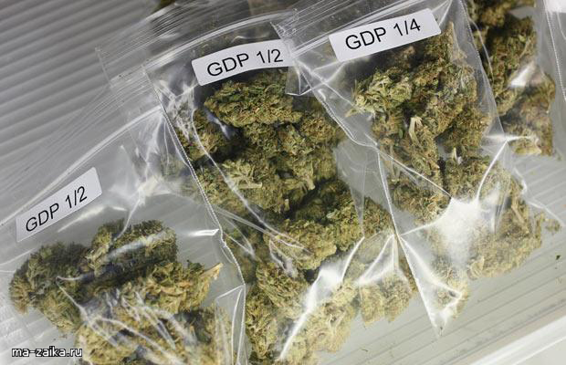
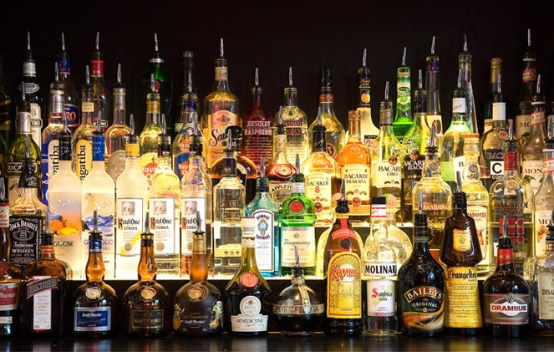
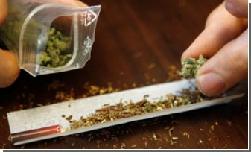
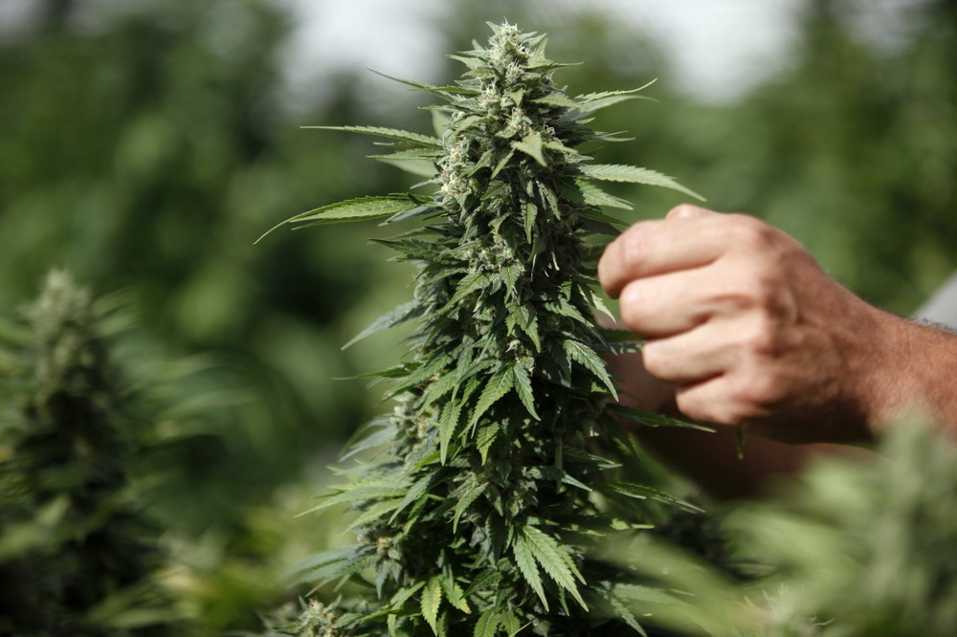


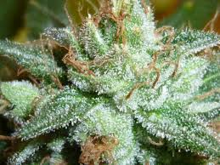

Slide 9
Drug/street name | Symptoms | Health Effects
Barbiturates,methalqualone quaaludes, ludes, yellow jackets, red devils, blue devils, Nembutal, Seconal, sopors, Valium Tranxene, Xanax,Librium (1-16 hours effect) | Slurred speech, disorientation, drunken behavior with no odor of alcohol. Sedation, fatigue. Decreased breathing, pulse & blood pressure. | Can cause slurred speech, staggering gait, poor judgment, & slow, uncertain reflexes. Large doses can cause unconsciousness and death. Mixing of these depressants with alcohol causes thousands of accidental deaths.
Cocaine/coke, snow, blow, gold dust, lady, Bernice, C, toot (1/2 to 2 hours effect) | Apathy, anxiety, sleeplessness, paranoia, hallucinations, craving for more cocaine. Weight loss. Constant sniffing. Mood swings. | Causes dilated pupils, increased blood pressure, heart rate, breathing rate, & body temperature. Can cause seizures, heart attacks and death.
Crack Cocaine/crack, rock (5-10 minute effect) | Same as cocaine. | More & stronger cocaine is getting to the brain quicker, increasing risks of cocaine use.

Slide 10
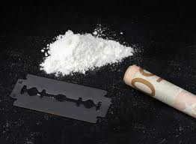
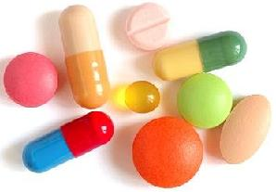
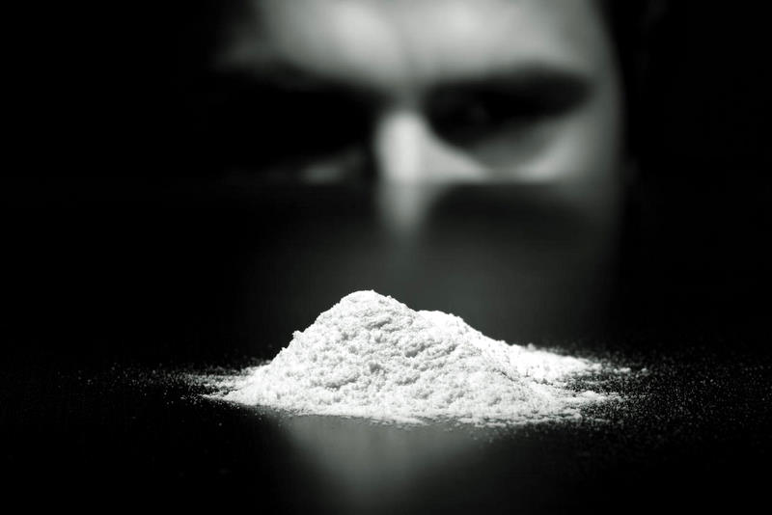
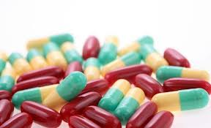
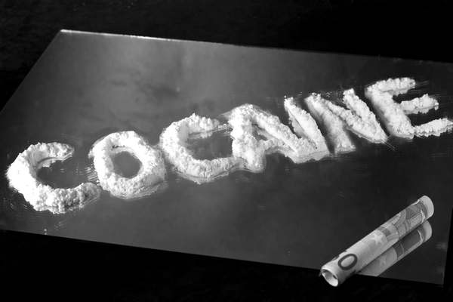
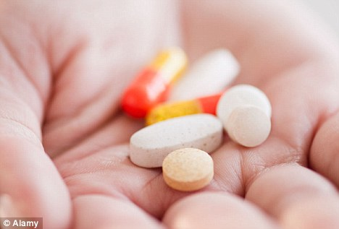
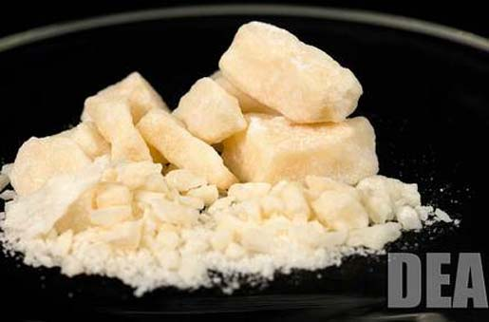

Slide 11
Drug/street name | Symptoms | Health Effects
Amphetamines/uppers, speed, black beauties, dexies, bennies, crystal meth, crank, crystal, ice, hearts, crossroads, white crosses, caffeine, nicotine, diet pills(1/2 to 2 hours effect) | Decreased appetite, dilated pupils, sleeplessness, agitation, unusual increase in activity, mood swings, paranoia, anti-social behavior, loss of appetite, anxiety, weight loss. | Increases heart rate, breathing rate, blood pressure. High doses can cause tremors, loss of coordination & death from stroke or heart failure. Frequent use of large amounts can produce brain damage, ulcers, malnutrition, hallucinations, convulsions & coma.
PCP (phencyclidine)/angel dust, killer weed, crystal cyclone, elephant tranquilizer, rocket fuel (Variable effects) | Sweating, dizziness, numbness, hallucinations, confusion, agitation. Violence and aggression or silence & withdrawn state. Poor perception of time and distance. Overdose can lead to death. | Increased heart rate, and blood pressure. Large doses cause convulsions, comas, heart & lung failure, and ruptured brain vessels. Users may show long-term effects on memory, judgment, concentration, &perception.

Slide 12
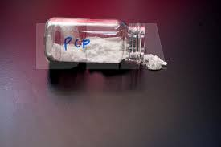
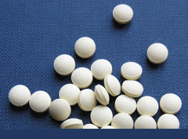
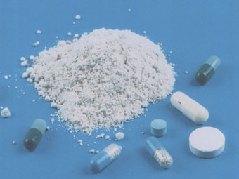

Slide 13
Drug/street name | Symptoms | Health Effects
Heroin/Mexican brown, China White, Persian porcelain, "H", smack, horse, junk, black tar, Codeine, Morphine, Meporidine-demerol, Opium, Paragoric, Percodan, Fentanyal, Darvon, Talwin, Tussionex (12-24 hours effect) | Watery eyes, runny nose, yawning, loss of appetite, tremors, irritability, panic, chills, sweating, cramps, nausea, apathy, euphoria, itching, constricted pupils, reduced vision. | Repeated use can lead to infections of the heart lining & valves, skin abscesses & congested lungs. May cause nausea and vomiting. Can lead to convulsions, coma, & death.
Gas, Glue & Rush/Locker Room, aerosol cans, poppers, snappers,amyl nitrate, gasoline, lighter fluid, whippets. (Inhaled through a saturated cloth or in a bag covering nose and mouth.)(Variable effects) | Lack of coordination, slurred speech, drowsiness, loss of appetite, fatigue. Hallucinations, dizziness, scrambled words & disconnected sentences. Nausea, running nose, decreased heart rate. | Brain damage occurs when used over a long period of time. All these chemicals carry considerable risk, particularly of cardiac arrhythmia. Nausea, vomiting. Can also cause suffocation the first time or any time used.

Slide 14
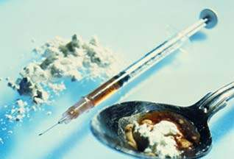
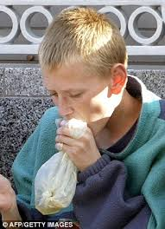
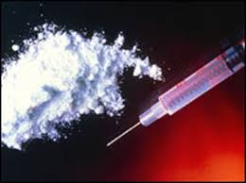
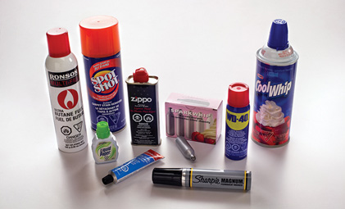

Slide 15
Drug/street name | Symptoms | Health Effects
Hallucinogens/LSD, Mescaline,Peyote, Mesk, buttons, Psilocybin, magic mushrooms, acid, blotteracid, MDA-love drug (3-12 hours effect) | Beady eyes, nervous, erratic behavior, laughing, crying, panic, personality changes, "sees” smells, "hears" colors. Psychological changes can be permanent. Poor perception of time and distance. Overdose can lead to death. | Dilated pupils, nausea, increased blood pressure, hallucinations, stomach cramps, blackouts. Flashbacks, a recurrence of the drug effects, may be a problem for some. Overdose can lead to death.
MDMA/Adam, Ecstacy, X-TC ( A Designer Drug: structural analogs of controlled substances.) (Variable up to days) | Confusion, depression, sleep problems, anxiety, paranoia, muscle tension, involuntary teeth clenching, nausea. | Increased heart rate & blood pressure. Blurred vision, chills, sweating. Believed to cause permanent brain damage.
Steroids/Roids, juice, protein, muscles builder (Variable effect) | Similar to effects of anti-depressants and stimulants. Can increase moodiness and aggressive behavior | Can develop liver cancer, cardiovascular problems, sterility, sexual dysfunction and stunted growth.

Slide 16
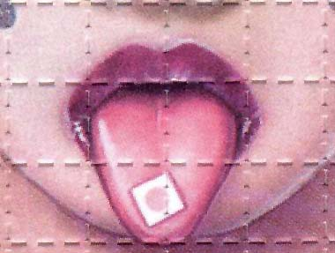
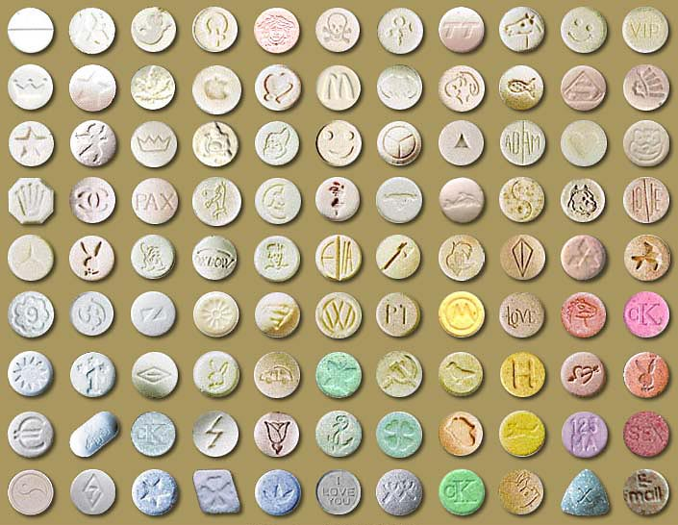
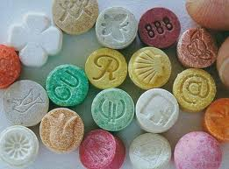
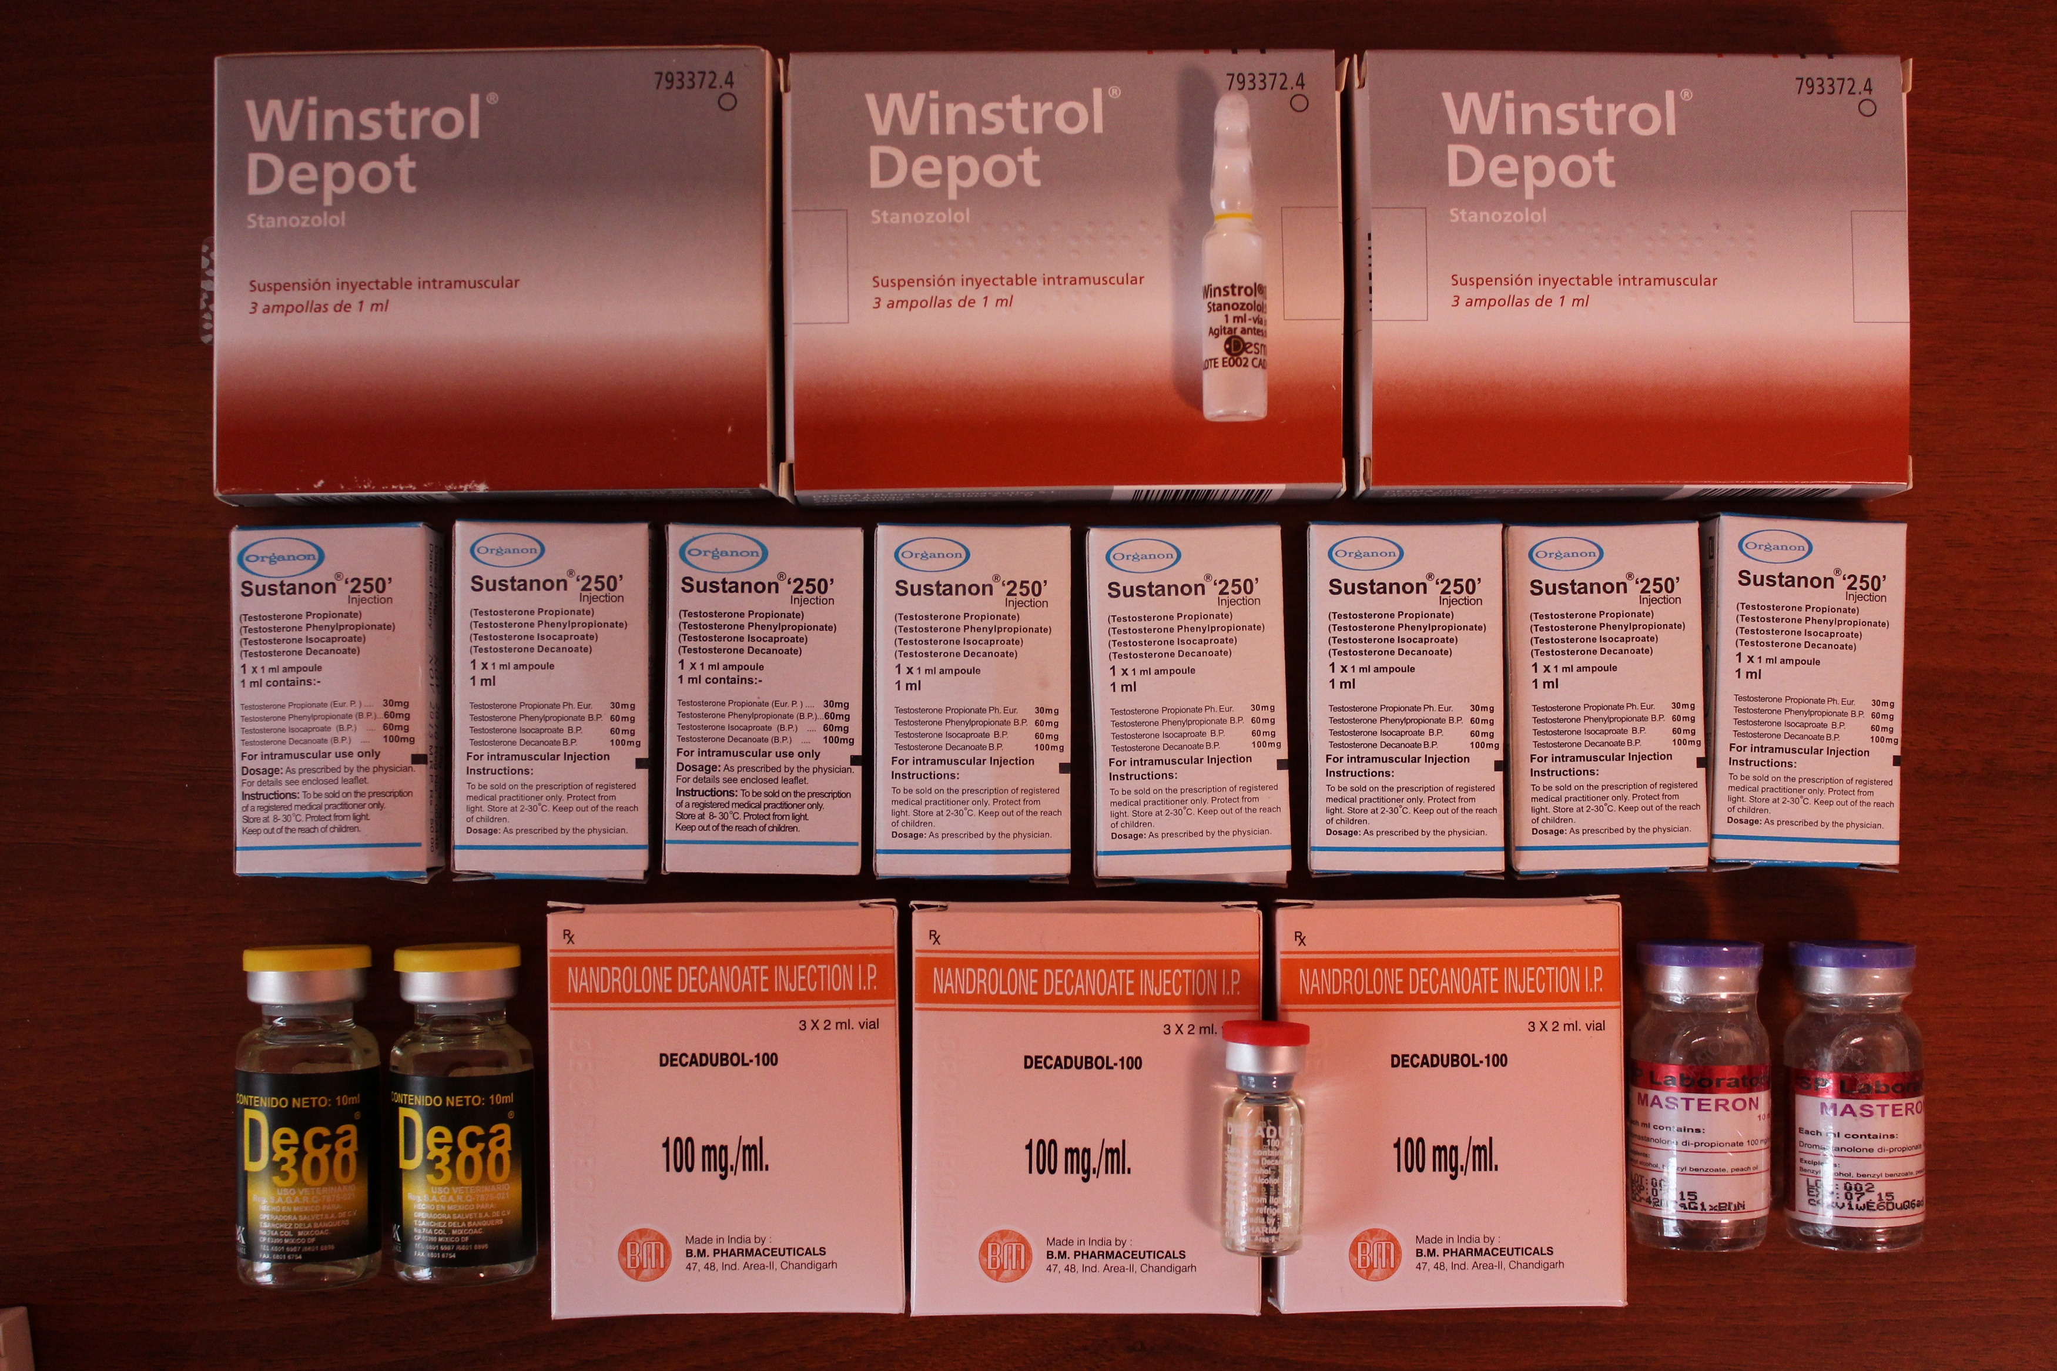
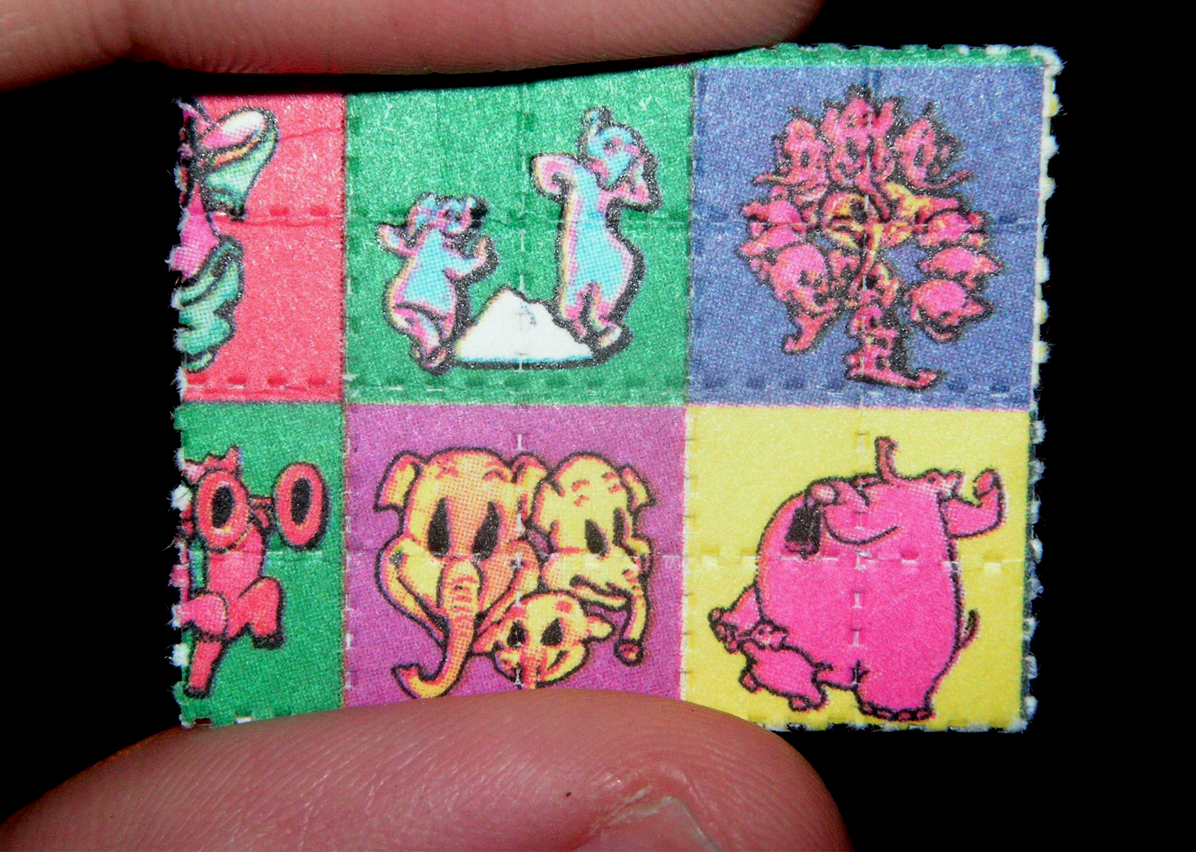
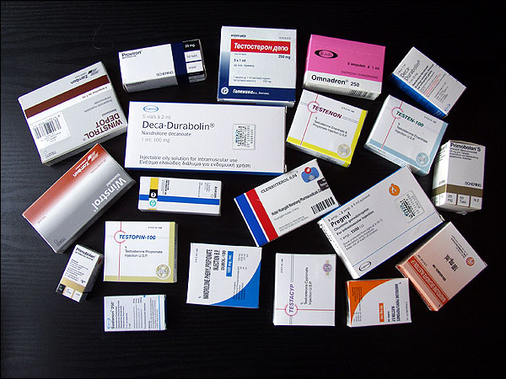
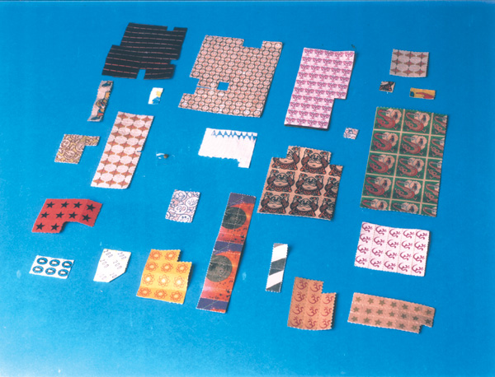

Slide 17
Solve course you.
You're the owner of your life .
So manage it wisely!

Slide 18
