Slide 1
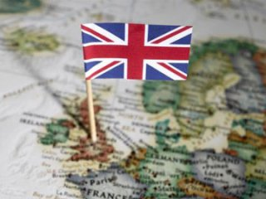
Great Britain

Slide 2
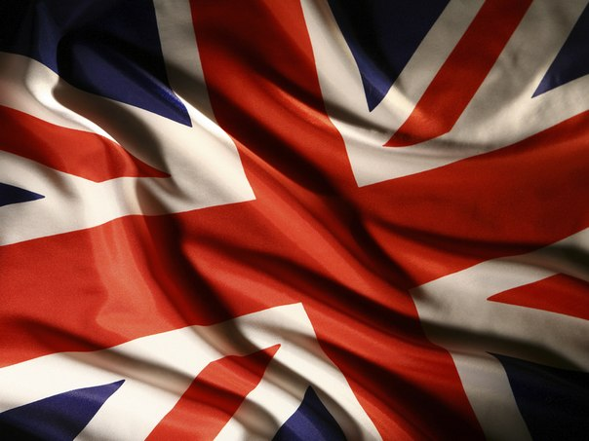
UK
The official name of Great Britain is the United Kingdom of Great Britain and Northern Ireland (the UK).
United Kingdom of Great Britain and Northern Ireland

Slide 3
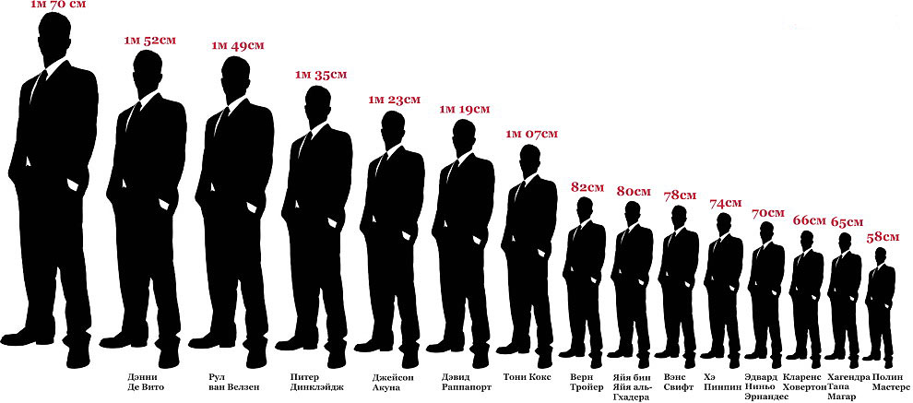
Population
Its population is about 61 million people

Slide 4
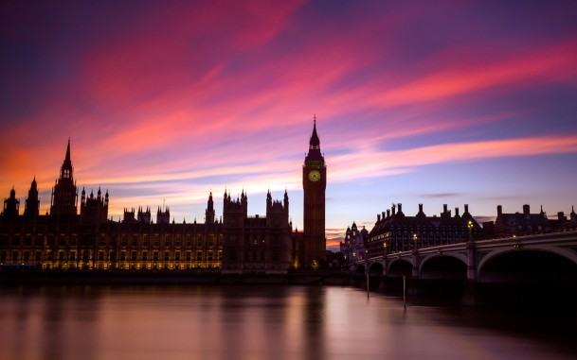
Capital
Its capital London.

Slide 5
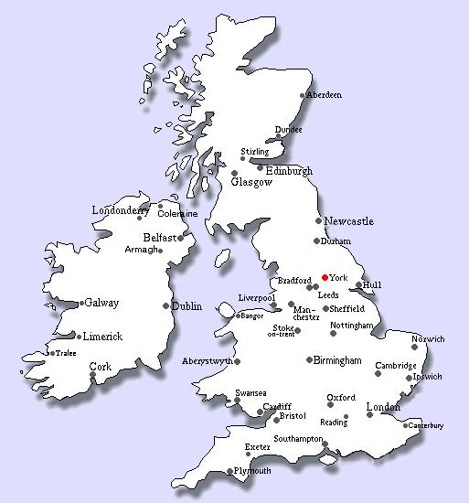
Country is
The United Kingdom is an island country.

Slide 6
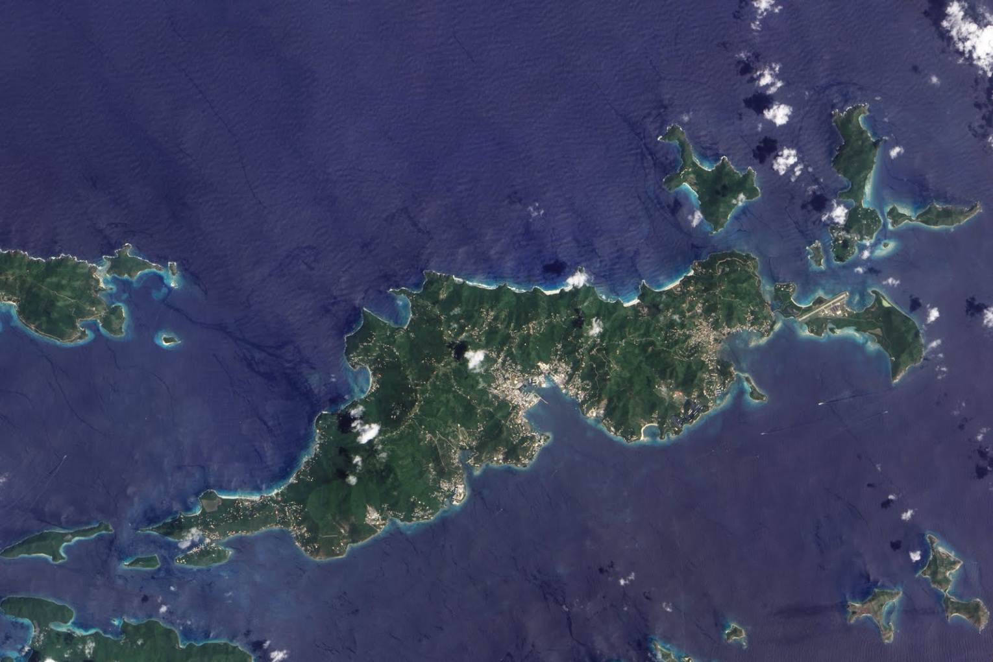
Total
Its total area is 244,000 square kilometres.

Slide 7
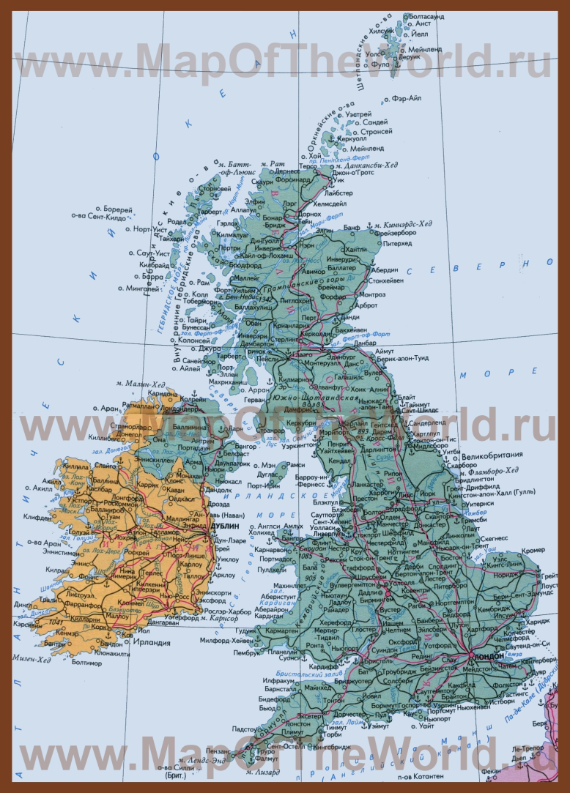
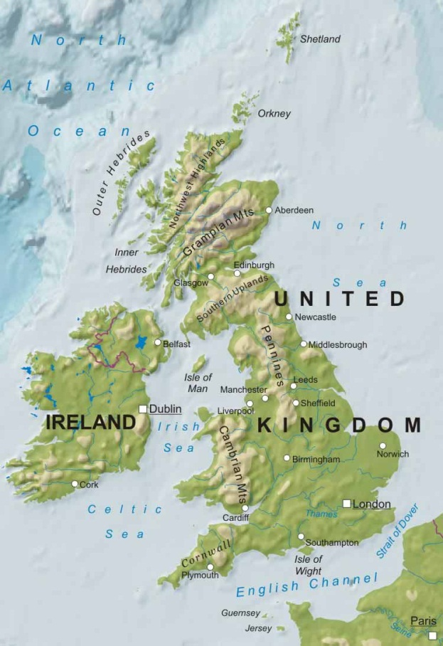
…
The two main islands are Great Britain and Ireland.

Slide 8
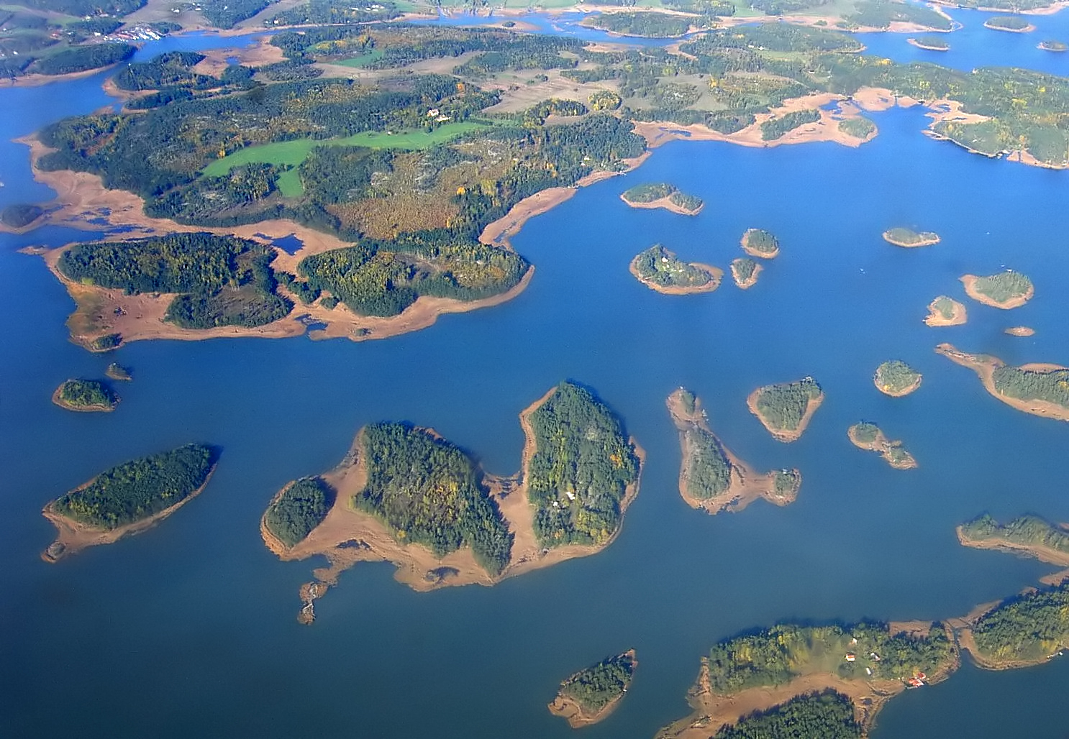
…
It is situated on the British Isles which consist of more than 5,000 large and small islands.

Slide 9
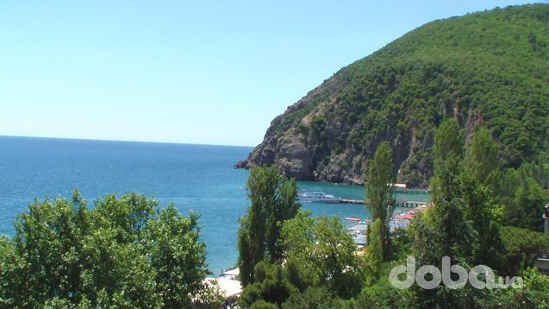
Geography
They are separated by the Irish Great Britain is about 1,000 km from the south coast to the extreme north and about 500 km across.

Slide 10
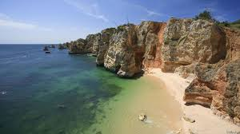
….
The UK is bounded by the Atlantic Ocean in the north and northwest and the North Sea in the east.The English Channel separates it from the mainland in the south. The Strait of Dover, 18 miles wide, separates it from France. Great Britain is separated from Belgium and the Netherlands by the North Sea, and from Ireland by the Irish Sea.

Slide 11
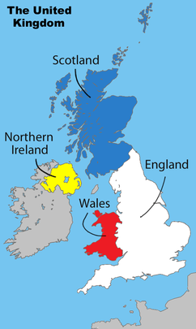
…
Historically, the territory of the United Kingdom is divided into four parts: England, Scotland, Wales and Northern Ireland.

Slide 12

This is not very pleasant for the five million Scotsmen, three million Welsh and two million Irishmen who are not certainly English but are all British.

Slide 13
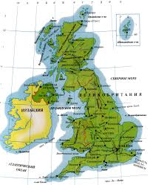
England occupies the southern and eastern parts of Great Britain. It has an area of 130,000 sq km. Scotland, covering 79,000 sq km, lies to the north. Wales, to the west, has an area of 21,000 sq km and Northern Ireland — 14,000 sq km.

Slide 14
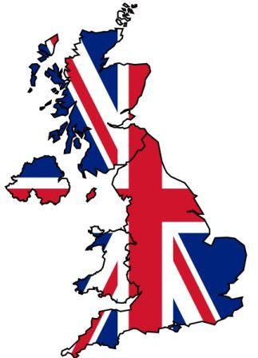

Slide 15
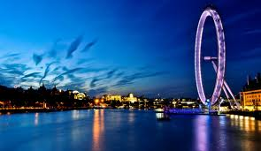

Slide 16
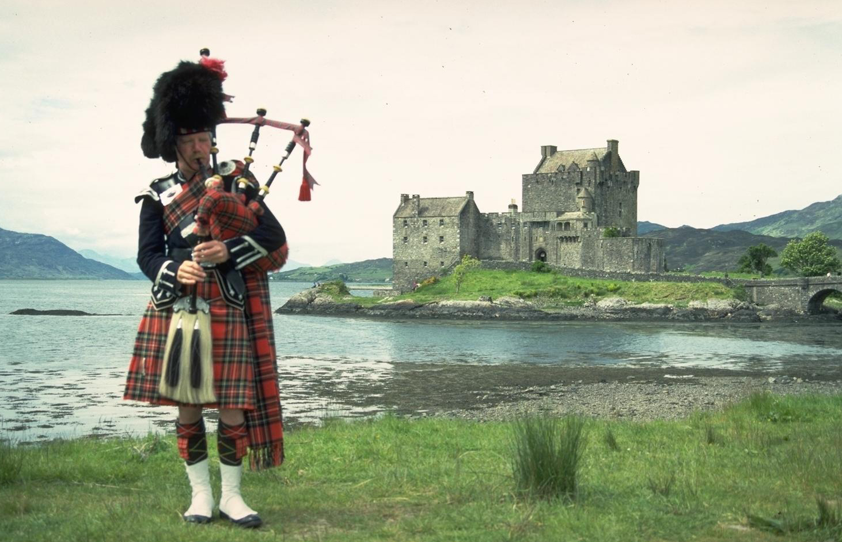

Slide 17
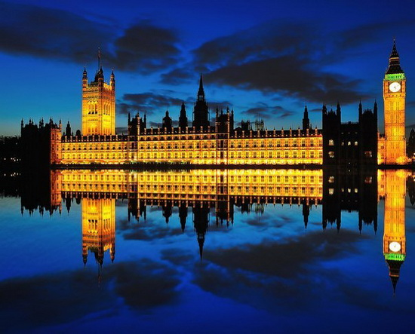

Slide 18
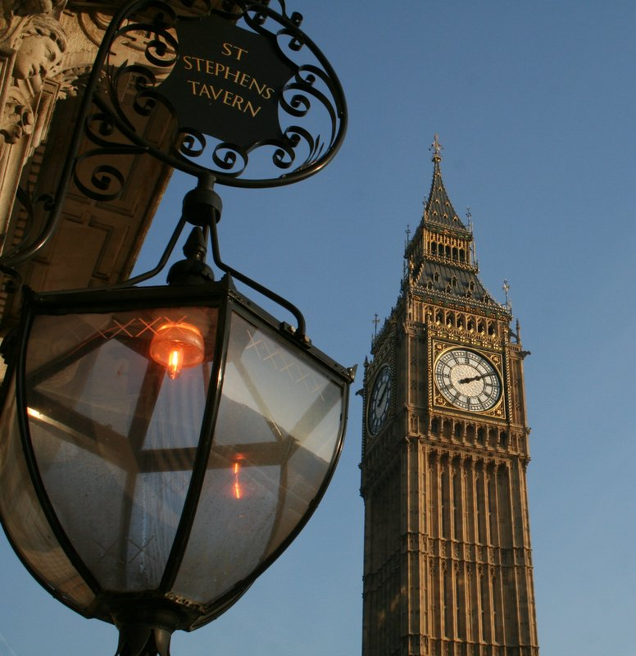

Slide 19
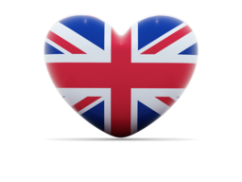

Slide 20
