Slide 1
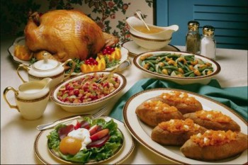
Christmas food

Slide 2
Christmas is the most important religious holiday in Ukraine. It is celebrated on the night of the sixth to the seventh of January. On this day people glorify Jesus Christ, sing carols and prepare ukrainian Christmas dishes.

Slide 3
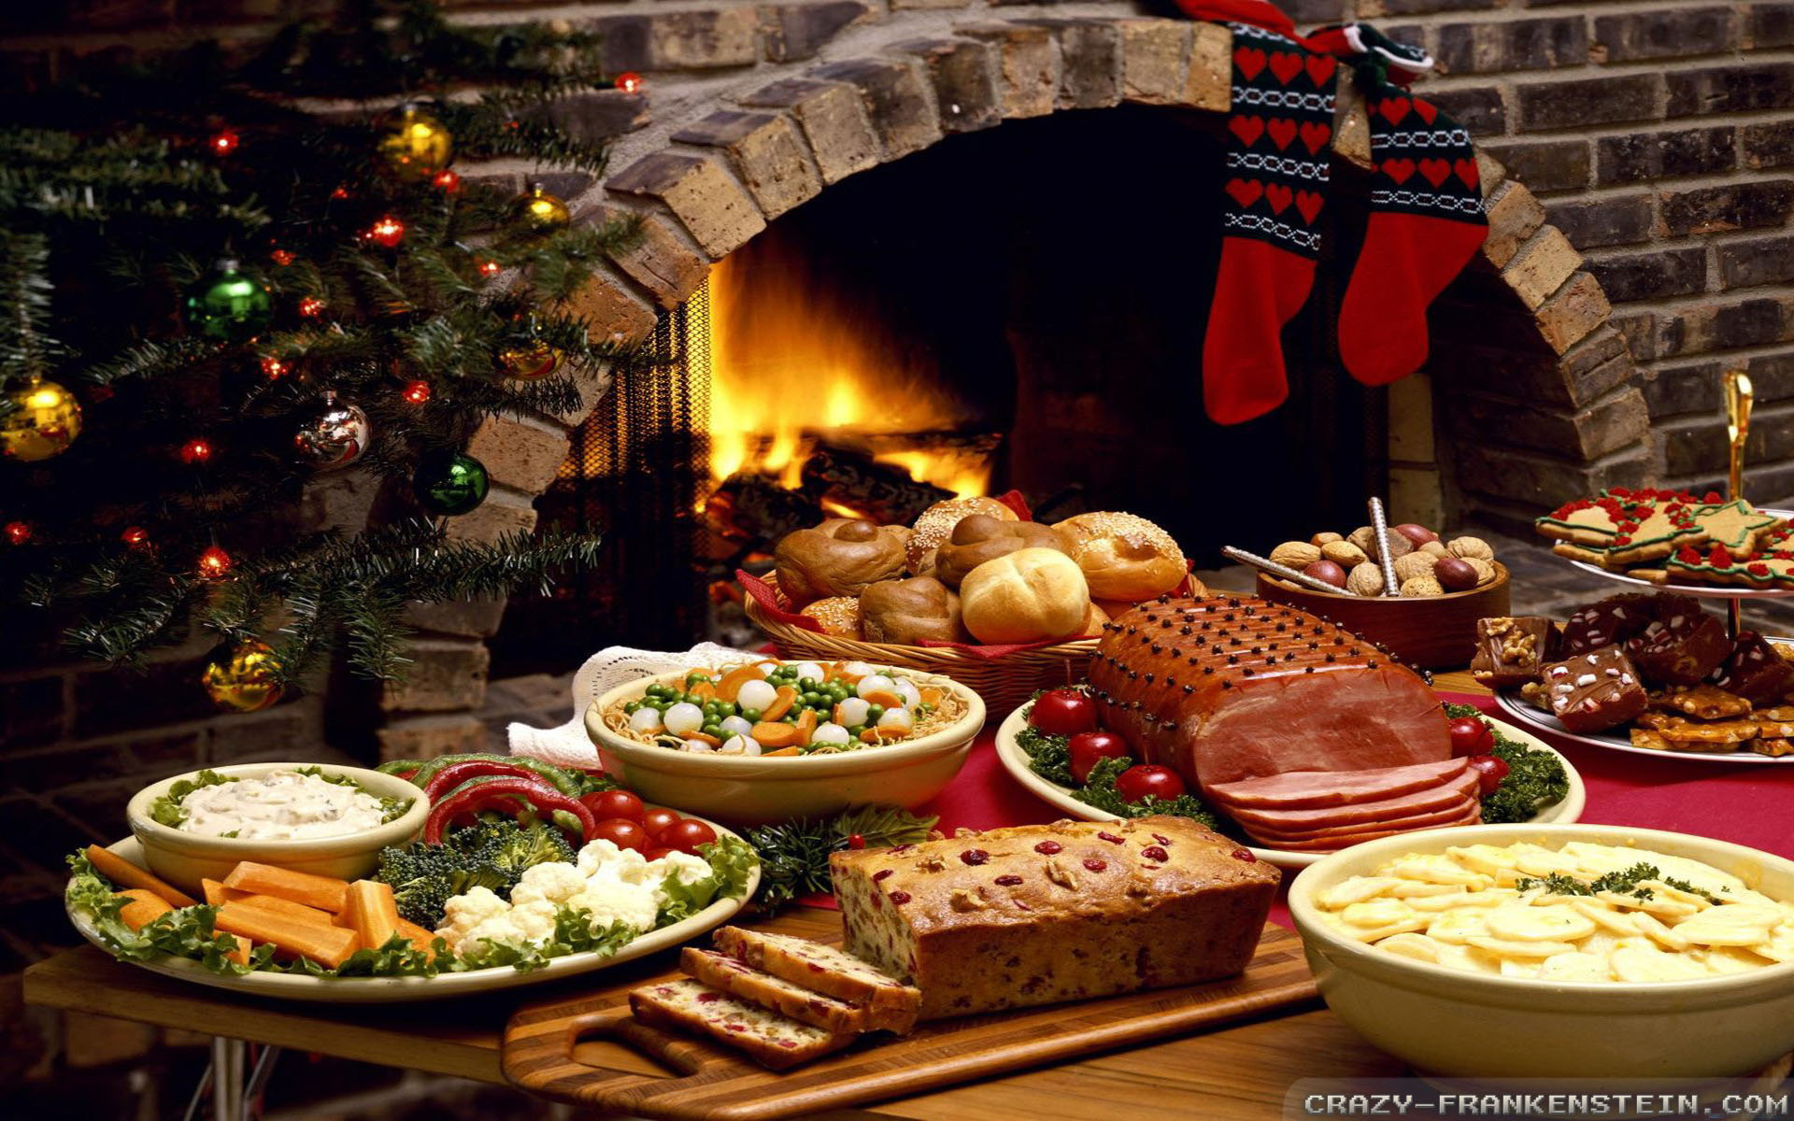
The most important part of the celebration of Christmas is a festive table. In Ukraine there are so many Christmas dishes, but the most important of them are kutya, stewed fruit, cake vinihret, cabbage soup, cabbage rolls, fried fish and vegetable stew. It is very important that all dishes were meatless.

Slide 4
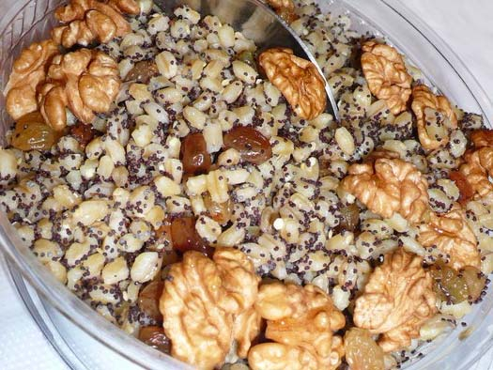
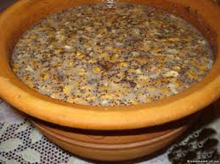
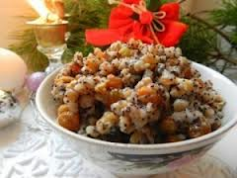
Kutya is one of the main Christmas dishes. Prepare kutya at Christmas and Baptism. Kutya include wheat, barley or rice. Also add the poppy seeds, nuts, honey and other spices.

Slide 5
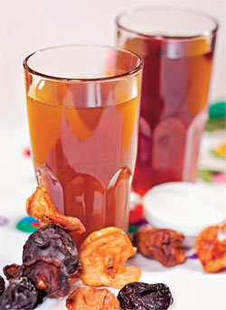
Uzvar - sweet decoction with dried fruit, prepared on the eve of religious holidays - Christmas and Baptism. Uzvar at Christmas is traditionally prepared for kutya. Uzvar was formerly one of the most traditional drinks. It was prepared in the summer with fresh berries and at autumn, winter and spring - with dried fruit like cherries, apples, pears, apricots.

Slide 6
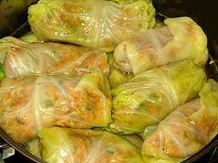
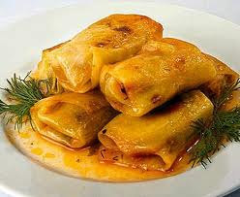
Stuffed cabbage is also a very common dish in Ukraine. They are prepared at any time, but at Christmas it is very popular. This dish is prepared with fresh cabbage leaves and stuffed with meat, rice or buckwheat, corn or oat cereals, potatoes, beans, mushrooms, onions, carrots and spices.

Slide 7
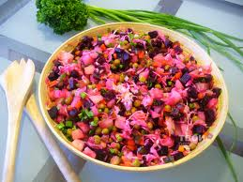
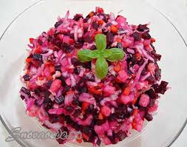
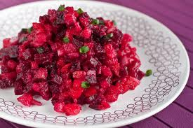
Vinegret popular in Ukraine dish of various mixtures of raw and boiled vegetables: potatoes, beets, sauerkraut, salted cucumbers, carrots, beans, onions, spices. The main ingredient, without which there is no vinegret - beets. Served cold.

Slide 8
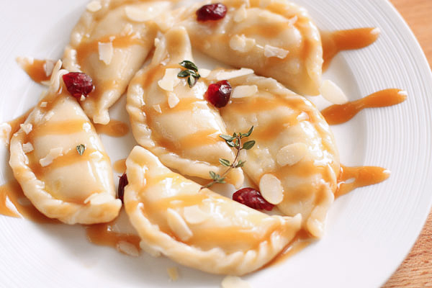
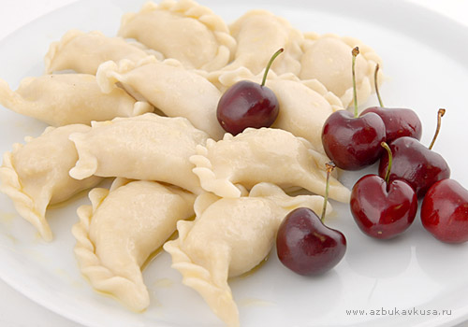
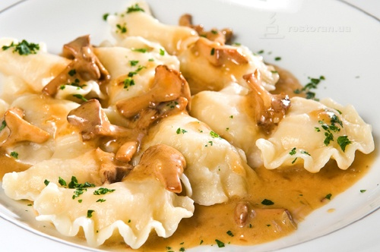
Varenyky - national Ukrainian dish. They include: boiled dough stuffed with mushrooms, potatoes, fruits and vegetables. The dish is served with sour cream or oil with fried onions. Varenyky with cherry, poppy seeds, apples and plums sprinkled with sugar or honey.

Slide 9
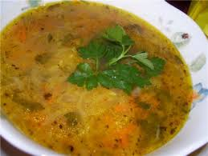
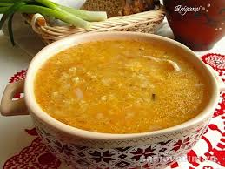
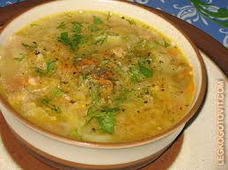
Cabbage soup - filling vegetable soup with sour cabbage. Cabbage differ from each set of products from which they are prepared. Cabbage soup cook for a vegetarian or mushroom broth or pork fat. Cabbage can be cooked in an ordinary fish broth. Cabbage soup served with sour cream and sprinkle with chopped parsley, dill.

Slide 10
Thanks for your attention

