Slide 1
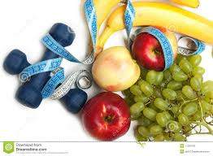


Healthy lifestyle

Slide 2


The health of a person is the main value in the life. A healthy way of life is very fashionable nowadays. But it is not only popular; it is also useful for our organism!
http://english-exam.ru/konkursy-sochinenii/4-i-konkurs/zdorovyi-obraz-zhizni-3642-3697.html#ixzz3EXGE3Mjb

Slide 3
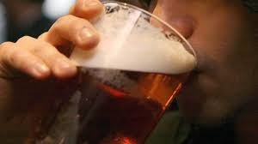
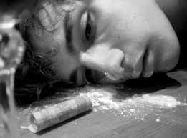

It is important to avoid bad habits:
Аlcohol misuse
Drug abuse
Smoking

Slide 4
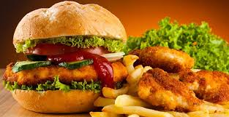
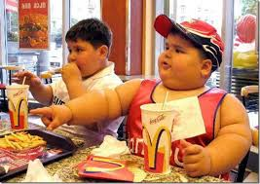
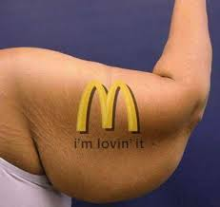
We live in the era of fast food culture:

Slide 5
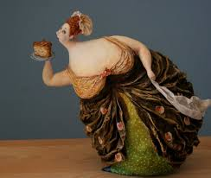
Nowadays people often face the problem of obesity. This problem has already captured many countries.
1.Mexico - 32,8%
2.USA – 31,8 %
3. Syria – 31,6%
4. Venezuela and Libya – 30,8%
5 .Trinidad and Tobago - 30%
http://english-exam.ru/konkursy-sochinenii/3-i-konkurs/sochinenie-0804-b-problema-ozhirenija.html#ixzz3EXUo4u9L

Slide 6




Bad habits and a healthy lifestyle are incompatible.
http://english-exam.ru/konkursy-sochinenii/4-i-konkurs/zdorovyi-obraz-zhizni-3642-3697.html#ixzz3EXcVlgBp

Slide 7
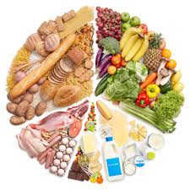



How can we lead a healthy way of life?
Healthy Food
Sport
Walks on fresh air
Sound sleep

Slide 8
Steps to a healthy lifestyle:
1. Get active for an hour or more each day.
2.Choose water as a drink.
3.Eat more fruit and vegetables.
4.Turn off the TV or computer and get active.
5. Eat fever and select healthier alternatives

Slide 9


Slide 10
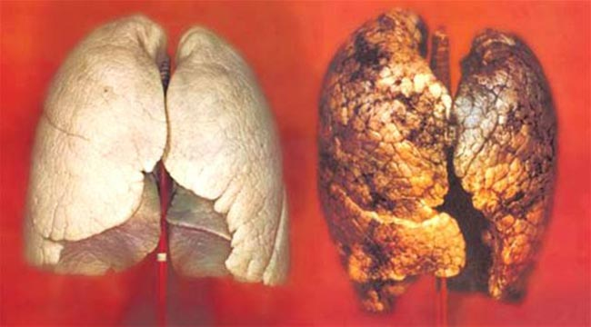

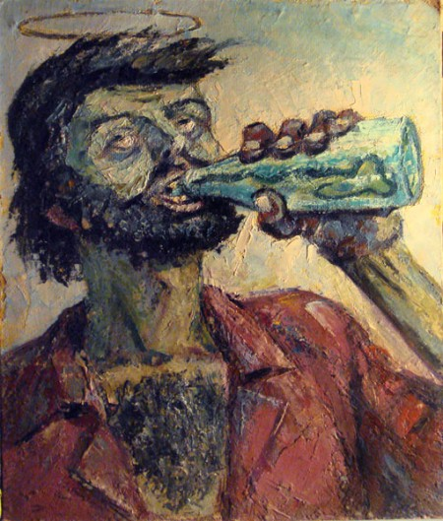
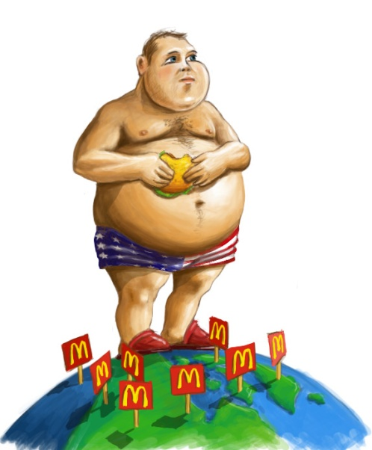


Make Your Choice:
or

Slide 11


Thank you for your attention!

