Slide 1
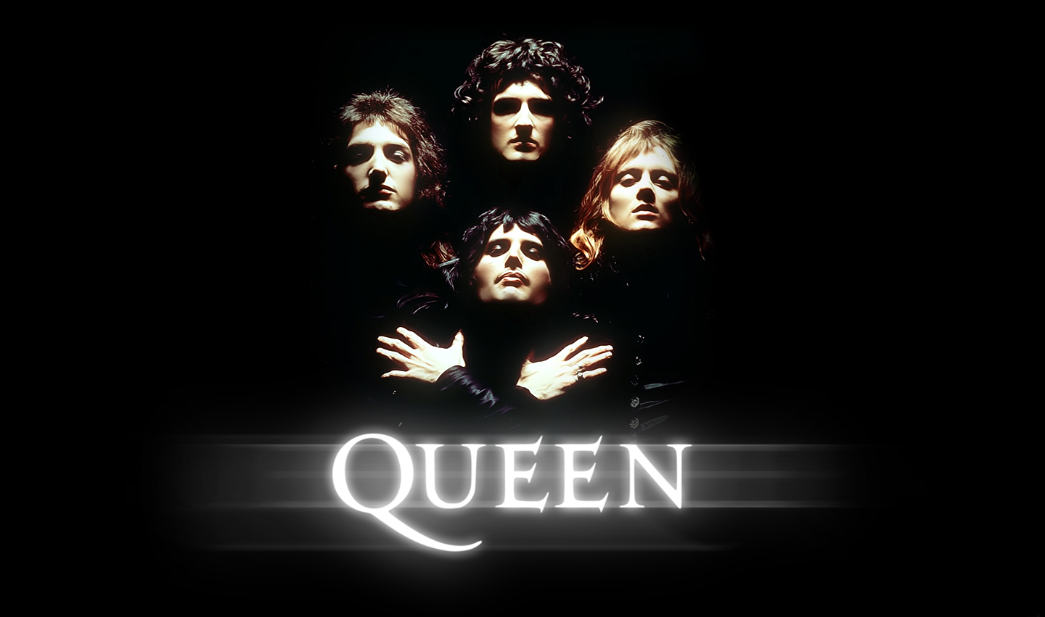

Slide 2
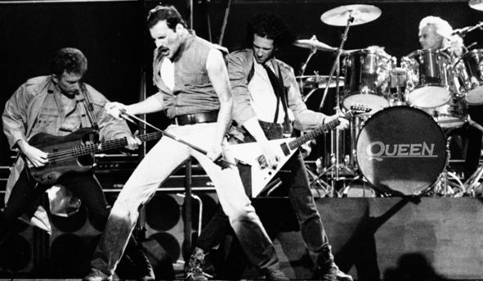
Queen are a British rock band formed in London in 1970, originally consisting of Freddie Mercury (lead vocals, piano), Brian May (guitar, vocals), John Deacon (bass guitar), and Roger Taylor (drums, vocals). Queen's earliest works were influenced by progressive rock, hard rock and heavy metal, but the band gradually ventured into more conventional and radio-friendly works, incorporating further diverse styles into their music. Queen - the popular British rock band that has achieved the wide popularity in the mid-70s of the XX century, is one of the most successful teams in the history of rock music, the world general circulation of albums is 500 million .

Slide 3
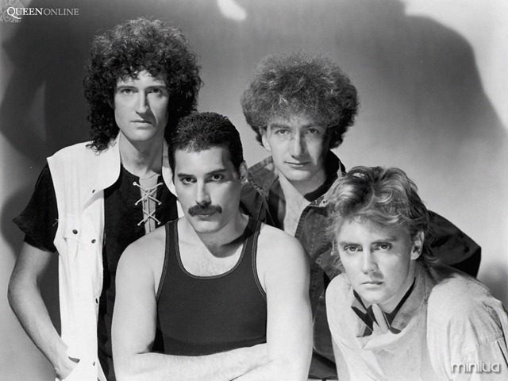
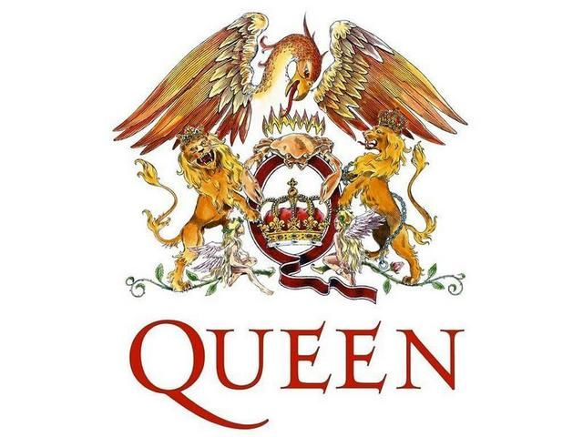
Before joining Queen, Brian May and Roger Taylor had been playing together in a band named Smile with bassist Tim Staffell. Freddie Mercury (then known as Farrokh/Freddie Bulsara) was a fan of Smile. Mercury himself joined the band, changed the name of the band to "Queen", and adopted his familiar stage name. John Deacon was recruited to recording their eponymous debut album (1973).

Slide 4
The first album in the biography «Queen» was recorded for two years and was released in 1973 under the same name. The following year released two albums : «Queen II», «Sheer Heart Attack» (ranked second in the UK charts) , made ​​the first movie.
In 1975, the biography «Queen» the album «A Night at the Opera» ( four times platinum ), becoming one of the greatest for the group. The song «Bohemian Rhapsody» is one of the most famous works in the history of " Queen ". The song was shot clip with unique special effects for the time . Band concerts are held not only in the UK , but also in the United States , Japan and Canada. The undoubted hits «Queen»: «We Will Rock You» and «We Are the Champions» came out in the album in 1977 «News of the World». Album «Queen» «The Game» in 1980, marks a new era for the band. Now the musicians began to actively use the synthesizer. Freddie changed his stage image. After the release of the album «A Kind Of Magic» in 1986, the band went on a tour of Europe, which has become one of the greatest in the history of rock music, collecting a total of about one million people. In 1990, the «Queen» was not released new songs. The group received the award «Brit Awards». And in 1991 came the album «Innuendo» with the greatest hit «The Show Must Go On». In the November 23, 1991 Mercury confirmed publicly he has AIDS, and died on November 24.

Slide 5
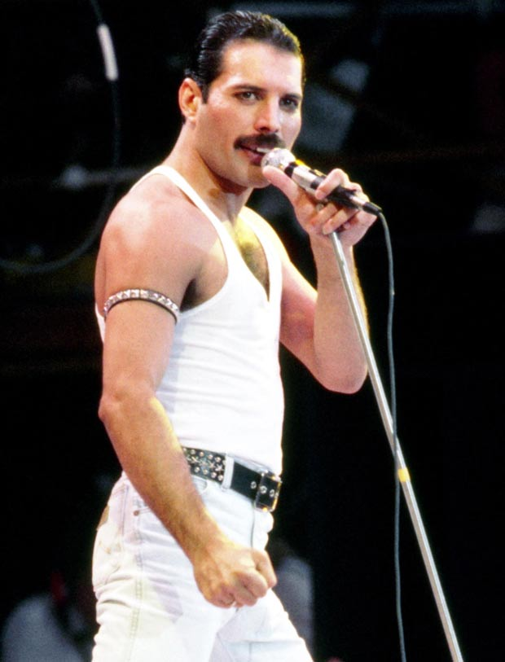
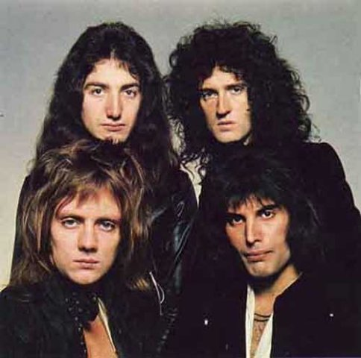
In April 1992, was held a huge concert dedicated to Freddie Mercury , with many stars and friends of the singer. And in 1992, they released their last album «Made in Heaven», which consisted of unreleased tracks , session recordings .
After the death of Mercury musicians gave concerts in which soloists Robbie Williams , George Michael , Zemfira . The best was the union with Paul Rodgers , with whom the band recorded a new song, «Say it's Not True». In September 2008, the band played a huge charity concert in Kharkov , collecting about 350,000 listeners. They had 16 studio albums and 6 concert albums. Concert performances of group were brightest and significant in the history of the world rock.

