Slide 1
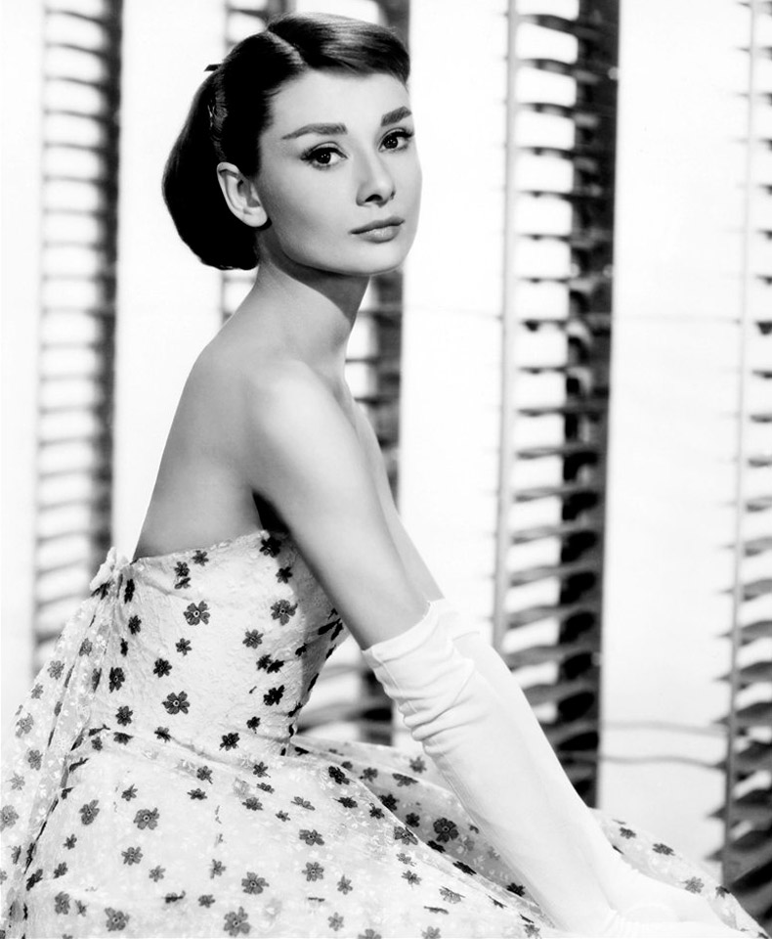
Audrey Hepburn
May 4,1929 - January 20,1993

Slide 2
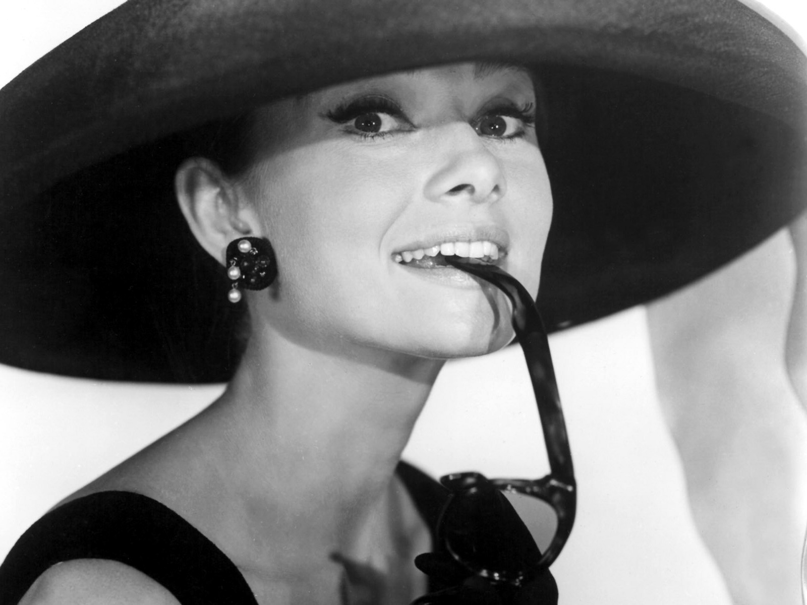
Audrey Hepburn - the British and American actress, fashion model and humanitarian activist. Received the "Oscar" in 1954 for Best Actress in the film "Roman Holiday" (1953)

Slide 3
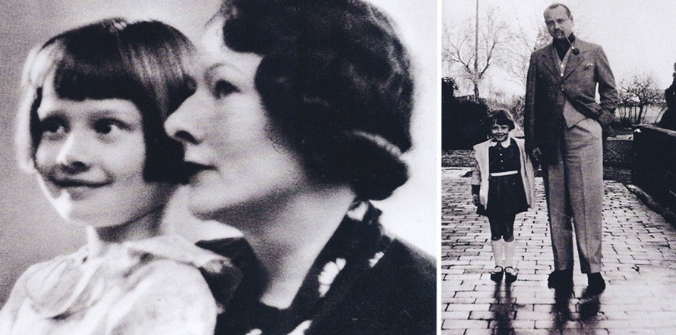
Audrey Kathleen Ruston was born May 4, 1929 in Brussels. She was the only child in the family. Her mother was a strong woman, father was a good-natured, so the girl preferred to him. He left the family when Audrey was a child. After his parents divorced in 1935, Hepburn lived with her mother in Arnhem, the outbreak of the Second World War and a period of German occupation. This period was difficult for her family. After the liberation of the Netherlands in the country started to receive humanitarian aid. As UNICEF has saved her early youth, she later wished to repay that debt, and in 1954 began performing on radio UNICEF.

Slide 4
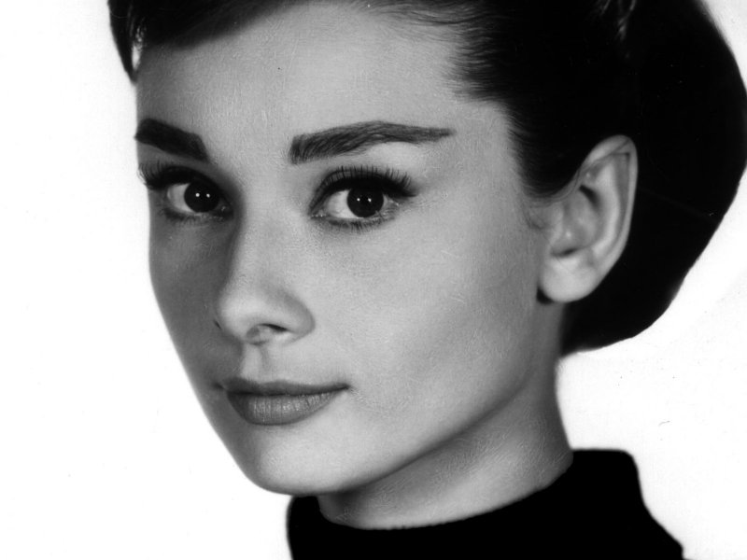
Her acting career began with the educational film "Dutch for seven lessons." Then she played in the musical theater. The first feature film to actually Hepburn was a British film «One Wild Oat», in which she played a girl-registrar at the hotel.

Slide 5
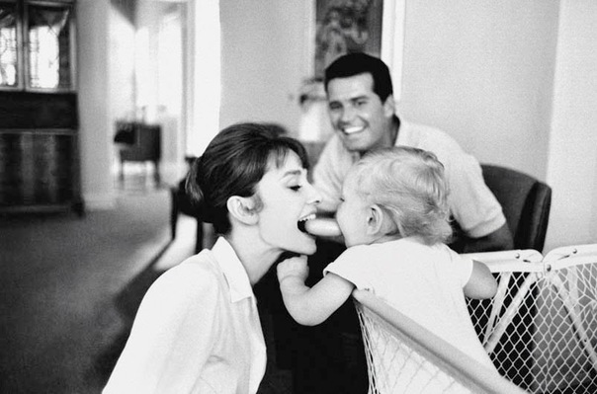
In 1954, Audrey returned to the stage as a mermaid in the play "Ondine", where her partner was Mel Ferrer, whom she in the same year she married and later in 1960 gave birth to a son, Sean.

Slide 6
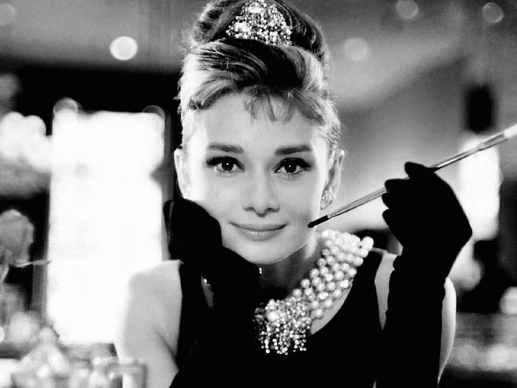
The role of Holly Golightly, played by Hepburn in the film "Breakfast at Tiffany's" in 1961, has become one of the most iconic images of American cinema of the XX century. Hepburn called the role "the most jazz in his career."

Slide 7
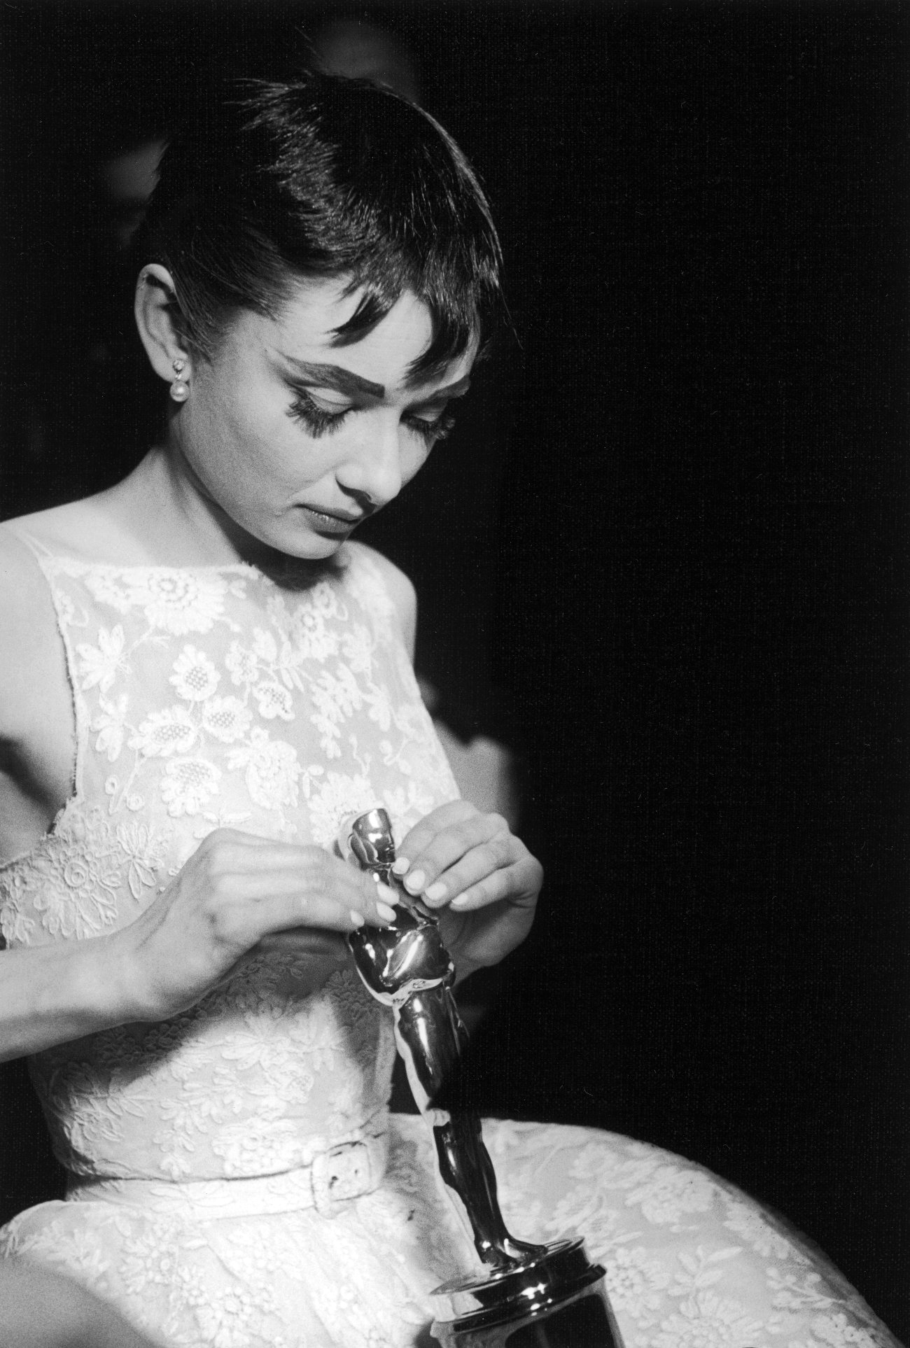
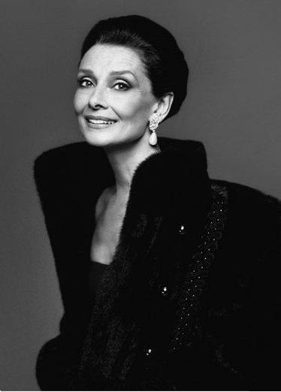
Hepburn's final role in the film, the so-called cameo role was an angel in Steven Spielberg's "Always", filmed in 1989.

Slide 8
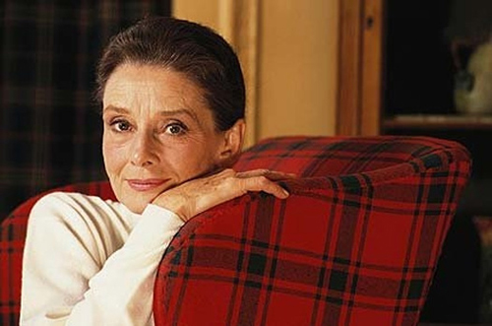
In mid-October, with Audrey Hepburn went to Los Angeles for an examination . The result was disappointing. November 1, 1992 was an operation to remove the tumor. The diagnosis after surgery was encouraging, but after three weeks the actress again hospitalized with severe pain in the abdomen. This indicated that the actress live only a few months. Soon she returned to Toloshenaz as in Los Angeles she has nothing could not help. Last Christmas she spent with her ​​husband and children . She called it the happiest Christmas of her life. Audrey Hepburn died on January 20, 1993 at the age of 63 years old.

