Slide 1
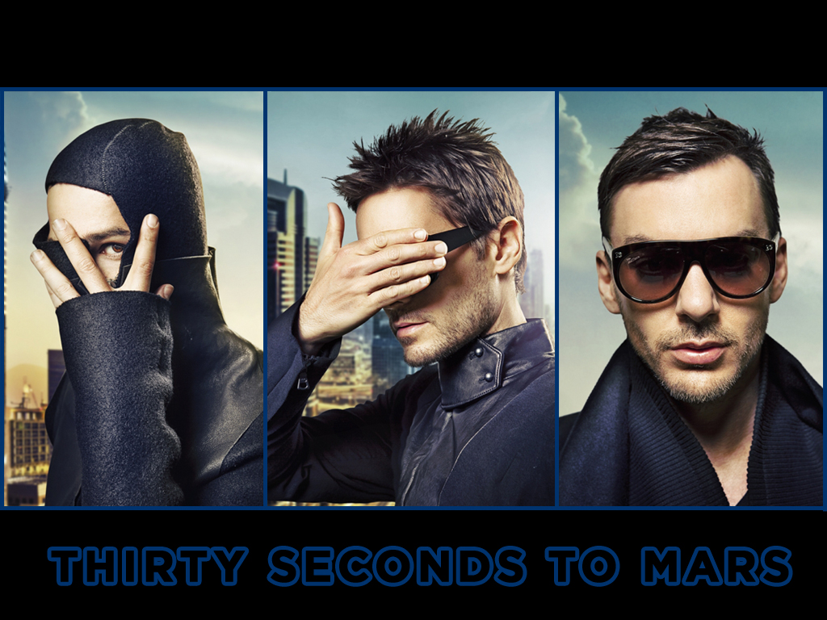

Slide 2
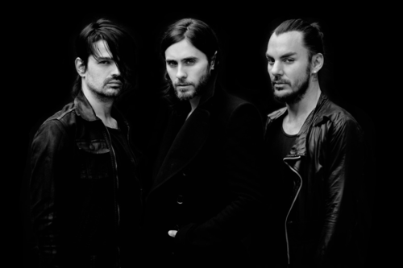
30 Seconds to Mars - an American rock band from Los Angeles, California, performing alternative rock.

Slide 3
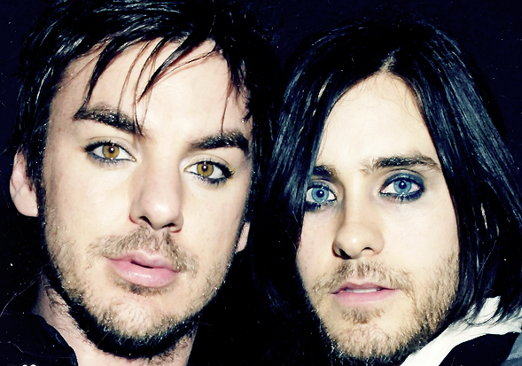
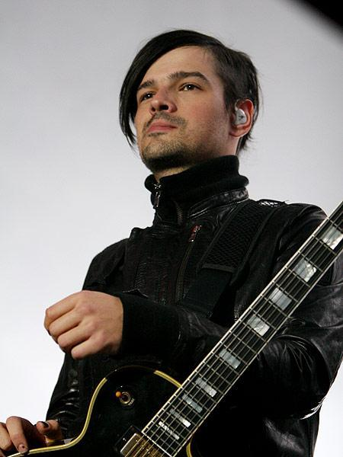

Founded in 1998 by brothers Jared and Shannon Leto. Apart from them at the moment the group includes guitar player Tomo Milicevic (born Tomo Miličević).

Slide 4
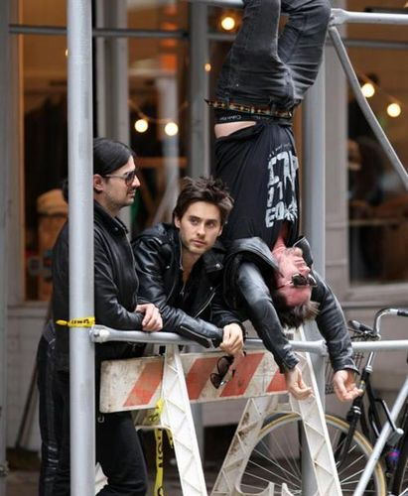
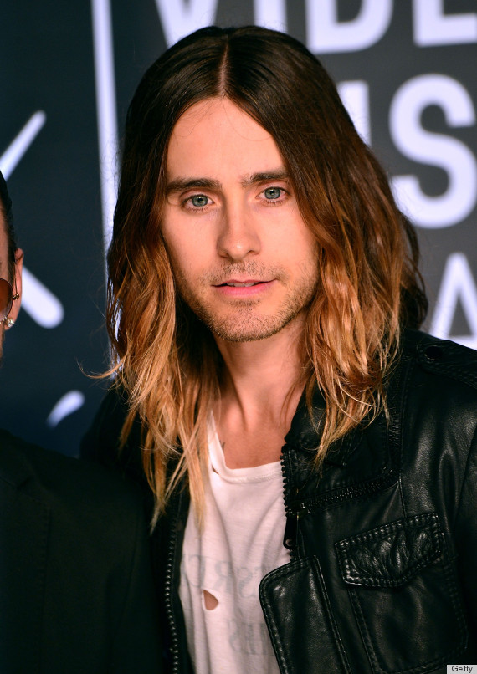

Slide 5
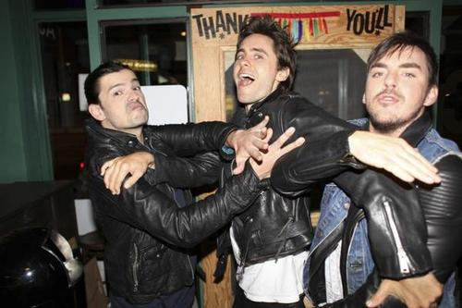
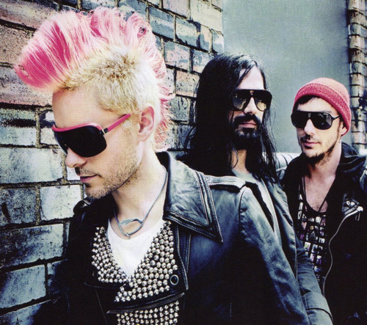
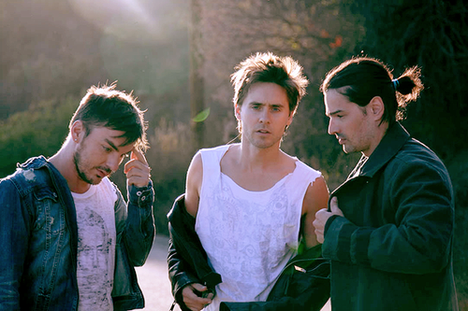
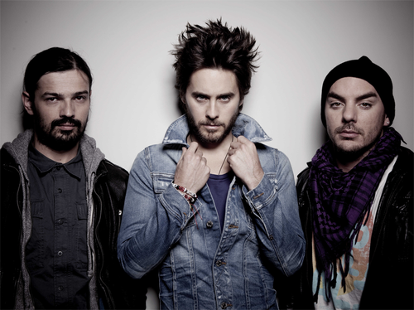

Slide 6

The band name was taken from an article by the Harvard professor about the technological progress, in which humanity in the literal sense of the word would soon be "in thirty seconds from Mars."

Slide 7
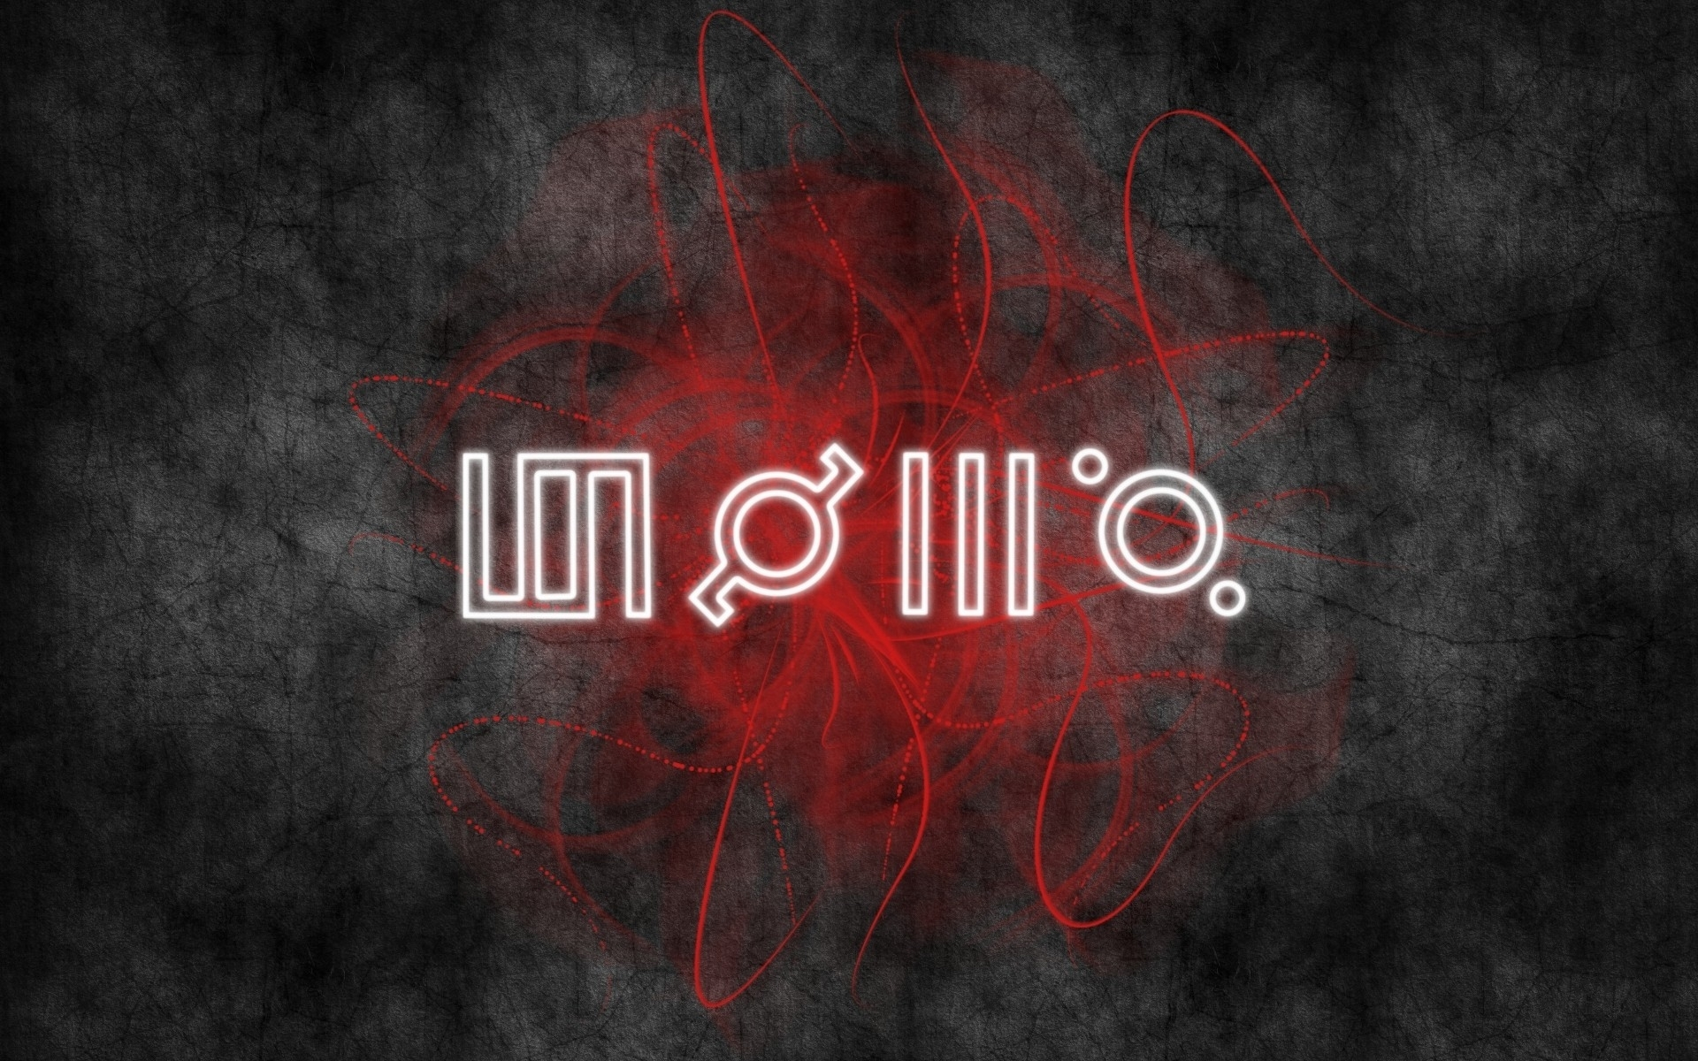
Despite the fact that the band members themselves never explained the four glyphs,
it is obvious that they are a graphic representation of the group's name.

Slide 8




BAND HAS SEVERAL LOGOS
Trinity
Seal
Mithra
Triad
The cross in the circle

Slide 9



Symbol with an arrow graphic representation of the slogan ‘Provehito in Altum’, is the emblem of fans who call themselves the Echelon.
“The Echelon" is part of the Mars Army, which includes the fans across the world.

Slide 10

‘30 Seconds to Mars is the grandiosity of Pink Floyd and the energy of The Sex Pistols’
Jared Leto

Slide 11
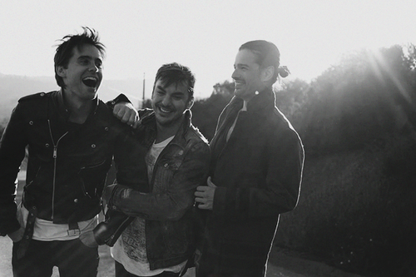
Recordings 30STM
Albums
2002 — 30 Seconds to Mars
2005 — A Beautiful Lie
2009 — This Is War
2013 — Love Lust Faith + Dreams
Mini albums
2002 — Acoustic Live Radio Show
2007 — AOL Sessions Undercover
2008 — To the Edge of the Earth

Slide 12
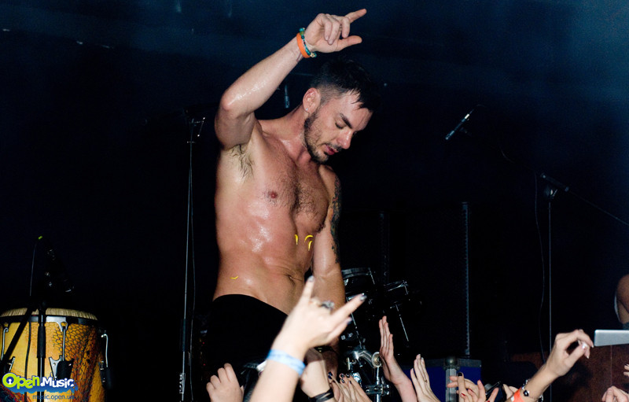
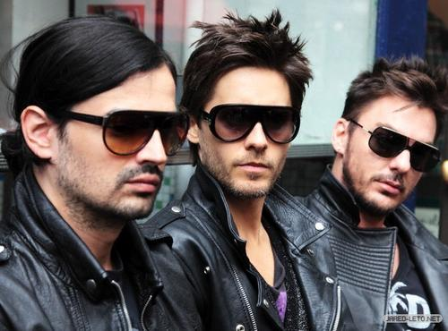
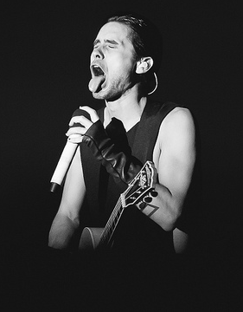
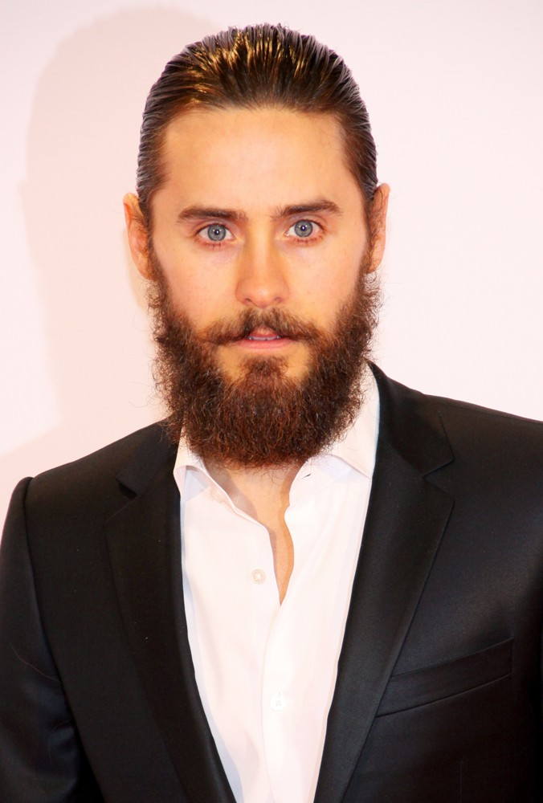
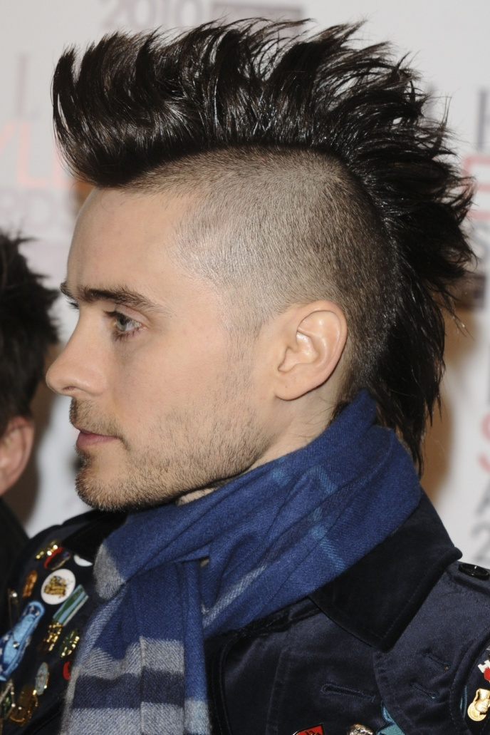

Slide 13
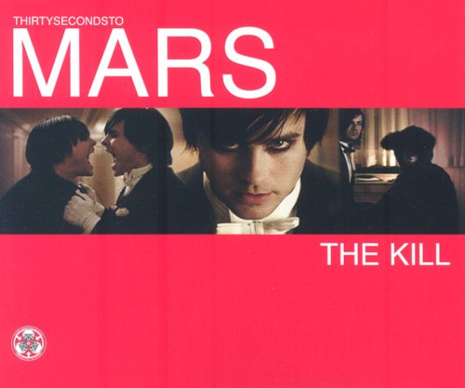
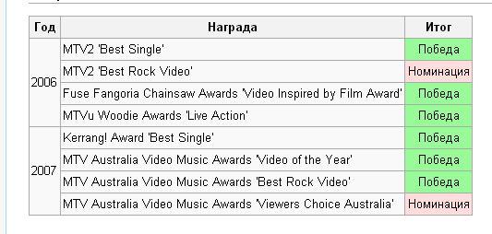

was released as the second single from their second album, A Beautiful Lie.
‘THE KILL’

Slide 14
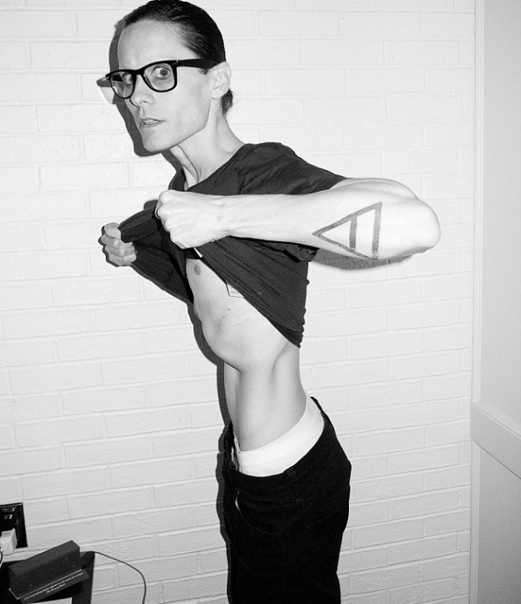
THANK YOU FOR ATTENTION!!!

